Slide 1
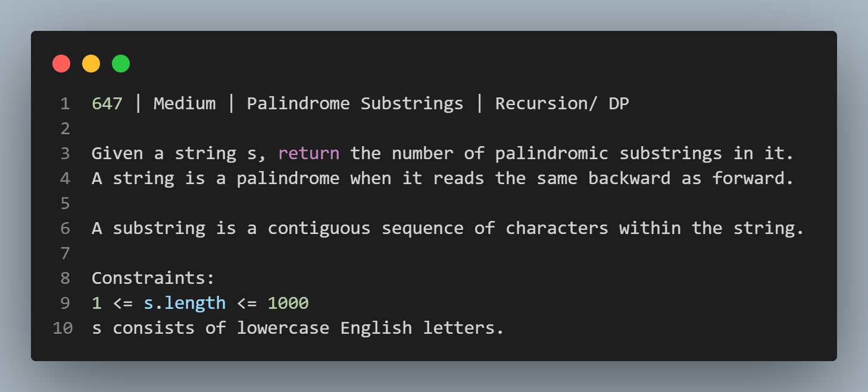

Slide 2
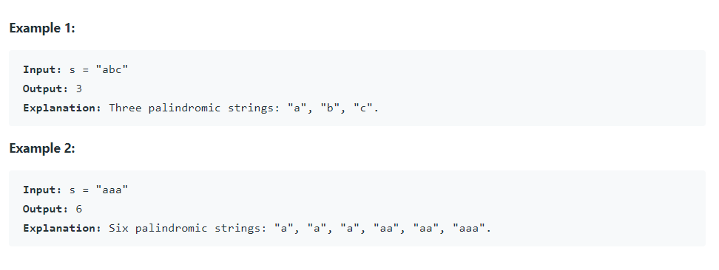

Slide 3
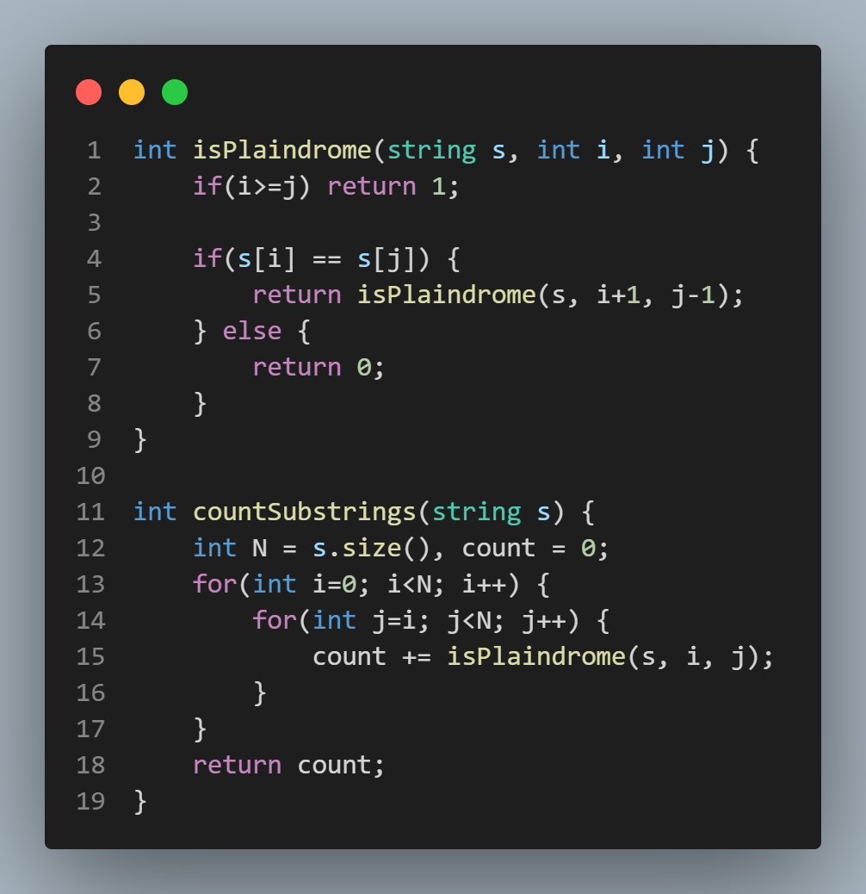

Slide 4
In the approach, the time complexity is O(N^3) & Space is O(N). So, I got Time Limit Exceeded. Now, We can further optimise the time, with dynamic programming.

Slide 5
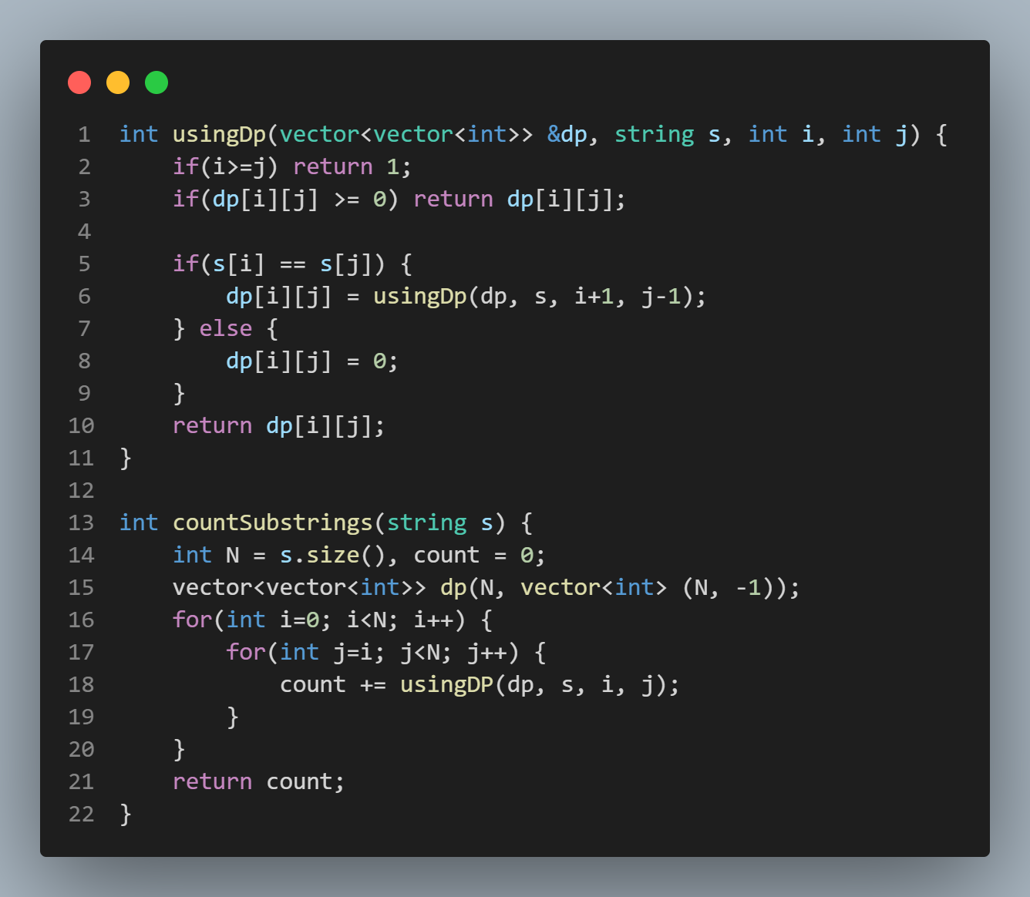

Slide 6





#100daysofDSA
/rvislive
Rakesh Vishwakarma

