Slide 1
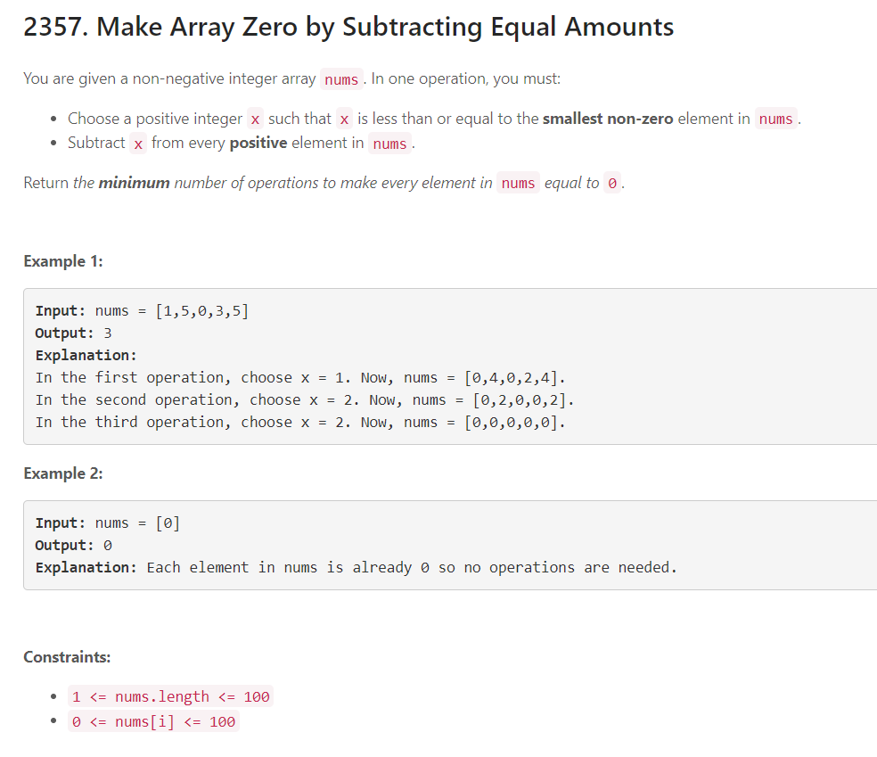

Slide 2
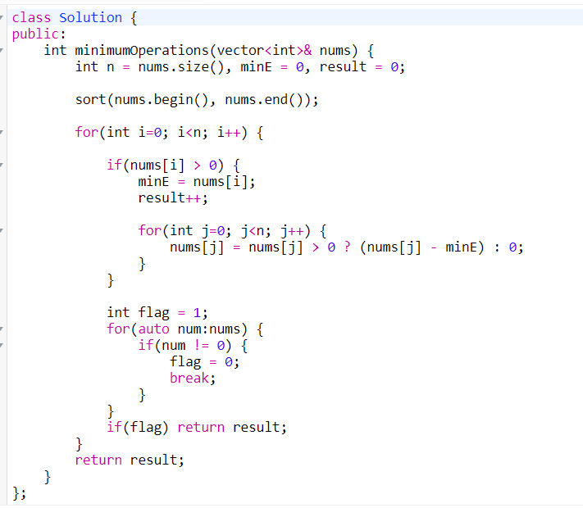

Slide 3





#100daysofDSA
/rvislive
Rakesh Vishwakarma

