Slide 1
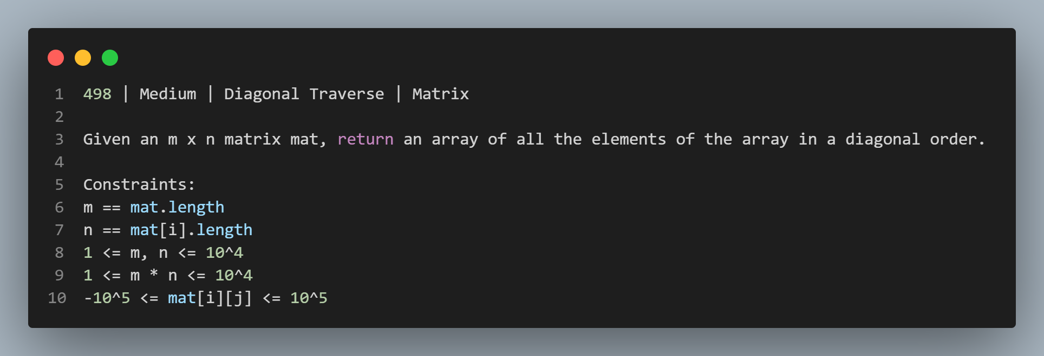

Slide 2
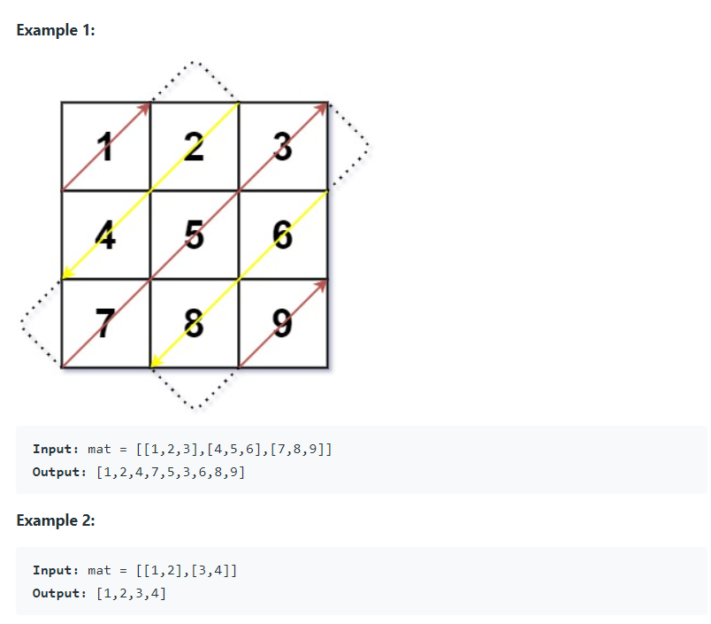

Slide 3
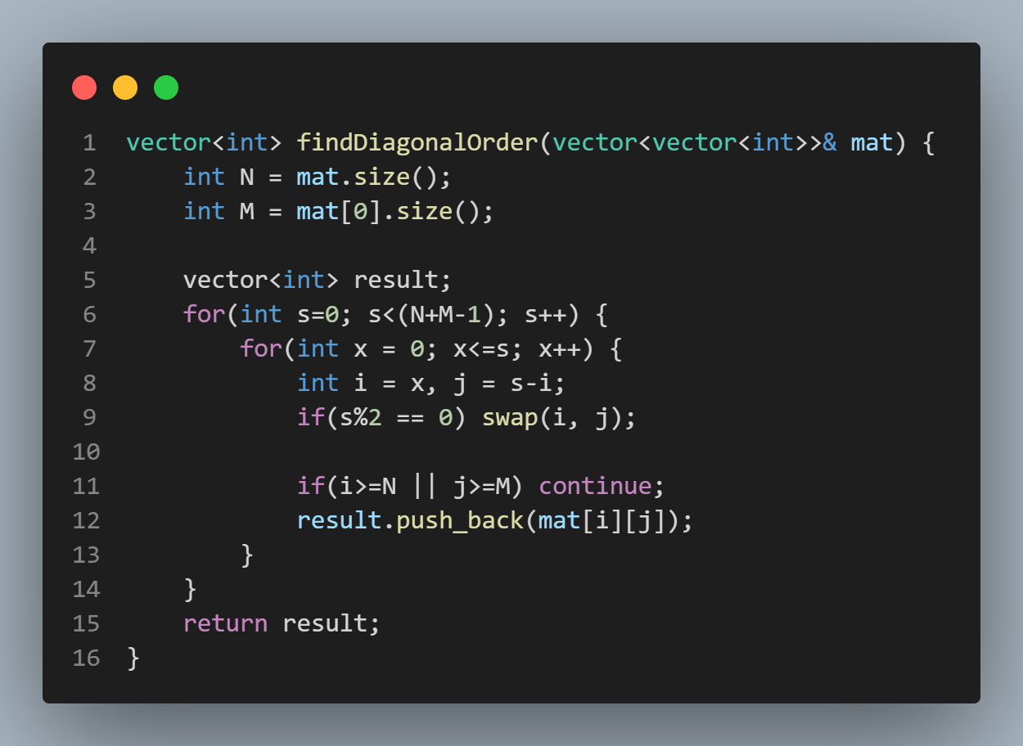

Slide 4





#100daysofDSA
/rvislive
Rakesh Vishwakarma

