Slide 1
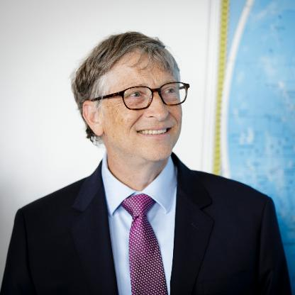
#2. Bill Gates
Bill Gates, 63
Cofounder, Bill & Melinda Gates Foundation
NET WORTH
$94.8 B
Source of Wealth : Microsoft, Self Made

