Slide 1
Evo
Evacuation intelligence · multimodal hazard fusion · hybrid ML inference
evac-evo.vercel.app · github.com/rvkshn-10/Evo

Slide 2
Operational impact
How Evo helps people in emergencies
Fuses live hazard telemetry with site occupancy to estimate evacuation success and duration per campus
Surfaces high-risk monitoring spots before drills or real events — density, occupancy, hazard proximity
Single geospatial dashboard for dispatchers, safety officers, and researchers (not fragmented feeds)
Sub-second ONNX/OpenVINO inference on edge CPU or Intel Neural Compute Stick for local deployments
Longitudinal disaster history for after-action review, export to SQL/CSV for institutional analysis

Slide 3
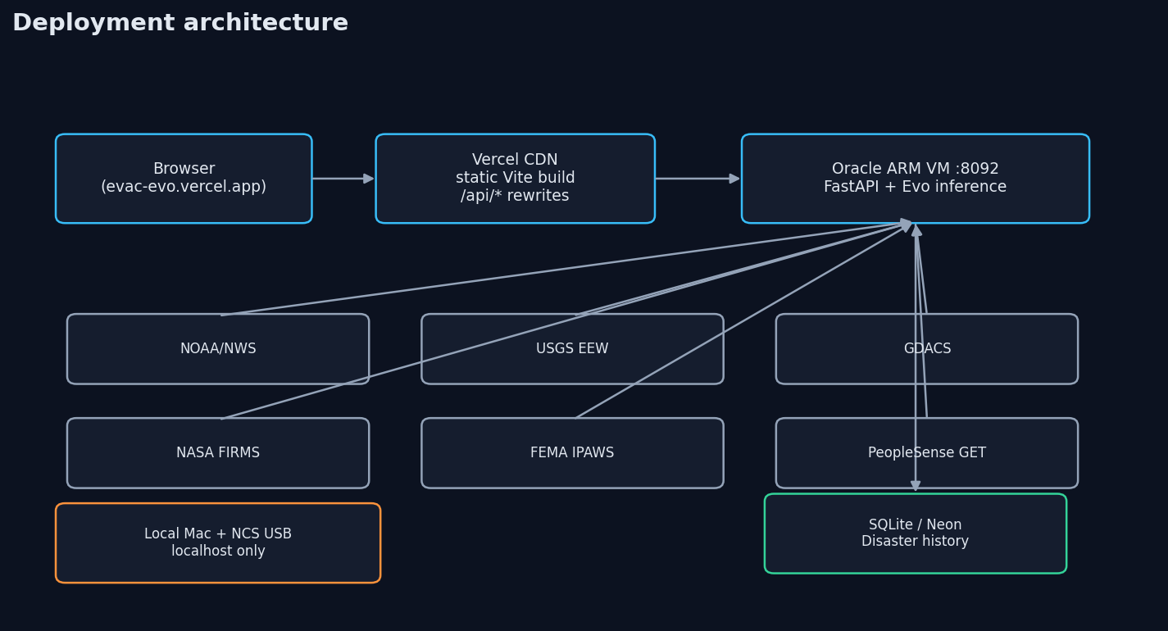
System architecture
Evo · evac-evo.vercel.app

Slide 4
Production deployment
Frontend: Vercel hosts static Vite build (web/dist) at evac-evo.vercel.app
vercel.json rewrites /api/* → Oracle VM FastAPI :8092 (TLS at Vercel edge)
Backend: Oracle Always Free ARM Ubuntu — python3 main.py via systemd
CORS: CORS_ORIGINS + *.vercel.app regex in main.py
History DB: SQLite locally; Neon Postgres optional via DATABASE_URL
Split keeps heavy Python/ML off serverless; UI deploys on every git push

Slide 5
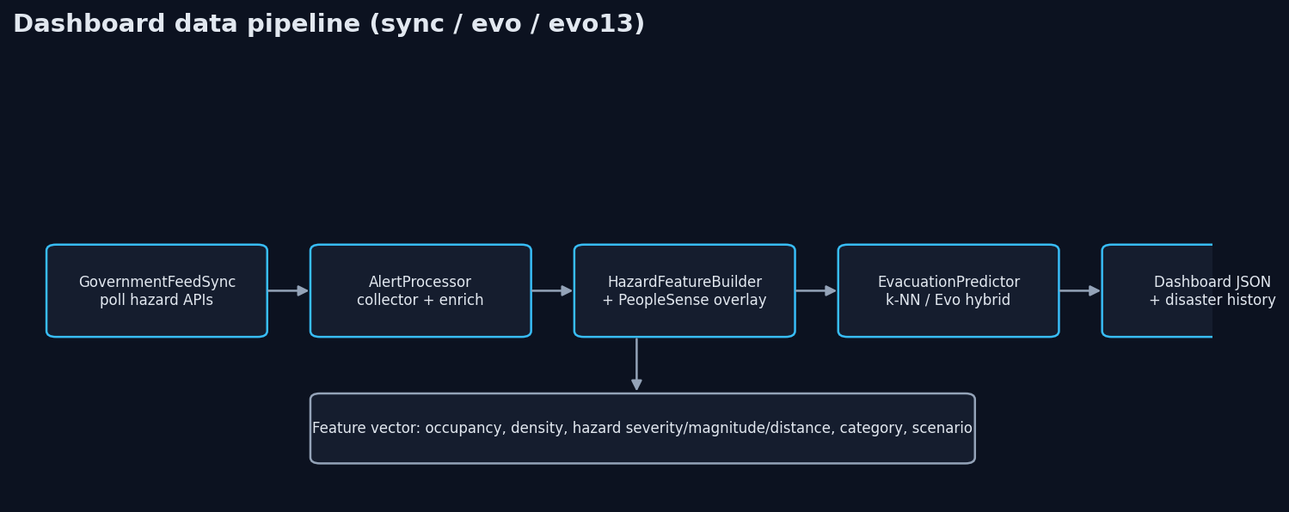
Backend data pipeline
Evo · evac-evo.vercel.app

Slide 6
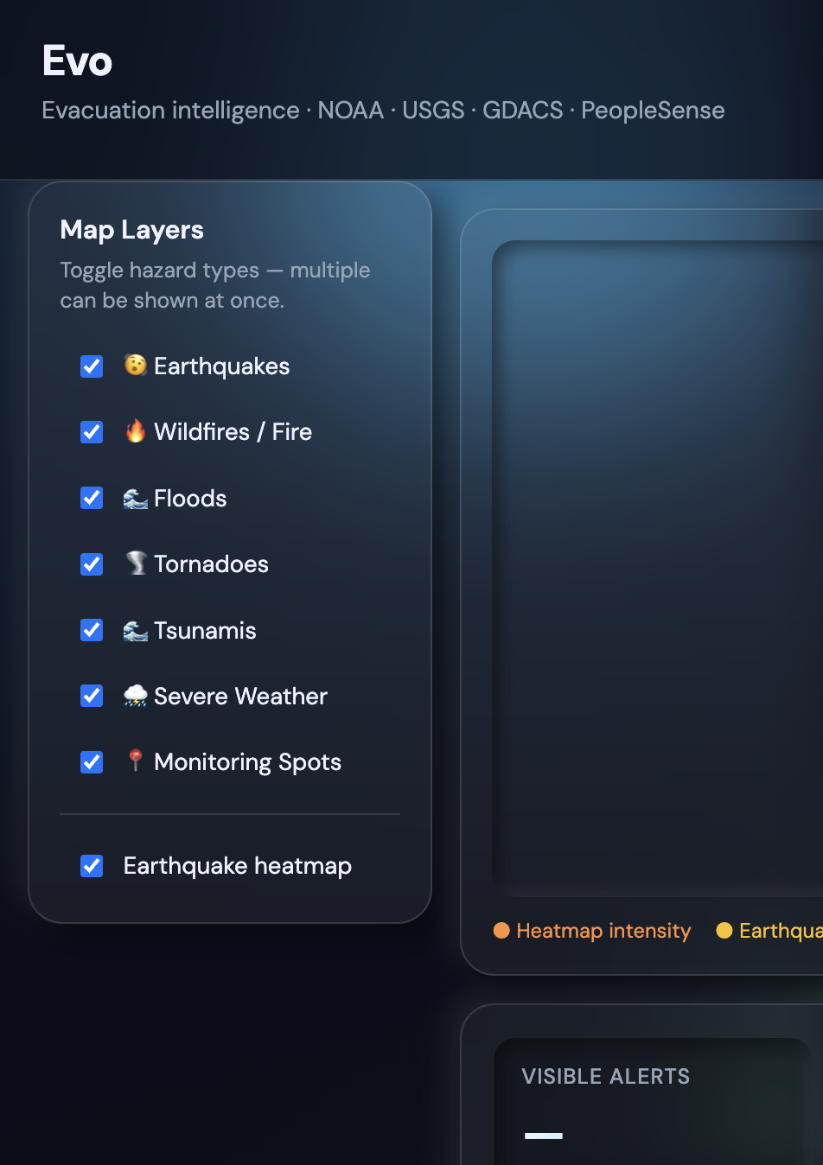
Live dashboard
Leaflet map · hazard layers · predictions table · run modes

Slide 7
Multimodal inputs
NOAA/NWS — CAP alerts, severity, polygons
USGS — significant quakes + EEW candidates
GDACS — global disaster context
NASA FIRMS — wildfire thermal hotspots
FEMA IPAWS — public alert feed
PeopleSense — occupancy Count, Density, Volatility
FCUSD reference corpus — 4,082 labeled evacuation rows
Monitoring spots — GPS, category, GGV2 match rules
Hazard feature builder — severity, magnitude, distance, depth
All merged into a fixed-length feature vector per site

Slide 8
Alert ingestion & enrichment
GovernmentFeedSync polls feeds → output/feeds/last_sync.json
AlertProcessor.collect_live_hazards() — single-pass per dashboard request
Per-alert: PeopleSense overlay → nearest hazard to spot → EvacuationPredictor
Auto-deploy: Extreme/Severe NOAA + EEW → PeopleSense event POST (if enabled)
Risk band: high if evac_rate < 0.9 OR density > 0.85 OR occupancy > 1500
Published: GET /api/dashboard JSON + optional disaster_history snapshot

Slide 9
Geospatial map (Leaflet)
Base: OpenStreetMap tiles; center from quakes or Sacramento default
Heatmap layer: earthquake intensity (L.heatLayer) — toggleable
Markers: cyan monitoring spots, yellow quake epicenters, red/orange hazard zones
Filter matrix: earthquake, wildfire, flood, tornado, tsunami, severe_weather, monitoring
hazard_category assigned server-side in AlertProcessor._hazard_category()

Slide 10
Run modes — overview
sync — feed refresh + k-NN predictions + history (default, no LLM cost)
evo — Evo 1.2 hybrid ONNX/OpenVINO inference + history
evo13 — research estimator with enriched reference + optional Evo 1.3 artifacts
external_ai — sync + Gemini→OpenAI narrative summary (RAG-style briefing)
broadcast — full 7-agent LangChain pipeline (does not write disaster history)

Slide 11
Run mode: Sync only
POST /api/alerts/sync?mode=sync
EvacuationPredictor: weighted k-NN (k=25) over reference JSON
Distance metric: scenario + category + occupancy/density covariates
No OpenAI/Gemini — suitable for continuous monitoring without API spend
Persists snapshot to SQLite/Neon via save_dashboard_snapshot()

Slide 12
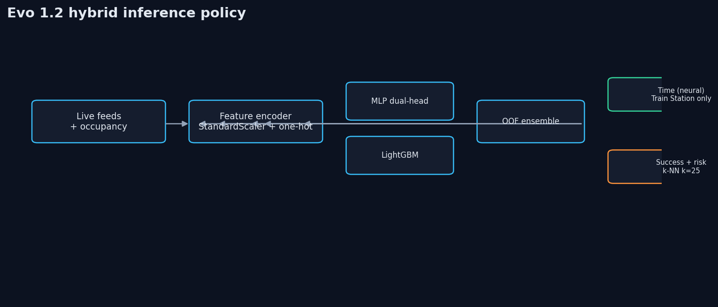
Run mode: Evo 1.2 hybrid (production)
Dual-head ensemble: MLP + LightGBM (OOF average)
10 numeric + categorical features → StandardScaler + one-hot
Hybrid policy: k-NN for success/risk; neural for time at Train Station hubs
5-fold StratifiedGroupKFold CV; synthetic augmentation grouped by row_id
Exported ONNX + OpenVINO IR from Colab training

Slide 13
Evo 1.3 — synthetic demo trained
complete_research_demo · production promotion disabled
Preflight passed: 12 PeopleSense rows + 6 synthetic drill outcomes
Selected: MLP + LightGBM OOF ensemble (mlp_lightgbm_oof_average)
Success MAE 1.657% ✅ · Success R² 0.185 ❌ · Time MAE 0.873 min ✅ · Time R² 0.596 ❌
ONNX parity ✅ · OpenVINO parity ❌ → research runtime uses verified ONNX
Classification: DATA_CEILING · keep_evo1.2_hybrid
Artifacts in models/evo1.3/ — illustrative until real drill labels replace synthetic data

Slide 14
Run mode: External AI (RAG-style briefing)
After dashboard build: generate_intelligence_summary() via llm_router
Retrieval context: alert headlines, quake counts, high-risk spot tally from live JSON
Generation: Gemini 2.0 Flash → OpenAI mini → GPT-4o failover chain
Output: 4–6 sentence operational briefing in API response (not stored in history DB)
Analogous to RAG: structured telemetry retrieved first, then LLM synthesis — not fine-tuned on FCUSD

Slide 15
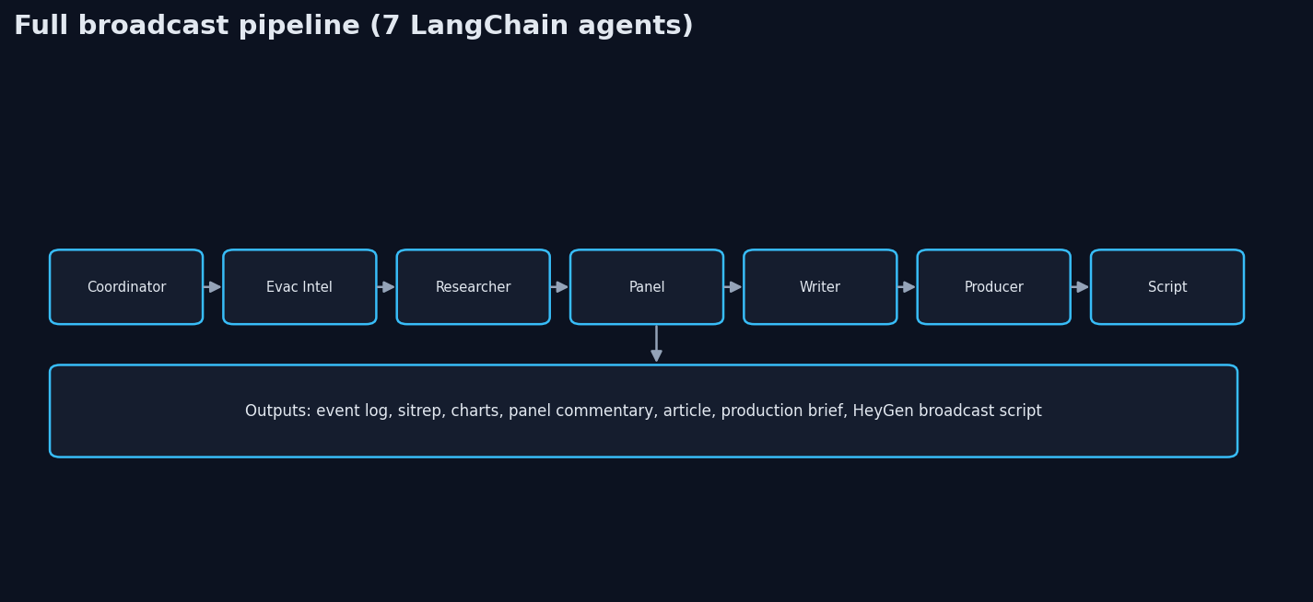
Run mode: Full broadcast
7 GPT-4o agents · HeyGen-ready script output

Slide 16
Training pipeline (Google Colab)
model_training/evo1_2/train_evo1_2.py — hazard seed + reference rows + grouped CV
Requirements: numpy, pandas, scikit-learn, torch, lightgbm, onnx, openvino
Notebook: model_training/evo1_2/ (export to docs/colab/)
Artifacts → models/evo1.2/: evo1.2.onnx, openvino/, metrics.json, validation_report.json
Quality gates: MAE, R², baseline beats, ONNX/OpenVINO parity, p95 < 10 ms
Phase B (Evo 1.3): drill-aligned PeopleSense + real_outcomes.json

Slide 17
Model validation status (Phase A)
Success MAE 1.647% (pass < 2%) · Success R² 0.184 (fail ≥ 0.25)
Time MAE 0.830 min (pass) · Time R² 0.636 (fail ≥ 0.75)
OpenVINO p95 0.341 ms (pass) · Classification: DATA_CEILING
Interpretation: live covariates lack evacuation outcome labels
Production policy: hybrid k-NN success + neural time at transit categories

Slide 18
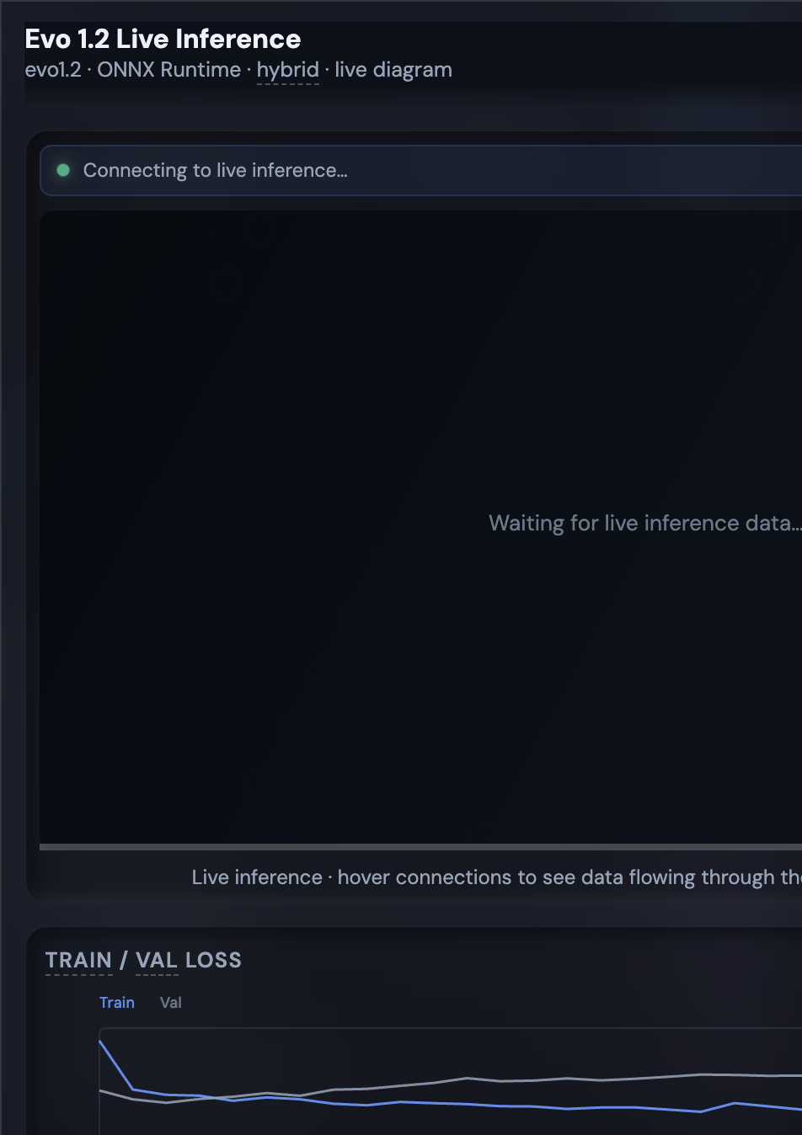
Model panel — live inference UI
◈ Model button opens modal
Live DAG: Ingest → Encode → MLP/LGBM → Merge
Animated packets = inference trace
Hover edges for raw→scaled values
Polls /api/evo/live-flow every 2.8s

Slide 19
Cross-validation loss curves
Train loss (blue): combined MLP training error per epoch — rapid initial descent
Val loss (gray): held-out fold error — plateau indicates generalization limit
Divergence → overfitting; parallel tracks → data ceiling (limited labeled outcomes)
Curves from metrics.json — grouped StratifiedGroupKFold, not a single holdout
Gates require val MAE/R² thresholds before model promotion

Slide 20
Metrics in the model modal
Success MAE — mean abs error on evac success %
Success R² — explained variance (success head)
Time MAE — minutes error on evacuation time
Time R² — explained variance (time head)
Runtime — ONNX Runtime vs OpenVINO backend
Gates passed — all promotion checks true
Research preview — failed R² or parity gates
Hybrid policy — which head (k-NN vs neural) drove live spot
Feature importance — permutation on validation fold
Live success/time — current dashboard prediction

Slide 21
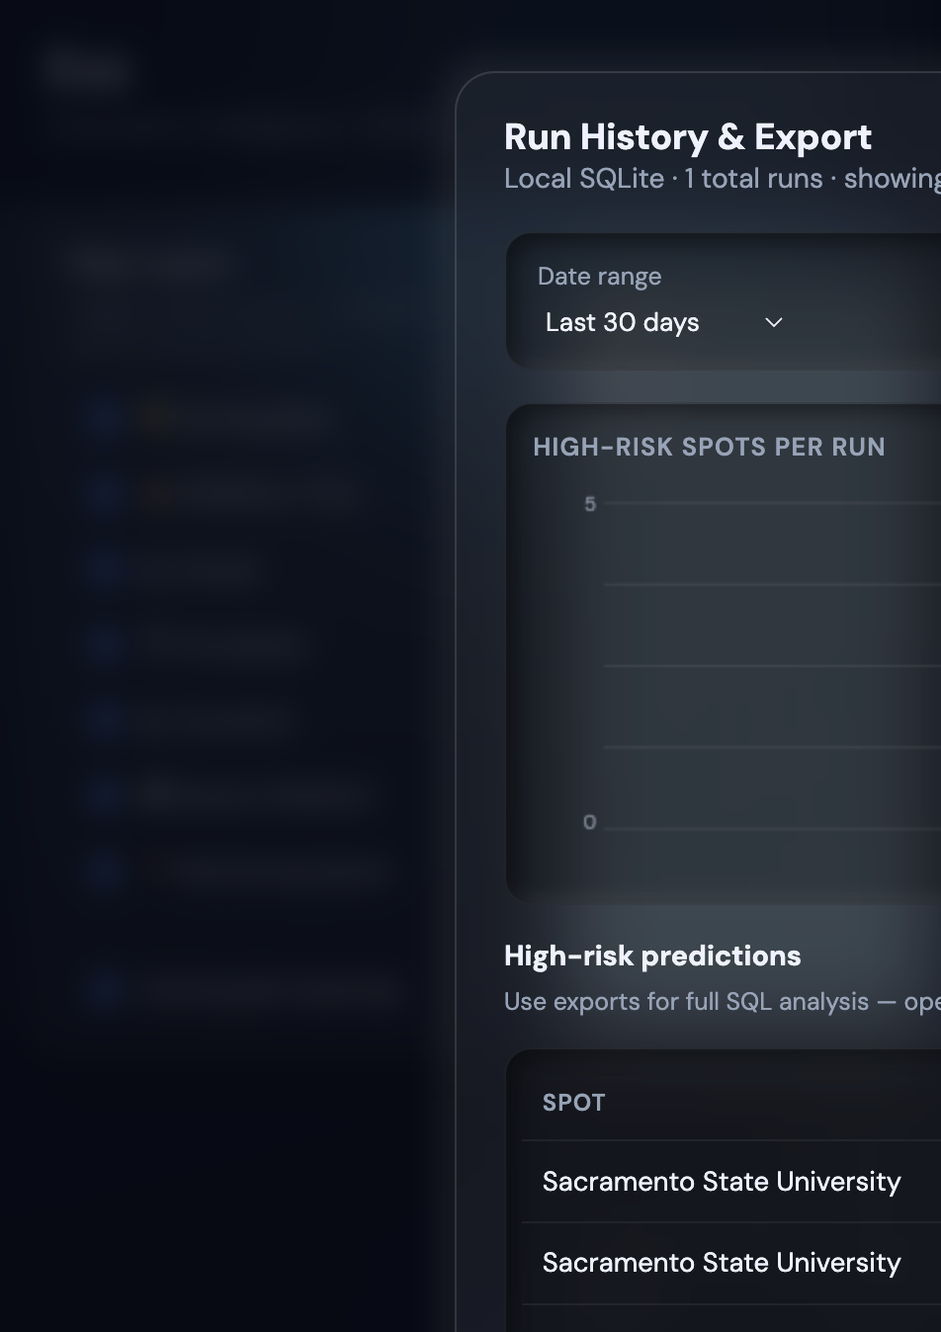
Disaster history & export
Tables: disaster_snapshots, hazard_events, evacuation_predictions
Written on sync/evo/evo13/external_ai runs
Charts: high-risk spots, alerts/quakes per run
Export: JSON, CSV ZIP, SQLite
Neon Postgres when DATABASE_URL set

Slide 22
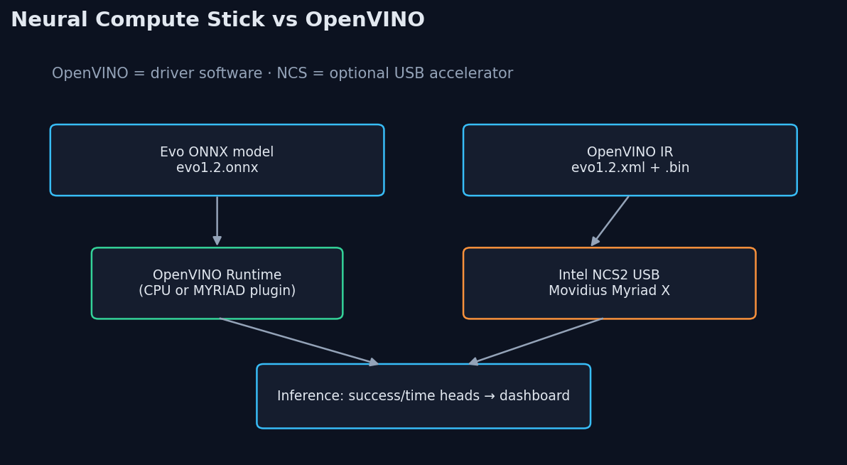
Neural Compute Stick & OpenVINO
OpenVINO = driver · NCS = optional USB hardware · see docs/NCS_SETUP.md

Slide 23
Edge inference with Intel NCS
NCS2 (Myriad X) or NCS1 (Myriad 2) via USB on local Mac
OpenVINO MYRIAD plugin compiles same evo1.2.xml as cloud CPU path
Dashboard Inference device: Auto / CPU / NCS1 / NCS2
POST /api/evo/accelerator — hot-swap without API restart
Vercel shows banner: cloud has no USB — CPU only in production
docs/NCS_SETUP.md — full install guide (OpenVINO is the driver, not separate from NCS)

Slide 24
Feature vector & encoding
Numeric: log-scaled occupancy, density, hazard severity/magnitude/distance/depth, …
Categorical: site category, scenario, event_type, hazard_source → one-hot
StandardScaler fit on training fold; schema in feature_schema.json
Live-flow UI shows each edge as raw → scaled tensor values
k-NN operates in hand-crafted distance space; MLP/LGBM in scaled ℝⁿ

Slide 25
Path to production deployment
Now: research preview live at evac-evo.vercel.app with Evo 1.2 hybrid policy
After Colab training completes: copy artifacts → models/evo1.3/, git push
Oracle: git pull + systemctl restart emergency-api
Vercel: auto-deploy frontend on push to main
Optional: Neon DATABASE_URL for durable multi-region history
NCS: local Mac demonstrations; cloud remains CPU for public URL

Slide 26
Colab notebooks
docs/colab/ — add exported notebooks here
Evo_1_2_Training.ipynb — grouped CV, ONNX/OpenVINO export
Evo_1_3_Training.ipynb — Phase B supervised training with preflight guard
After export: place notebooks in docs/colab/ for presentation appendix
Training outputs: validation_report.json drives promotion_recommendation

Slide 27
Thank you
evac-evo.vercel.app
github.com/rvkshn-10/Evo
docs/NCS_SETUP.md · docs/Evo_PhD_Deck.pptx

