Slide 1

Towards an Unified Engineering Model for Long (and short?) Range Forces and Wave Propagation
Giorgio Fontana
University of Trento – Italy
SPESIF 2010
APL – Johns Hopkins University – Laurel (MD) USA

Slide 2

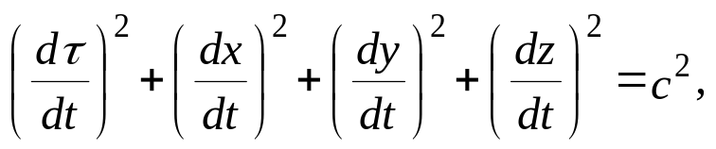
INTRODUCTION
OUR GOAL: Same principles and governing physical laws might be applied to all problems: gravitation, electromagnetism, (and nuclear forces ?) Easy quantization should be possible.
New approach to gravitation based on Maxwell’s equations in the four-dimensional-space plus time (Hyperspace).
Integrates with conventional electromagnetism and with consolidated physics.
The Hyperspace is the four dimensional space spawned by the Minkowski metric after a “coordinate transformation/reinterpretation”. τ is the invariant measure of distance.
Minkowski metric (experimentally validated by Special Relativity applications)
Hyperspace speed invariant
(⇨ it is the same equation)
(⇨ it is NOT interpreted as a metric in this context)
x, y, z, τ are the space coordinates of the Hyperspace. It is understood that in the Hyperspace our matter universe “travels” at the speed of light along the τ coordinate (see next slide), the speed is reduced by a function of particles internal (intrinsic) energy and other forms of kinetic energy in space-time.

Slide 3
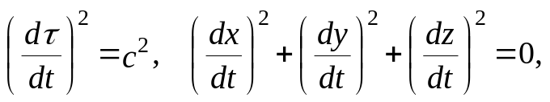
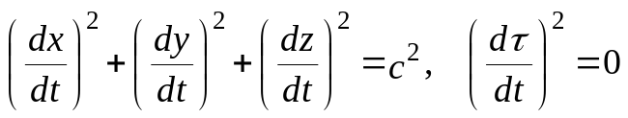
IMPLICATIONS OF HYPERSPACE COORDINATE SYSTEM
Photons are orthogonal to matter in Hyperspace, it follows that:
Parallel “worlds” must exist in Hyperspace
Matter “currents” must exist in Hyperspace
Let’s take the Hyperspace speed invariant (slide 2) and decompose it:
See next slide
Explanation of:
Matter:
Hyperspace speed
(⇨ v _{x,y,z} = 0)
Orthogonality of:
Photons:
Hyperspace speed
(⇨ v _{x,y,z} = c)
The Absoluteness of Hyperspace:
because τ is invariant (absolute), we deduce that considering:
The four contributions are expressed by an absolute system of four coordinates.
(extending the property by symmetry)

Slide 4
PICTORIAL OF THE “PARALLEL WORLDS” PARADIGM
From matter and photon equations of previous slide:
Appearing Red star is a matter event emitting a photon.
Appearing Green star is a matter event detecting a photon.
r
τ
We sit on one of the rectangles. We react to photons coming from rectangles more on the right and send photons to rectangles on the left. This is causality. Each rectangle represents a parallel World.
FIRST RUN
<Press spacebar or left mouse button for the animation >

Slide 5
PICTORIAL OF THE “PARALLEL WORLDS” PARADIGM
r
The orthogonality of matter and photons in Hyperspace implies the existence of parallel worlds and mass currents.
τ
We sit on one of the rectangles. We react to photons coming from rectangles more on the right and send photons to rectangles on the left. This is causality. Each rectangle represents a parallel World.
SECOND RUN
<Press spacebar or left mouse button for the animation >

Slide 6


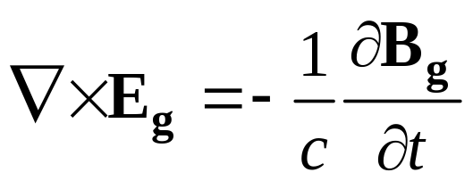
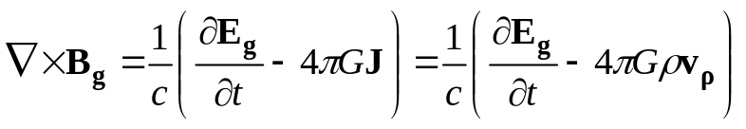
GRAVITOELECTROMAGNETISM IN SPACE-TIME
(Let’s now discuss Gravity)
The applicability of Maxwell equations for modeling problems related to gravity is traditionally accepted, on the other hand nearly all modern approaches straightly derive the Maxwell formulation from GR, and those are named Gravito-Electro-Magnetic (GEM) theories, see the following equations:
Traditionally defined in three space dimensions plus time.

Slide 7


GRAVITOELECTROMAGNETISM IN THE HYPERSPACE
(The Hypothesis)
Let’s make a sign change to an equation, restoring the original Heaviside formulation (see the paper for the motivations), add a space dimension because this is an HYPERSPACE model, and add space-time Lorentz invariance because it is experimentally validated:
space-time Lorentz invariance
Four space dimensions plus time.
gravitational refractive index

Slide 8
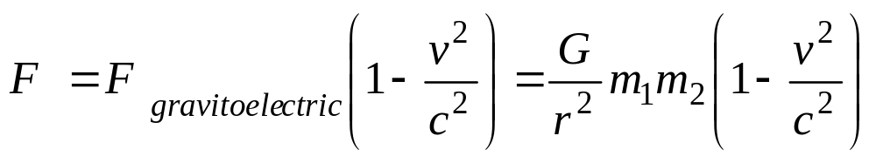
GRAVITOELECTROMAGNETIC FORCE (unitary n)
(First Thesis)
Gravitoelectromagnetic traditional Lorentz force between two co-moving particles in Hyperspace.
m₁ and m₂ are respectively the Hyperspace mass-charges of particle 1 and particle 2. Because of the additional complexity allowed by the four dimensional space, equation (8) is applicable only to particles that travel at the same speed along τ in Hyperspace, that are on the same proper time location (same space-time).
v=c in Hyperspace, it follows that, in general, F = 0

Slide 9
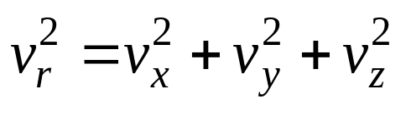
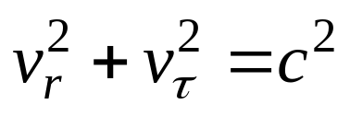

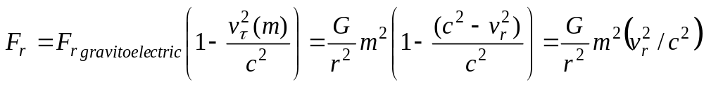
HOW THE GRAVITATIONAL FORCE IN SPACE-TIME ORIGINATES
Consider massive particles
Another decomposition
of Hyperspace speed invariant of slide 2.
Let:
and
We observe that has terms depending on 3D/Spacetime physics (em zero point, etc). 3D electric charge is due to chargeons, 4D mass charge is due to massons, both are subelementary partons. 3D means that the parton obeys 3D Maxwell equations, 4D means that the parton obeys 4D Maxwell equations. Both charges are invariant in Hyperspace.
Assuming m₁ = m₂ = m, and that v_{r} of the two particles are reciprocally uncorrelated over a time interval (zero covariance for the stochastic process, it follows that the contributions of this motion to the force integrates to zero), the gravito-magnetic component of the force in space-time depends only on the fully correlated v_{τ} and the total gravito-electro-magnetic force becomes:

Slide 10
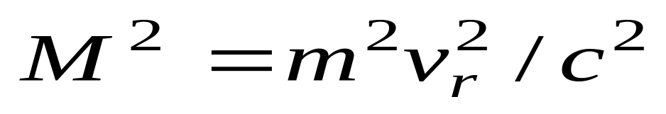
HOW THE GRAVITATIONAL FORCE IN SPACE-TIME ORIGINATES (2)
If both particles have the same kinetic energy in space-time (including vibrational and rotational energy), that is required to keep them in the same space-time, from slide 9 we have:
Mass in space-time
Mass-charge in Hyperspace
M is the mass of each particle as observed in space-time. Its value has two factors, one is the mass-charge of the particle in Hyperspace, and the other is the speed in the three-dimensional subset of space coordinates of Hyperspace related to space-time.

Slide 11
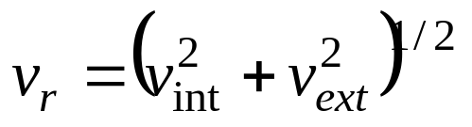
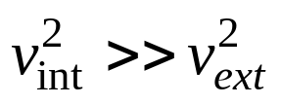
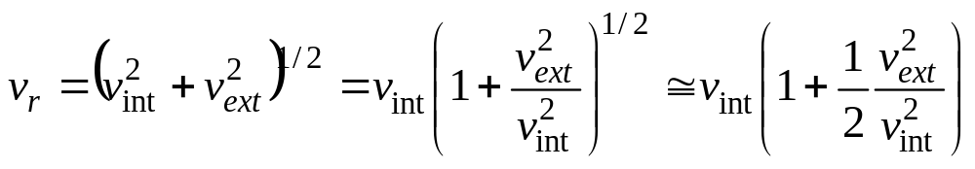
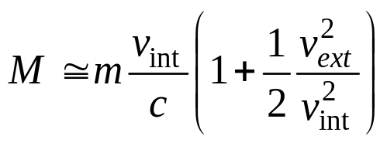
INTERNAL AND EXTERNAL SPEED OF PARTICLES
(An Exercise)
with:
Absolute system of coordinates
Non Newtonian
Flyby anomalies?

Slide 12
CONSERVATION OF MOMENTUM
Consider the “Parallel Worlds” paradigm of slide 4.
It follows that there exist mass currents in Hyperspace.
These mass currents are “coupled” by gravito-magnetism in Hyperspace.
Consider currents of particles, with a dominant component for matter particles directed along the τ coordinate (slide 3). The Faraday-Henry law (eq. 3 in the paper) has been adopted to describe the working principles of electrical transformers, it has a gravitational counterpart (eq. 9 in the paper):

Slide 13
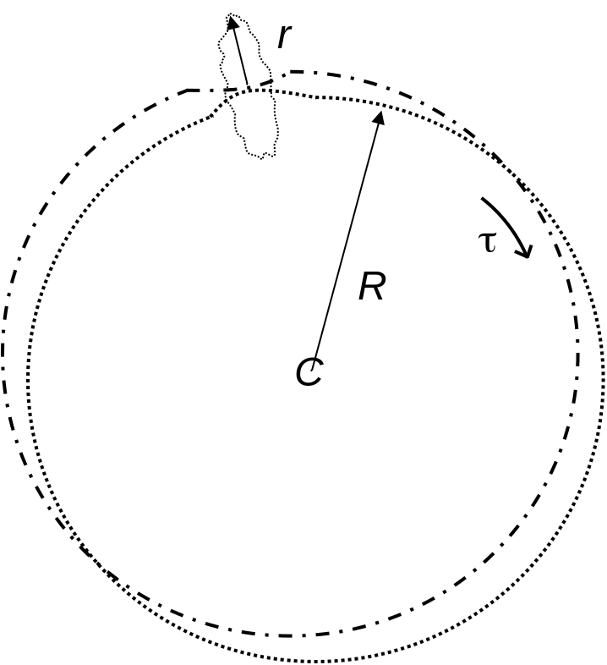
CONSERVATION OF MOMENTUM 2
Let’s take two ring shaped flows of particles in which a small section along the ring approximate the flow of two interacting space-time particles and their histories.
Small r can be interpreted as the actual radius of the universe in three dimensions, R is the radius of the four dimensional universe that includes parallel space-time universes.
The overall shape of the four dimensional universe is annular or toroidal with R>>r as a prerequisite to have high coupling factor k (Fontana, 1995). k is a well known parameter of electrical transformers.
(It is also possible to speculate that there may exist a focus point along the τ coordinate, where all currents merge, this point may represent the classical “big bang” for this specific model.)
Fig.1

Slide 14
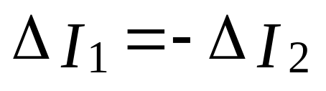
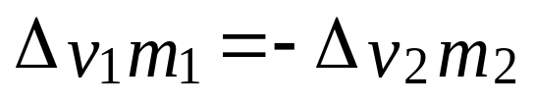
CONSERVATION OF MOMENTUM 3
In electrodynamics this is a 1:1 current transformer operating in the short circuit configuration, and with unitary coupling factor k (i.e. perfect coupling, see Fontana, 1995, for a detailed calculation of the relationship between k and the geometry of the currents) we have for changes in currents:
Expressing the current as speed times mass-charge per unitary length we have:
that, decomposed in the four orthogonal components, is conservation of momentum for Newton mechanics.

Slide 15

CONSERVATION OF MOMENTUM 4
The most famous Newton equation is considered to be the result of mathematical modeling of experimental observations. It is indeed possible to deduce it form gravitoelectromagnetic coupling under the restrictive condition of perfect coupling, which is always valid at small and planetary scale and far from C as depicted in slide 13 Fig. 1 at cosmological scales.
From Equation (24), infinitesimal changes in speed in an isolated system respect to a common time gives:
that defines a long range force F, which is entitled to mediate conservation of momentum.

Slide 16
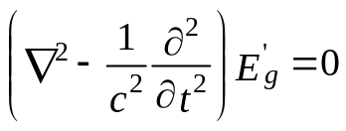
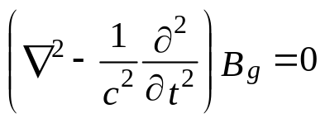
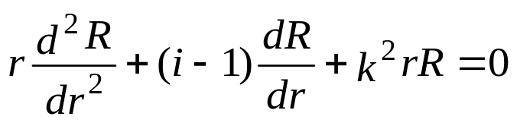
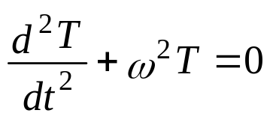
GRAVITATIONAL WAVES
(An Exercise)
(a linear solution)
Adopting the same procedure as for electromagnetic waves, substituting E’_{g} = E_{g} c :
The two equations are formally equivalent.
Solving one of them with separation of variables:
The temporal equation is trivial with harmonic solutions.

Slide 17
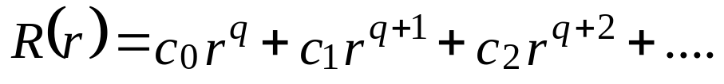
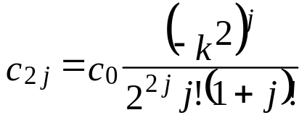
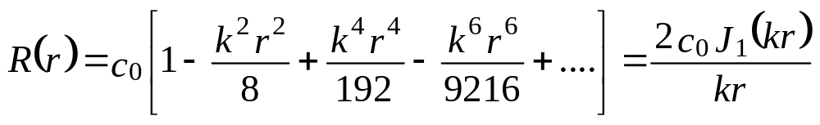
GRAVITATIONAL WAVES 2
For the spatial part we have i=4 and:
Where J₁ is the first order Bessel function.

Slide 18
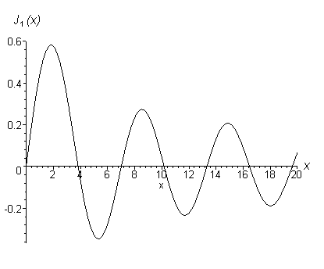
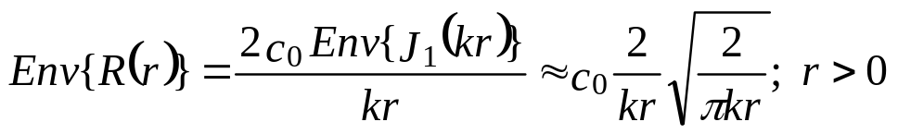
GRAVITATIONAL WAVES 3
The amplitude envelope of the oscillating solution:
Indicates that the radial attenuation of a hyperspherical GW has a faster rate than the radial attenuation of a spherical 3D wave.

Slide 19
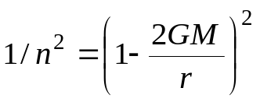
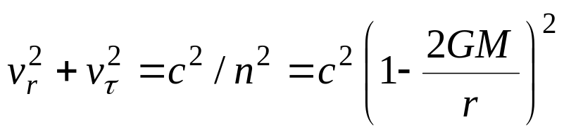
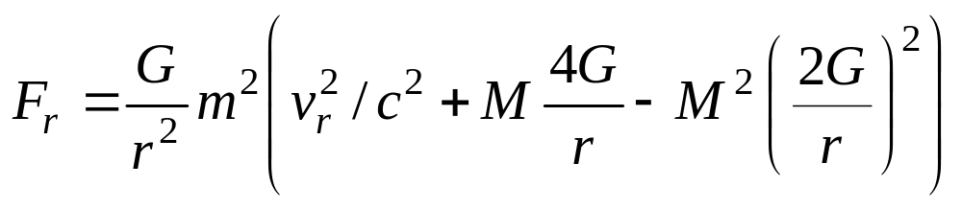
ABOUT THE REFRACTIVE INDEX n (NON-LINEARITY)
Let’s introduce the
The Hyperspace speed invariant with non-unitary gravitational refractive index
Schwarzschild’s metric
(See Almeida, isotropic n)
Three components of the Gravitational force (with the method of slide 9):
We already know this term (slide 10).

Slide 20

IS THIS MODEL OF GRAVITY RELATED TO THE STRONG NUCLEAR FORCE?
Second and third term are equal in magnitude for:
At relativistic v_{r} , the first and third terms are ∼equal for:
For the proton mass, this radius (minimum radius) corresponds to 1.11⋅10⁻³⁷m, the Schwarzschild’s radius of the proton, r_{s} ≈ 2.4⋅10⁻⁵²m, the conventional radius is 10⁻¹⁵m.
Model for the strong nuclear force?

Slide 21
CONCLUSION
It is well known that Maxwell equations can be applied to solve problems related to real world gravitating systems with results comparable to those of General Relativity. This paper has elaborated on extending the Maxwell approach by including concepts from Euclidean Relativity and 4DO. The main results are the postulated existence of mass carrying sub-elementary particles named massons (4D) that combine with chargeons (3D) to drive gravity in space-time through a 3-to-4 dimensional interface. Newtonian gravity may have an additional component that depends on kinetic energy of individual masses in space-time. Strong coupling among mass currents in Hyperspace is shown to originate conservation of momentum. After including the Schwarzschild’s metric of General Relativity, it was possible to find two additional terms in the expression of the 4Dspace+time Maxwell gravitational force in space-time. The formula provides some degrees of freedom for treating gravitational anomalies like repulsive gravity near ultra-dense objects or phenomena observed at extremely short distance, which may include the strong nuclear force. The propagation of GW in the linear regime has been described and discussed.
Next slide: COMMENTS

Slide 22
ADDITIONAL (non-formalized) COMMENTS
In HYPERSPACE, gravitation and electromagnetism are separate interactions. Gravity does not “emerge”, but it “is” fundamental.
The HYPERSPACE is experimentally unknown, but if this paper is correct there must exist the gravitational force in Hyperspace that obey 4D+time Maxwell equations and there we may have quantized carriers of the gravitational charge.
Combining 4D massons with 3D chargeons we have a nice working model for classical electromagnetism and space-time gravity, plus an intriguing model for inertia, conservation of momentum and conservation of energy, etc.
In space-time, gravity and electromagnetism interact through all particles that have mass and charge (fermions). In space-time gravity emerges because of this interaction.
Electromagnetic quantum fluctuations are real (as shown by Casimir effect) but the associated gravitational fields may only emerge through fermions.
The gravitational refractive index n is 1 for fermions and bosons in the linear theory (v=c). n may be different from 1 for non-linear propagation of fermions and bosons (v>c and v<c are possible). n is experimentally unknown for free massons propagation and for Hyperspace gravitational waves (are they related to Einstein GW?).
If neutrinos are a kind of free massons, then n is 1 for free massons (from experiments).
Photons might have Hyperspace mass and its effect on them may be
undetectable by observing only co-moving photons (slide 8).

