Slide 1
Date-A-Scientist
Machine Learning Fundamentals
Yonel Meza Avila
2018-12-20

Slide 2
Table of Contents
Exploration of the Dataset for classification
Question(s) to Answer
Augmenting the Dataset
Classification Approaches
Exploration of the Dataset for regression
Question(s) to Answer
Regression Approaches
Conclusions/Next steps

Slide 3
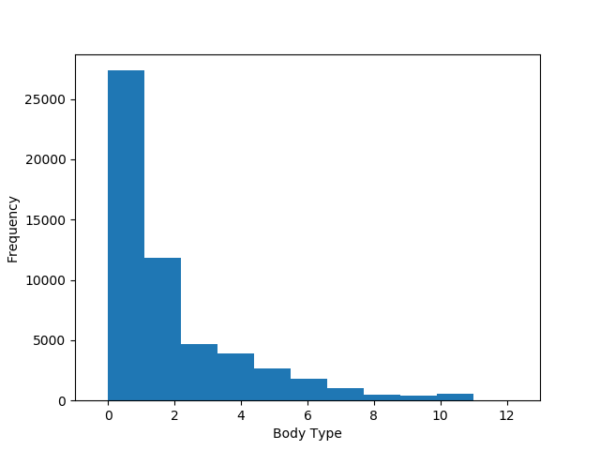
Exploration of the Dataset
The first column I explored was “Body Type”:
Value | Count
average | 1207
fit | 906
athletic | 799
curvy | 448
thin | 348
a little extra | 322
skinny | 125
full figured | 102
overweight | 60
jacked | 40
used up | 40
rather not say | 10

Slide 4
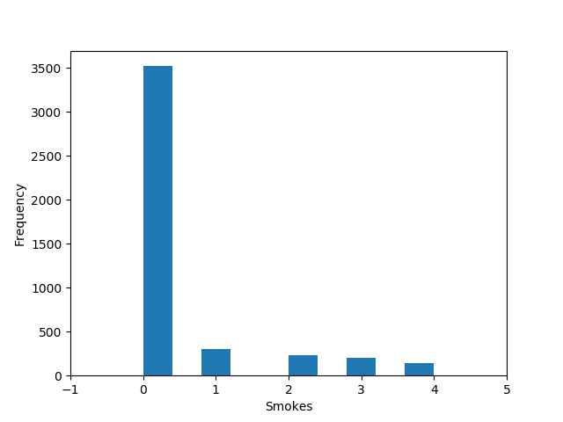
Exploration of the Dataset
The first column I explored was “smokes”:
Value | Count
no | 3523
sometimes | 305
when drinking | 233
yes | 200
trying to quit | 146

Slide 5
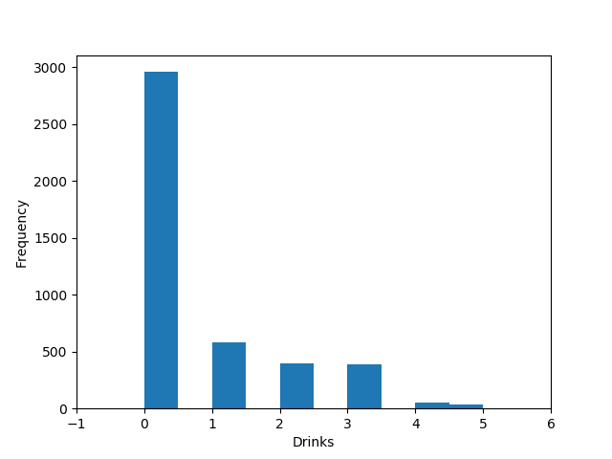
Exploration of the Dataset
The first column I explored was “drinks”:
Value | Count
socially | 2958
rarely | 581
often | 396
not at all | 386
very often | 52
desperately | 34

Slide 6
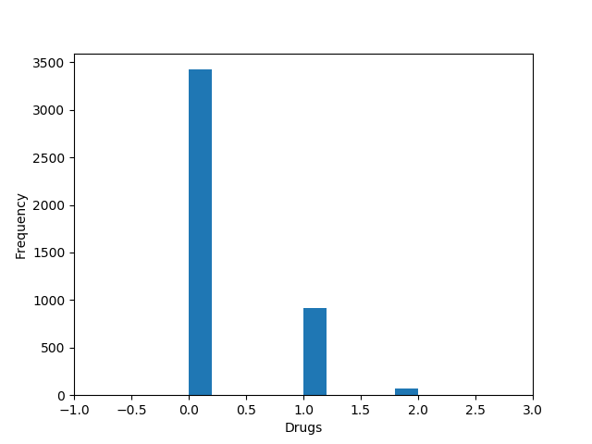
Exploration of the Dataset
The first column I explored was “drugs”:
Value | Count
Never | 3423
Sometimes | 916
often | 68

Slide 7
Exploration of the Dataset
Almost all the columns that I explored seems to be not even, almost all of them has a some of the categories has much more responses than other, for example in “Smoke” we have that “No” has almost 80% but the other responses have less that 10% this can be a problem (and it was) when you are try to learn and predict from that kind of data.

Slide 8
Question(s) to Answer
When I saw the data I wanted to see if we can predict the body type using the combination of: drinks, smokes, drugs and diet, obviously because those parameters normally affect you body shape.
Normally people that use drugs or smoke get thinner and some others that drinks get fatter and so on.

Slide 9
Augmenting the Dataset
As I had string values (labels) for the column that I wanted to use I created a column for each one of them with a code, using the result value_counts method, I iterated them and create an map and with that I created the new column, for example:
The columns I created were: smokes_code, drinks_code, drugs_code, diet_code and body_type_code
code = 0 diet_mapping = {} for diet in df.diet.value_counts().index: diet_mapping[diet] = code code += 1 df["diet_code"] = df.diet.map(diet_mapping)

Slide 10
Classification Approaches
I use the K-Nearest Neighbors and the Support Vector Machines approaches.

Slide 11
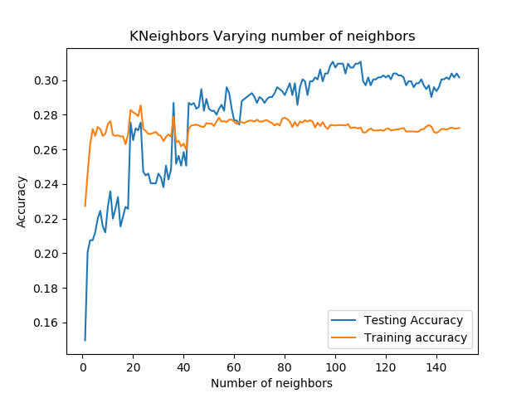
K-Nearest Neighbors approach
For this approach I created a loop to test the accuracy varying the number of neighbors, as you can see on the chart there is a improvement of the accuracy on ~20-40 neighbors then it doesn’t get any better, the problem here is that the best accuracy that I got was around 0.28, it’s a pretty bad result, I think the problem is the distribution of the data.

Slide 12
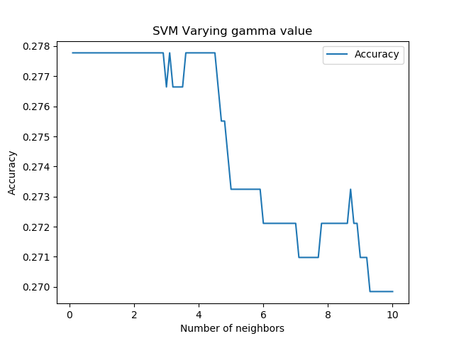
SVM approach
For this approach I created a loop to test the accuracy varying the gamma value, the loop increase the gamma value by 0.1 from 0.1 to 10 and using the default kernel, as you can see on the chart there isn’t much variation of the accuracy from 0.1 to 2 after that it drops but not by much, almost 0.01, getting a max value of almost 0.28, I think the problem here, as it was with the other approach, is the distribution of the data.

Slide 13
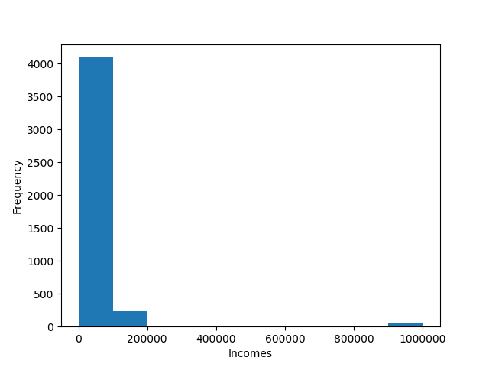
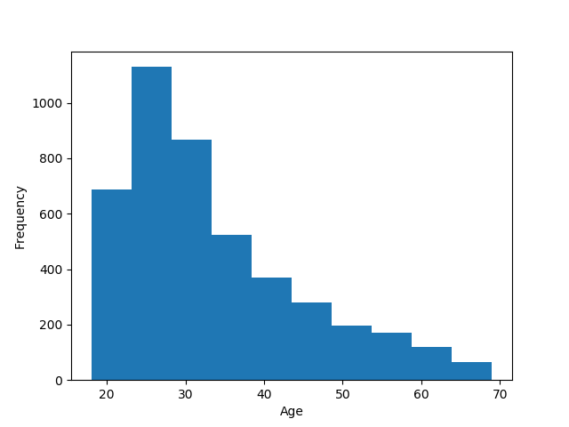
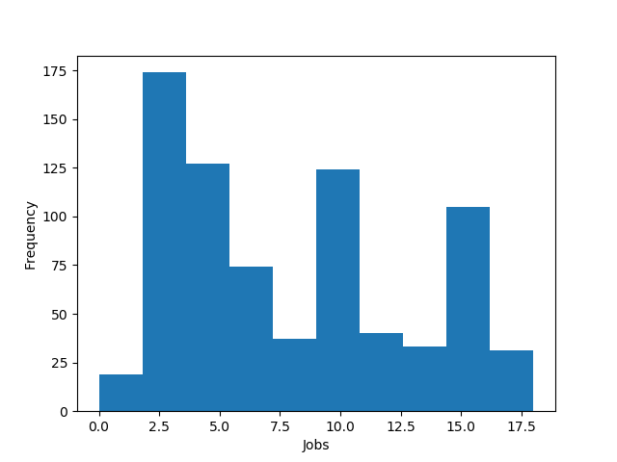
Exploration of the Dataset for regression
For this I need some continuous variables so I did another exploration, for this part I found age and incomes, and as a related variable job. Ages and Jobs has a more distributed data that the other variables that I used for the classification, but the income variable hasn’t. As I did for the classification I create a new column (job_code) fo the variable job

Slide 14
Question(s) to Answer
When I saw the data for this part I wanted to see if we can predict the income using the combination of: age and job, I added the age part because it can be directly related with the time of experience of a person have in a job, so I though that it can be related to the income also.
Normally I persona that have a “more complicated” job have a better income, and when you have more experience also you can get a better income.

Slide 15
Classification Approaches
I use the Linear Regression (with multiple variables) and the K-Nearest Neighbor Regressor approaches.

Slide 16
Linear Regression approach
For this approach I created a training group for the fit method and a verification group for the test I got pretty bad scores ~0.1, what I did next was filter the data, I remove some of the records that were off, like the people that answer that their income were more than 100k, and some others like the one that answered 'rather not say’ in the job column, after some of those filters, the best scores that I got were:
For training: 0.38
For verification: 0.37
These scores better that the one I got at first but I think they aren’t good enough.

Slide 17
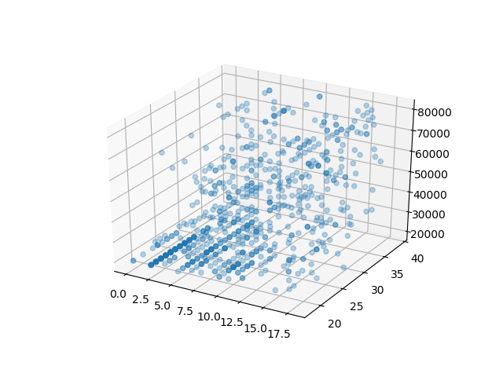
Linear Regression approach
After I saw those result I decided to create a 3d chart to see the data distribution and as you can see the data didn’t align with a plane, it is scattered so it can’t be good represented by a plane

Slide 18
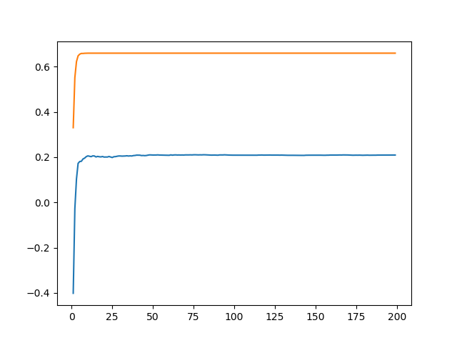
K-Nearest Neighbor Regressor approach
For this approach I created a loop as I did for the K-Nearest Neighbor in the classification part, varying the neighbors number, with this I got a much better result 0.6 that is almost twice that the one I got with the other approach, but even with this result I think this approach isn’t the right one for this data.

Slide 19
Conclusions/Next steps
With this exercise I can conclude:
The distribution of the data is pretty important, we need to have a good set of data or we can improve the data that we have using some techniques like filtering (the one I use for regression).
Not all the methods that we have are a good fit for the data that we could have, we have to evaluate which one we can use.
Some of the methods that I learn here are pretty have parameters that we can adjust and get different results but this tuning is like “trials and errors” sometimes is difficult find a good set of those parameters

