Slide 1
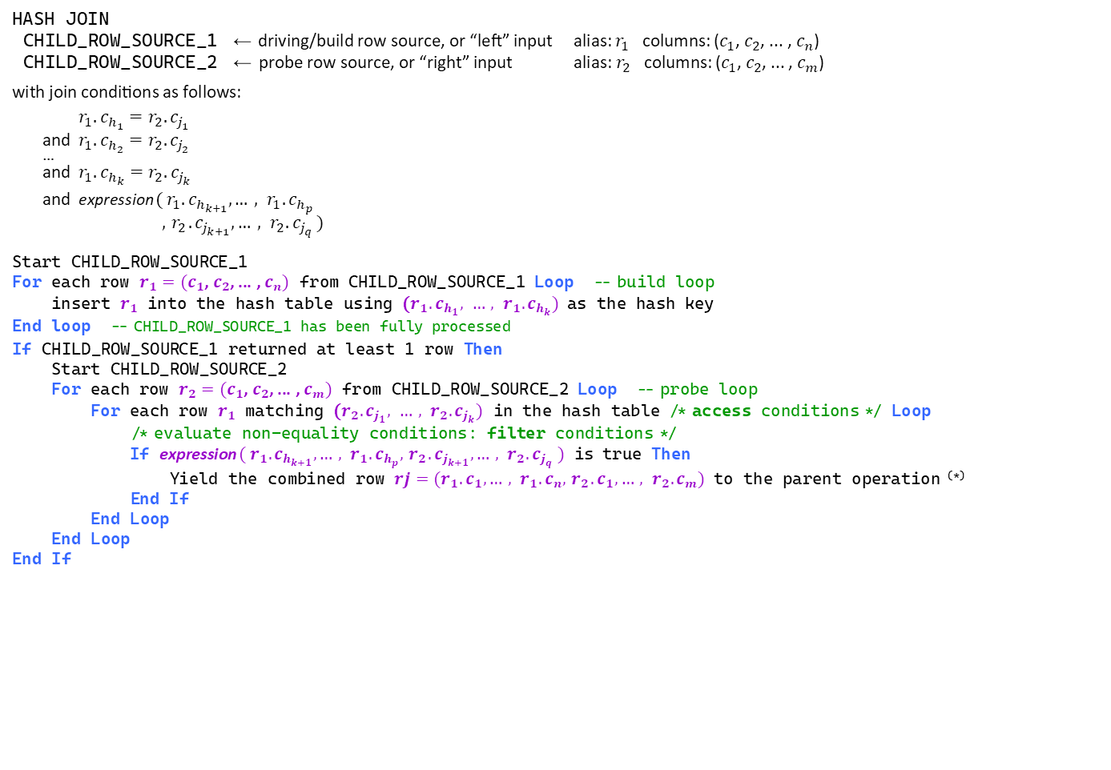
HASH JOIN pseudo-code (high-level, simplified perspective)
HASH JOIN
CHILD_ROW_SOURCE_1 ← driving/build row source, or “left” input alias: $r_{1}$ columns: ($c_{1}$, $c_{2}$, ... , $c_{n}$)
CHILD_ROW_SOURCE_2 ← probe row source, or “right” input alias: $r_{2}$ columns: ($c_{1}$, $c_{2}$, ... , $c_{m}$)
with join conditions as follows:
$r_{1}.c_{h_{1}}=r_{2}.c_{j_{1}}$
and $r_{1}.c_{h_{2}}=r_{2}.c_{j_{2}}$
…
and $r_{1}.c_{h_{k}}=r_{2}.c_{j_{k}}$
and expression ( $r_{1}.c_{h_{k+1}}, …, r_{1}.c_{h_{p}}$ $,{ r}_{2}.c_{j_{k+1}},…, r_{2}.c_{j_{q}}$ )
Start CHILD_ROW_SOURCE_1
For each row $r_{1}=(c_{1}$, $c_{2}$, ... , $c_{n})$ from CHILD_ROW_SOURCE_1 Loop -- build loop
insert $r_{1}$ into the hash table using ($r_{1}.c_{h_{1}}, …, r_{1}.c_{h_{k}})$ as the hash key
End loop -- CHILD_ROW_SOURCE_1 has been fully processed
If CHILD_ROW_SOURCE_1 returned at least 1 row Then
Start CHILD_ROW_SOURCE_2
For each row $r_{2}=(c_{1}$, $c_{2}$, ... , $c_{m})$ from CHILD_ROW_SOURCE_2 Loop -- probe loop
For each row $r_{1}$ matching ($r_{2}.c_{j_{1}}, …, r_{2}.c_{j_{k}})$ in the hash table /* access conditions */ Loop
/* evaluate non-equality conditions: filter conditions */
If expression $( r_{1}.c_{h_{k+1}}, …, r_{1}.c_{h_{p}},{ r}_{2}.c_{j_{k+1}},…, r_{2}.c_{j_{q}} )$ is true Then
Yield the combined row $rj=(r_{1}.c_{1}, …, r_{1}.c_{n},{ r}_{2}.c_{1},…, r_{2}.c_{m})$ to the parent operation ^{(*)}
End If
End Loop
End Loop
End If
equality conditions
non-equality conditions
^{(*)} Actually, only projected columns are passed to the parent operation
Key points:
CHILD_ROW_SOURCE_1 and _2 are started only once (per start of the parent), and processed independently, in turn
The hash table (in workarea) is built from CHILD_ROW_SOURCE_1: rows from CHILD_ROW_SOURCE_2 are not buffered (iff the hash join can be processed fully in memory)
The hash key is formed of equi-joined columns; non-equality join conditions are always used as filter conditions, and evaluated by iterating on rows matching the probe key in the hash table—if there are too many such rows, a lot of CPU time could go into that
The optimizer may swap join inputs, depending on (estimated) memory requirements of using either as the build row source

