Slide 1
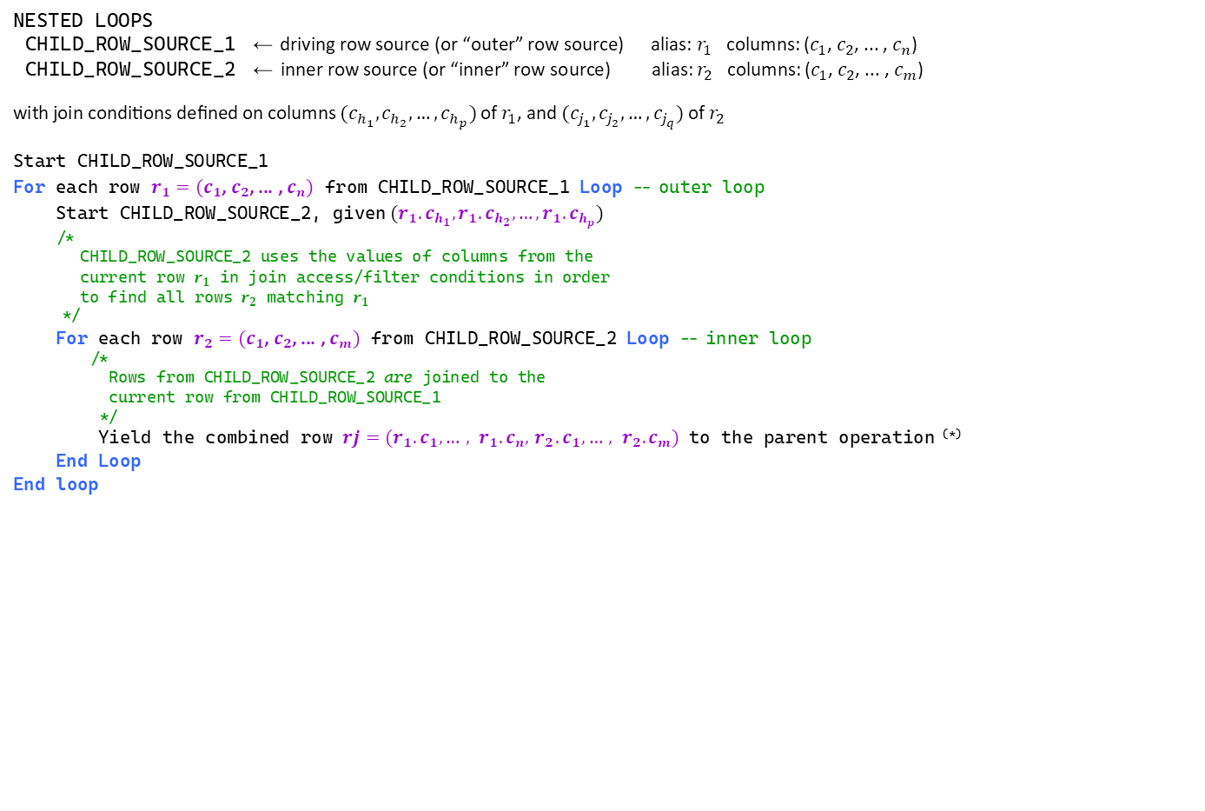
NESTED LOOPS pseudo-code (high-level, simplified perspective)
NESTED LOOPS
CHILD_ROW_SOURCE_1 ← driving row source (or “outer” row source) alias: $r_{1}$ columns: ($c_{1}$, $c_{2}$, ... , $c_{n}$)
CHILD_ROW_SOURCE_2 ← inner row source (or “inner” row source) alias: $r_{2}$ columns: ($c_{1}$, $c_{2}$, ... , $c_{m}$)
with join conditions defined on columns ($c_{h_{1}}, c_{h_{2}},…,c_{h_{p}})$ of $r_{1}$, and ($c_{j_{1}}, c_{j_{2}},…,c_{j_{q}})$ of $r_{2}$
Start CHILD_ROW_SOURCE_1
For each row $r_{1}=(c_{1}$, $c_{2}$, ... , $c_{n})$ from CHILD_ROW_SOURCE_1 Loop -- outer loop
Start CHILD_ROW_SOURCE_2, given ${(r_{1}.c}_{h_{1}}, {r_{1}.c}_{h_{2}},…,{r_{1}.c}_{h_{p}})$
/*
CHILD_ROW_SOURCE_2 uses the values of columns from the
current row $r_{1}$ in join access/filter conditions in order
to find all rows $r_{2}$ matching $r_{1}$
*/
For each row $r_{2}=(c_{1}$, $c_{2}$, ... , $c_{m})$ from CHILD_ROW_SOURCE_2 Loop -- inner loop
/*
Rows from CHILD_ROW_SOURCE_2 are joined to the
current row from CHILD_ROW_SOURCE_1
*/
Yield the combined row $rj=(r_{1}.c_{1}, …, r_{1}.c_{n},{ r}_{2}.c_{1},…, r_{2}.c_{m})$ to the parent operation ^{(*)}
End Loop
End loop
^{(*)} Actually, only projected columns are passed to the parent operation
Key points:
CHILD_ROW_SOURCE_1 is started once per start of its parent
CHILD_ROW_SOURCE_2 is started as many times as CHILD_ROW_SOURCE_1 supplies a row to be joined with
CHILD_ROW_SOURCE_2 uses join columns from the “outer row” as input
Join access/filter conditions are processed by CHILD_ROW_SOURCE_2

