Slide 1
select /*+ full(dep) full(loc) */
emp.last_name, job.job_title, loc.city
from jobs job,
employees emp,
departments dep,
locations loc
where job.job_id = emp.job_id
and emp.department_id = dep.department_id
and dep.location_id = loc.location_id
and (emp.email = 'HBROWN' or job.job_id = 'HR_REP');
LAST_NAME JOB_TITLE CITY
--------------- ----------------------------------- --------------------
Jacobs Human Resources Representative London
Brown Public Relations Representative Munich
2 rows selected.
Shh! We Have a [SQL] Plan
SQL_ID 6um9z82ayj75t, child number 0
Plan hash value: 1743992561
-------------------------------------------------------------------------------------------------------------------------------------------------------------------
| Id | Operation | Name | Starts | E-Rows |E-Bytes| Cost (%CPU)| E-Time | A-Rows | A-Time | Buffers | OMem | 1Mem | Used-Mem |
-------------------------------------------------------------------------------------------------------------------------------------------------------------------
| 0 | SELECT STATEMENT | | 1 | | | 12 (100)| | 2 |00:00:00.01 | 21 | | | |
|* 1 | HASH JOIN | | 1 | 7 | 511 | 12 (9)| 00:00:01 | 2 |00:00:00.01 | 21 | 1106K| 1106K| 536K (0)|
|* 2 | HASH JOIN | | 1 | 7 | 427 | 9 (12)| 00:00:01 | 2 |00:00:00.01 | 14 | 1106K| 1106K| 553K (0)|
| 3 | MERGE JOIN | | 1 | 7 | 378 | 6 (17)| 00:00:01 | 2 |00:00:00.01 | 8 | | | |
| 4 | TABLE ACCESS BY INDEX ROWID| JOBS | 1 | 19 | 513 | 2 (0)| 00:00:01 | 19 |00:00:00.01 | 2 | | | |
| 5 | INDEX FULL SCAN | JOB_ID_PK | 1 | 19 | | 1 (0)| 00:00:01 | 19 |00:00:00.01 | 1 | | | |
|* 6 | FILTER | | 19 | | | | | 2 |00:00:00.01 | 6 | | | |
|* 7 | SORT JOIN | | 19 | 107 | 2889 | 4 (25)| 00:00:01 | 107 |00:00:00.01 | 6 | 15360 | 15360 |14336 (0)|
| 8 | TABLE ACCESS FULL | EMPLOYEES | 1 | 107 | 2889 | 3 (0)| 00:00:01 | 107 |00:00:00.01 | 6 | | | |
| 9 | TABLE ACCESS FULL | DEPARTMENTS | 1 | 27 | 189 | 3 (0)| 00:00:01 | 27 |00:00:00.01 | 6 | | | |
| 10 | TABLE ACCESS FULL | LOCATIONS | 1 | 23 | 276 | 3 (0)| 00:00:01 | 23 |00:00:00.01 | 7 | | | |
-------------------------------------------------------------------------------------------------------------------------------------------------------------------
Predicate Information (identified by operation id):
---------------------------------------------------
1 - access("DEP"."LOCATION_ID"="LOC"."LOCATION_ID")
2 - access("EMP"."DEPARTMENT_ID"="DEP"."DEPARTMENT_ID")
6 - filter(("EMP"."EMAIL"='HBROWN' OR "JOB"."JOB_ID"='HR_REP'))
7 - access("JOB"."JOB_ID"="EMP"."JOB_ID")
filter("JOB"."JOB_ID"="EMP"."JOB_ID")

Slide 2
----------------------------------------------------------------------------------------------------------------------------------------------------------------
| Id | Operation | Name | Starts | E-Rows |E-Bytes| Cost (%CPU)| E-Time | A-Rows | A-Time | Buffers | Reads |
----------------------------------------------------------------------------------------------------------------------------------------------------------------
| 0 | SELECT STATEMENT | | 1 | | | 8 (100)| | 2 |00:00:00.01 | 16 | 1 |
| 1 | VIEW | VW_ORE_8CFACDC3 | 1 | 2 | 100 | 8 (0)| 00:00:01 | 2 |00:00:00.01 | 16 | 1 |
| 2 | UNION-ALL | | 1 | | | | | 2 |00:00:00.01 | 16 | 1 |
| 3 | NESTED LOOPS | | 1 | 1 | 73 | 4 (0)| 00:00:01 | 1 |00:00:00.01 | 8 | 1 |
| 4 | NESTED LOOPS | | 1 | 1 | 61 | 3 (0)| 00:00:01 | 1 |00:00:00.01 | 6 | 1 |
| 5 | NESTED LOOPS | | 1 | 1 | 54 | 2 (0)| 00:00:01 | 1 |00:00:00.01 | 4 | 0 |
| 6 | TABLE ACCESS BY INDEX ROWID | EMPLOYEES | 1 | 1 | 27 | 1 (0)| 00:00:01 | 1 |00:00:00.01 | 2 | 0 |
|* 7 | INDEX UNIQUE SCAN | EMP_EMAIL_UK | 1 | 1 | | 0 (0)| | 1 |00:00:00.01 | 1 | 0 |
| 8 | TABLE ACCESS BY INDEX ROWID | JOBS | 1 | 1 | 27 | 1 (0)| 00:00:01 | 1 |00:00:00.01 | 2 | 0 |
|* 9 | INDEX UNIQUE SCAN | JOB_ID_PK | 1 | 1 | | 0 (0)| | 1 |00:00:00.01 | 1 | 0 |
| 10 | TABLE ACCESS BY INDEX ROWID | DEPARTMENTS | 1 | 1 | 7 | 1 (0)| 00:00:01 | 1 |00:00:00.01 | 2 | 1 |
|* 11 | INDEX UNIQUE SCAN | DEPT_ID_PK | 1 | 1 | | 0 (0)| | 1 |00:00:00.01 | 1 | 1 |
| 12 | TABLE ACCESS BY INDEX ROWID | LOCATIONS | 1 | 1 | 12 | 1 (0)| 00:00:01 | 1 |00:00:00.01 | 2 | 0 |
|* 13 | INDEX UNIQUE SCAN | LOC_ID_PK | 1 | 1 | | 0 (0)| | 1 |00:00:00.01 | 1 | 0 |
| 14 | NESTED LOOPS | | 1 | 1 | 73 | 4 (0)| 00:00:01 | 1 |00:00:00.01 | 8 | 0 |
| 15 | NESTED LOOPS | | 1 | 1 | 73 | 4 (0)| 00:00:01 | 1 |00:00:00.01 | 7 | 0 |
| 16 | NESTED LOOPS | | 1 | 1 | 61 | 3 (0)| 00:00:01 | 1 |00:00:00.01 | 6 | 0 |
| 17 | NESTED LOOPS | | 1 | 1 | 54 | 2 (0)| 00:00:01 | 1 |00:00:00.01 | 4 | 0 |
| 18 | TABLE ACCESS BY INDEX ROWID | JOBS | 1 | 1 | 27 | 1 (0)| 00:00:01 | 1 |00:00:00.01 | 2 | 0 |
|* 19 | INDEX UNIQUE SCAN | JOB_ID_PK | 1 | 1 | | 0 (0)| | 1 |00:00:00.01 | 1 | 0 |
|* 20 | TABLE ACCESS BY INDEX ROWID BATCHED| EMPLOYEES | 1 | 1 | 27 | 1 (0)| 00:00:01 | 1 |00:00:00.01 | 2 | 0 |
|* 21 | INDEX RANGE SCAN | EMP_JOB_IX | 1 | 1 | | 0 (0)| | 1 |00:00:00.01 | 1 | 0 |
| 22 | TABLE ACCESS BY INDEX ROWID | DEPARTMENTS | 1 | 1 | 7 | 1 (0)| 00:00:01 | 1 |00:00:00.01 | 2 | 0 |
|* 23 | INDEX UNIQUE SCAN | DEPT_ID_PK | 1 | 1 | | 0 (0)| | 1 |00:00:00.01 | 1 | 0 |
|* 24 | INDEX UNIQUE SCAN | LOC_ID_PK | 1 | 1 | | 0 (0)| | 1 |00:00:00.01 | 1 | 0 |
| 25 | TABLE ACCESS BY INDEX ROWID | LOCATIONS | 1 | 1 | 12 | 1 (0)| 00:00:01 | 1 |00:00:00.01 | 1 | 0 |
----------------------------------------------------------------------------------------------------------------------------------------------------------------
Query Block Name / Object Alias (identified by operation id):
-------------------------------------------------------------
1 - SET$2A13AF86 / VW_ORE_8CFACDC3@SEL$8CFACDC3
2 - SET$2A13AF86
3 - SET$2A13AF86_1
6 - SET$2A13AF86_1 / EMP@SET$2A13AF86_1
7 - SET$2A13AF86_1 / EMP@SET$2A13AF86_1
8 - SET$2A13AF86_1 / JOB@SET$2A13AF86_1
9 - SET$2A13AF86_1 / JOB@SET$2A13AF86_1
10 - SET$2A13AF86_1 / DEP@SET$2A13AF86_1
11 - SET$2A13AF86_1 / DEP@SET$2A13AF86_1
12 - SET$2A13AF86_1 / LOC@SET$2A13AF86_1
13 - SET$2A13AF86_1 / LOC@SET$2A13AF86_1
14 - SET$2A13AF86_2
18 - SET$2A13AF86_2 / JOB@SET$2A13AF86_2
19 - SET$2A13AF86_2 / JOB@SET$2A13AF86_2
20 - SET$2A13AF86_2 / EMP@SET$2A13AF86_2
21 - SET$2A13AF86_2 / EMP@SET$2A13AF86_2
22 - SET$2A13AF86_2 / DEP@SET$2A13AF86_2
23 - SET$2A13AF86_2 / DEP@SET$2A13AF86_2
24 - SET$2A13AF86_2 / LOC@SET$2A13AF86_2
25 - SET$2A13AF86_2 / LOC@SET$2A13AF86_2
Part #1: Introduction

Slide 3
Overview of SQL processing
SQL statement
Parsing
Data dictionary
System statistics
Object statistics
Physical model, constraints
SQL controls (SQL Profiles, SQL Plan Baselines…)
Syntax check
Semantic check
Soft parse
Shared pool check
Hard parse
Runtime information
Execution environment (NLS parameters...)
Bind variables
Dynamic sampling
Optimization
SQL query transformations
Logical optimizer
Transformed query
Generation of multiple execution plans
Physical optimizer
Cost estimator
System global area (SGA)
Cardinality
feedback
Shared pool
Generation of query plan
Row source generation
Library cache
Shared SQL area
SQL execution
Cardinality feedback

Slide 4
A plan is a tree of row source operations
0
SELECT STATEMENT
select emp.employee_id,
emp.first_name, emp.last_name
from departments dep,
employees emp
where dep.department_name = 'IT'
and emp.department_id = dep.department_id
and not exists
( select 1 from employees sub
where sub.manager_id = emp.employee_id );
1
NESTED LOOPS ANTI
2
NESTED LOOPS
3
TABLE ACCESS FULL
4
TABLE ACCESS BY INDEX ROWID BATCHED
6
INDEX RANGE SCAN
DEPARTMENTS (DEP@SEL$1)
EMPLOYEES (EMP@SEL$1)
EMP_MANAGER_IX (SUB@SEL$2)
filter("DEP"."DEPARTMENT_NAME" ='IT')
access("SUB"."MANAGER_ID" ="EMP"."EMPLOYEE_ID")
5
INDEX RANGE SCAN
SQL_ID 74dt9au6977k8, child number 0
Plan hash value: 2491633195
------------------------------------------------------------------
| Id | Operation | Name |
------------------------------------------------------------------
| 0 | SELECT STATEMENT | |
| 1 | NESTED LOOPS ANTI | |
| 2 | NESTED LOOPS | |
|* 3 | TABLE ACCESS FULL | DEPARTMENTS |
| 4 | TABLE ACCESS BY INDEX ROWID BATCHED| EMPLOYEES |
|* 5 | INDEX RANGE SCAN | EMP_DEPARTMENT_IX|
|* 6 | INDEX RANGE SCAN | EMP_MANAGER_IX |
------------------------------------------------------------------
EMP_DEPARTMENT_IX (EMP@SEL$1)
access("EMP"."DEPARTMENT_ID" ="DEP"."DEPARTMENT_ID")

Slide 5
SQL plan operations & options
select distinct operation, options from v$sql_plan union
select distinct operation, options from dba_hist_sql_plan
order by 1, 2;
Only a limited subset of all operations and options can fit on this slide!

Slide 6
select loc.city, dep.department_name
from ( select location_id, city
from locations
where city in ('Whitehorse', 'Toronto')
) loc
full outer join
( select department_id, location_id, department_name
from departments
where department_id in (20, 230)
) dep
on dep.location_id = loc.location_id;
SQL_ID faskun742dmdj, child number 0
Plan hash value: 2763787302
----------------------------------------------------------------------------------------------------------------------------------------------------------
| Id | Operation | Name | Starts | E-Rows |E-Bytes| Cost (%CPU)| E-Time | A-Rows | A-Time | Buffers | Reads |
----------------------------------------------------------------------------------------------------------------------------------------------------------
| 0 | SELECT STATEMENT | | 1 | | | 4 (100)| | 3 |00:00:00.01 | 7 | 1 |
| 1 | VIEW | VW_FOJ_0 | 1 | 2 | 68 | 4 (0)| 00:00:01 | 3 |00:00:00.01 | 7 | 1 |
|* 2 | HASH JOIN FULL OUTER | | 1 | 2 | 120 | 4 (0)| 00:00:01 | 3 |00:00:00.01 | 7 | 1 |
| 3 | VIEW | | 1 | 2 | 60 | 2 (0)| 00:00:01 | 2 |00:00:00.01 | 3 | 1 |
| 4 | INLIST ITERATOR | | 1 | | | | | 2 |00:00:00.01 | 3 | 1 |
| 5 | TABLE ACCESS BY INDEX ROWID BATCHED| LOCATIONS | 2 | 2 | 24 | 2 (0)| 00:00:01 | 2 |00:00:00.01 | 3 | 1 |
|* 6 | INDEX RANGE SCAN | LOC_CITY_IX | 2 | 2 | | 1 (0)| 00:00:01 | 2 |00:00:00.01 | 2 | 1 |
| 7 | VIEW | | 1 | 2 | 60 | 2 (0)| 00:00:01 | 2 |00:00:00.01 | 4 | 0 |
| 8 | INLIST ITERATOR | | 1 | | | | | 2 |00:00:00.01 | 4 | 0 |
| 9 | TABLE ACCESS BY INDEX ROWID | DEPARTMENTS | 2 | 2 | 38 | 2 (0)| 00:00:01 | 2 |00:00:00.01 | 4 | 0 |
|* 10 | INDEX UNIQUE SCAN | DEPT_ID_PK | 2 | 2 | | 1 (0)| 00:00:01 | 2 |00:00:00.01 | 2 | 0 |
----------------------------------------------------------------------------------------------------------------------------------------------------------
Query Block Name / Object Alias (identified by operation id):
-------------------------------------------------------------
1 - SEL$1 / from$_subquery$_005@SEL$4
2 - SEL$1
3 - SEL$2 / LOC@SEL$1
4 - SEL$2
5 - SEL$2 / LOCATIONS@SEL$2
6 - SEL$2 / LOCATIONS@SEL$2
7 - SEL$3 / DEP@SEL$1
8 - SEL$3
9 - SEL$3 / DEPARTMENTS@SEL$3
10 - SEL$3 / DEPARTMENTS@SEL$3
Predicate Information (identified by operation id):
---------------------------------------------------
2 - access("DEP"."LOCATION_ID"="LOC"."LOCATION_ID")
6 - access(("CITY"='Toronto' OR "CITY"='Whitehorse'))
10 - access(("DEPARTMENT_ID"=20 OR "DEPARTMENT_ID"=230))
Part #2: Retrieving and Displaying Plans

Slide 7
Method #1: EXPLAIN PLAN
Syntax:
EXPLAIN PLAN [ set statement_id = 'identifier' ] [ INTO [schema.]plan_table_name ] FOR sql_statement;
Semantics: sql_statement is not run; instead EXPLAIN PLAN:
generates a plan for that statement
inserts the plan details into SYS.PLAN_TABLE$, aka "PUBLIC".PLAN_TABLE (or into the specified plan table)
select * from table(dbms_xplan.display('PLAN_TABLE', 'identifier', 'display_fmt'));
Prints a tabular representation of the plan, with details according to display_fmt
Method #2: retrieve and display actual plans
Cursors still available in the cursor cache
Retrieve the sql_id and child_number
Print the plan details using: select * from table(dbms_xplan.display_cursor('sql_id', child_number, 'display_fmt'));
Special case: latest cursor in this session: select * from table(dbms_xplan.display_cursor(null, null, 'display_fmt'));
Plans stored in the AWR ^{(*)}
Retrieve the sql_id (and, possibly, the plan hash_value)
Print the plan details using: select * from table(dbms_xplan.display_awr('sql_id', hash_value, null, 'display_fmt'));
(*) Requires the Advanced Diagnostics Pack license
db_id; null = current database id

Slide 8
Plan-related tables & views
Predicted plans from EXPLAIN PLAN: PLAN_TABLE
Actual plans from the cursor cache: V$SQL_PLAN_STATISTICS_ALL
Actual plans from the AWR: DBA_HIST_SQL_PLAN ^{(*)}
Requirements
EXPLAIN PLAN: privileges to run the target statement + READ or SELECT on all underlying tables (otherwise ORA-01039 is raised)
Plans from the cursor cache: READ / SELECT grants on the following:
V$SQL
V$SQL_PLAN_STATISTICS_ALL
V$SESSION (columns sql_id, child_number, prev_sql_id, prev_child_number)
Plus, possibly: V$ACTIVE_SESSION_HISTORY ^{(*)}, etc.
Plans from the AWR ^{(*)} : READ / SELECT grants on the following:
DBA_HIST_SQLTEXT
DBA_HIST_SQL_PLAN
Plus, possibly: DBA_HIST_SQLSTAT, DBA_HIST_ACTIVE_SESS_HISTORY, DBA_HIST_SNAPSHOT, etc.
(*) Requires the Advanced Diagnostics Pack license
EXPLAIN PLAN requires high privileges on the application’s data.
Access to actual plans from the cursor cache or the AWR ^{(*)} requires DBA-level (viewing) privileges.

Slide 9
EXPLAIN PLAN vs actual plans — which method should you use?
“EXPLAIN PLAN lies”: the plan generated by EXPLAIN PLAN can be different from actual plans, due to EXPLAIN PLAN limitations:
EXPLAIN PLAN does not use bind peeking Therefore, it always assumes VARCHAR data type, possibly using different type conversions than in reality And it cannot use column histograms at all, possibly resulting in a wholly different plan shape
EXPLAIN PLAN requires privileges to run the target statement, plus READ / SELECT privileges on all underlying tables, creating opportunities for view merging that might otherwise not happen
EXPLAIN PLAN always uses the latest published statistics, as opposed to statistics at the time when the actual cursor was created
Et caetera… (adaptive plans?)
EXPLAIN PLAN still has its uses:
For quick checking — or demonstration purposes — without actually running a statement
As a workaround for dbms_xplan.display_cursor not being able to correctly render complex predicates — yielding meaningless expressions such as filter( IS NULL)
But you should be aware of the limitations.
Remark: the TKPROF utility uses EXPLAIN PLAN in the Execution Plan section, possibly resulting in a mismatch with the Row Source Operation section, which uses actual plan execution statistics from the trace file.
Bottom line: you mostly want to use actual plans, especially in SQL tuning activities.

Slide 10
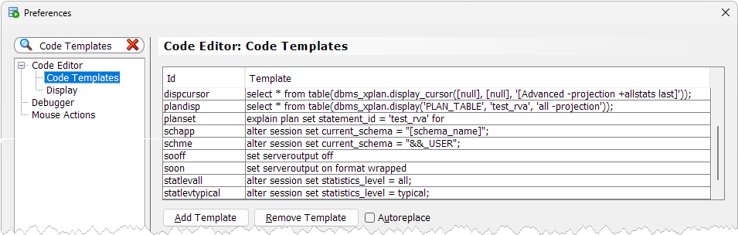
SQL Dev. tip: use code templates to save typing
(Stored in: %APPDATA%\SQL Developer\CodeTemplate.xml)
Choose Ids which are:
easy to remind & type
And:
which work well with auto-completion (so you just type a prefix, then Alt + Space)
Id | Template
schapp | alter session set current_schema = "[schema_name]";
schme | alter session set current_schema = "&&_USER";
sooff | set serveroutput off
soon | set serveroutput on format wrapped
statlevall | alter session set statistics_level = all;
statlevtypical | alter session set statistics_level = typical;
planset | explain plan set statement_id = 'test_rva' for
plandisp | select * from table(dbms_xplan.display('PLAN_TABLE', 'test_rva', 'all -projection'));
dispcursor | select * from table(dbms_xplan.display_cursor([null], [null], '[Advanced -projection -qbregistry +allstats last]'));
DB ≥ 19c

Slide 11
Demo: EXPLAIN PLAN
set pagesize 50000
variable JOB_ID varchar2(10)
exec :JOB_ID := 'SA_REP';
variable
print JOB_ID
explain plan set statement_id = 'test #1' for
select count(*)
from hr.employees emp
where emp.job_id = :JOB_ID
and emp.hire_date > date '2010-01-01';
select * from table(dbms_xplan.display('PLAN_TABLE', 'test #1', 'All -projection'));
Plan hash value: 2830499944
-------------------------------------------------------------------------------------------
| Id | Operation | Name | Rows | Bytes | Cost (%CPU)| Time |
-------------------------------------------------------------------------------------------
| 0 | SELECT STATEMENT | | 1 | 17 | 2 (0)| 00:00:01 |
| 1 | SORT AGGREGATE | | 1 | 17 | | |
|* 2 | TABLE ACCESS BY INDEX ROWID| EMPLOYEES | 6 | 102 | 2 (0)| 00:00:01 |
|* 3 | INDEX RANGE SCAN | EMP_JOB_IX | 6 | | 1 (0)| 00:00:01 |
-------------------------------------------------------------------------------------------
Query Block Name / Object Alias (identified by operation id):
-------------------------------------------------------------
1 - SEL$1
2 - SEL$1 / EMP@SEL$1
3 - SEL$1 / EMP@SEL$1
Predicate Information (identified by operation id):
---------------------------------------------------
2 - filter("EMP"."HIRE_DATE">TO_DATE(' 2010-01-01 00:00:00', 'syyyy-mm-dd hh24:mi:ss'))
3 - access("EMP"."JOB_ID"=:JOB_ID)
Include most useful information, without column projections
Estimated by the SQL Optimizer
Note: there is a pending transaction in the session at this stage, because EXPLAIN PLAN has inserted rows into the PLAN_TABLE.

Slide 12
Demo: dbms_xplan.display_cursor
Statistics level must be “all”, in order to collect actual plan statistics (Note: inherent overhead due to per-row source counting & timing)
set pagesize 50000
alter session set statistics_level = all;
set serveroutput off
variable JOB_ID varchar2(10)
exec :JOB_ID := 'SA_REP';
select count(*)
from hr.employees emp
where emp.job_id = :JOB_ID
and emp.hire_date > date '2010-01-01';
select * from table(dbms_xplan.display_cursor(null, null, 'All -projection +peeked_binds +allstats last'));
SQL_ID b0x08w3bzxjdv, child number 0
-------------------------------------
Plan hash value: 1756381138
--------------------------------------------------------------------------------------------------------------------------
| Id | Operation | Name | Starts | E-Rows |E-Bytes| Cost (%CPU)| E-Time | A-Rows | A-Time | Buffers |
--------------------------------------------------------------------------------------------------------------------------
| 0 | SELECT STATEMENT | | 1 | | | 3 (100)| | 1 |00:00:00.01 | 6 |
| 1 | SORT AGGREGATE | | 1 | 1 | 17 | | | 1 |00:00:00.01 | 6 |
|* 2 | TABLE ACCESS FULL| EMPLOYEES | 1 | 30 | 510 | 3 (0)| 00:00:01 | 30 |00:00:00.01 | 6 |
--------------------------------------------------------------------------------------------------------------------------
Query Block Name / Object Alias (identified by operation id):
-------------------------------------------------------------
1 - SEL$1
2 - SEL$1 / EMP@SEL$1
Peeked Binds (identified by position):
--------------------------------------
1 - :1 (VARCHAR2(30), CSID=873): 'SA_REP'
Predicate Information (identified by operation id):
---------------------------------------------------
2 - filter(("EMP"."JOB_ID"=:JOB_ID AND "EMP"."HIRE_DATE" >TO_DATE(' 2010-01-01 00:00:00', 'syyyy-mm-dd hh24:mi:ss')))
Prevents SQL Dev from reading the dbms_output buffer after each statement (thereby ruining prev_sql_id, prev_child_number in v$session)
Use prev_sql_id, prev_child_number from v$session
Include actual plan statistics (if available) in the readout
Actual (A)
Estimated (E)
Actual (A)
Important: always pay attention to the “Notes” section, if there is one.

Slide 13
SQL_ID dcnc91w8z6s9d, child number 0
Plan hash value: 2945430922
------------------------------------------------------------------------------------------------------------------------------------------------------------
| Id | Operation | Name | Starts | E-Rows |E-Bytes| Cost (%CPU)| E-Time | A-Rows | A-Time | Buffers | Reads |
------------------------------------------------------------------------------------------------------------------------------------------------------------
| 0 | SELECT STATEMENT | | 1 | | | 9 (100)| | 2 |00:00:00.01 | 20 | 2 |
| 1 | NESTED LOOPS | | 1 | 1 | 48 | 6 (0)| 00:00:01 | 2 |00:00:00.01 | 20 | 2 |
| 2 | NESTED LOOPS | | 1 | 2 | 48 | 6 (0)| 00:00:01 | 2 |00:00:00.01 | 18 | 2 |
| 3 | NESTED LOOPS | | 1 | 2 | 74 | 4 (0)| 00:00:01 | 2 |00:00:00.01 | 8 | 2 |
| 4 | TABLE ACCESS BY INDEX ROWID BATCHED | EMPLOYEES | 1 | 2 | 44 | 2 (0)| 00:00:01 | 2 |00:00:00.01 | 4 | 1 |
|* 5 | INDEX SKIP SCAN | EMP_NAME_IX | 1 | 2 | | 1 (0)| 00:00:01 | 2 |00:00:00.01 | 2 | 1 |
| 6 | TABLE ACCESS BY INDEX ROWID | EMPLOYEES | 2 | 1 | 15 | 1 (0)| 00:00:01 | 2 |00:00:00.01 | 4 | 1 |
|* 7 | INDEX UNIQUE SCAN | EMP_EMP_ID_PK | 2 | 1 | | 0 (0)| | 2 |00:00:00.01 | 2 | 1 |
|* 8 | INDEX UNIQUE SCAN | EMP_EMP_ID_PK | 2 | 1 | | 0 (0)| | 2 |00:00:00.01 | 10 | 0 |
| 9 | NESTED LOOPS SEMI | | 2 | 1 | 23 | 3 (0)| 00:00:01 | 2 |00:00:00.01 | 8 | 0 |
|* 10 | TABLE ACCESS BY INDEX ROWID BATCHED| EMPLOYEES | 2 | 1 | 15 | 2 (0)| 00:00:01 | 2 |00:00:00.01 | 4 | 0 |
|* 11 | INDEX SKIP SCAN | EMP_NAME_IX | 2 | 1 | | 1 (0)| 00:00:01 | 3 |00:00:00.01 | 2 | 0 |
|* 12 | TABLE ACCESS BY INDEX ROWID | EMPLOYEES | 2 | 6 | 48 | 1 (0)| 00:00:01 | 2 |00:00:00.01 | 4 | 0 |
|* 13 | INDEX UNIQUE SCAN | EMP_EMP_ID_PK | 2 | 1 | | 0 (0)| | 2 |00:00:00.01 | 2 | 0 |
| 14 | TABLE ACCESS BY INDEX ROWID | EMPLOYEES | 2 | 1 | 11 | 1 (0)| 00:00:01 | 2 |00:00:00.01 | 2 | 0 |
------------------------------------------------------------------------------------------------------------------------------------------------------------
Query Block Name / Object Alias (identified by operation id):
-------------------------------------------------------------
1 - SEL$1
4 - SEL$1 / JAM1@SEL$1
5 - SEL$1 / JAM1@SEL$1
6 - SEL$1 / MGR1@SEL$1
7 - SEL$1 / MGR1@SEL$1
8 - SEL$1 / MGR2@SEL$1
9 - SEL$BE5C8E5F
10 - SEL$BE5C8E5F / JAM2@SEL$2
11 - SEL$BE5C8E5F / JAM2@SEL$2
12 - SEL$BE5C8E5F / MID@SEL$3
13 - SEL$BE5C8E5F / MID@SEL$3
14 - SEL$1 / MGR2@SEL$1
Peeked Binds (identified by position):
--------------------------------------
1 - (VARCHAR2(30), CSID=873): 'Julia'
Predicate Information (identified by operation id):
---------------------------------------------------
5 - access("JAM1"."FIRST_NAME"=:EMP_FIRST_NAME)
filter("JAM1"."FIRST_NAME"=:EMP_FIRST_NAME)
7 - access("MGR1"."EMPLOYEE_ID"="JAM1"."MANAGER_ID")
8 - access("MGR2"."EMPLOYEE_ID"="MGR1"."MANAGER_ID")
filter( IS NOT NULL)
10 - filter("JAM2"."EMPLOYEE_ID"<>:B1)
11 - access("JAM2"."FIRST_NAME"=:B1)
filter("JAM2"."FIRST_NAME"=:B1)
12 - filter("MID"."MANAGER_ID"=:B1)
13 - access("JAM2"."MANAGER_ID"="MID"."EMPLOYEE_ID")
Part #3: Understanding SQL Plans

Slide 14
Christian Antognini’s classification of plan operations
In Troubleshooting Oracle Performance ^{(*)}, Antognini defined 4 Categories of Plan operations.
This is a model—there are exceptions, and special cases—but a most helpful one.
^{(*)} Troubleshooting Oracle Performance, 2nd Edition [link] Christian Antognini, Apress, 2014 ISBN-13 (softcover): 978-1-4302-5758-5 / ISBN-13 (electronic): 978-1-4302-5759-2
Category of plan operations | Definition | Examples
Stand-alone | Single child operations, which start their child operation only once. Many operations belong in that category. | VIEW COUNT STOPKEY SORT UNIQUE / ORDER BY / GROUP BY HASH UNIQUE / GROUP BY … Single-child FILTER
Iterative | Single child operations, which may start their child operation repeatedly (or not at all) | INLIST ITERATOR PARTITION LIST / RANGE / HASH ITERATOR
Unrelated-combine | Operations with 2 (or more) child operations, which run their child operations only once, in turn, independantly of one another | HASH JOIN MERGE JOIN UNION ALL
Related-combine | Operations with 2 (or more) child operations, in which processing is driven by rows from one of the children, and the other child operations are called repeatedly, using the current row of the driving child as input | NESTED LOOPS FILTER with multiple children CONNECT BY WITH FILTERING UNION ALL (RECURSIVE WITH)

Slide 15
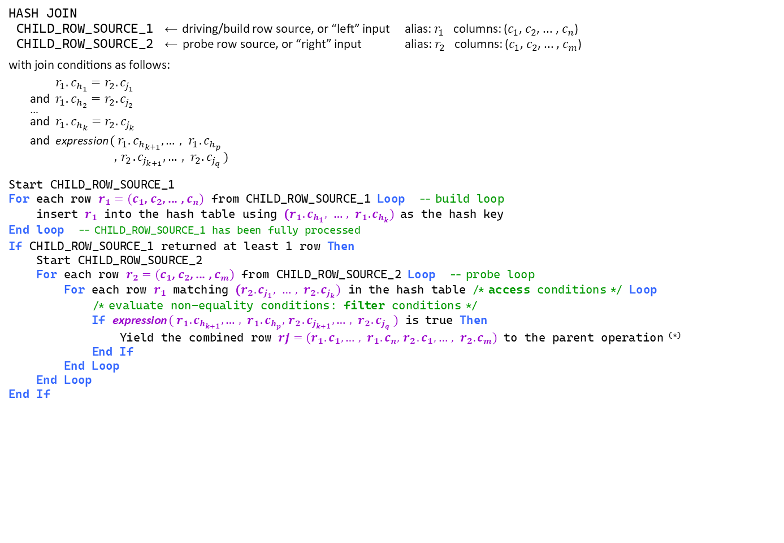
HASH JOIN pseudo-code (high-level, simplified perspective)
HASH JOIN
CHILD_ROW_SOURCE_1 ← driving/build row source, or “left” input alias: $r_{1}$ columns: ($c_{1}$, $c_{2}$, ... , $c_{n}$)
CHILD_ROW_SOURCE_2 ← probe row source, or “right” input alias: $r_{2}$ columns: ($c_{1}$, $c_{2}$, ... , $c_{m}$)
with join conditions as follows:
$r_{1}.c_{h_{1}}=r_{2}.c_{j_{1}}$
and $r_{1}.c_{h_{2}}=r_{2}.c_{j_{2}}$
…
and $r_{1}.c_{h_{k}}=r_{2}.c_{j_{k}}$
and expression ( $r_{1}.c_{h_{k+1}}, …, r_{1}.c_{h_{p}}$ $,{ r}_{2}.c_{j_{k+1}},…, r_{2}.c_{j_{q}}$ )
Start CHILD_ROW_SOURCE_1
For each row $r_{1}=(c_{1}$, $c_{2}$, ... , $c_{n})$ from CHILD_ROW_SOURCE_1 Loop -- build loop
insert $r_{1}$ into the hash table using ($r_{1}.c_{h_{1}}, …, r_{1}.c_{h_{k}})$ as the hash key
End loop -- CHILD_ROW_SOURCE_1 has been fully processed
If CHILD_ROW_SOURCE_1 returned at least 1 row Then
Start CHILD_ROW_SOURCE_2
For each row $r_{2}=(c_{1}$, $c_{2}$, ... , $c_{m})$ from CHILD_ROW_SOURCE_2 Loop -- probe loop
For each row $r_{1}$ matching ($r_{2}.c_{j_{1}}, …, r_{2}.c_{j_{k}})$ in the hash table /* access conditions */ Loop
/* evaluate non-equality conditions: filter conditions */
If expression $( r_{1}.c_{h_{k+1}}, …, r_{1}.c_{h_{p}},{ r}_{2}.c_{j_{k+1}},…, r_{2}.c_{j_{q}} )$ is true Then
Yield the combined row $rj=(r_{1}.c_{1}, …, r_{1}.c_{n},{ r}_{2}.c_{1},…, r_{2}.c_{m})$ to the parent operation ^{(*)}
End If
End Loop
End Loop
End If
equality conditions
non-equality conditions
^{(*)} Actually, only projected columns are passed to the parent operation
Key points:
CHILD_ROW_SOURCE_1 and _2 are started only once (per start of the parent), and processed independently, in turn
The hash table (in workarea) is built from CHILD_ROW_SOURCE_1: rows from CHILD_ROW_SOURCE_2 are not buffered (iff the hash join can be processed fully in memory)
The hash key is formed of equi-joined columns; non-equality join conditions are always used as filter conditions, and evaluated by iterating on rows matching the probe key in the hash table—if there are too many such rows, a lot of CPU time could go into that
The optimizer may swap join inputs, depending on (estimated) memory requirements of using either as the build row source

Slide 16
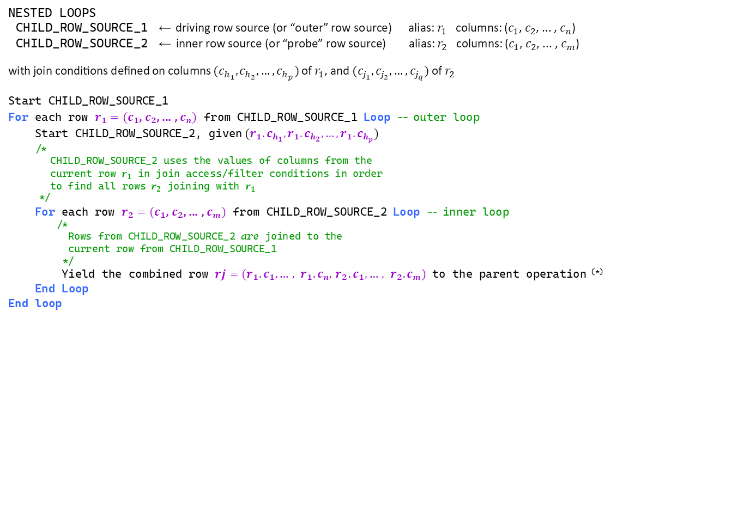
NESTED LOOPS pseudo-code (high-level, simplified perspective)
NESTED LOOPS
CHILD_ROW_SOURCE_1 ← driving row source (or “outer” row source) alias: $r_{1}$ columns: ($c_{1}$, $c_{2}$, ... , $c_{n}$)
CHILD_ROW_SOURCE_2 ← inner row source (or “probe” row source) alias: $r_{2}$ columns: ($c_{1}$, $c_{2}$, ... , $c_{m}$)
with join conditions defined on columns ($c_{h_{1}}, c_{h_{2}},…,c_{h_{p}})$ of $r_{1}$, and ($c_{j_{1}}, c_{j_{2}},…,c_{j_{q}})$ of $r_{2}$
Start CHILD_ROW_SOURCE_1
For each row $r_{1}=(c_{1}$, $c_{2}$, ... , $c_{n})$ from CHILD_ROW_SOURCE_1 Loop -- outer loop
Start CHILD_ROW_SOURCE_2, given ${(r_{1}.c}_{h_{1}}, {r_{1}.c}_{h_{2}},…,{r_{1}.c}_{h_{p}})$
/*
CHILD_ROW_SOURCE_2 uses the values of columns from the
current row $r_{1}$ in join access/filter conditions in order
to find all rows $r_{2}$ joining with $r_{1}$
*/
For each row $r_{2}=(c_{1}$, $c_{2}$, ... , $c_{m})$ from CHILD_ROW_SOURCE_2 Loop -- inner loop
/*
Rows from CHILD_ROW_SOURCE_2 are joined to the
current row from CHILD_ROW_SOURCE_1
*/
Yield the combined row $rj=(r_{1}.c_{1}, …, r_{1}.c_{n},{ r}_{2}.c_{1},…, r_{2}.c_{m})$ to the parent operation ^{(*)}
End Loop
End loop
^{(*)} Actually, only projected columns are passed to the parent operation
Key points:
CHILD_ROW_SOURCE_1 is started once per start of its parent
CHILD_ROW_SOURCE_2 is started as many times as CHILD_ROW_SOURCE_1 supplies a row to be joined with
CHILD_ROW_SOURCE_2 uses join columns from the “outer row” as input
Join access/filter conditions are processed by CHILD_ROW_SOURCE_2

Slide 17
merge into
( select emp.employee_id, emp.job_id, emp.salary
from employees emp
) tgt
using ( select sal.employee_id, sal.salary_incr_pct
from &_USER..salary_raises sal
) src
on ( tgt.employee_id = src.employee_id )
when matched then update
set tgt.salary = tgt.salary * (1 + src.salary_incr_pct / 100)
where ( select job.max_salary from jobs job
where job.job_id = tgt.job_id ) >=
tgt.salary * (1 + src.salary_incr_pct / 100);
1 row merged.
SQL_ID 44srjbwp278ra, child number 0
Plan hash value: 3955867600
-------------------------------------------------------------------------------------------------------------------------------------------------
| Id | Operation | Name | Starts | E-Rows |E-Bytes| Cost (%CPU)| E-Time |IN-OUT| A-Rows | A-Time | Buffers |
-------------------------------------------------------------------------------------------------------------------------------------------------
| 0 | MERGE STATEMENT | | 1 | | | 5 (100)| | | 0 |00:00:00.01 | 12 |
| 1 | MERGE | EMPLOYEES | 1 | | | | | | 0 |00:00:00.01 | 12 |
| 2 | VIEW | | 1 | | | | | | 3 |00:00:00.01 | 7 |
| 3 | NESTED LOOPS | | 1 | 3 | 111 | 5 (0)| 00:00:01 | | 3 |00:00:00.01 | 7 |
| 4 | NESTED LOOPS | | 1 | 3 | 111 | 5 (0)| 00:00:01 | | 3 |00:00:00.01 | 4 |
| 5 | TABLE ACCESS FULL | SALARY_RAISES | 1 | 3 | 24 | 2 (0)| 00:00:01 | | 3 |00:00:00.01 | 2 |
|* 6 | INDEX UNIQUE SCAN | EMP_EMP_ID_PK | 3 | 1 | | 0 (0)| | | 3 |00:00:00.01 | 2 |
| 7 | TABLE ACCESS BY INDEX ROWID| EMPLOYEES | 3 | 1 | 29 | 1 (0)| 00:00:01 | | 3 |00:00:00.01 | 3 |
| 8 | TABLE ACCESS BY INDEX ROWID | JOBS | 2 | 1 | 12 | 1 (0)| 00:00:01 | PCWP | 2 |00:00:00.01 | 4 |
|* 9 | INDEX UNIQUE SCAN | JOB_ID_PK | 2 | 1 | | 0 (0)| | PCWP | 2 |00:00:00.01 | 2 |
-------------------------------------------------------------------------------------------------------------------------------------------------
Query Block Name / Object Alias (identified by operation id):
-------------------------------------------------------------
1 - SEL$76AA3327
3 - SEL$8984BF49
5 - SEL$8984BF49 / SAL@SEL$4
6 - SEL$8984BF49 / EMP@SEL$3
7 - SEL$8984BF49 / EMP@SEL$3
8 - SEL$6 / JOB@SEL$6
9 - SEL$6 / JOB@SEL$6
Predicate Information (identified by operation id):
---------------------------------------------------
6 - access("EMP"."EMPLOYEE_ID"="SAL"."EMPLOYEE_ID")
9 - access("JOB"."JOB_ID"=:B1)
Part #4: Demos

Slide 18
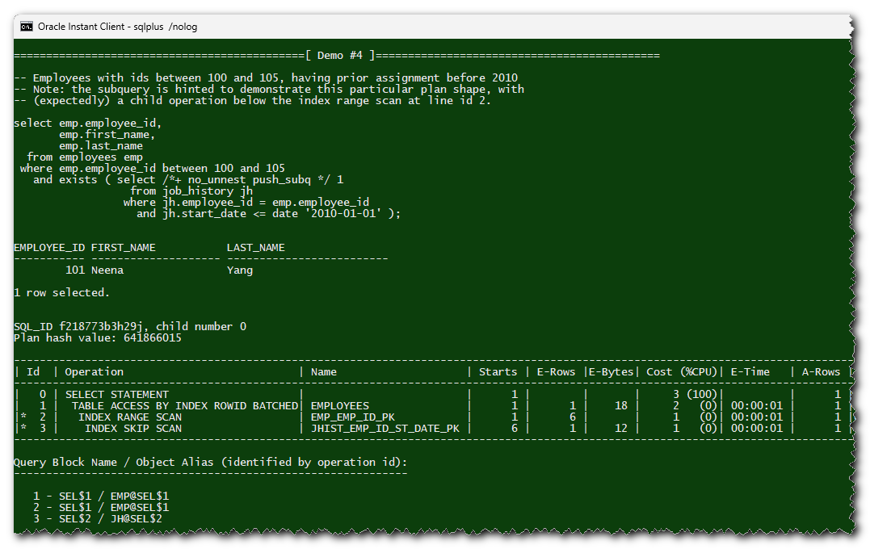
Demo SQL scripts
Source code : link
Requirements
HR schema, from the Oracle Database Sample Schemas 23c [download link; installation instructions]
A user with DML rights on HR’s tables, plus READ/SELECT on a few v$ views
Principles
The demo consists in 4 SQL*Plus scripts intended for a live demo:
A simple query is run
The corresponding plan (from the cursor cache) is shown, possibly with a comment or two
The script pauses before continuing with the next example
Repeat…
See the README [link] for details.

