Slide 1
Robustness of Graphical Neural Network Part 2
Zhe Xu

Slide 2
Contents
Batch Virtual Adversarial Training for Graph Convolutional Networks
ICML 2019 Workshop on Learning and Reasoning with Graph-Structured Data
Topology Attack and Defense for Graph Neural Networks: An Optimization Perspective
IJCAI 2019, the 28th International Joint Conference on Artificial Intelligence

Slide 3
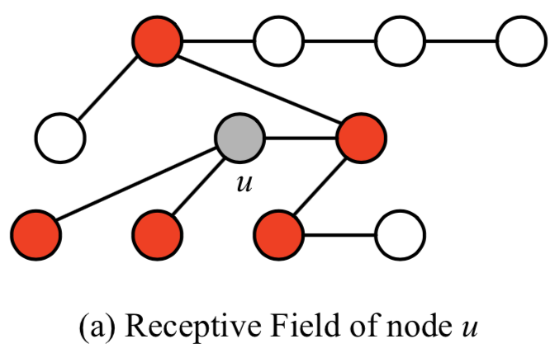
Challenges
Graph Convolutional networks (GCNs) do not consider the smoothness of the model’s output distribution against local perturbations around the input
The receptive field (RF) (marked by red) of a node u in two-layer GCNs.
Methods
Batch Virtual Adversarial Training (BVAT)
Sample-based BVAT (S-BVAT)
Optimization-based BVAT (O-BVAT)

Slide 4
Virtual Adversarial Training (VAT)
A regularization method based on the priori knowledge that outputs of most naturally occurring systems are smooth with respect to spatial and/or temporal inputs .
adversarial direction: most reduce the model’s probability of correct classification
Virtual adversarial direction: most greatly alter the output distribution in the sense of distributional divergence

Slide 5


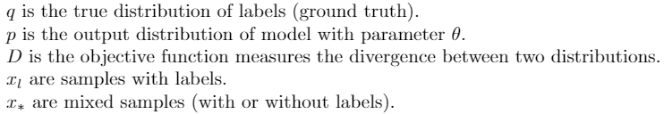
Adversarial Training
Batch Virtual Adversarial Training for Graph Convolutional Networks
Virtual Adversarial Training

Slide 6
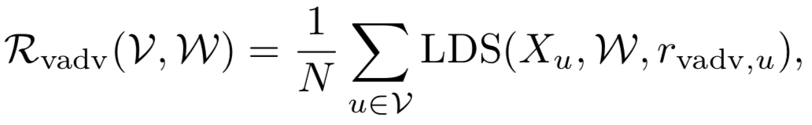
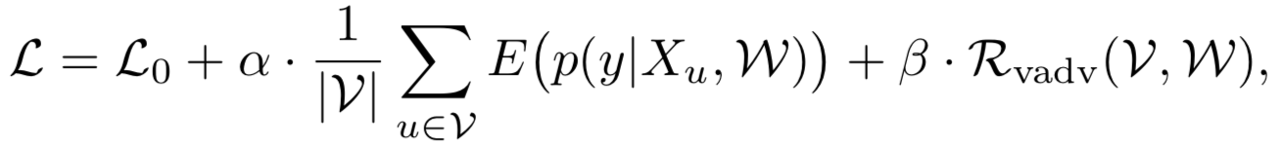
Extend VAT to GCN
A straightforward extension into GCNs is using the average LDS loss for all nodes as a regularization term

Slide 7
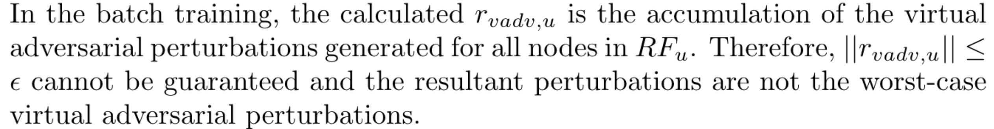


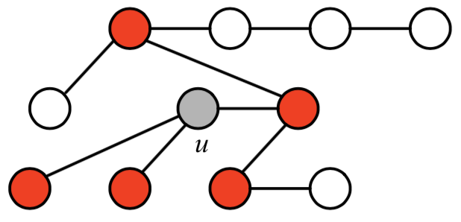
Extend VAT to GCN
Example: for GCNs with 2 layers, if batch size = 2 and select node u and v in batch training, the perturbations on node k will accumulate twice, makes it far from the worst case.

Slide 8
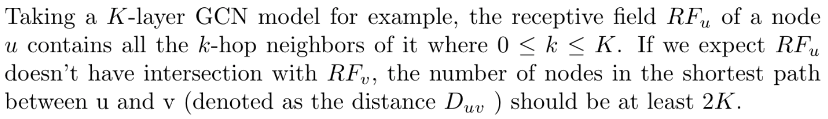
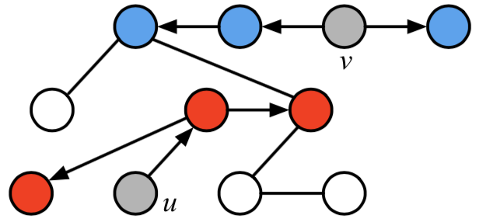
Sample-based BVAT (S-BVAT)
The motivation of sample-based BVAT is that we expect to make the model be aware of the relationship between nodes and limit the propagation of adversarial perturbations to prevent perturbations from different nodes interacting with each other.
In S-BVAT, they generate virtual adversarial perturbations for a subset VS ⊂ V of nodes, whose receptive fields do not overlap with each other.
Example: two nodes u and v are selected to calculate the LDS loss, and the virtual adversarial perturbations are applied to the features in their receptive fields (marked by red and blue), which do not have intersection.

Slide 9
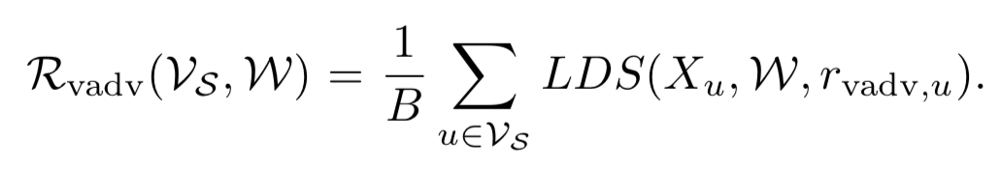
Sample-based BVAT (S-BVAT)

Slide 10
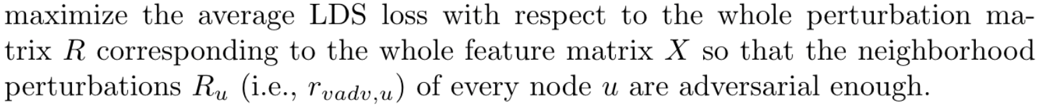
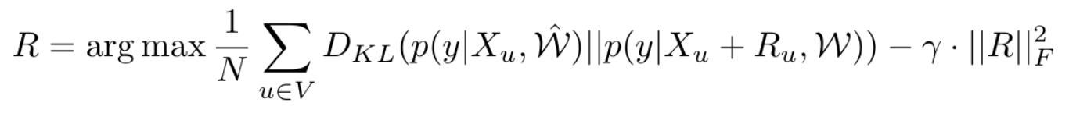
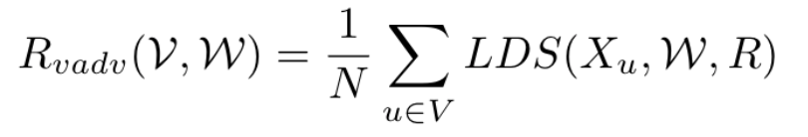
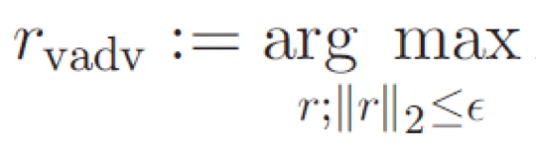
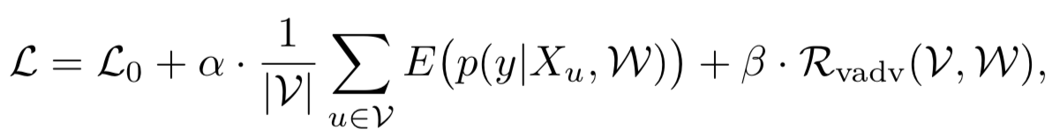
Optimization-based BVAT (O-BVAT)

Slide 11
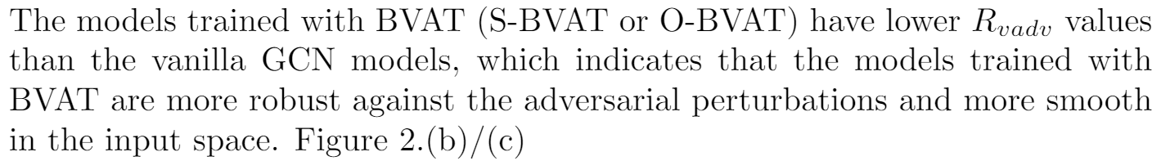
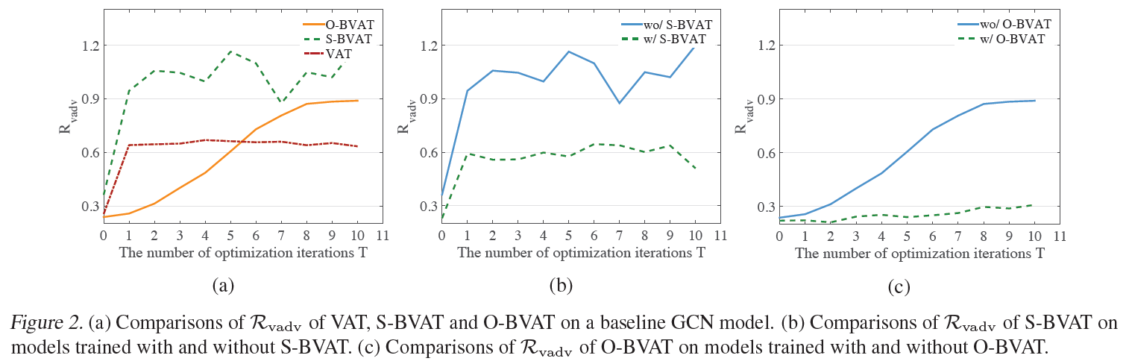
Experiments

Slide 12
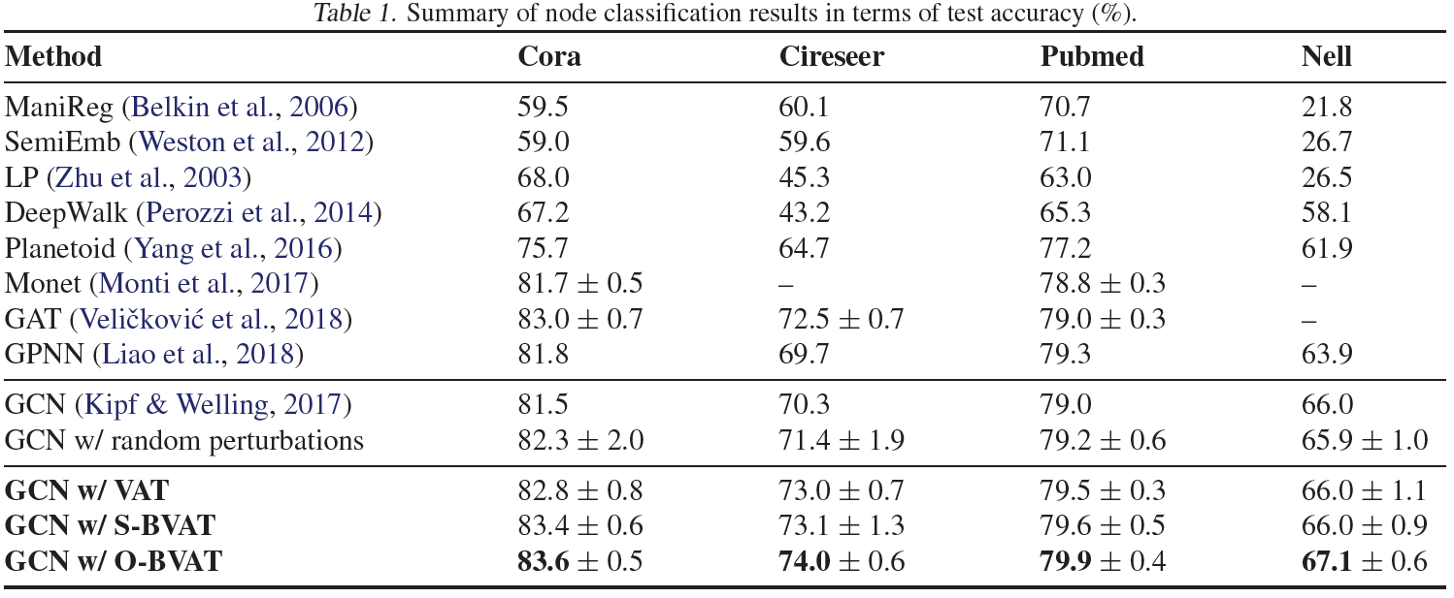
Experiments
Performance on the Semi-supervised Node Classification task

Slide 13
Contents
Batch Virtual Adversarial Training for Graph Convolutional Networks
ICML 2019 Workshop on Learning and Reasoning with Graph-Structured Data
Topology Attack and Defense for Graph Neural Networks: An Optimization Perspective
IJCAI 2019, the 28th International Joint Conference on Artificial Intelligence

Slide 14
Challenges
conventional (first-order) continuous optimization methods do not directly apply to attacks using edge manipulations (we call topology attack) due to the discrete nature of graphs
Methods
projected gradient descent (PGD) topology attack
min-max topology attack

Slide 15
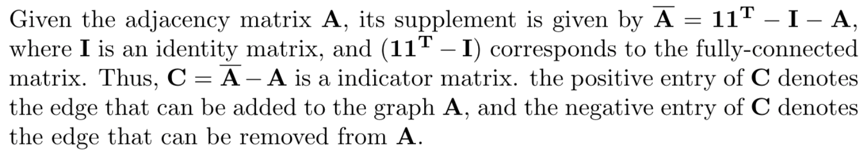
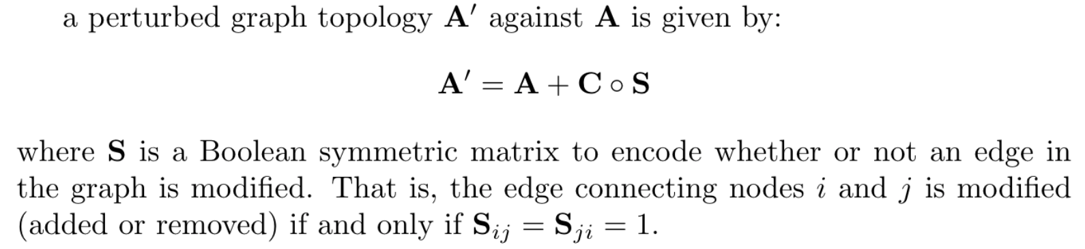
Topology Attack in Terms of Edge Perturbation

Slide 16
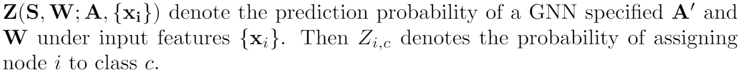
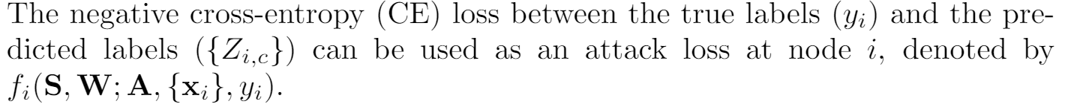
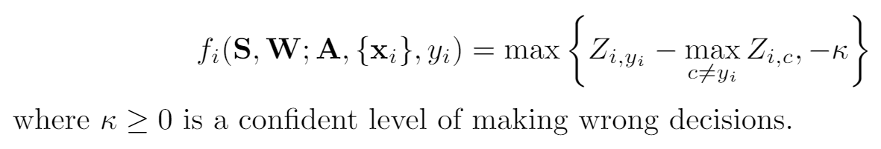
Attack Loss
Cross-entropy (CE) loss
Carlili-Wagner (CW) loss

Slide 17
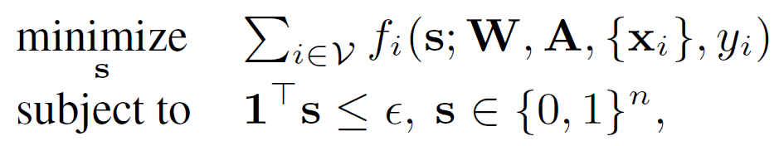
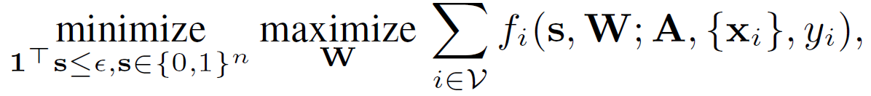
Attack Generation
a) Attacking a pre-defined GNN with known W
b) Attacking an interactive GNN with re-trainable W.
Replace symmetric matrix variable S with its vector form s which consists of N(N-1)/2 unique perturbation variables in S.

Slide 18
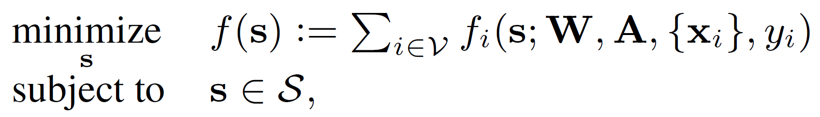
PGD Topology Attack
Attacking a pre-defined GNN with known W

Slide 19

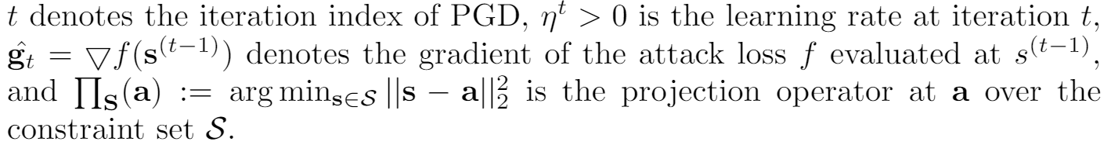
PGD Topology Attack
Attacking a pre-defined GNN with known W
Solution: projected gradient descent (PGD)

Slide 20
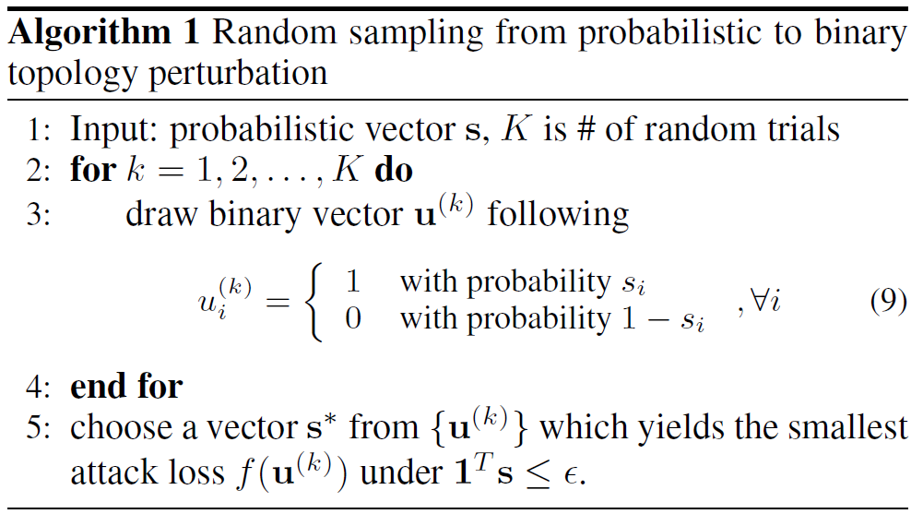
PGD Topology Attack
Attacking a pre-defined GNN with known W
Use randomization sampling to transform the probabilistic vector s into a near-optimal binary vector s*. (The topology perturbation on a graph is discrete)

Slide 21
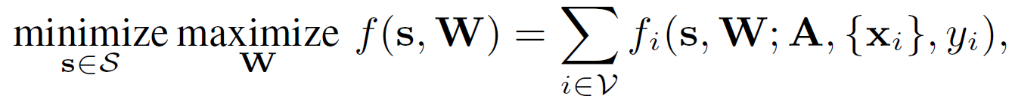
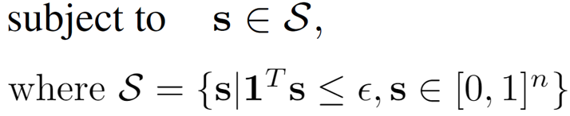
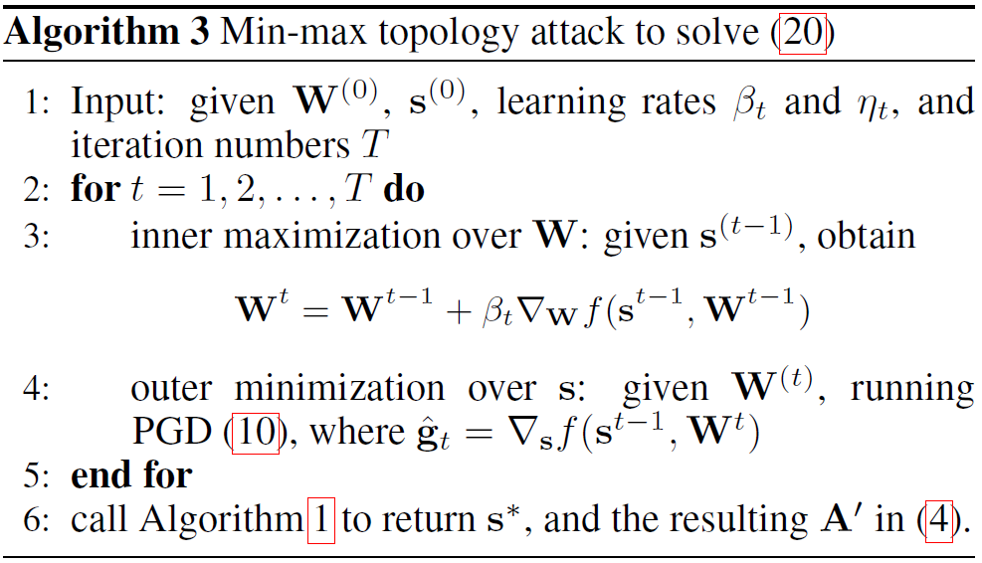
Min-max Topology Attack
Attacking an interactive GNN with re-trainable W.

Slide 22

Robust Training for GNNs
similar with the formula of min-max topology attack:

Slide 23
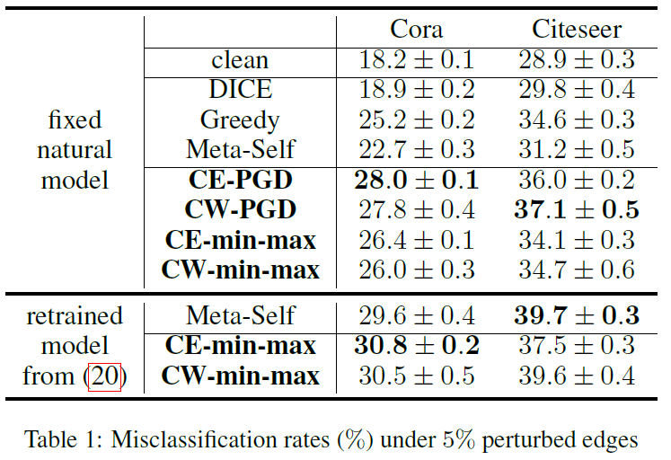
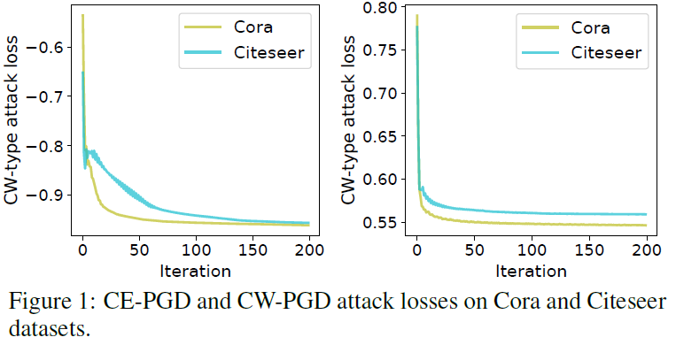
Experiments: Attack Performance

Slide 24
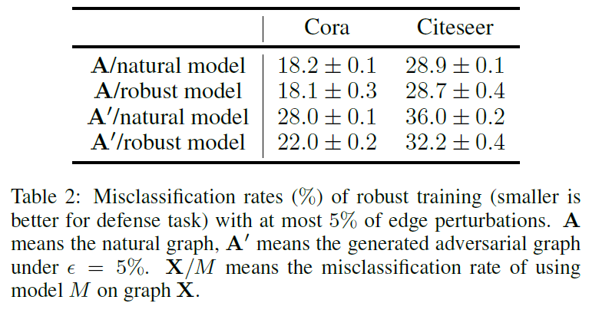
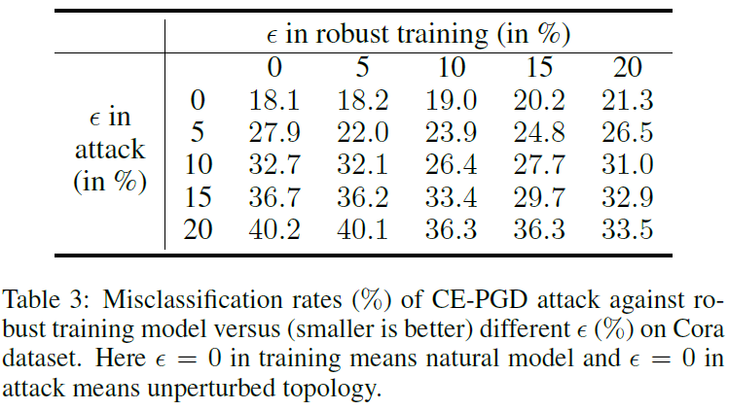
Experiments: Defense Performance
robust training algorithm does not harm the test accuracy but successfully improves the robustness as the attack success rate drops from 28:0% to 22:0% in Cora dataset.

Slide 25
References
Miyato, Takeru, et al. "Virtual adversarial training: a regularization method for supervised and semi-supervised learning." IEEE transactions on pattern analysis and machine intelligence 41.8 (2018): 1979-1993.
Deng, Zhijie, Yinpeng Dong, and Jun Zhu. "Batch Virtual Adversarial Training for Graph Convolutional Networks." arXiv preprint arXiv:1902.09192 (2019).
Xu, Kaidi, et al. "Topology Attack and Defense for Graph Neural Networks: An Optimization Perspective." arXiv preprint arXiv:1906.04214 (2019).

