Slide 1
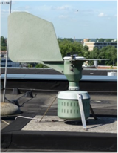



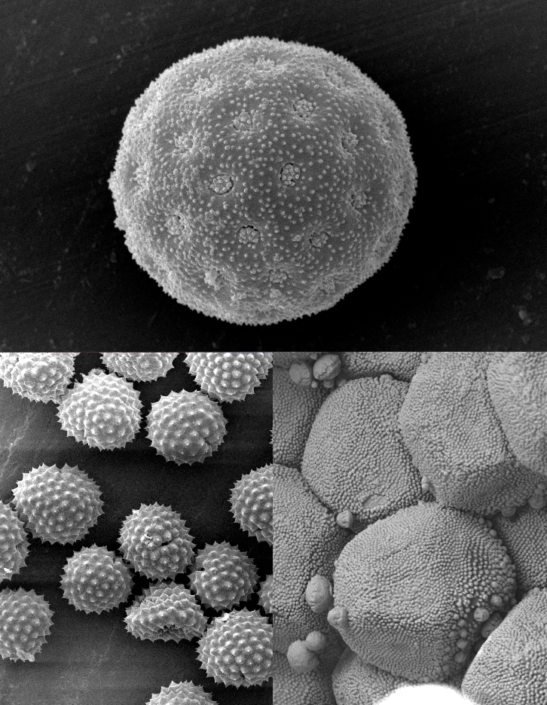
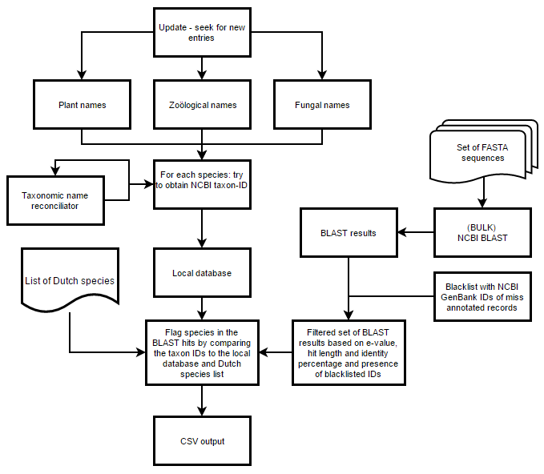
A bioinformatic pipeline for the
identification of airborne allergens Laura Kreijger², Midas Kuilman², Arjan Olsthoorn², Dirk van der Torre², Jozsef Geml^{1,3}, Ivo Horn², Arjen Speksnijder^{1,3} & Barbara Gravendeel^{1,2,3}
1. Naturalis Biodiversity Center, Endless Forms group, Vondellaan 55, 2332 AA Leiden, The Netherlands
2. University of Applied Sciences Leiden, Science and Technology department, Zernikedreef 11, 2333 CK Leiden, The Netherlands
3. Leiden University, Institute Biology Leiden, Sylviusweg 72, 2333 BE Leiden, The Netherlands
Background
Airborne allergens are produced by plants (pollen), animals (hairs) and fungi (spores) (Fig 1).
If many of these allergens are around, hay fever patients suffer from coughing fits and a running nose.
Forecasts such as www.allergieradar.nl can help
these patients to plan their
outdoor activities.
These forecasts are based on DNA barcodes generated from sticky traps in so-called pollen samplers (Fig 2) on the roof of hospitals such as the Leiden University Medical Center.
Currently airborne allergens trapped in these samplers are processed microscopically.
To increase speed and accuracy, DNA barcoding of the material captured by pollen samplers was developed (Kraaijeveld et al. 2015).
The aim of our project was to
build a bioinformatic pipeline for automatic processing of DNA
barcodes generated from pollen and spores.
Methods
With literature research, a list of
allergenic species was made. This list contains plant, animal and fungal species.
Manually, a blacklist of NCBI-entries that were thought to be wrongly identified was made.
Using the website nederlandsesoorten.nl, a
database was made for Dutch species causing hayfever.
Naturalis already had a barcode-
checker script that searched for
species in the CITES-database for legally protected species. This script was used as a template and modified to search the manually made databases for allergenic Dutch species. The script was also configured to be uploaded to, and run on the web-based platform Galaxy.
Results
The outline of the final airborne allergens pipeline is visualised in a flowchart (Fig 3).
Both databases (allergenic species, Dutch species) are automatically updated every time the pipeline is executed.
FASTA-files with DNA
sequences are BLAST-ed against the NCBI-database.
The hits resulting from the BLAST
are then filtered and compared
with the contents of both databases.
Conclusion
The pipeline correctly predicted which species from a test FASTA-file were allergenic. From this, we can conclude that our pipeline for the identification of airborne allergens works.
Acknowledgements
We thank Bertie Joan van Heuven, Youri Lammers, Michael Stech and Letty de Weger for their help and support.
References
Kraaijeveld, K., de Weger, L. A., Ventayol García, M., Buermans, H., Frank, J., Hiemstra, P. S. and den Dunnen, J. T. (2015), Efficient and sensitive identification and quantification of airborne pollen using next-generation DNA sequencing. Molecular Ecology Resources 15.
Hay fever patients suffer from coughing fits and a running nose on days with many airborne allergens. Special allergy forecasts can help these patients to plan their outdoor activities.
These forecasts are based on data generated by pollen samplers.
For the automatic processing of pollen sampler data, we built a bioinformatic pipeline.
Figure 2: Burkard pollen sampler at Leiden University Medical Center.
Figure 1: Common airborne allergens. Clockwise: pollen (Atriplex prostrata), spores (Puccinia graminis), pollen (Ambrosia artemisifolia). Photographs made by Bertie Joan van Heuven (Naturalis Biodiversity Center).
Figure 3: Flowchart of our pipeline.

