Slide 1
ComPhy 2012 What did we learn?
Rutger Vos

Slide 2
Scaling up
Biology is becoming a “Big Science” with large, multidimensional data sets
Programming skill and databases will help you deal with these amounts of data:
No clicking around, no handwork (faster, cleaner)
You will re-do your work many times (easier)

Slide 3
Normalizing and integrating
Your data are linked to things in the real world
Make these links explicit:
Links to taxon identifiers (NCBI)
Links to sequences (GenBank)
Links to trees and studies (TreeBASE)

Slide 4
Sharing and re-using
“Stand on the shoulders of giants”
In a “Big Science”, we can’t do all on our own
Identify ways to share and re-use data:
TreeBASE
Dryad
Etc.
(Also version control systems!)

Slide 5
Standardizing
Data standards enable sharing, re-using, and integrating
Understand the standards that you work with, and follow them:
NeXML, phyloXML, NEXUS, NEWICK, FASTA, etc.

Slide 6
Versioning
Your research will progress, you will change/add/delete things
Pick the right tools to track this for you:
Need to remember what you did
Need to justify to others (collaborators, reviewers)
May need to go “back in time”

Slide 7
Phyloinformatics
Phyloinformatics applies the principles of scaling up, integrating, sharing and re-using to the problem of phylogeny

Slide 8
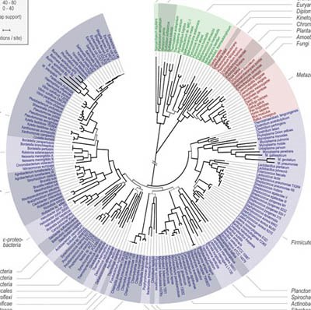
Example
O. R. P. Bininda-Emonds, M. Cardillo, K. E. Jones, R. D. E. MacPhee, R. M. D. Beck, R. Grenyer, S. A. Price, R. A. Vos, J. L. Gittleman and A. Purvis, 2007. The delayed rise of present-day mammals. Nature 446: 507-512.

Slide 9

What’s next?
By applying the principles of phyloinformatics we can do things like:
Get the tree for a set of names (even with misspellings, synonyms)
Use it for gene tree/species tree reconciliation
Comparative analysis
Etc.

Slide 10

Get involved!
Participate in the phyloinformatics community:
Share data
Share open source code
Collaborate

Slide 11

Stay in touch!
LinkedIn group
Nescent.org, our wiki
@rvosa, @nescent, @treebase, @phylofoundation, @museumnaturalis, etc.
GitHub

