Slide 1

EXPENSE TRACKER WITH PREDICTION
Group members with Student Id
Purvesh Gangapurkar 20104063
Rahul Patil 20104073
Ambadas Malegave 20104112
Project Guide
Ms. Charul Singh

Slide 2
Contents
Introduction
Objectives
Scope
Literature Survey
Proposed System
Algorithms Used
Project Outcomes
Block Diagram
Use Case/DFD
Technology Stack
Suggestions of Review 1
Result & Discussion
Conclusion & Future scope
Reference

Slide 3
1. Introduction
Problem Identified :
The main problem faced by peoples were budget planning.
The traditional method of record-keeping is tedious and unreliable.
Solution Proposed :
By Tracking Expenses, it will be very helpful for the people to do their budget planning.
By using our Expense tracker system users can rely on the computer for all record-keeping and calculations.

Slide 4
2. Objectives
To keep a track of Income-Expense on a day-to-day basis.
To keep an accurate record of your money inflow and outflow.
To help everyone who want to know their possible future expenses.
To provide Graphical overview of expenses.
To Minimize manual effort with daily record of expenditures and incomes.
To provide Immediate and easy retrieval of report.

Slide 5
3. Scope
Personal finance management: An expense tracker with prediction can help individuals manage their personal finances more effectively by tracking their spending, providing insights into their financial habits.
Financial education: An expense tracker with prediction can be a useful tool for promoting financial literacy and educating users on financial management best practices.
Business expense tracking: Businesses can use an expense tracker with a prediction to track their expenses, optimize their budgets, and make data-driven decisions based on their spending patterns.

Slide 6
4. Literature Survey
Sr.no | Title | Author(s) | Year | Algorithms | Limitations | Result
1 | Predicting Future Expenses using Machine Learning | Shivani Gupta, Pankaj Yadav, and Rajesh Yadav | 2019 | Long Short-Term Memory (LSTM) Neural Network | Only trained and tested on a small dataset | The model achieved less accuracy in predicting future financial status
2 | Forecasting Daily Expenses Using Machine Learning and Data Analytics | Ashok Kumar Sharma and Shilpa Choudhary | 2020 | Gradient Boosting Decision Tree (GBDT) | Limited to predicting daily expenses only | The model achieved an accuracy of 83.6% in predicting future daily expenses
3 | A Personalized Expense Tracking System with Future Expense Prediction | Alina Mustafina, Andrey Somov, and Tatiana Baidyk | 2021 | Bayesian Networks | Only tested on a small dataset | Predicting future monthly expenses 85% accuracy

Slide 7
5. Proposed System:
User Friendly and Easy To Manage :
Simple and interactive user interface.
All important information displayed at one place i.e. Dashboard.
Categories :
Classify the expenses according to their Categories.
Built in and customizable filters :
Provides the filtering facilities based date such as last month, this month or for any specific date.
Graph and Pie chart :
Graph and Pie chart is displayed to make the understanding more clear.

Slide 8
5. Proposed System(continued)
5. Expense Report :
Detailed Report is displayed.
6. Predictive Analysis :
The system could use machine learning to analyze a user's spending history and predict future expenses, such as exepense of each category for next month or expense for next 6 months.

Slide 9
6. Algorithms Used
Linear regression:
Linear regression is a machine learning algorithm used to model the relationship between a dependent variable and one or more independent variables. It estimates the coefficients of a linear equation to make predictions based on input values. It is simple, effective, and widely used in various fields.

Slide 10
6. Algorithms Used(Continued)
2. Random forest Regressor :
Random Forest Regressor is a popular ensemble learning algorithm for regression tasks, predicting continuous numerical values. It combines multiple decision trees trained on random data subsets to create a robust and accurate model. It handles complex data patterns, mitigates overfitting, and is widely used in domains like finance, healthcare, and marketing due to its high accuracy, scalability, and interpretability.

Slide 11
7. Outcome of Project
Expense Tracking: Users can easily track their expenses by manually entering their spendings.
Expense Management: Our expense tracker system can provide users with a comprehensive overview of their spending habits and help them manage their expenses more effectively by categorizing their expenses, setting budgets, and sending reminders.

Slide 12
7. Outcome of Project
Multi-User Support: Our system can support multiple users at a time, allowing families or businesses to track their expenses and manage their finances.
Predictions: User can see the predictions of their future expenses category wise. Also can view predicted expenses for next 6 months.

Slide 13
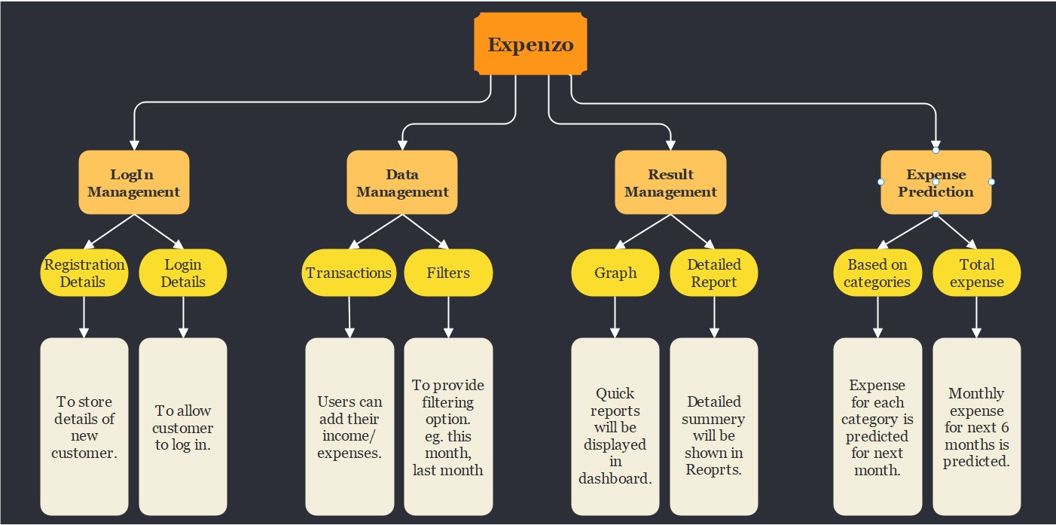
8. Block Diagram

Slide 14
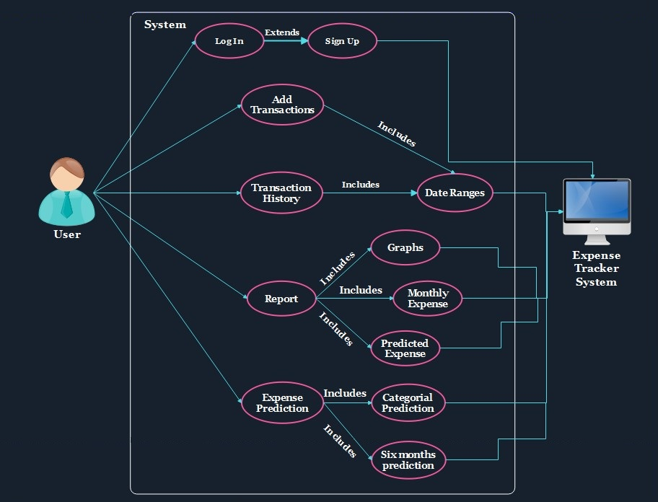
9. Use case Diagram

Slide 15
10. Technology Stack
Front-end: HTML, CSS, JS
Database: Google Firebase
Back-end: Python Flask
Integrated Development Environment (IDE): VS Code
Platform: Windows 10/11

Slide 16
11. Suggestion Of Review 1
Proper sign in and sign up validations.
Use constant currency option INR.
Proper implementation of transaction history filter.
Implementation of ML algorithms.

Slide 17
12. Result And Discussion
Expense tracking website with predictive capabilities helps users track their spending and provides insights into future expenses.
The website can predict upcoming expenses by analyzing spending patterns and historical data, which helps users make informed financial decisions.
Users can be more mindful of their spending habits and plan their finances accordingly based on personalized insights and predictions.

Slide 18
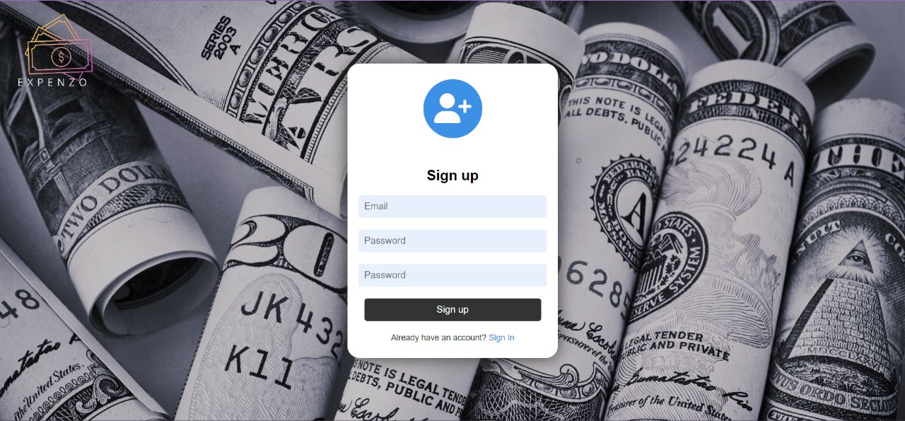
12. Result And Discussion
Sign up Page: User can use this page to register themselves on the site.

Slide 19
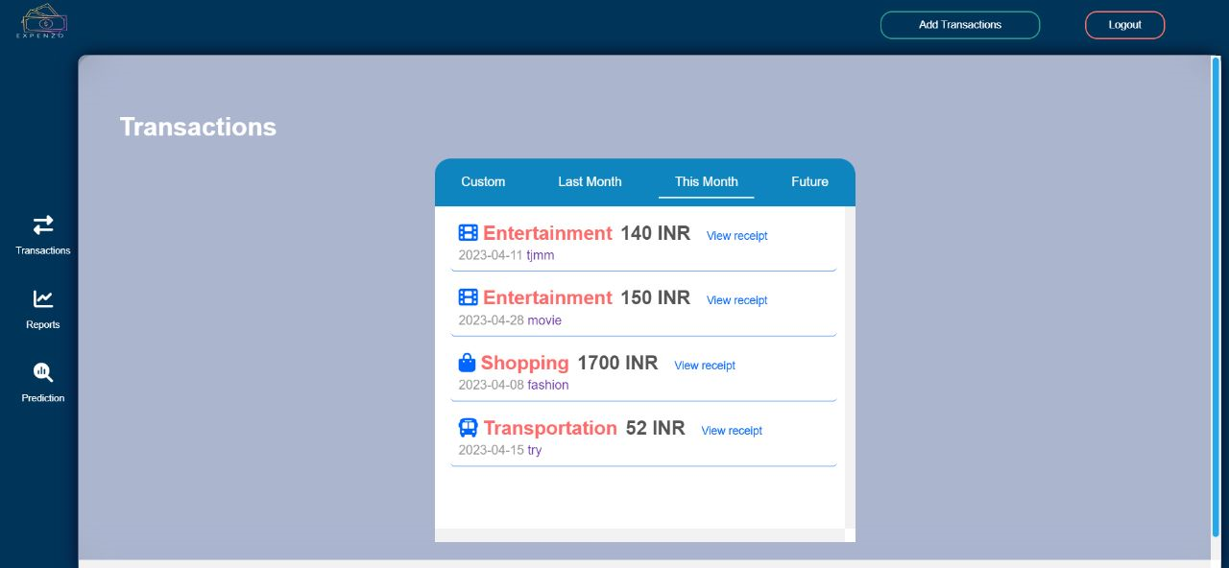
12. Result And Discussion(Continued)
Transactions Page: User can add and new transactions & view the transaction history.

Slide 20
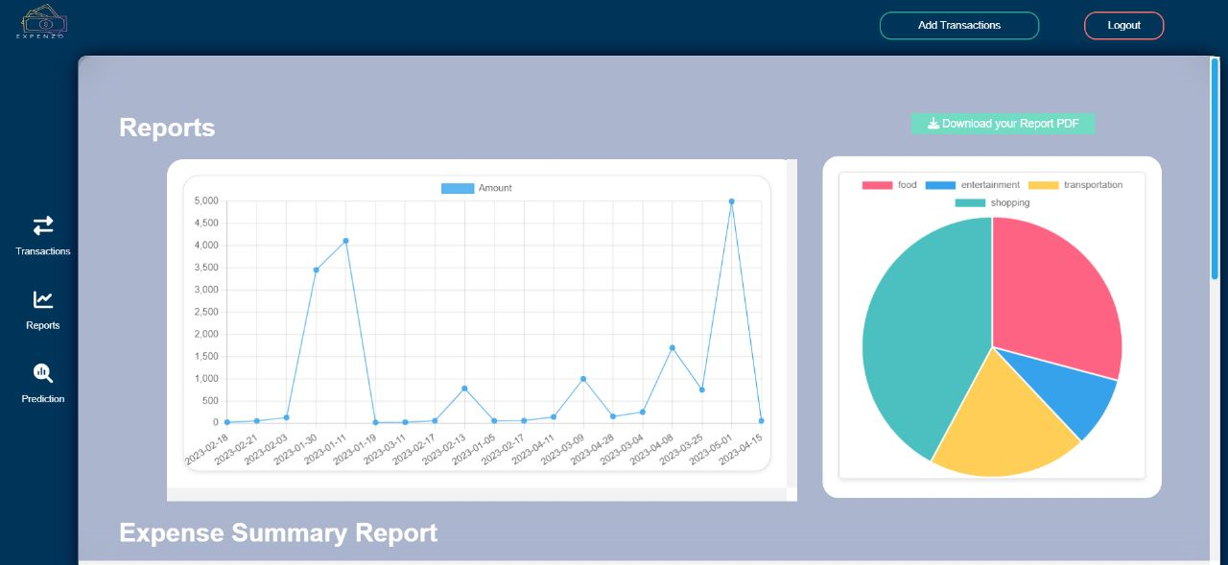
12. Result And Discussion(Continued)
Report Page: User can view the report of monthly expenses in graphical format.

Slide 21
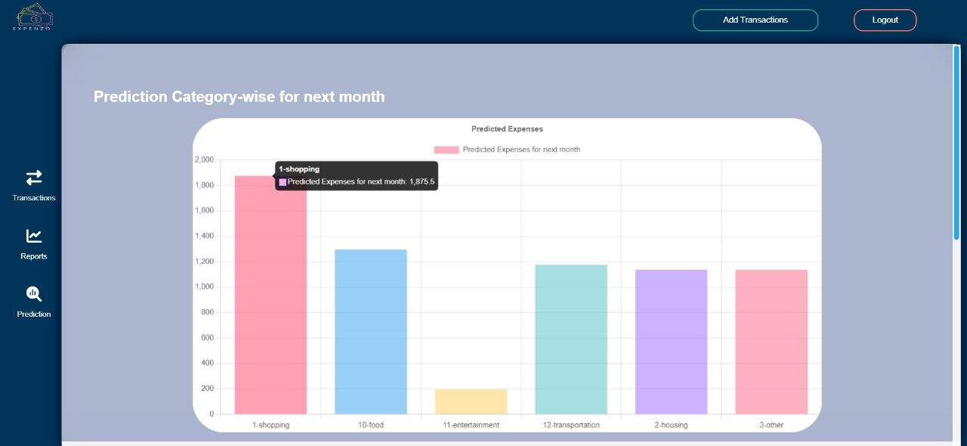
12. Result And Discussion(Continued)
Prediction Page: User can view the prediction of monthly expenses in graphical format.

Slide 22
13. Conclusion & Future Scope
An expense tracking website with predictive capabilities is a valuable tool for managing personal finances effectively.
A website analyzing spending patterns and offering personalized insights and expense predictions can help users improve financial planning, boost savings, and reduce stress.
To maximize benefits from an expense tracking website with predictive features, users can track expenses, review spending, set goals, and use predictions.
Key features of such a website automated data analysis, pesonalized insights and predictions, budget tracking and goal setting, integration with other financial tools, and a user-friendly interface.

Slide 23
13. Conclusion & Future Scope (Continued)
Future Scope :
Integration with financial institutions: The expense tracker can be integrated with the user's bank accounts and credit cards.
Social sharing: Integrating social sharing options can enable users to share their financial goals creating a community of people who are working towards improving their financial health.
Machine learning algorithms: The use of advanced ML algorithms to make more accurate predictions based on the user's spending patterns and historical data.

Slide 24
14. Reference :
[1] Shivani Gupta, Pankaj Yadav, and Rajesh Yadav. "Predicting Future Expenses using Machine Learning." 2019 International Conference on Automation, Computational and Technology Management (ICACTM). IEEE, 2019. DOI: 10.1109/ICACTM.2019.8761543.
[2] Ashok Kumar Sharma and Shilpa Choudhary. "Forecasting Daily Expenses Using Machine Learning and Data Analytics." International Journal of Control and Automation. Vol. 13, No. 3, pp. 266-280, 2020. DOI: 10.14257/ijca.2020.13.3.24.
[3] “Money Lover: Budget Planner, Expense Tracker - Apps on Google Play.” [Online]. Available: https://play.google.com/store/apps/details?id=com.bookmark.money
[4] Alina Mustafina, Andrey Somov, and Tatiana Baidyk. "A Personalized Expense Tracking System with Future Expense Prediction." 2021 IEEE International Conference on Computational Intelligence and Virtual Environments for Measurement Systems and Applications (CIVEMSA). IEEE, 2021. DOI: 10.1109/CIVEMSA51473.2021.9503471.

Slide 25
Thank You...!!

