Slide 1
WELLCOME TO JAVA PROGRAMING…
Design By
Er. Mirza Ghazanfar Baig.

Slide 2
INTRODUCTION
JAVA is designed to meet the challenges of application development in heterogeneous, network-wide distributed environments. Most important among these challenges is secure delivery of application that consume the minimum of software resources, can run on any hardware and software platform, and can be extended dynamically.
JAVA is a general-purpose computer programming language that is concurrent, class-base, object-oriented, and specifically designed to have as few implementation dependencies as possible. It is intended to let application developers “Write One, Run Anywhere” (WORA), meaning that code that runs on one platform does not need to be recompile to run on another.

Slide 3
WHAT IS JAVA?
Java is an “Easy” programming language, just a tool like C++, VB, …and English. Somehow a language tool itself is not so complex.
Java works for internet project (mainly), and apply “3-Tired Architecture”, coding on the Server-Side, So besides Java language knowledge, we need to learn lots of thing about telecommunication on web, to finish a real-time project.
Java Applies Object-Oriented Tech. Java is not so difficulty, though OOP is. A java expert must be an OOP expert.
Java is very Portable, Cross-Platform, Platform Independent, Open Source & Free-Ware.

Slide 4
History
James Gosling and Sun Microsystems.
Java, whose original name was Oak
Java, May 20, 1995, Sun World
HotJava, The first Java-enabled Web browser
JDK Evolutions
J2SE, J2ME and J2EE (not mentioned in the book, but could discuss here optionally)

Slide 5
Characteristics of Java
Java is simple
Java is dynamic
Java is robust
Java is portable
Java is secure
Java is interpreted
Java is object-oriented
Java is architecture-neutral
Java is multithreaded

Slide 6
Integrated Development Environment
Java IDE Tools
IDE means the Environment in which Java Programs or Applications are Developed and Run.
JVM Forte by Sun Micro Systems.
Borland JBuilder
Microsoft Visual J++
WebGain Café
IBM Visual Age for Java

Slide 7
What is JDK, JRE and JVM?
JDK (Java Development Kit)
  It provide Environment to Develop and Run the Java Program for Developers.
JRE (Java Run Environment)
  It provide Environment to Run the Java Application for Clients.
JVM (Java Virtual Machine)
  It is Responsible to Run the Java Program or Application Line by Line for Developers and Client both.
  JDK = JRE + Development Tools
  JRE = JVM + Library Classes.

Slide 8
JDK Versions
1 - JDK Alpha and Beta. (1994)
2 - JDK 1.0(1996)
3 - JDK 1.1(1997)
4 - J2SE 1.2(1998)
5 - J2SE 1.3(2000)
6 - J2SE 1.4(2002)
7 - J2SE 5.0(2005)
8 - Java SE 6.0(2006)
9 - Java SE 7.1 Versioning change. (2011) Java 5 updates.
8 - Java SE 8.1 (2014) Java 6 updates.

Slide 9
JDK Editions
Java Standard Edition (J2SE)
  J2SE can be used to develop client-side standalone applications or applets.
Java Enterprise Edition (J2EE)
  J2EE can be used to develop server-side applications such as Java servlets and Java Server Pages.
Java Micro Edition (J2ME)
  J2ME can be used to develop applications for mobile devices such as cell phones.

Slide 10
How JAVA Works?
Java's platform independence is achieved by the use of the JVM (Java Virtual Machine).
A Java program consists of one or more files with a .java extension, these are plain old text files.
When a Java program is compiled the .java files are fed to a compiler which produces a .class file for each .java file
The .class file contains Java bytecode.
Bytecode is like machine language, but it is intended for the Java Virtual Machine not a specific chip such as a Pentium or PowerPC chip

Slide 11
To run a Java program the bytecode in a .class file is fed to an interpreter which converts the byte code to machine code for a specific chip (IA-32, PowerPC)
Some people refer to the interpreter as "The Java Virtual Machine" (JVM).
The interpreter is platform specific because it takes the platform independent bytecode and produces machine language instructions for a particular chip.
So a Java program could be run an any type of computer that has a JVM written for it. PC, Mac, Unix, Linux, BeaOS, Sparc

Slide 12
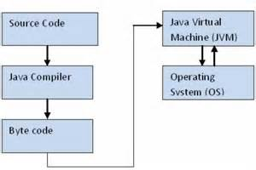
The Interpreter's are sometimes referred to as the Java Virtual Machines.

Slide 13
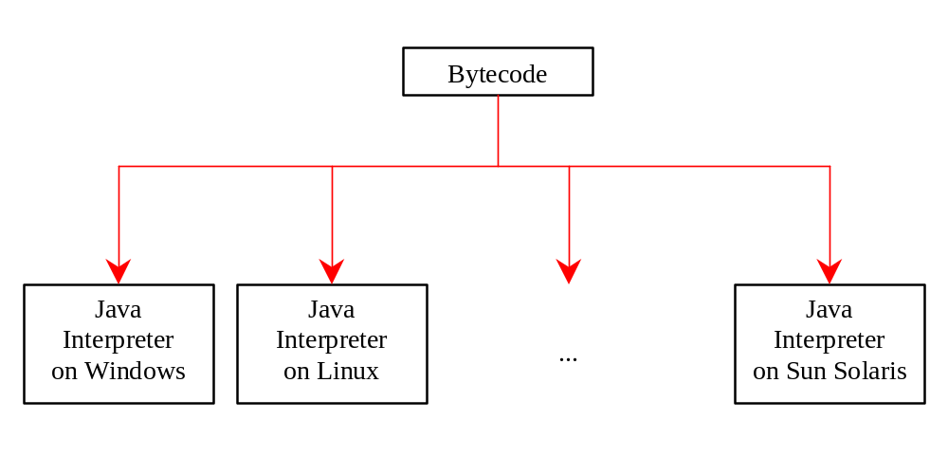
Getting Started with Java Programming
A Simple Java Application
Compiling Programs
Executing Applications

Slide 14
Executing JAVA Applications
On Command Prompt
  Type javac then Class or File Name .java.
Ex- javac Welcome.java
  Java then Byte Code or Java .Class file name.
Ex- java Welcome
Output:...

Slide 15
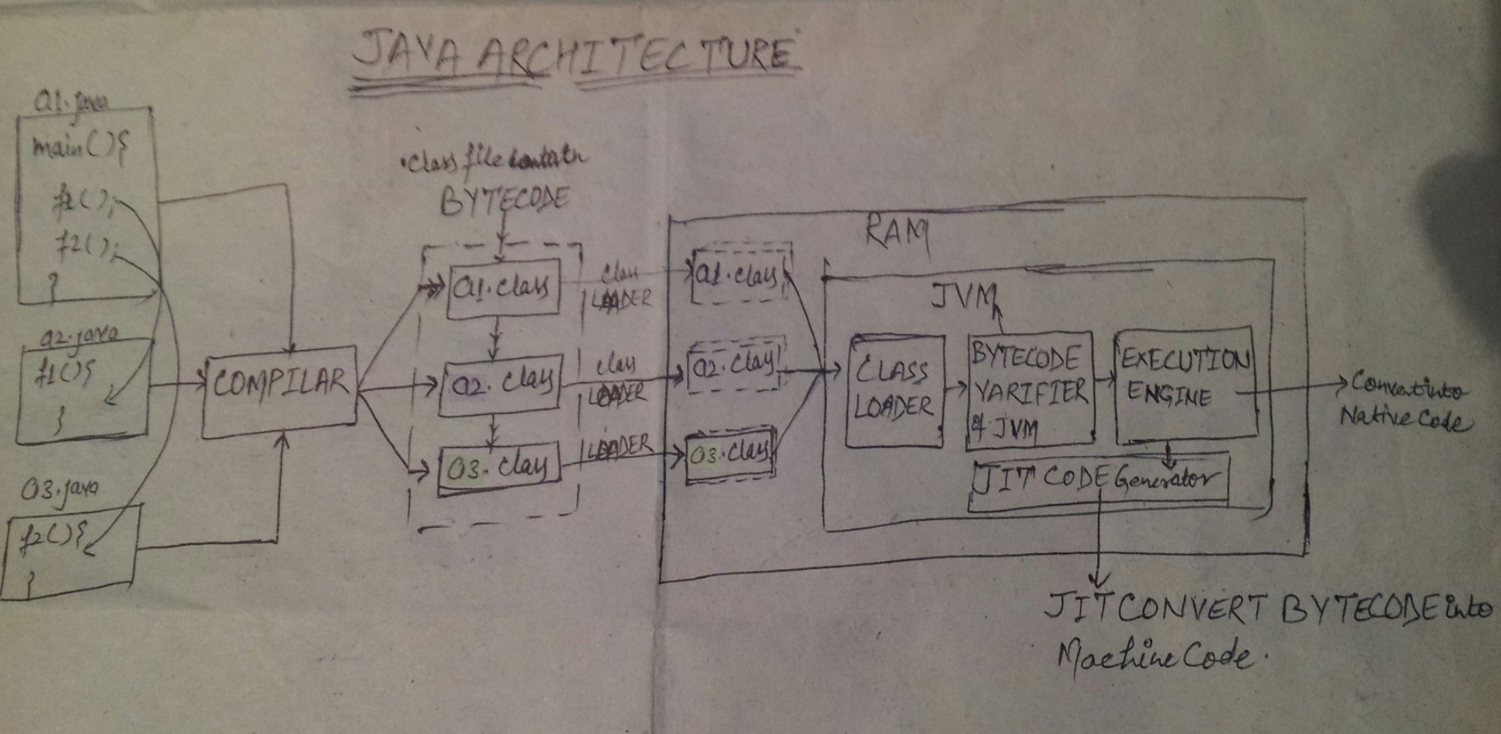
Compiling and Running a Program
Where are the files stored in the directory?

Slide 16

Creating and Compiling Programs
The output of the compiler is .class file

Slide 17
Anatomy of a Java Program
Comments
Package
Reserved words
Modifiers
Statements
Blocks
Classes
Methods
The main method

Slide 18
Comments
We use the Comment to enhancing the readability of our program.
In Java, comments are preceded by two forward slashes (//) in a line, or enclosed between /* and */ in one or multiple lines. When the compiler sees //, it ignores all text after // in the same line. When it sees /*, it scans for the next */ and ignores any text between /* and */.

Slide 19
Package
A Package is a namespace that organize a set of related classes and interfaces.
The second line in the program specifies a package name, for the class Welcome. Forte compiles the source code in Welcome.java, generates Welcome.class, and stores Welcome.class in the folder.

Slide 20
Reserved Words
Reserved words or keywords are words that have a specific meaning to the compiler and cannot be used for other purposes in the program. For example, when the compiler sees the word class, it understands that the word after class is the name for the class. Other reserved words are as public, static, and void. Their use will be introduced later in the book.

Slide 21
Modifiers
Java uses certain reserved words called modifiers that specify the properties of the data, methods, and classes and how they can be used. Examples of modifiers are public and static. Other modifiers are private, final, abstract, and protected. A public datum, method, or class can be accessed by other programs. A private datum or method cannot be accessed by other programs.

Slide 22
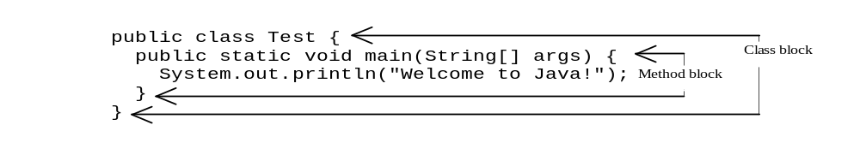
Statements
A statement represents an action or a sequence of actions. The statement System.out.println("Welcome to Java!") in the program in Example 1.1 is a statement to display the greeting "Welcome to Java!" Every statement in Java ends with a semicolon (;).
Blocks
A pair of braces in a program forms a block that groups components of a program.

Slide 58
Methods
What is System.out.println? It is a method: a collection of statements that performs sequence of operations to display a message on the console. It can be used even without fully understanding the details of how it works. It is used by invoking a statement with a string argument. The string argument is enclosed within parentheses. And the argument is "Welcome to Java!" You can call the same println method with a different argument to print a different message.

Slide 59
Main Method
The main method provides the control of program flow. The Java interpreter executes the application by invoking the main method.
The main method looks like this:
public static void main(String args[]) {
// Statements;
}

Slide 60
Classes
The class is the essential Java construct. A class is a template or blueprint for objects. To program in Java, you must understand classes and be able to write and use them. The mystery of the class will continue to be unveiled throughout this book. For now, though, understand that a program is defined by using one or more classes.

Slide 61
Infoseek | Brand of My5 Technology Pvt. Ltd.

Slide 62
Thank You!
Design By
Er. Mirza Ghazanfar Baig.
Infoseek | Brand of My5 Technology Pvt. Ltd.

