Slide 1

A Neuro-Driven Mobile Robot Enhanced
by LoRa and EEG Technology
Guided by
Mr. K. Aswin, M.E.,
Assistant Professor / CSE,
Dhanalakshmi Srinivasan Engineering
College(Autonomous) - Perambalur
Presented by
Akash R – (DSUG20104010)
Balaji M – (DSUG20104022)
Barath K – (DSUG20104026)
Kannan S – (DSUG20104067)

Slide 2
ABSTRACT
The "Cognitive Rover" project presents an innovative integration of cognitive science, robotics, and long-range communication technology. The aim is to develop a mobile robot capable of neuro-driven control through EEG signals obtained from a Brain-link headset. The communication between the robot and a remote control interface is facilitated by LoRa technology, providing an efficient and reliable means of data transfer over long distances.

Slide 3
Implement a Brain-Computer Interface (BCI) using EEG signals to interpret cognitive states.
Develop a communication system between the robot and a user interface using LoRa technology.
Enable the user to control the robot's movements and actions through neuro-driven commands.
Integrate a camera on the robot to provide a live video feed for remote monitoring.
OBJECTIVE

Slide 4
The existing remote-controlled robotic systems typically utilize communication methods such as Wi-Fi, Bluetooth, or RF for short to medium-range control.
Control interfaces often involve traditional handheld devices with joysticks or web-based interfaces.
EXISTING SYSTEM

Slide 5
Limited Communication Range
Wired Connections
Dependency on Line-of-Sight
Power Consumption
Limited Autonomous Capabilities
DISADVANTAGES

Slide 6
The proposed system consists of two ESP32 boards, each equipped with LoRa modules for seamless long-range communication.
One ESP32 board interfaces with a Brain-link headset through Bluetooth, interpreting EEG signals to control the robot's behaviour.
The second ESP32 board is embedded in the mobile robot, featuring a camera for live video streaming.
The LoRa communication ensures a robust link between the user interface and the robot, allowing for real-time control and monitoring.
PROPOSED SYSTEM

Slide 7
Neuro-Driven Control
Reduced Dependency on Wired Connections
Long-Range Communication
Low Power Consumption
Real-time Monitoring
Remote Control and Automation
ADVANTAGES

Slide 8
SYSTEM REQUIREMENTS
HARDWARE REQUIREMENTS
Monitor type: 15 Inch color monitor
Sensor: EEG Headset, LoRa Module
Microcontroller: ESP32, ESP32 Camera Module
Ram Size: 2GB
SOFTWARE REQUIREMENTS
Operating System: Windows OS
Language: Embedded C, Matlab
IDE: Arduino IDE, Matlab IDE
Application: Windows Application

Slide 9
LITERATURE SURVEY

Slide 10
TITLE | AUTHOR NAME | YEAR | METHODOLOGY | LIMITATIONS
Arduino Based Bluetooth Voice-Controlled Robot Car and Obstacle Detector | Rajeshwari Sissodia, ManMohan Singh Rauthan,Varun Barthwal | 2023 | Arduino Uno microcontroller and an HC-05 Bluetooth module, the project establishes communication for voice controlled. | Scalability, range limitations with Bluetooth, and voice recognition accuracy affected by noise and accents.
Car Control by using brain waves and Arduino based Mind wave Mobile | Khalid Alsammarraie, Timur Inan | 2022 | An Android app interprets brainwaves and communicates with the car via Bluetooth. | Accuracy of brainwave interpretation and latency in communication between the BCI app.
Wi-Fi Controlled Multi-sensor Robotic Car | J.J.Dhanish Kumar, R.Gokul, S.Harshini, G.Nithish | 2022 | A smartphone-controlled robotic car using minimal technology, primarily the Node MCU interfaced with various modules. | Scalability and autonomy may be constrained, requiring future enhancements to improve intelligence
BCI based Robotic Arm Control using MI-EEG and Spiking Neural Network | Joshua Alfred, Harshavardhan S, John Sahaya Rani Alex | 2022 | This study uses MI-EEG signals to control a robotic arm. Preprocessing removes noise, and features are extracted. | Challenges may include signal variability and its only for arm.
Wireless car control system based on ARDUINO UNO R3 | Lang Chen, Jianbo Zhang, Yao Wang | 2018 | The paper designs a wireless car control system, using modular principles and an ARDUINO UNO R3, along with ultrasonic, Bluetooth, and motor driver. | Possible constraints include scalability and compatibility with varied hardware configurations..

Slide 11
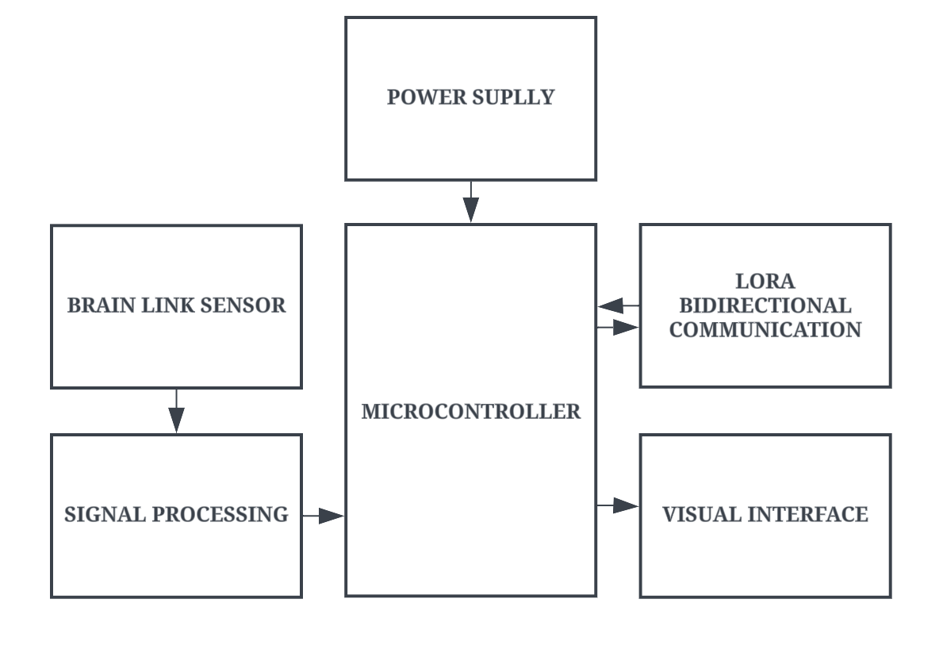
BLOCK DIAGRAM
Processing Side

Slide 12
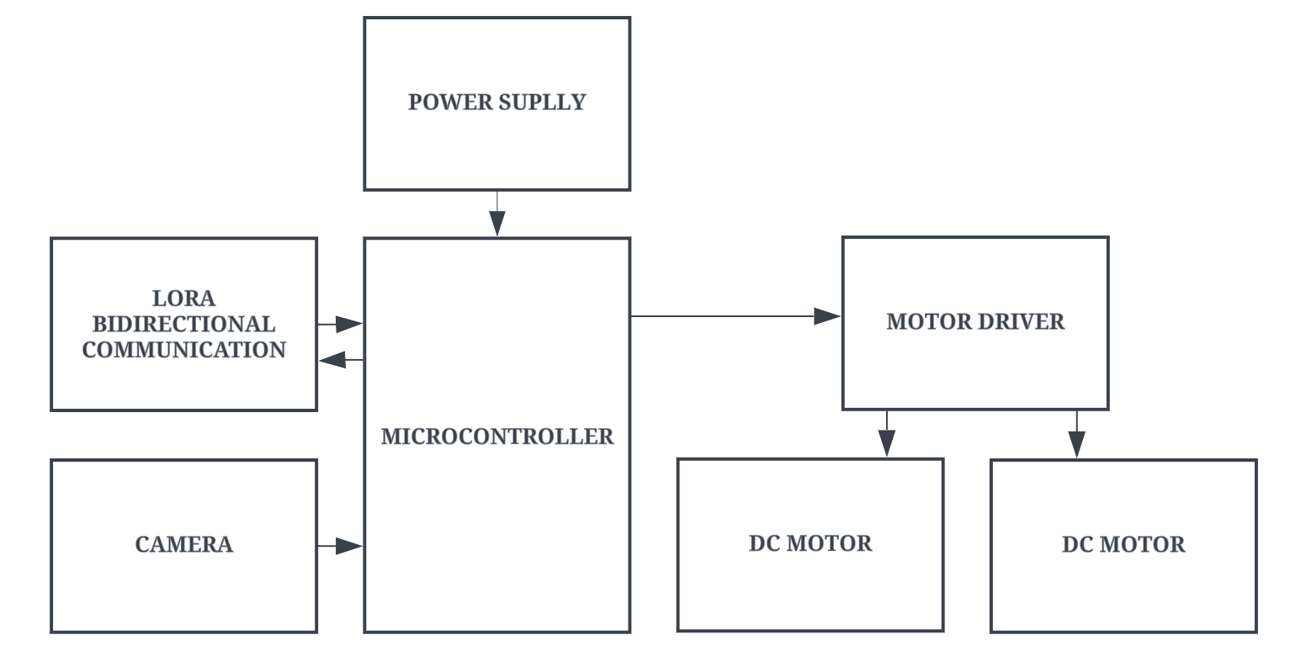
BLOCK DIAGRAM
Rover Side

Slide 13
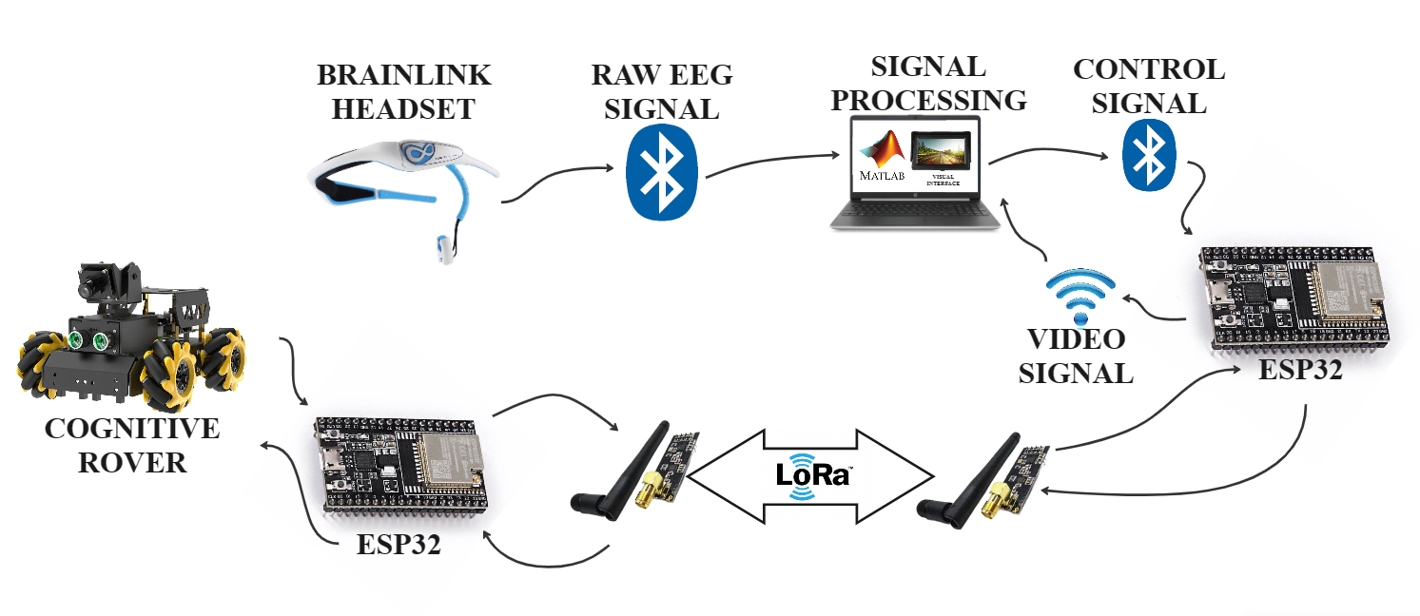
ARCHITECTURE DIAGRAM
Proposed System Workflow

Slide 14
Brain-Computer Interface (BCI) Implementation
Integration of LoRa Communication
Neuro-Driven Control System
Real-Time Video Streaming
MODULE

Slide 15
Brain-Computer Interface (BCI) Implementation:
Utilize the Brain-link headset to capture EEG signals Establish a communication bridge between EEG interpretation and robot control.
Develop algorithms to interpret cognitive states from EEG data.
Establish a communication bridge between EEG interpretation and robot control.
MODULE DESCRIPTION

Slide 16
Integration of LoRa Communication:
Employ ESP32 boards with integrated LoRa modules for wireless communication.
Implement bidirectional communication protocols between the robot and the remote control interface.
Optimize data transfer for efficiency and reliability over long distances.
MODULE DESCRIPTION

Slide 17
Neuro-Driven Control System:
Develop algorithms to translate interpreted EEG signals into actionable commands for robot movements and actions.
Ensure adaptability and real-time responsiveness in the control system.
Implement user-friendly interfaces for seamless cognitive control.
MODULE DESCRIPTION

Slide 18
Real-Time Video Streaming:
Integrate a camera system on the robot to capture live video feed.
Develop mechanisms for real-time video streaming to the remote control interface.
Optimize video compression and transmission for efficiency.
MODULE DESCRIPTION

Slide 19
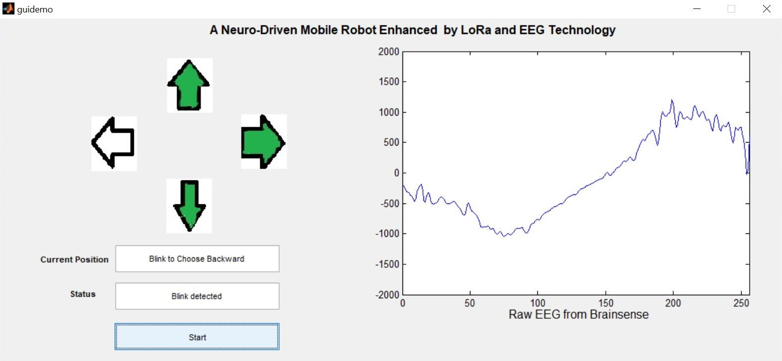
OUTPUT
Matlab Signal Processed Interface

Slide 20
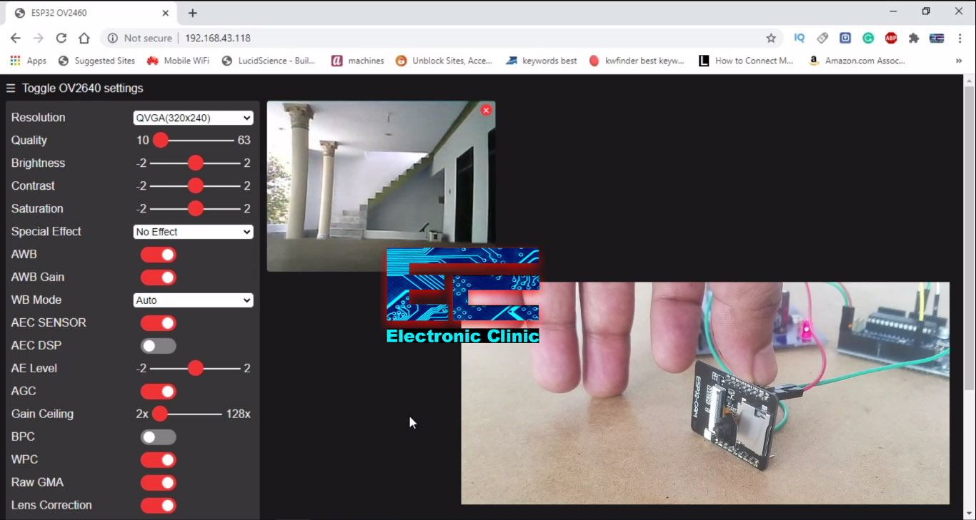
OUTPUT
Live Streaming

Slide 21
CONCLUSION
In conclusion, the Cognitive Rover successfully integrates neuro-driven control and LoRa communication, opening new possibilities in mobile robotics. This marks a step forward in redefining human-robot interaction and sets the stage for future advancements in the field.

Slide 22
Integrating additional sensors to broaden the rover's sensory capabilities, enabling it to gather more comprehensive data about its environment and make more informed decisions.
Developing intuitive interfaces that simplify interaction with the rover, making it easier for operators to control and collaborate with the system, ultimately enhancing its usability and effectiveness.
FUTURE ENHANCEMENT

Slide 23
REFERENCES
G. Quere, A. Hagengruber, M. Iskandar, S. Bustamante, D. Leidner, F. Stulp, and J. Vogel, “Shared control templates for assistive robotics,” in 2020 IEEE International Conference on Robotics and Automation (ICRA). IEEE, 2020, pp. 1956–1962.
B. Xu, W. Li, X. He, Z. Wei, D. Zhang, C. Wu, and A. Song, “Motor imagery based continuous teleoperation robot control with tactile feedback,” Electronics, vol. 9, no. 1, p. 174, 2020.
X. Jiang, J. Zhao, B. Du, and Z. Yuan, “Self-supervised contrastive learning for eeg-based sleep staging,” in 2021 International Joint Conference on Neural Networks (IJCNN), pp. 1–8, IEEE, 2021.

Slide 24
REFERENCES
R. Abiri, S. Borhani, E. W. Sellers, Y. Jiang, and X. Zhao, “A comprehensive review of eeg-based brain–computer interface paradigms,” Journal of neural engineering, vol. 16, no. 1, p. 011001, 2019.
Shubh Srivastava, Rajanish Singh. Voice Controlled Robot Car Using Arduino, International Research Journal of Engineering and Technology (IRJET), ISSN: 2395-0056, Volume: 07, Issue: 05, May 2020.

Slide 25
THANK YOU!!!!

