Slide 1

LORAWAN Based Smart Farming Modular IOT Architecture
Guided by
Mr. K. Aswin, M.E.,
ASSISTANT PROFESSOR / CSE,
Dhanalakshmi Srinivasan Engineering College(Autonomous)
Perambalur
Presented by
Akash R – (DSUG20104010)
Arun Iyyappan M – (DSUG20104017)
Christo Edwinraj V – (DSUG20104030)
Dhanush T – (DSUG20104034)

Slide 2
ABSTRACT
The Internet of Things (IoT) is transforming agriculture with automated systems and sensors. Wireless Sensor Networks (WSN) offer a cost-effective solution for monitoring and control, but long-distance communication remains a challenge.
LoRa technology, known for its extended range, two-way communication, and affordability, is a promising solution. This study integrates LoRaWAN technology into agriculture, focusing on long-distance, low-cost communication.
The report presents a comprehensive examination of LoRaWAN for collecting agricultural data, transmitting it to a cloud platform, and includes a web-based visualization tool for validation. This research aims to optimize communication in agriculture, leveraging the benefits of LoRa technology.

Slide 3
OBJECTIVE
The objective of a smart agricultural system using LoRa wireless technology is to observe and control the temperature, humidity, moisture, and motor of the field via website and android mobile application. Field data will transmit using LoRa technology, without an internet connection, and with high distance.

Slide 4
EXISTING SYSTEM
Previously, the development of the WSN system for smart agriculture based on the Zigbee wireless sensor network.
In this model, at the transmitting side, the Microcontroller and ZIGBEE transceiver and different sensors are connected with a microcontroller.
All the sensor’s data are controlled and collected by the microcontroller, and using the ZIGBEE transceiver transmits the sensed data wirelessly.
At the receiving side, another microcontroller and the ZIGBEE transceiver are there, it will receive the sensed data and use for the personal computer.
It communicate at speeds up to 250kbps while physically separated by distances up to 50 meters.

Slide 5
DISADVANTAGES
Limited Range
Low Data Rate
Power Consumption
Scalability
Interference

Slide 6
PROPOSED SYSTEM
The proposed system utilizes LoRa (Long Range) technology to establish a wireless network for smart agriculture.
We have divided this technology into two parts, one for field and another for the control hub (LoRaWAN Gateway).
The field area, End device that connected with Moisture sensor, LDR, Rain, and DHT sensor and one receiver for the water pump control.
The End device generates useful data of farm like temperature, humidity, soil moisture.
The role of the LoRaWAN Gateway is to receive the whole data generated by the on field components and also transmit the command to control the motor whereas the device stores the data and displays on the for remotely monitoring.

Slide 7
ADVANTAGES
Long-Range Communication
Low Power Consumption
Real-time Monitoring
Remote Control and Automation
User-Friendly Interface

Slide 8
HARDWARE COMPONENTS
Doit Esp32 Devkit V1Board
Lora SX1278 RA02
Lora ANTENNA
Ldr Sensor
Dht11 Temperature And Humidity Sensor
Soil Moisture Sensor
Raindrop Sensor
Liquid Crystal Display 16x2
I2c Module
Relay
Submersible Water Pump
9v Dc Hi-watt Battery

Slide 9
LITERATURE SURVEY

Slide 10
TITLE | AUTHOR | YEAR | METHODS | MERITS | DEMERITS
Development of WSN System for Precision Agriculture | Santosh Kumar, Uday Kumar R.Y | 2015 | ZIGBEE technology is used as WSN | WSN provides a simple cost effective solution to monitor and control. ZIGBEE technology is used as WSN | ZIGBEE has a low Range than Bluetooth and LoRa
Internet of Things (IoT) for Precision Agriculture Application | ManishKumar Dholu, K. A. Ghodinde | 2018 | Wi-Fi Module | Communication with the gateway wirelessly through Wi-Fi module as it gives an advantage over Bluetooth | Wi-Fi has short-range communication, over LoRa WSN.
IoT Based Intelligent Agriculture Field Monitoring System | Md Ashifuddin Mondal, Zeenat Rehena | 2018 | GSM | The level of water content is low the pump gets ON automatically or the level of water content in land is high the pump gets OFF automatically | These batteries have a limited lifespan, and replacing them can be costly
IOT Based Smart Agriculture System | G. Sushanth, S. Sujatha | 2020 | GSM/GPRS | Send suggestions via SMS to the farmer directly on his mobile using the GSM module | Continuous internet connectivity is required
IOT BASED SMART CROP-FIELD MONI -TORING AND AUTOMATION IRRIGATION SYSTEM | R. Nageswara Rao, B. Sridhar | 2018 | Raspberry PI | The main Advantage of this work is crop development at low quantity water consumption. | Raspberry PI is Expensive

Slide 11
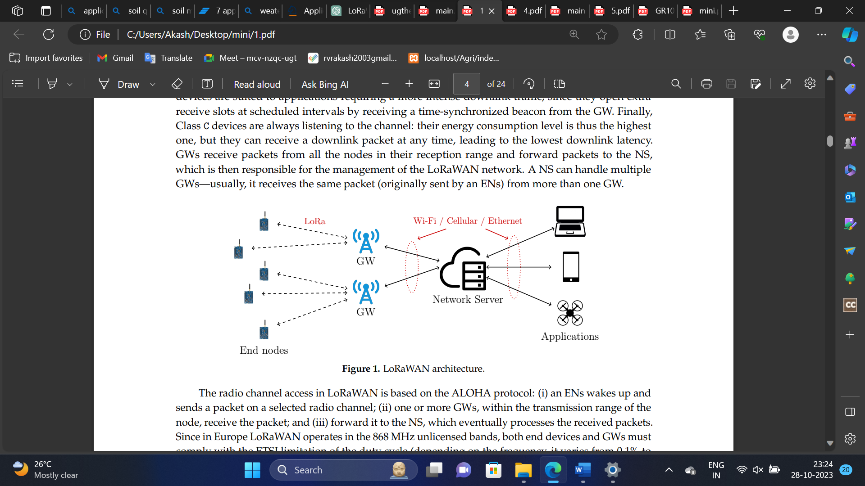
ARCHITECTURE DIAGRAM

Slide 12
MODULES
Installing the ESP32 and LoRa Library in Arduino IDE
Implementation of the ESP32 LoRaWAN Gateway
Implementation of the ESP32 Sensor Node
Prepare Database and WebPage
000Webhost Web Hosting

Slide 13
Installing the ESP32 and LoRa Library in Arduino IDE
MODULE DESCRIPTION
In the first step , we are going to do some basic interaction between LoRa and ESP32. For doing that we require a number of two ESP32, and two LoRa RA02 SX1278 modules . There is mandatory to operate the LoRa module with antenna, else output power will damage the module. For doing this interaction, we need to create one transmitter and one receiver.
To be able to program the ESP32 using Arduino IDE, you need to add support for the ESP32 boards. Follow the next steps:
Go to File > Preferences.

Slide 14
MODULE DESCRIPTION
Implementation of the ESP32 LoRaWAN Gateway
To create a LoRaWAN gateway, we need an ESP32 development board and a LoRa transceiver module (we are using SX1278 (Ra-02) module). The ESP32 is responsible for receiving LoRaWAN packets from sensor nodes and forwarding them to the LoRaWAN network server like PhpMyAdmin.
Use the ESP32 module in the receiving side, so we easily upload and store the received data of soil moisture sensor, LDR, Raindrop, Temperature and Humidity values on the database.

Slide 15
MODULE DESCRIPTION
Implementation of the ESP32 Sensor Node
The sensor is capable of measuring temperature, humidity, LDR and soil moisture. To create the sensor node, we integrate the sensor with an ESP32.
The sensor node is programmed to collect data from the sensor and transmit it to the gateway using LoRaWAN technology.

Slide 16
MODULE DESCRIPTION
Prepare Database and WebPage
We want to provide remote access to farmers, so we are created one website by that farmers can easily monitor the temperature and humidity of the field. But first of all, we have to create one database.
In the first step we need to start Apache and MySql from XAMPP.
Open phpMyAdmin on a browser. And create one new database, after that create one table in that database and store the sensor value in that.
The database name is a “agriculture”, and the table name is the “sensor”. In the table we store the id number of data, then temperature, humidity, soil moisture and date and time.

Slide 17
MODULE DESCRIPTION
000Webhost Web Hosting
000WebHost is a free web hosting company and its power by hosting. They also provide web hosting at zero charges including 99.9% uptime certified. We use this free web hosting for providing worldwide accessibility for the farmer. For that, we host the website on this web hosting. For that, we need to login with the email id.
After login, create a new site, for that we provide one unique name of the site and it displays a dashboard for controlling a website.

Slide 18
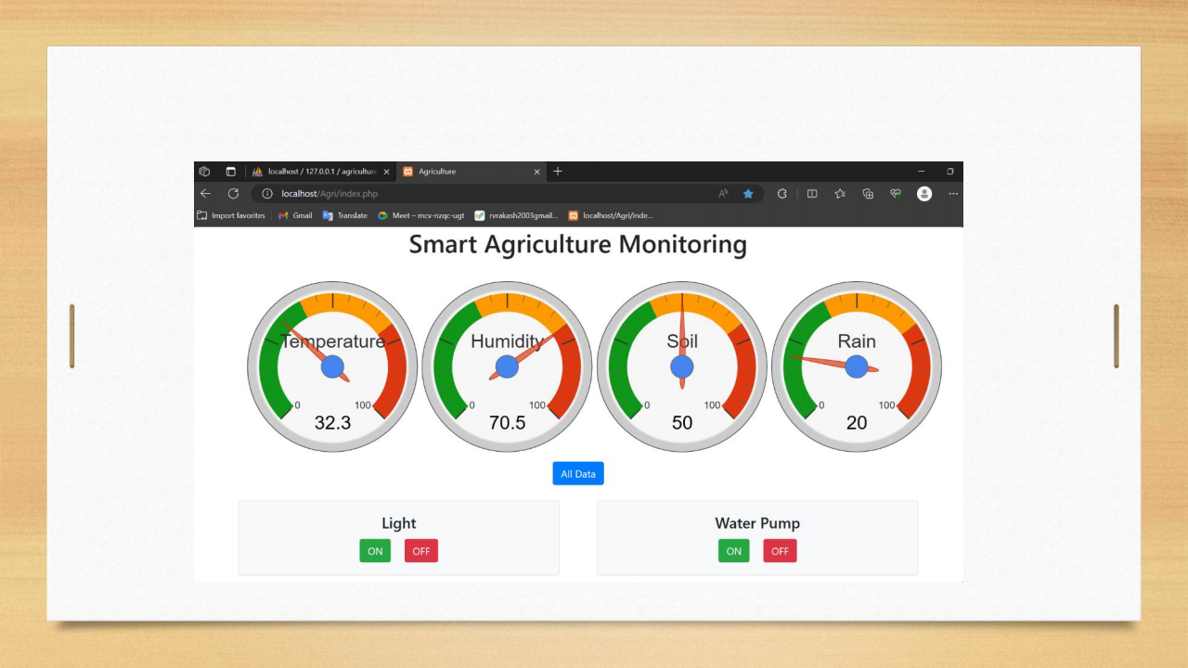
SCREENSHOT
Smart Agriculture Home Page of Web Site

Slide 19
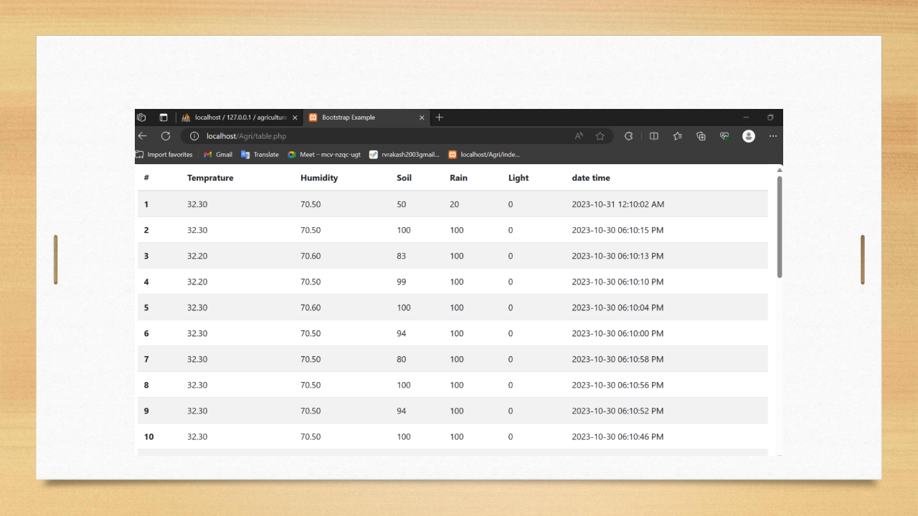
SCREENSHOT
Collection of Live Sensor data in Table Form on Web Site

Slide 20
CONCLUSION
The system has been configured to use the LoRa module to create a smart agriculture control and monitoring system.
To be used this technology we can place the transmitter at the different places in the field whereas the data generated by them are collected with the help of the Gateway.
LoRa technology is very suitable in the agriculture sector because it does not require internet connection moreover it operated at a greater distance.
We've also added the ability to control and monitor the device remotely using computer software.

Slide 21
FUTURE ENHANCEMENT
In future, planned to make this as an application which can be easily used by everyone.
By using MySQL, the database will be created and the user information will be stored in that database for their future reference.
The system can be improved by adding the feature that the IOT based smart farming is generated for the many large scale production and it is linked with database to store the data of every field in the farmer login when the farmer can see the information in the website.
This will even more helpful for the field owners to monitor their field.

Slide 22
REFERENCE
[1] Santoshkumar and Udaykumar R.Y, “Development of WSN system for
precision agriculture,” in 2015.
[2] M. Dholu and K. A. Ghodinde, “Internet of Things (IoT) for Precision
Agriculture Application,” in 2018.
[3] D. Davcev, K. Mitreski, S. Trajkovic, V. Nikolovski, and N. Koteli,
“IoT agriculture system based on LoRaWAN,” in 2018.
[4] Y. Kim, R. G. Evans, and W. M. Iversen, “Remote Sensing and
Control of an Irrigation System Using a Distributed WSN,” in 2008.
[5] A. Hanggoro, M. A. Putra, R. Reynaldo, and R. F. Sari, “Green house
monitoring and controlling using Android mobile application,” in 2013.

Slide 23
THANK YOU!!!!

