Slide 1

Machine Learning Models To Predict Covid Mortality
Rutgers Bootcamp for Data Science
Abraham Abate, Ashish Shukla,
Jialin Huang, Roger Vroom
March 23, 2023
Image: Corona Borealis Studio/Shutterstock.com

Slide 2
Background
Coronavirus disease (COVID-19) is an infectious disease caused by a newly discovered coronavirus. Most people infected with COVID-19 virus will experience mild to moderate respiratory illness and recover without requiring special treatment. Older people, and those with underlying medical problems like cardiovascular disease, diabetes, chronic respiratory disease, and cancer are more likely to develop serious illness.
The main goal of this project is to build a machine learning model that, given a Covid-19 patient's current symptom, status, and medical history, will predict whether the patient is in high risk or not. We decided to focus on Covid-19 due to its continued impact on the world's population. While deaths have declined, we are still interested in the factors that lead to severe complications.

Slide 3
Goals:
The selected topic and the reasoning for that selection. (6 points)
A description of the data source. (6 points)
The questions that the team planned to answer with the data. (6 points)
A description of the data exploration phase of the project. (6 points)
A description of the analysis phase of the project. (6 points)

Slide 4
Data Exploration:
Predicting a person’s likelihood to contract Covid death vs mortality based Supervised ML
Use six different machine learning models
Use a checklist of existing conditions -> correlation to % of Covid mortality

Slide 5


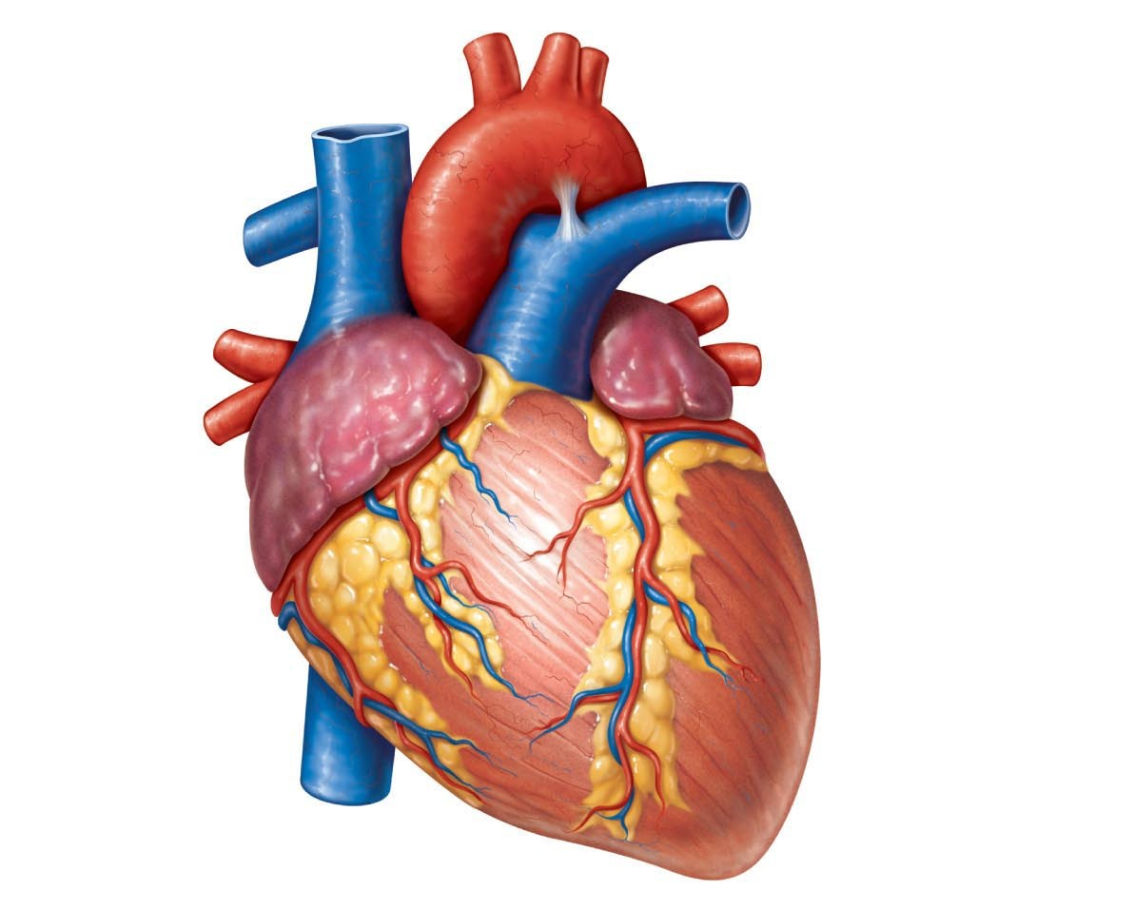
Pre-existing Diseases or Conditions
This Photo by Unknown Author is licensed under CC BY
This Photo by Unknown Author is licensed under CC BY-NC-ND
This Photo by Unknown Author is licensed under CC BY-NC-ND

Slide 6
Prediction Model/Machine Learning
Covid-19 Dataset
Clinical data
Machine Learning
Random Forest
Application
Mortality and Severity Prediction
Logistic Regression
AdaBoost
Gradient Boosted Classifier

Slide 7
Accuracies of Different ML Models
 | Logistic Regression | Random Forest | Gradient Boosted Classifier | Easy Ensemble AdaBoost Classifier | Support Vector Machine | Deep Learning
Training Data Accuracy Score | 0.914 | 0.896 | 0.896 | 0.849 | 0.913
Accuracy Score | 0.912 | 0.911 | 0.912 | 0.845 | 0.104 | 0.912
Accuracy Score = % of Covid patients with underlying disease having a high risk to develop severe Covid leading to fatality

Slide 8
Summary of Prediction Results
Different ML models were trained on top of these 14 features to predict patients' mortality or discharge outcomes. From different ML models (e.g., Logistic Regression, random forest, Gradient Boosting Classifier, support vector machine, AdaBoost, and neural network), the logistic Regression model performance better with an accuracy of 91.4% followed by SVM (91.3%) and Deep learning (91.2%).
The trained models were then tested on the test dataset. Again, four models (Logistic Regression, Gradient Boosting Classifier, neural network) had the best performance with an accuracy of 91.2%, followed by random forest (91.1%) accuracy rate. SVM has the least accuracy rate of 10.4%. Easy Ensemble AdaBoost Classifier model is the only model with high sensitivity rate of 84% .

Slide 9
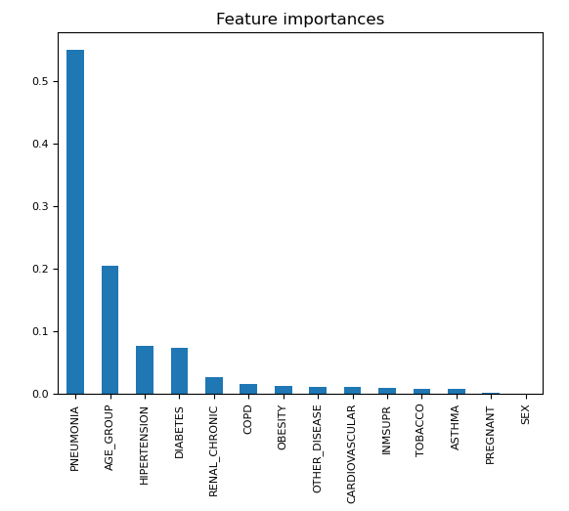
Feature Importance for Random Forest
Pneumonia contributes the most to decision tree model of ML prediction
Age group (under and over 65)
Hypertension
- New chart with age groups split into 2

Slide 10
Additional resources
Tableau - https://public.tableau.com/app/profile/jialin.huang3459/viz/CovidmortalitygroupprojectMar-2023/Story1
Github - https://github.com/rvroomiii/group_hub
Website

Slide 11
Credits
Data Source: https://www.kaggle.com/datasets/meirnizri/covid19-dataset
Software/Tool used:
Python
Pandas
Matplotlib
NumPy
SciPy
Jupyter Notebook
Visual Code Studio
Any recommendations for a future analysis. (10 points)
Anything that the team would have done differently if they had more time. (10 points)
We can use US/CDC data (large file we didn’t use this time)
CDC data as support for current data
Pneumonia + age group (broken down into more groups) as the highest correlation factors

