Slide 1

Machine Learning Models To Predict Covid Mortality
Rutgers Bootcamp for Data Science
Abraham Abate, Ashish Shukla,
Jialin Huang, Roger Vroom
March 23, 2023
Image: Corona Borealis Studio/Shutterstock.com

Slide 2
Background
Coronavirus disease (COVID-19) is an infectious disease caused by a newly discovered coronavirus. Most people infected with COVID-19 virus will experience mild to moderate respiratory illness and recover without requiring special treatment.
The main goal of this project is to build a machine learning model that, given a Covid-19 patient's current symptom, status, and medical history, will predict whether the patient is in high risk or not.

Slide 3
Objectives
We decided to focus on Covid-19 due to its continued impact on the world's population.
Dataset, provided by Mexican government, consists of 21 unique features and 1,048,576 unique patients
Compare and evaluate performances of different machine learning
Predict a person’s likelihood contract severe Covid by pre-existing conditions (features)
Develop website to predict user’s likelihood to contract severe Covid

Slide 4



Pre-existing Diseases or Conditions
This Photo by Unknown Author is licensed under CC BY
This Photo by Unknown Author is licensed under CC BY-NC-ND
This Photo by Unknown Author is licensed under CC BY-NC-ND
Older people, and those with underlying medical problems like cardiovascular disease, diabetes, chronic respiratory disease, cancer, and diabetes are more likely to develop serious Covid symptoms, possibly leading to mortality
https://www.mayoclinic.org/diseases-conditions/coronavirus/in-depth/coronavirus-who-is-at-risk/art-20483301

Slide 5
Data Exploration
Predict a person’s likelihood contract severe Covid leading
Use 6 different Supervised Machine Learning models
Determine pre-existing conditions’ correlations to Covid mortality

Slide 6
Prediction Model/Machine Learning
Covid-19 Dataset
Clinical data with pre-conditions
Machine Learning
Logistic Regression
Application
Mortality and Severity Prediction
Random Forest
Gradient Boosted Classifier
Easy Ensemble AdaBoost Classifier
Support Vector Machine
Deep Learning

Slide 7
Training Dataset Accuracies
 | Logistic Regression | Random Forest | Gradient Boosted Classifier | Easy Ensemble AdaBoost Classifier | Support Vector Machine | Deep Learning
Accuracy Score | 0.914 | 0.896 | 0.896 | 0.849 | 0.913
Logistic Regression model has the highest performance with an accuracy of 91.4% followed by SVM (91.3%) and Deep learning (91.2%).
Accuracy Score = % of Covid patients with underlying disease having a high risk to develop severe Covid leading to fatality

Slide 8
Testing Dataset Accuracies
 | Logistic Regression | Random Forest | Gradient Boosted Classifier | Easy Ensemble AdaBoost Classifier | Support Vector Machine | Deep Learning
Accuracy Score | 0.912 | 0.911 | 0.912 | 0.845 | 0.104 | 0.912
Four models (Logistic Regression, Gradient Boosting Classifier, neural network) had the best performance with an accuracy of 91.2%, followed by random forest (91.1%) accuracy rate.
SVM has the least accuracy rate of 10.4%.
Easy Ensemble AdaBoost Classifier model is the only model with high sensitivity rate of 84% .
Accuracy Score = % of Covid patients with underlying disease having a high risk to develop severe Covid leading to fatality

Slide 9
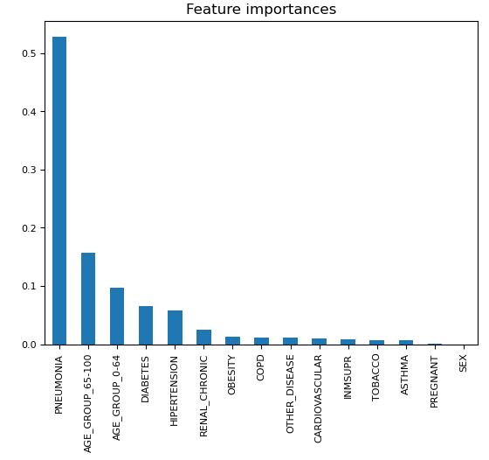
Feature Importance for Random Forest model
Features were ranked from the highest to the lowest
Pneumonia and age were the two top features at 54% and 20% respectively.

Slide 10
Website

Slide 11
Additional Resources
Tableau: https://public.tableau.com/app/profile/jialin.huang3459/viz/CovidmortalitygroupprojectMar-2023/Story1
Github:
https://github.com/rvroomiii/group_hub
Website:

Slide 12
Future Analysis
Recommendations for future analysis
US CDC data (>90 MB) too large for machine learning/model prediction
CDC data use in conjunction
Anything that the team would have done differently
Further break down age group into more subgroups

Slide 13
Credits
Data Source: https://www.kaggle.com/datasets/meirnizri/covid19-dataset
Software/Tool used:
Python
Pandas
Matplotlib
NumPy
SciPy
Jupyter Notebook
Visual Code Studio

