Slide 1

DS Challenge #4
the most interesting challenge yet...
pd.Series(contents)
1 Clustering types?
2 Observations?
3 Experiments!
4 Manual algorithm building
5 Mentos moment(s) :D

Slide 2


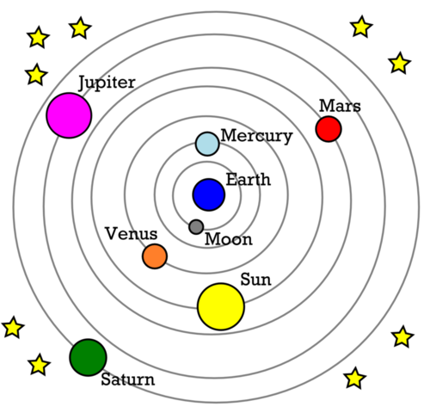
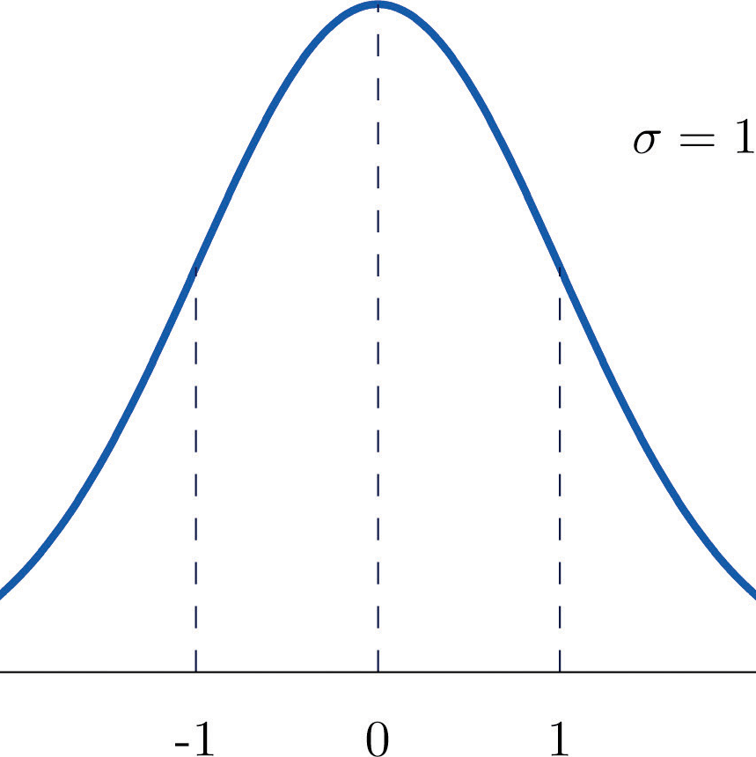
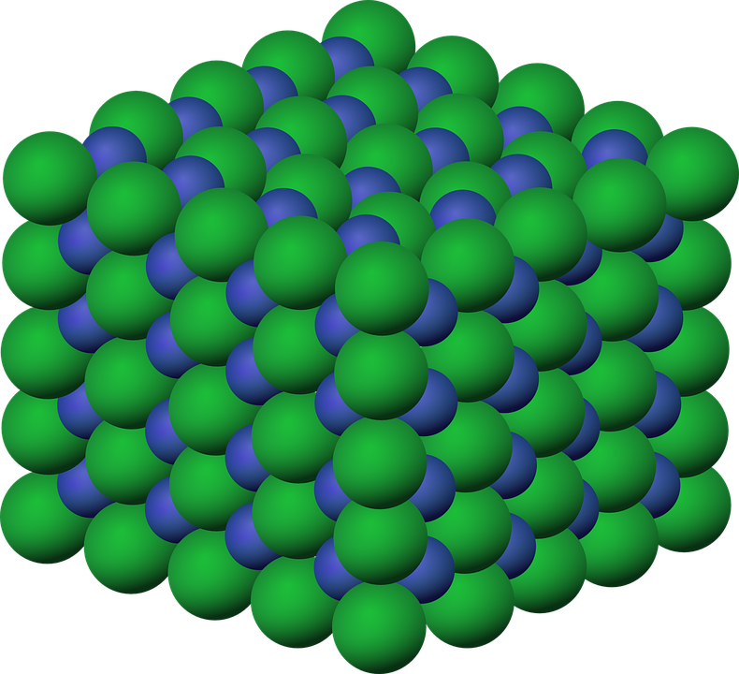
Clustering
CLUSTERING
TYPES
Connectivity-Based
Hierarchical
Centroid-based
K-means
Expectation-maximization
GMM
Density-based
DBSCAN
Based on computation of distances b/w the elements of the dataset.
Assign points to randomly chosen centroids based on their proximity to form clusters.
Calculates probability of each point belonging to a specific cluster.
Uses density to group similar data points. If element is within a sphere of a certain radius (neighborhood distance), it relates to that cluster.
Advantage is that we can classify points into multiple clusters based on probabilities.
Advantage is you do not have to specify the number of clusters in the begining.
Disadvantage is number of clusters must be known.
Disadvantages
a) it requires number of clusters
b) assumes normality of features

Slide 3
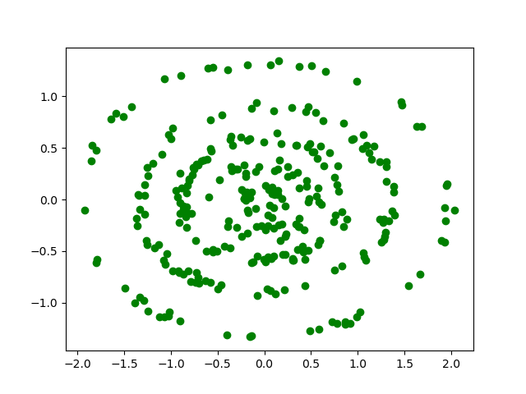
Observations
The answer to the problem is known. Unsupervised-Supervised? Semi-supervised?
The cluster centroids look all the same. Centroid-based algorithms won’t work on the current set of points.
Number of clusters = 4. All concentric circles.
pEDA

Slide 4
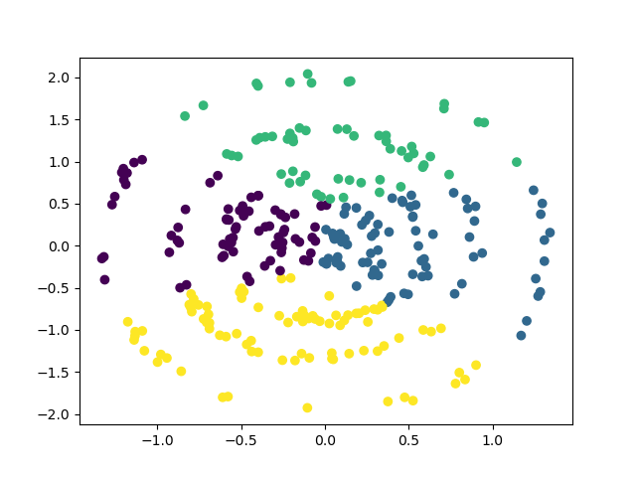
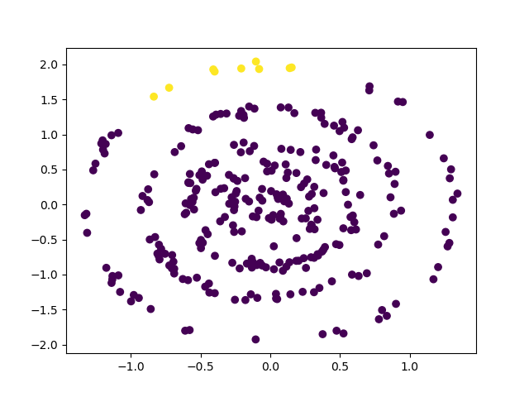
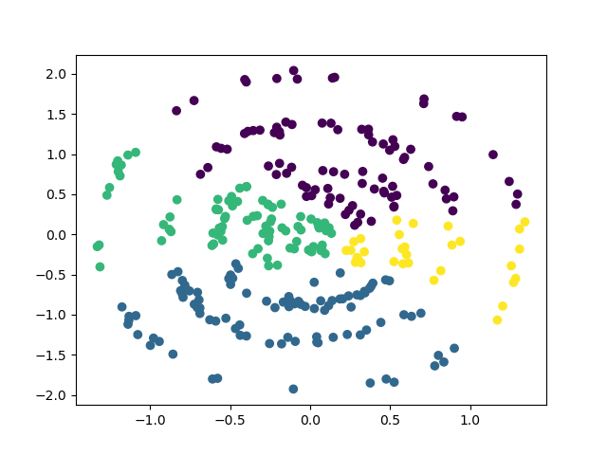
Experiments
K-Means
DBSCAN
Agglomerative HC
ALL WRONG!!!

Slide 5

Manual algorithm building
Potential idea: Fit a CIRCLE using some algorithm, Machine learning or otherwise. Classify all points that fall on a circle as a cluster.
Equation of a circle:
$$x^{2}+y^{2}=r^{2}$$
Objective: Find ‘r’ which is the radius of the circle.
Click here to understand how the equation works.

Slide 6
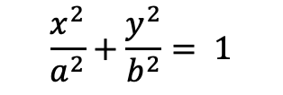
Mentos moment
Is it really a circle?
For a circle min(x), max(x), min(y), max(y) should all be equal.
It’s an ellipse!
$$\frac{x^{2}}{a^{2}}+\frac{y^{2}}{b^{2}}= 1$$
a: major axis, half the length of x-diameter
b: minor axis, half the length of y-diameter

Slide 7
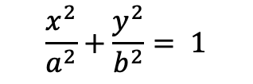
Mentos moment + Manual algorithm
Potential idea: Fit an ELLIPSE using some algorithm, Machine learning or otherwise. Classify all points that fall on an ellipse as a cluster.
Equation of an ellipse:
$$\frac{x^{2}}{a^{2}}+\frac{y^{2}}{b^{2}}= 1$$
Objective: Find ‘a’ and ‘b’

Slide 8
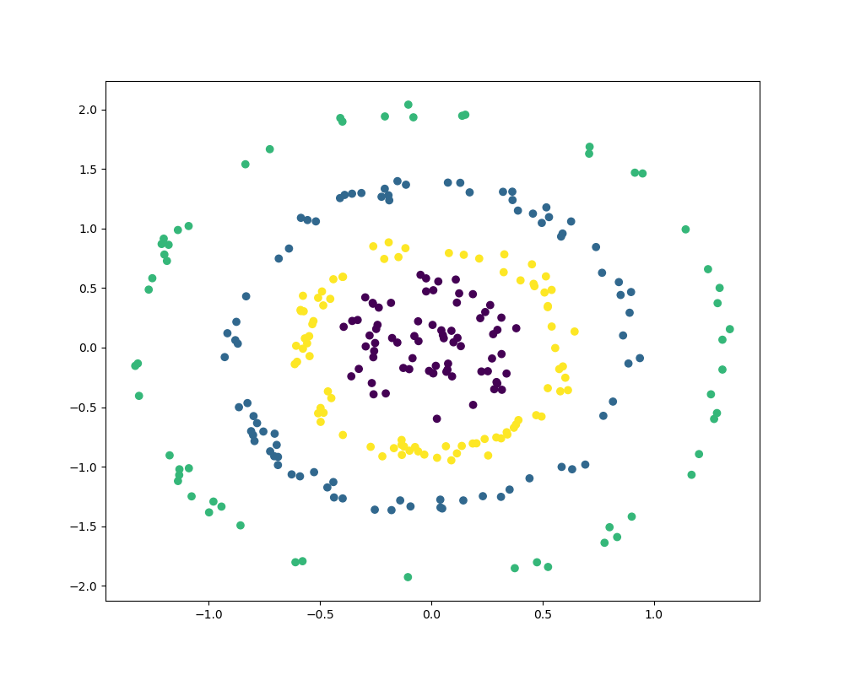
Mentos moment + Machine Learning
The idea now is straightforward.
Feature engineering: transform every ‘x’ and ‘y’ coordinate into a coordinate ‘r’ using the formula of the ellipse.
Use ANY clustering algorithm.
Look at the evident clusters!

Slide 9
Thank you!

