Slide 1

Write bug free python code with functional programming
Siddharta Govindaraj

Slide 2





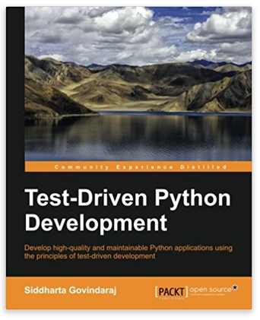
www.playfulpython.com
@playfulpython
https://www.linkedin.com/in/siddharta/

Slide 3
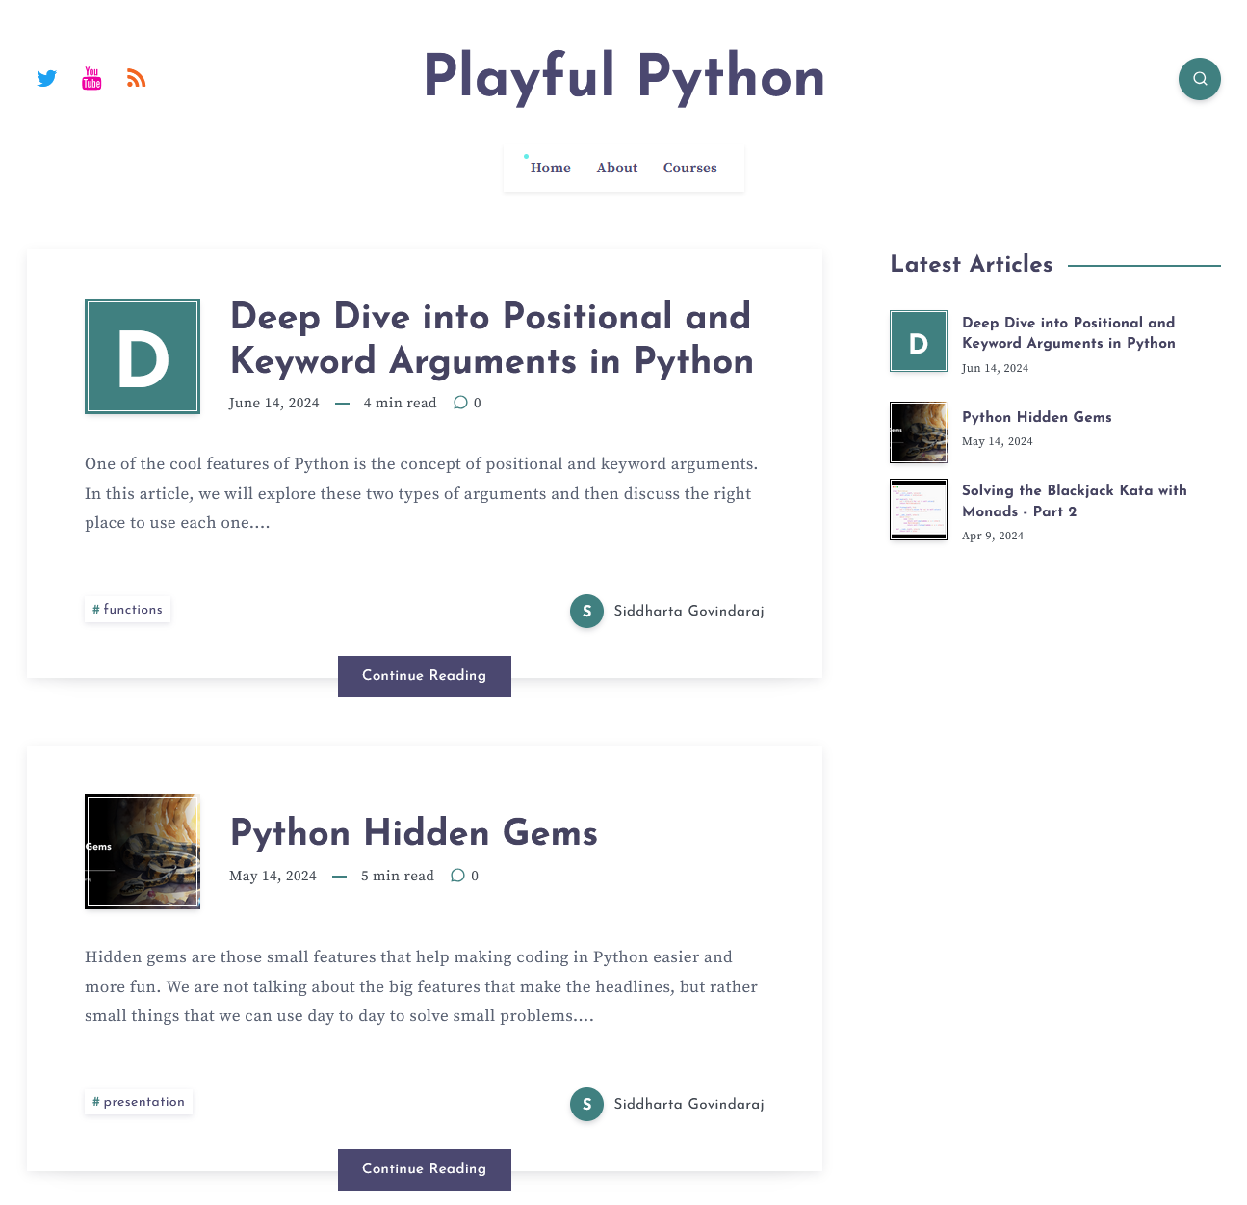

Slide 4
Pre-requisites for the workshop
You have a laptop with Python 3.10+ installed on it
You have a text editor or IDE to edit code
You have intermediate knowledge of Python. We will be using some newer features of Python

Slide 5
Agenda
Part 1: Two Types of Functions
Part 2: Data
Part 3: Higher Order Functions
Part 4: Monads
Part 5: Exercise

Slide 6
Part 1: Two Types of Fns
What is functional programming?

Slide 7
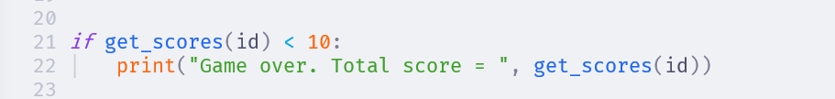

Slide 8
What is a function (in maths)?
Function maps a set of inputs to a set of outputs
The same input always maps to the same output

Slide 9
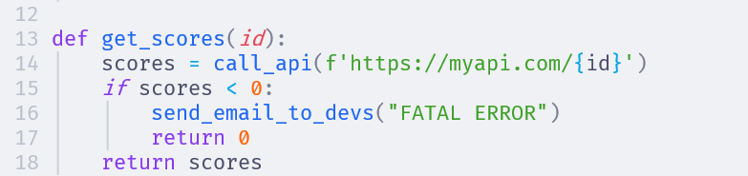
This function has some input apart from the function parameters
This function has some output apart from the return value
These extra inputs and outputs are called side effects

Slide 10
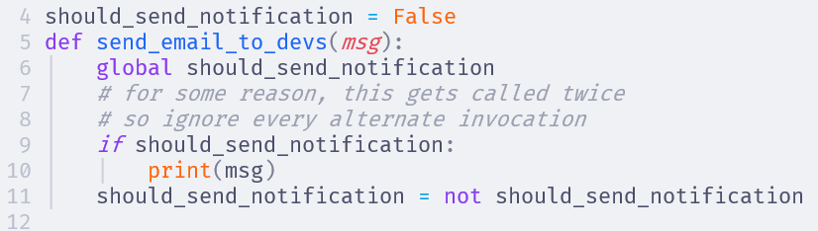
More side effects! This is hidden state
This function has different behaviours when we call it at different times with the same arguments

Slide 11
What is functional programming?
Functional programming is about applying the principles of mathematical functions to programming
Write small functions with simple inputs and outputs
Combine these small functions to create bigger functions
Create abstractions for repeating patterns of usage

Slide 12
Two types of functions
Pure functions are functions in the mathematical sense. They take all inputs from parameters and return all outputs from return values. Also called calculations
Impure functions have side effects, or hidden state. Their behaviour is unpredictable. We cannot infer the inputs or outputs from seeing the function call. We must read the implementation. Also called actions

Slide 13
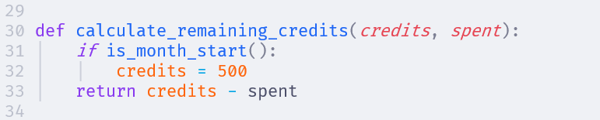
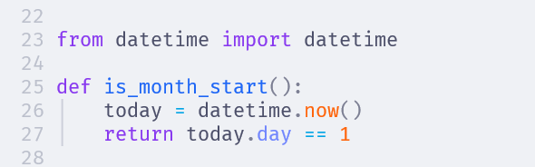

Oh my!! Impure functions are like a virus. If a function calls an impure function, it becomes impure. And if any other function calls this one, then…

Slide 14
Two types of functions
But, but, but… we do need to interact with APIs, and DBs and the outside world. A program that cannot do that is useless

Slide 15
Functional Core, Imperative Shell
Imperative Shell
Functional
Core
APIs
Databases
User Interface

Slide 16
Two types of functions
The goal of functional programming is to cleanly separate out calculations and actions in the design, so that the actions can be contained carefully

Slide 17
Part 2: Data
Mutable and Immutable data

Slide 18
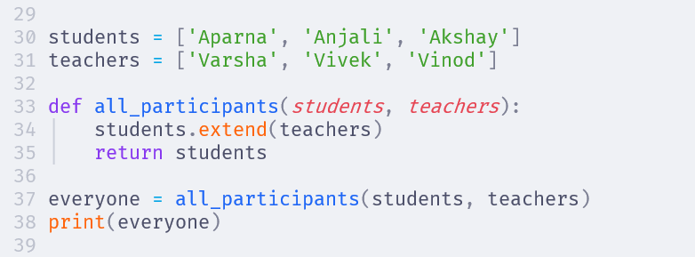

Slide 19
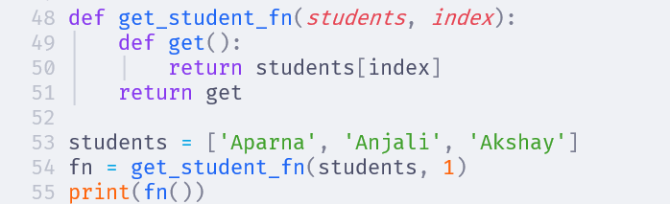

Slide 20
A list is mutable. If we change it, it affects all the other places where that list is used, making the operation impure

Slide 21
List operations
Prefer + instead of .extend()
Use [*lst, value] to append value to lst
Use lst[:-1] to remove the last element of a list
Use [val for val in lst if val != target] to remove a target value from a list
Use lst[:] to make a copy of a list

Slide 22
Dict operations
Use the union operator | to add or update keys in a dictionary
Use .copy() method to make a copy of the dictionary

Slide 23
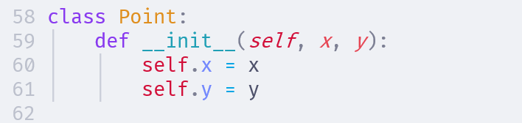
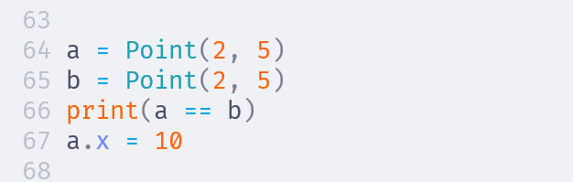
False
Mutable

Slide 24
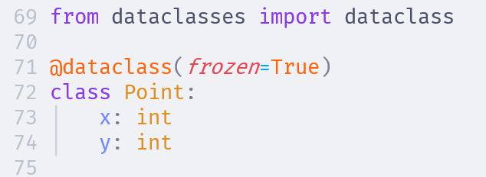
True
Error

Slide 25
Lesson Learned
Be very, very, careful with mutating data. It makes all the other functions that use the same data impure
tuples, numbers and strings are immutable in python
list, dict are mutable, so prefer immutable operations or make a copy and mutate
dataclasses make it easy to make immutable data structures

Slide 26
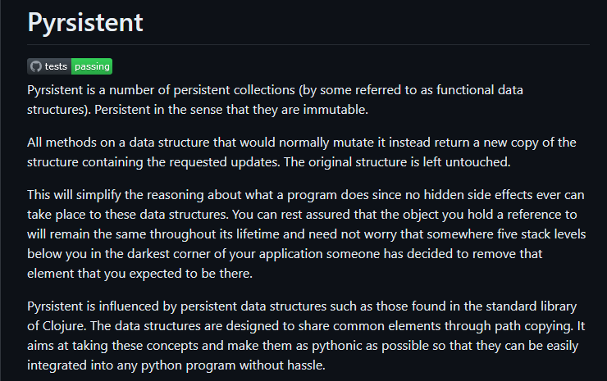
Or pip install pyrsistent

Slide 27
Part 3: Higher Order Fns
Functions that transform functions

Slide 28
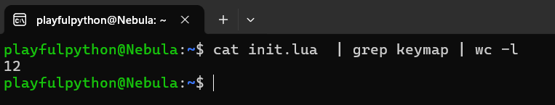
Function composition

Slide 29
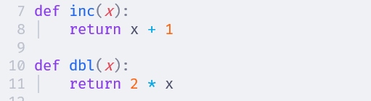
Function composition

Slide 30
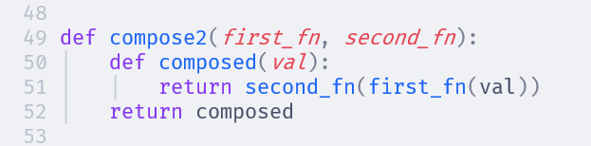

Function composition
Homework Generalise this to compose any number of functions

Slide 31
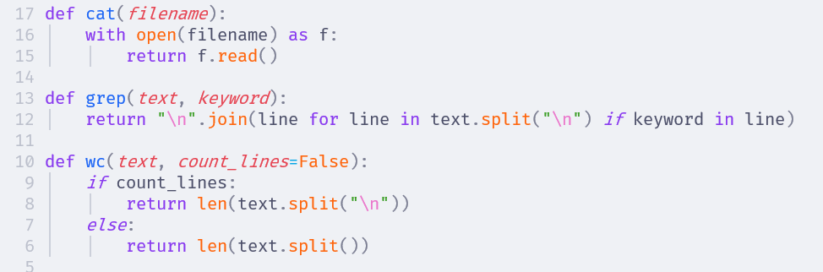
Function composition

Slide 32
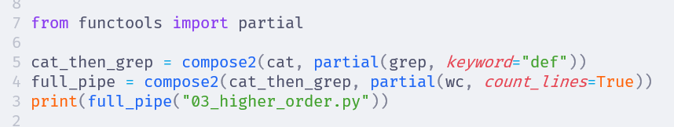
Function composition
Partial application converts a function that takes many arguments into a single argument function

Slide 33
Part 4: Monads
Abstractions for managing context

Slide 34
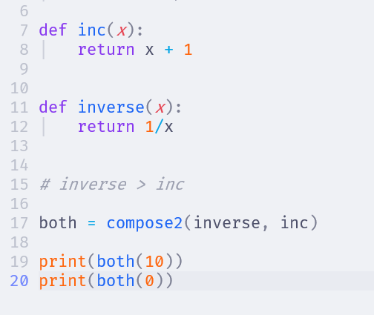

Slide 35
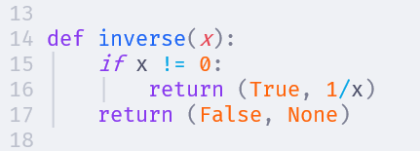
But now, inc() function cannot be composed with this!

Slide 36
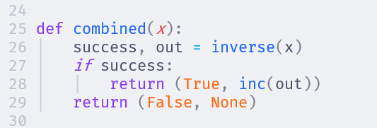
Can we abstract this pattern?

Slide 37
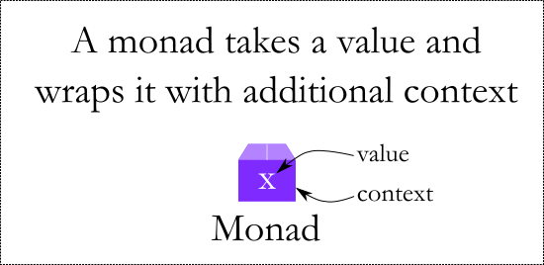
Maybe Monad

Slide 38
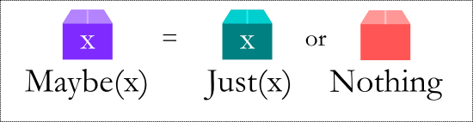
Maybe Monad

Slide 39
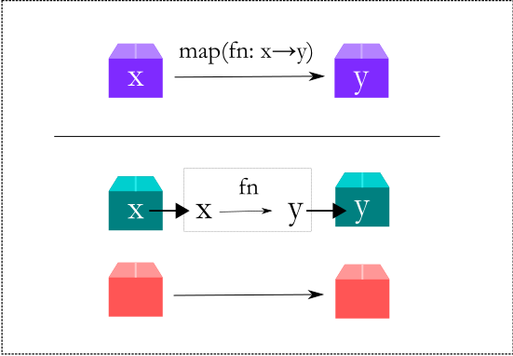
Maybe Monad

Slide 40
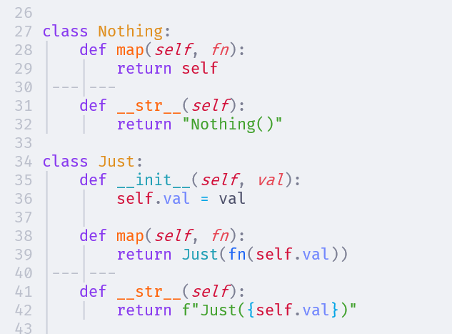

Slide 41
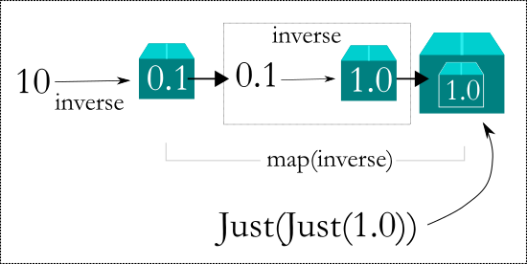
Maybe Monad

Slide 42
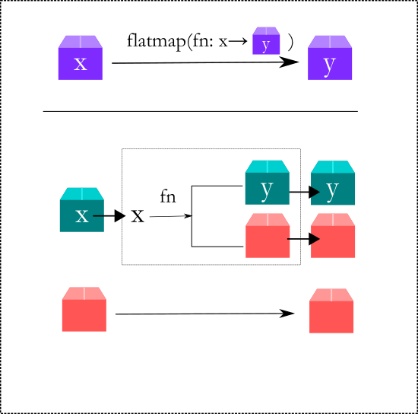
Maybe Monad

Slide 43
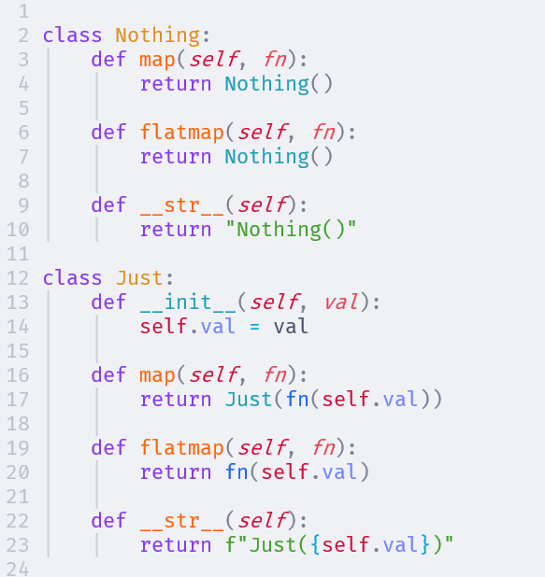

Slide 45
MultiValue Monad
This monad can be used to represent items that can have multiple values
Eg: sqrt returns +x and -x as output
Evaluate all possible solutions for
sqrt(sqrt(sqrt(4) + 2) +2)

Slide 46
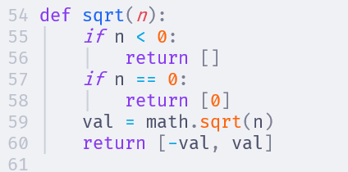

Slide 47
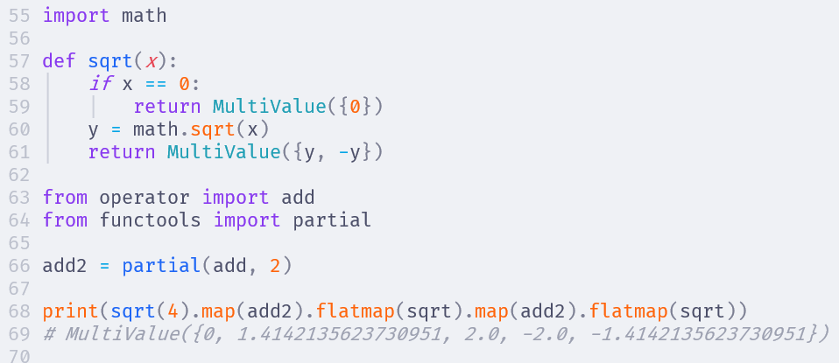

Slide 48
Part 5: Exercise

Slide 49
Blackjack
We start with a deck of regular playing cards.
A deck has 4 suits (Diamonds, Hearts, Clubs, Spades) with 13 cards in each suit.
Each suit has the ranks 2 to 10, plus the Ace, Jack, King and Queen.

Slide 50
Blackjack
A card is worth points:
King, Queen and Jack are worth 10 points
Ace is worth 1 or 11 points, you can choose
Number cards are worth their rank
The score of a hand is the total score of all the cards in the hand

Slide 51
Blackjack
Each turn the player can HIT or STAY. HIT means draw a card from the deck to the hand. STAY means you are done for the round.
Similarly the dealer will also choose to HIT or STAY.
At any point, if either player hand goes above 21 points they BUST and immediately lose. If both players have STAYed then the closest to 21 wins

Slide 52
Data Types
A card has a rank (1 to 13) and a suit (S, H, D, C). We can use a dataclass to represent this
A deck is a list of cards. When we start, the deck has Cards of all possible combinations of rank and suit
A hand is also a list of cards. Although in the code it is the same data type as a deck, conceptually a hand is different from the deck, so we will create a new data type for it

Slide 53
Code organisation
The exercise files are in the project/ directory
We will write code that is applicable to all card games in the file card_games.py
Blackjack specific code will be written in blackjack.py
utils.py contains some helper functions
monads.py contains the monad implementations

Slide 54
Blackjack
Blackjack has a deck of cards
We need to be able to draw cards from the deck and add it to a hand
We need to be able to score the cards in a hand

Slide 55
Getting started
Create a Card dataclass
Create a function to return a new deck
Create a function to shuffle a deck
Create a function to compose the above two and return a shuffled new deck

Slide 56
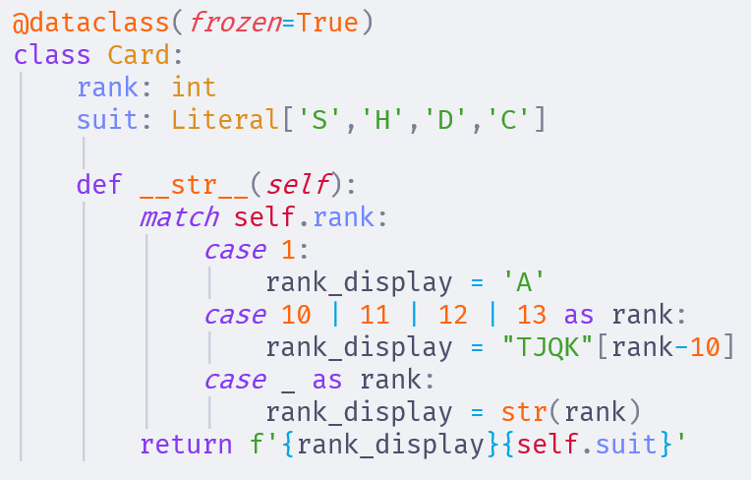

Slide 57
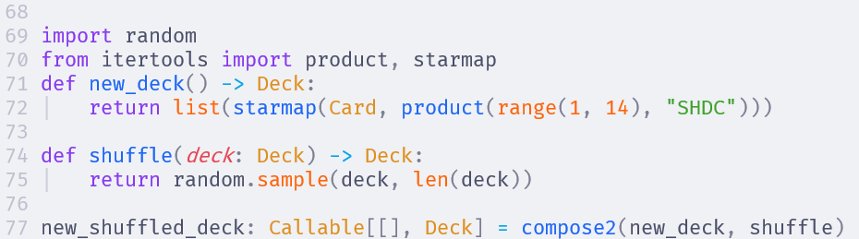

Slide 58
Scoring a hand
Each card has a score
Jack, Queen, King are worth 10 points
Number ranks are worth their number
Ace can be worth 1 point or 11 points, whichever is better for the player
A, K = 21 points
A, A, K = 12 points
A, 8, 5 = 14 points

Slide 59
How to write the scoring algorithm?
We can find all possible sums
Then choose the maximum one that does not bust
A, K = {11, 21}
A, A, K = {12, 22, 32}
8, 7 = {15}
A, 8, 7 = {16, 26}
8, 7, 10 = {25}. Bust

Slide 60
Use MultiValue monad to represent the points
A = MultiValue({1, 11})
K, Q, J = MultiValue({10})
All other = MultiValue({rank})
Total possible value of hand = sum of all points in the hand
Then filter all those values that bust
And choose the max of what is remaining

Slide 61
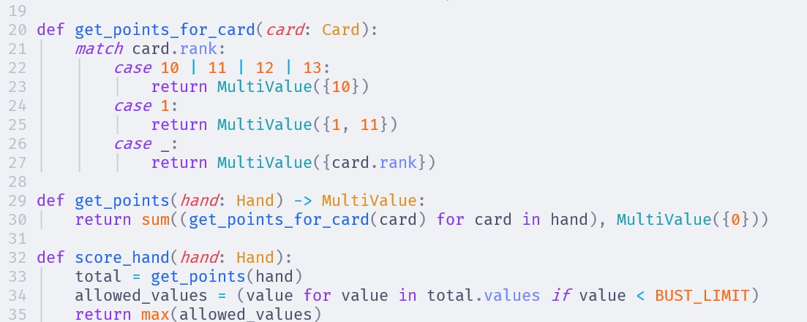

Slide 62
Now to draw a card
Given a deck, we need a function that will take the top card out. Return None if the deck is empty
Then we need another function to add the card to a hand
Finally, we combine both of these in draw_to_hand where it will draw from the deck, and add it to the hand. If the deck is empty then shuffle a new deck

Slide 63
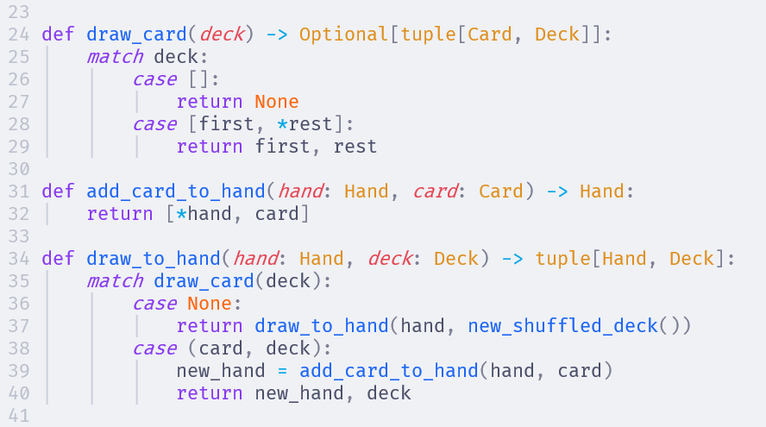

Slide 64
Finally the core game loop
Everything we have so far are pure functions. Now we need the core game loop
Setup the initial game state
List of players: Player, Dealer
Hands of each of the players: []
Deck: A new shuffled deck
And we need actions to get the input from the player and dealer

Slide 65
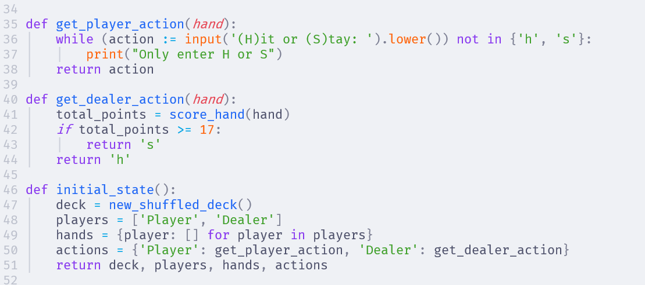

Slide 66
Finally the core game loop
Now we loop through each player one by one
Ask if hit or stay?
If hit, add a card to hand from deck
If now bust, end the game
If stay, remove the player from the list of players
When no more players left, the game is over

Slide 67
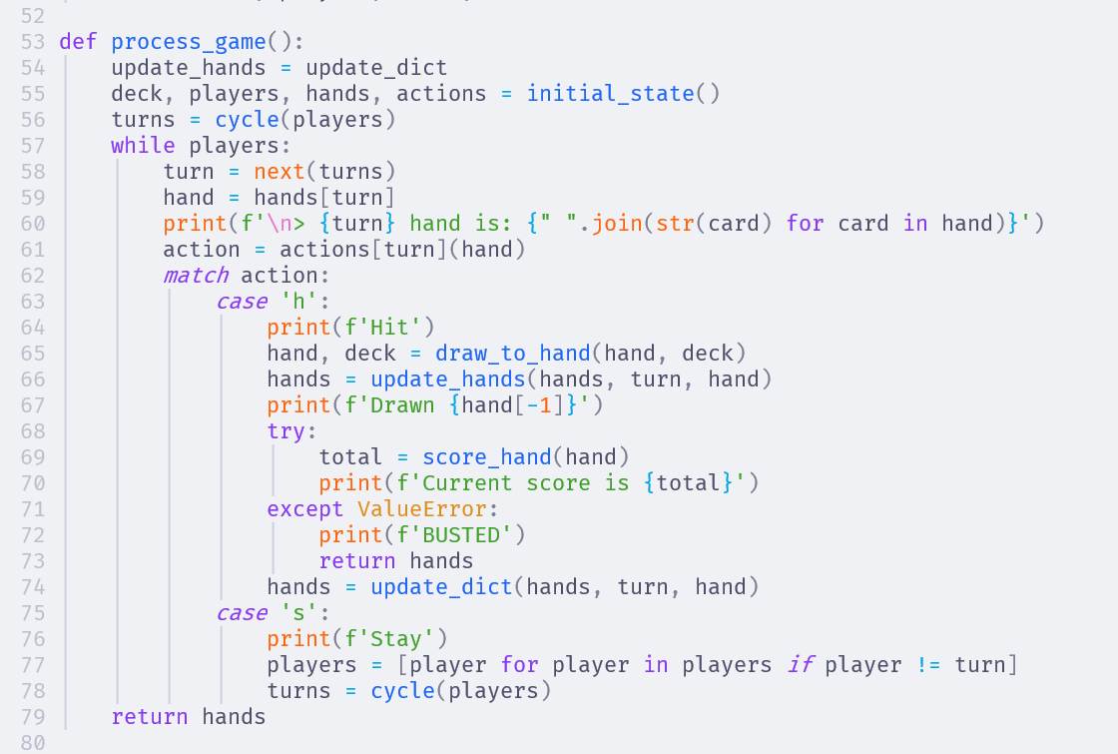

Slide 68
Homework
When a hand is busted, get the score_hand() function raises a ValueError (from the max function)
Typically, functional programming does not use exceptions. We use the Maybe monad to signify an error.
Change the code to use Maybe instead of the exception

Slide 69
Homework
There are a lot of print() everywhere. This is an action. How can we make this code more functional?
See the file blackjack_stream.py for an example how to handle it
Then research the Writer monad which is an abstraction on the same concept

Slide 70
Advanced Homework
What about the place where we ask the user for the input? This is also an action and it is making the core gameplay loop into an action.
How can be get it out of this function so that the core gameplay loop logic becomes a pure function?
Look up how to do coroutines in Python

Slide 71
www.playfulpython.com
@playfulpython
https://www.linkedin.com/in/siddharta/

