Slide 1

Determining Fraudulent Return orders in Reverse Supply Chain
Sprint 2-COMP 680
Presented By
` Group -4

Slide 2
Team & Responsibilities
Venkat Sairam Ravala
(ROFrauddetectionFlow- Backend development and Project Integration)
Sowmya Kasu
(ROFraudDataAnalyser-Backend Development)
Shamera Anjum Paleti
(UI, Database management, Requirement Gathering )
Linga Srikanth Rohan
(Fraud Detection service-Python development)
Guna Yaswanth Gadde
(ReturnOrderSchedulerService-Back End development)

Slide 3

Business Goal
To optimize the refund initiation process for members by leveraging advanced technologies, thereby speeding up the reverse supply chain process and reducing reliance on manual labor.

Slide 4
Sprint 1 vs Sprint 2
Aspect | Sprint 1 | Sprint 2
Objective | Research and select technologies for fraud detection, gather and prepare data, start model development. | Implement technologies to streamline refund processes, enhance fraud detection models, and automate manual tasks.
Business Goal | Study new technologies to identify fraudulent orders to quickly refund honest customers and stop fraud. | Optimize the refund initiation process using advanced technologies to speed up the process and reduce manual labor.
Main Focus | Establishing a foundation in data collection, preliminary analysis, and initial fraud detection setup. | Enhancing operational efficiency and refining the fraud prediction model to better integrate with real-time data flows.
Technologies Used | Focus on AI and machine learning, Kafka for real-time data streaming. | Advanced implementation of Random Forest algorithm, Flask for API, and enhanced use of Kafka and Java services.
User Stories | Develop a project plan, set up Kafka, research algorithms, gather dataset, and design initial architecture. | Maintain database efficiency, implement Java services for data handling, refine fraud detection, and update UI.
Technical Developments | Kafka integration, Random Forest research, and preliminary architecture setup. | Development of Java services for Kafka, REST APIs, UI enhancements, and the use of Python libraries for machine learning.

Slide 5

Sprint 2 Objective
Implement advanced technologies to streamline the refund initiation process, ensuring a seamless experience for members.
Reduce the time taken to process returns by automating manual tasks and introducing efficient workflows.
Develop a fraud prediction model using machine learning algorithms to identify potentially fraudulent return orders.
Calculate return scores to validate the credibility of members and prioritize refund processing accordingly.
Enhance operational efficiency by minimizing the dependency on manpower and improving overall process efficiency.

Slide 6

User Stories
To configure and maintain tables in a MySQL database to store return order related data efficiently.
To implement a scheduled task or event listener in Java to read data from the return order tables at regular intervals and trigger Kafka events with the return order data.
To filter return orders based on the "return_order_condition" column to identify orders that require further processing.
As a fraud detection task, to consume Kafka messages containing return order data and analyze each order to determine if it is Low Value Return (LVR) or Non-LVR based on the product price.
To calculate the return score for each customer based on their past return history and update the customer's score in the database.

Slide 7
User Stories
As a fraud detection task, we want to predict whether a return order is fraudulent or not using machine learning algorithms such as Random Forest based on a provided dataset.
To update the return order database with the predicted fraud status, return score, and refund mode (AUTO or Fraud_Manual) after performing fraud detection.
Design UI screen to view all return orders, including fraudulent return orders, displayed in a user-friendly format.
As a user, I want a UI form to input new return order records into the database, including order details such as order number, customer ID, product price, and return order condition.

Slide 8
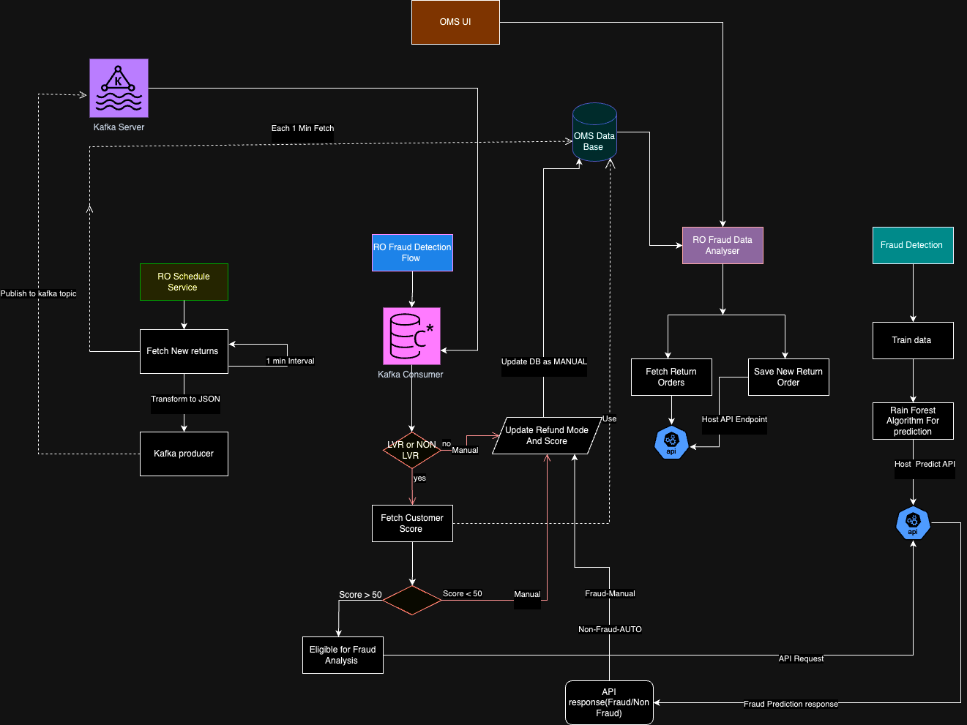
Fraud detection Service Process Flow

Slide 9
Technical Task Breakdown
Java services for Kafka consumer and producer
Java Spring Boot services for REST API to fetch orders and save orders for UI
HTML and JavaScript for UI page
Python libraries (such as pandas, scikit-learn) for Random Forest algorithm training
Flask for API hosting from Python for prediction results
REST API calls for prediction (e.g., using Python's requests library)
Mysql Workbench
Anaconda Distribution
IntelliJ IDEA,Postman

Slide 10
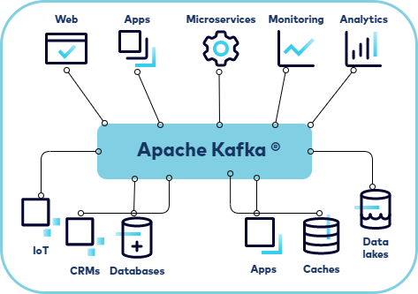
KAFKA
Kafka is often used for operational monitoring data..
It helps separate the systems that create messages from those that read them, making it better at dealing with live data compared to traditional messaging systems like Active MQ.
Kafka is reliable, can grow with your needs, and keeps data safe.
It's great for analyzing data as it comes in, organizing logs, keeping track of website clicks, spotting fraud, and managing large amounts of data in real time.
Major Responsibilities of Kafka:
Messaging
Website Activity Tracking
Metrics
Log Aggregation
Steam Processing
Event Sourcing
Commit Log

Slide 11
Launching Kafka Server
As we need to monitor real data for regular intervals, the server is set to be trigger a Kafka event with return order data.
In order to do so, we need to start both Zookeeper & Apache Kafka servers.
Scripts to Executed:
.\bin\windows\zookeeper-server-start.bat .\config\zookeeper.properties
.\bin\windows\kafka-server-start.bat .\config\server.properties
.\bin\windows\kafka-topics.bat --create --topic return-order-data --bootstrap-server localhost:9092 --replication-factor 1 --partitions 1

Slide 12
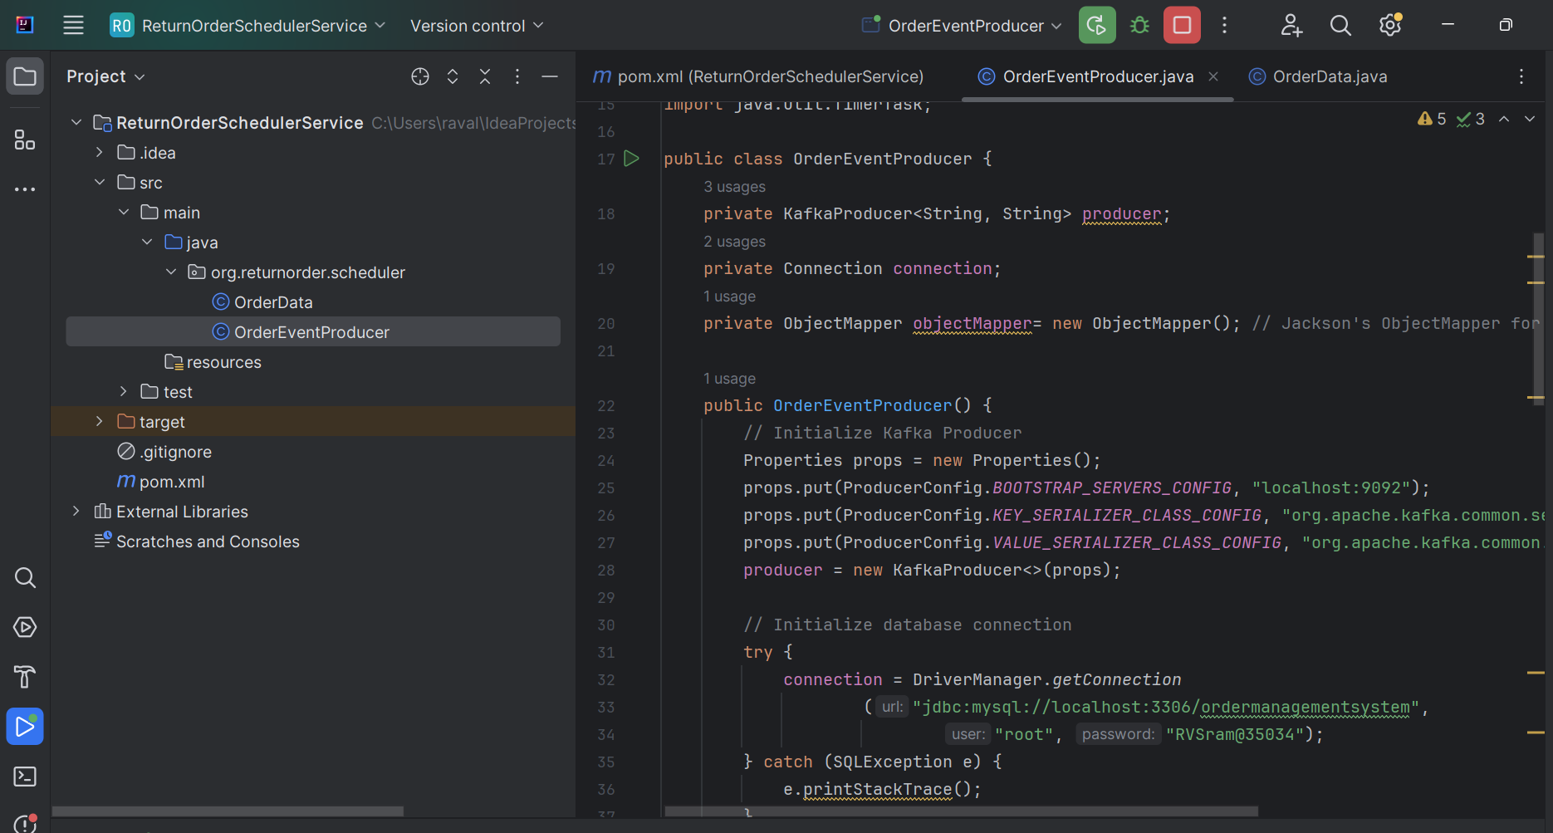
Services developed
1) ReturnOrderSchedulerService-Java, Maven

Slide 13
Implementation Approach
(ReturnOrderSchedulerService)
Initialize Kafka Producer:
  Create a Kafka producer with the specified properties.
  Set up the necessary configurations such as bootstrap servers and serializers.
Initialize Database Connection:
  Establish a connection to the MySQL database.
  Handle any potential SQLExceptions that may occur during the connection setup.
Schedule Periodic Task:
  Use a Timer to schedule the FetchAndSendDataTask at regular intervals.
  Configure the interval based on the desired frequency (e.g., every minute).
Send Order Data to Kafka:
  Implement the sendOrderData method to publish order data to the Kafka topic.
  Use the Kafka producer to send a ProducerRecord containing the order data.
  Flush the producer to ensure all pending records are sent.

Slide 14
Implementation Approach
(ReturnOrderSchedulerService)
Fetch and Send Data Task:
  Define the FetchAndSendDataTask class as a nested class within OrderEventProducer.
  Extend TimerTask and implement the run method to execute the task logic.
  Execute a SQL query to fetch return orders from the database where certain conditions are met.
  Iterate over the result set and extract order data.
  Convert the order data to JSON format using Jackson's ObjectMapper.
  Publish the JSON-formatted order data to the Kafka topic using the sendOrderData method.
Convert to JSON:
  Implement the convertToJson method to serialize the OrderData object to JSON.
  Handle any potential JsonProcessingException that may occur during serialization.

Slide 15
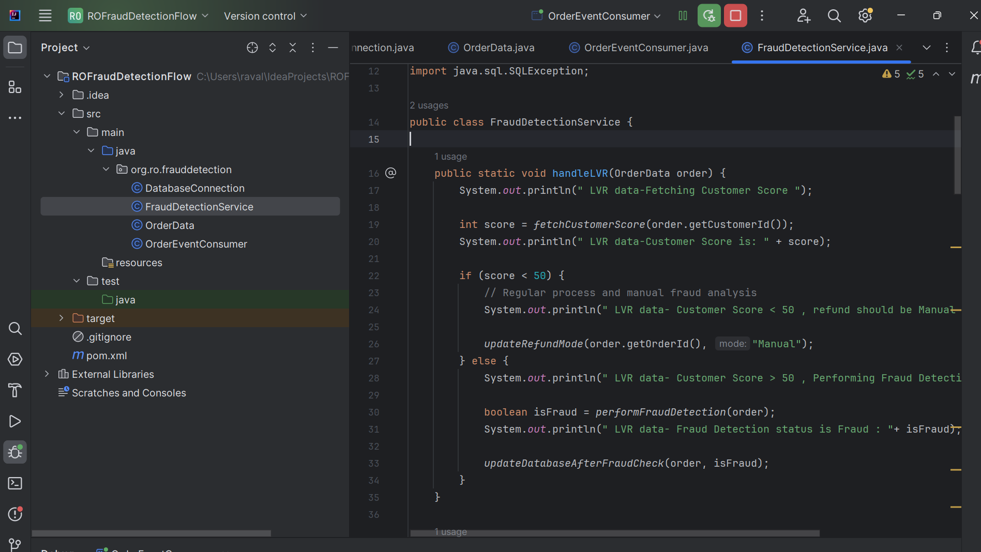
Services developed
2) ROFrauddetectionFlow-Java,Maven

Slide 16
Implementation Approach
(ROFrauddetectionFlow-Fraud Detection Flow Algorithm)
Checking whether returned item is of LVR(<20) or not and Handle LVR (Low-Value Return) Orders:
  Fetch the customer score from the database based on the customer ID.
  If the customer score is less than 50:
    Set the refund mode to "Manual".
  If the customer score is greater than or equal to 50:
    Perform fraud detection.
Handle NON-LVR Orders:
  Set the refund mode to "Manual".
Fetch Customer Score:
  Execute a SQL query to retrieve the return score of the customer from the database based on the customer ID.
  If the score exists, return it; otherwise, return -1.
Perform Fraud Detection:
  Send a POST request to the fraud detection API endpoint (http://localhost:5000/predict) with the order data.
  Receive the prediction response.
  Parse the response to determine if the order is predicted as fraud.

Slide 17
Implementation Approach
(ROFrauddetectionFlow-Fraud Detection Flow Algorithm)
Update Database After Fraud Check:
  Update the return order condition in the database based on the fraud detection result (fraud or non-fraud).
  Update the refund mode accordingly (either "Fraud_Manual" or "AUTO").
  If the order is detected as fraud, deduct 10 points from the customer's return score.
  Print a message confirming the updates.
Update Return Order Condition:
  Execute a SQL update query to update the return order condition in the database based on the order ID.
Update Refund Mode:
  Execute a SQL update query to update the refund mode in the database based on the order ID.
Update Return Score:
  Execute a SQL update query to adjust the customer's return score in the database based on the customer ID
  and the specified adjustment value.

Slide 18
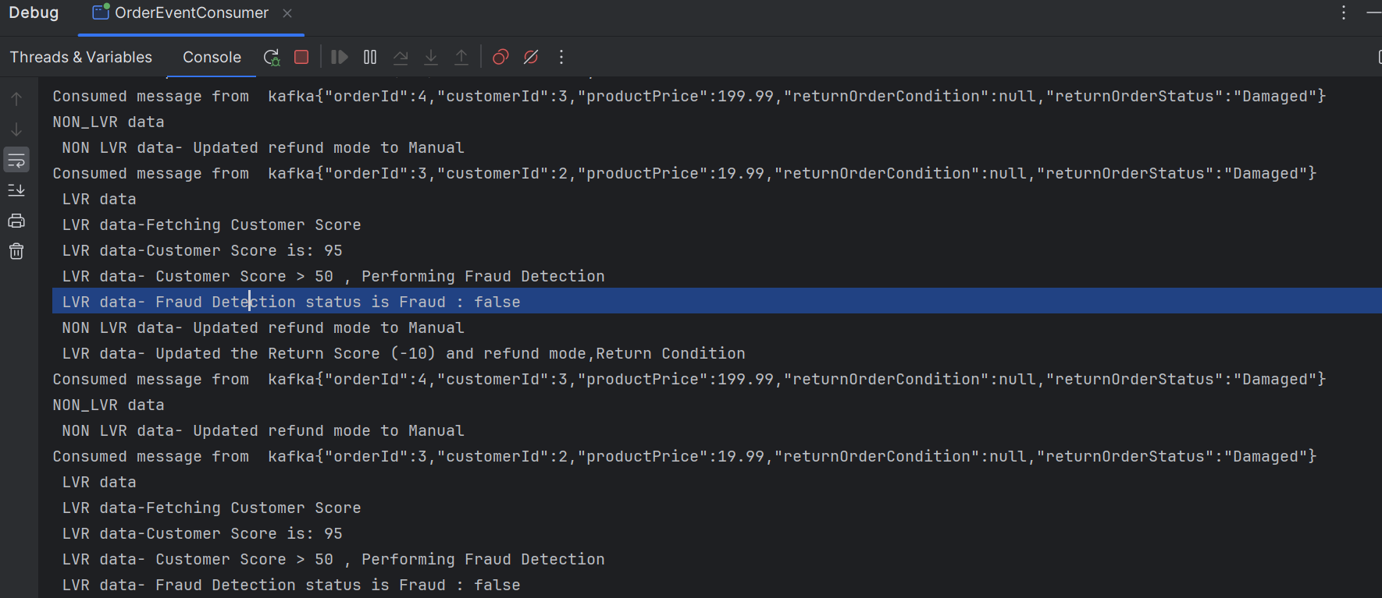
Prediction result from ROFrauddetectionFlow

Slide 19
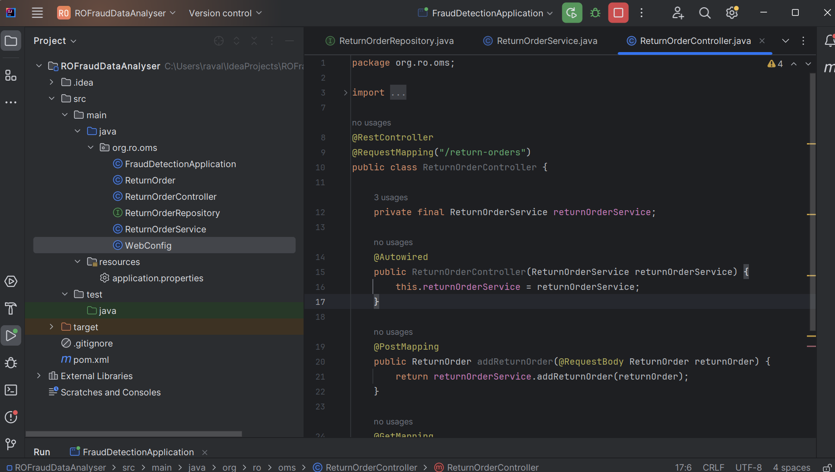
Services developed
3) ROFraudDataAnalyser- Java,SpringBoot,Maven,JPA,Rest API

Slide 20
Implementation Approach
(ROFraudDataAnalyser)
Add Return Order Endpoint (@PostMapping):
  Implement the addReturnOrder method, annotated with @PostMapping.
  Define the method to accept a ReturnOrder object as the request body (@RequestBody annotation).
  Delegate the processing of adding the return order to the ReturnOrderService.
  Return the added return order as the response.
Get All Return Orders Endpoint (@GetMapping):
  Implement the getAllReturnOrders method, annotated with @GetMapping.
  Define the method to fetch all return orders from the service layer using returnOrderService.
  Return the list of return orders as the response.

Slide 21
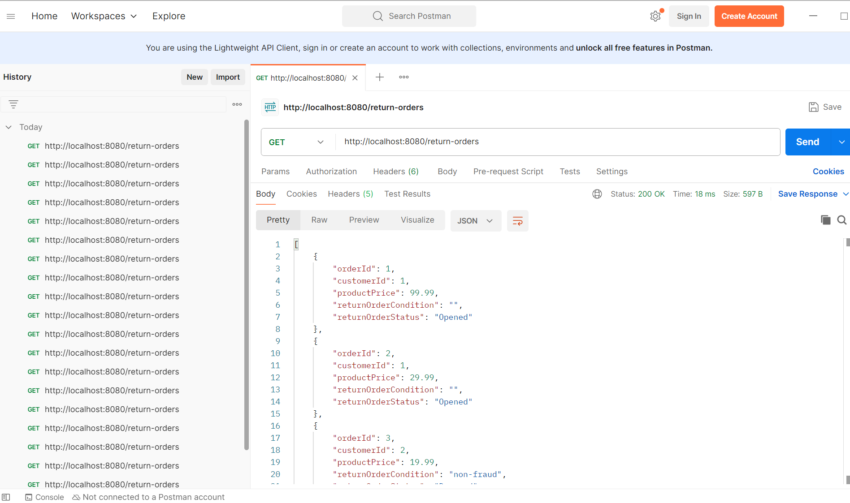
Api response from ROFraudDataAnalyser

Slide 22
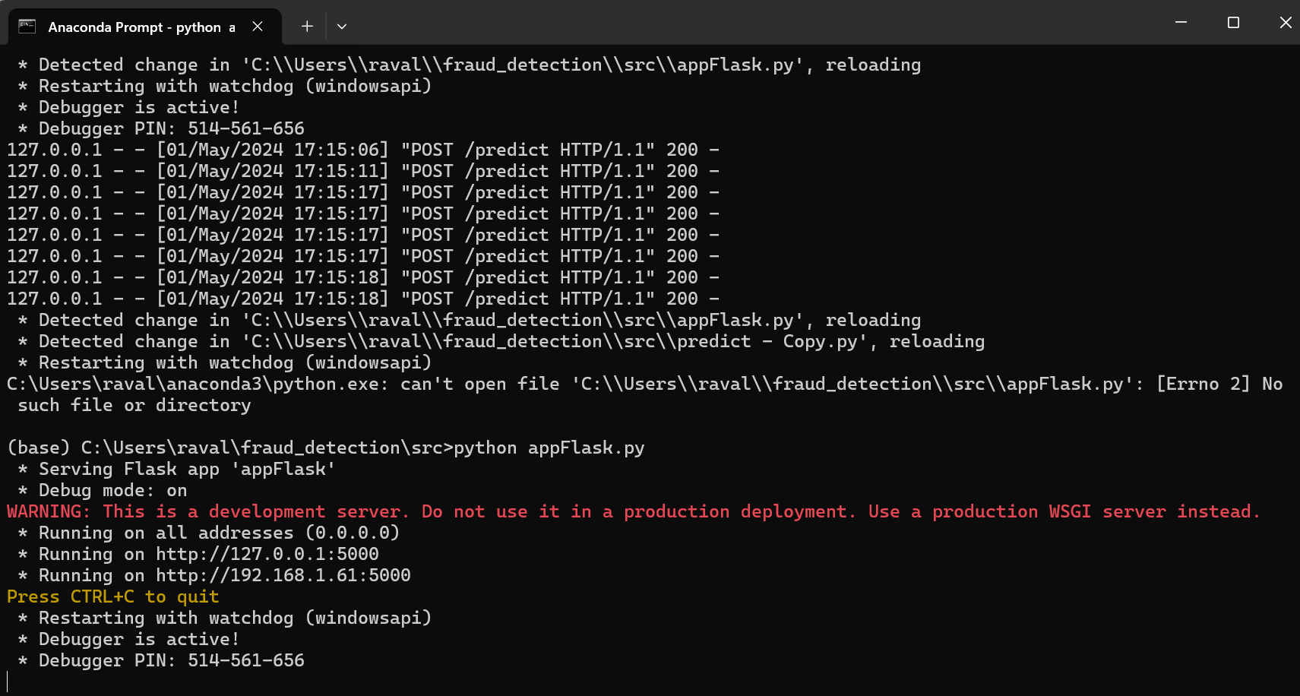
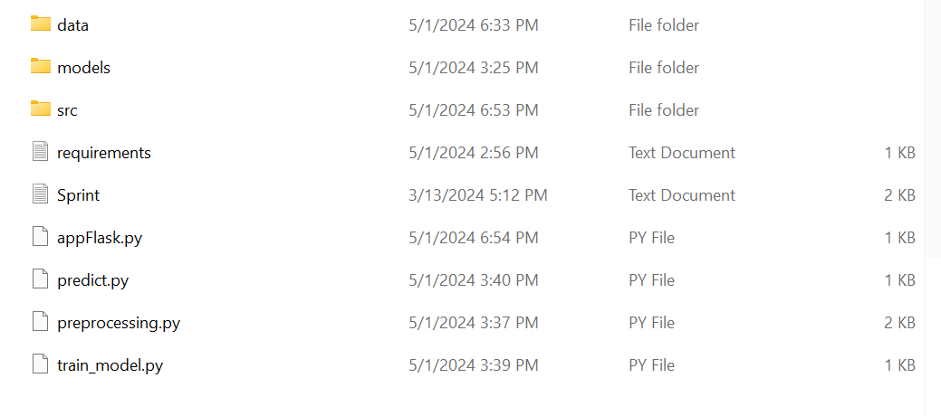
Services developed
4)fraud-detection(python, Random forest Algorithm)

Slide 23
Why we chosen Random Forest Algorithm?
Feature | Random Forest | K-Nearest Neighbors (KNN) | Logistic Regression
Model Type | Ensemble of decision trees | Instance-based learning | Statistical model based on regression techniques
Handling Non-Linearity | Excellent (can model complex relationships with interactions between features) | Good (can capture complex patterns but requires careful tuning of the distance metric) | Poor (models only linear relationships unless extended)
Feature Importance | Provides a built-in way to assess feature importance | No inherent method for feature importance | Coefficients can provide insights into feature importance
Robustness to Overfitting | High (especially with a large number of trees and proper tuning) | Low (sensitive to noisy data and outliers) | Moderate (can overfit but regularization techniques are available to mitigate this)
Handling Mixed Data Types | Handles both numerical and categorical data naturally | Requires numerical input; categorical features must be encoded | Primarily handles numerical inputs; categorical data must be binary or encoded
Scalability | Good (parallelizable across multiple trees) | Poor (computationally expensive as it requires storing all instances) | Excellent (efficient with large datasets)
Ease of Interpretation | Moderate (individual trees are interpretable, but ensemble results are harder to interpret) | Moderate (intuitive method, but interpretation becomes difficult with many dimensions) | High (model output and coefficients are straightforward to interpret)
Preprocessing Needs | Minimal (no need for feature scaling, handles missing values) | High (needs feature scaling, sensitive to irrelevant features) | Moderate (requires feature scaling for optimal performance, handles binary inputs)

Slide 24
Implementation Approach
(fraud-detection)
appFlask.py: Defines a Flask web application with a /predict endpoint to process data and predict fraud using a loaded RandomForest model and preprocessor.
predict.py: Contains functions for loading models, preparing input data, and making predictions, with example usage demonstrated in the script.
preprocessing.py: Manages data loading, preprocessing with one-hot encoding for categorical data, and data splitting into training and testing sets.
train_model.py: Orchestrates the training of a RandomForest model using preprocessed data, followed by saving the model and preprocessor together for later use.
These scripts form an end-to-end machine learning pipeline from data processing and model training to prediction serving via a web API.

Slide 25
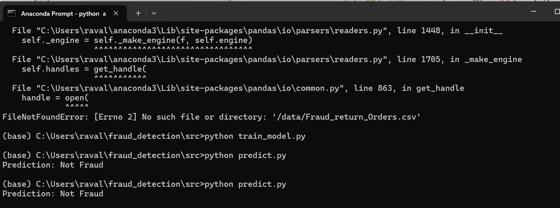
Prediction result from fraud-detection

Slide 26
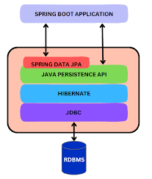
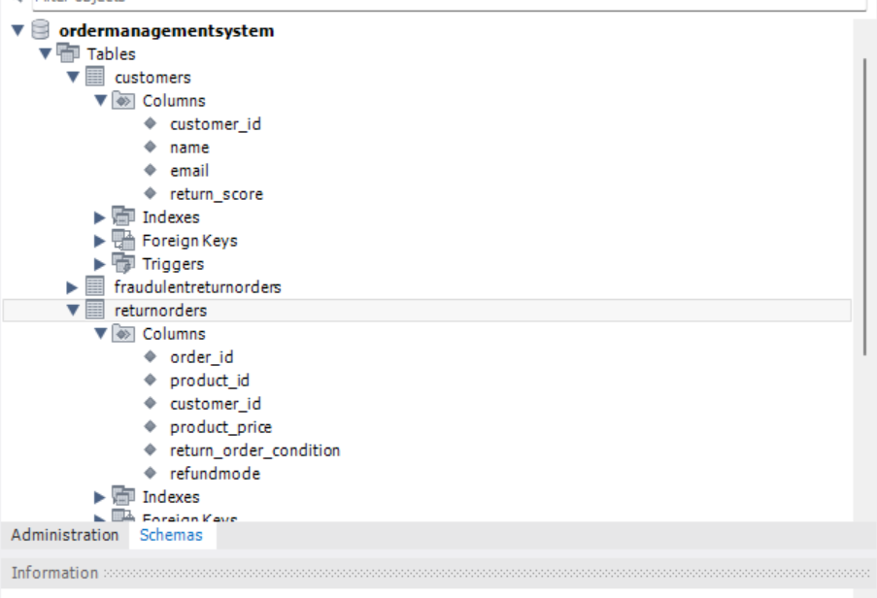


Database

Slide 27
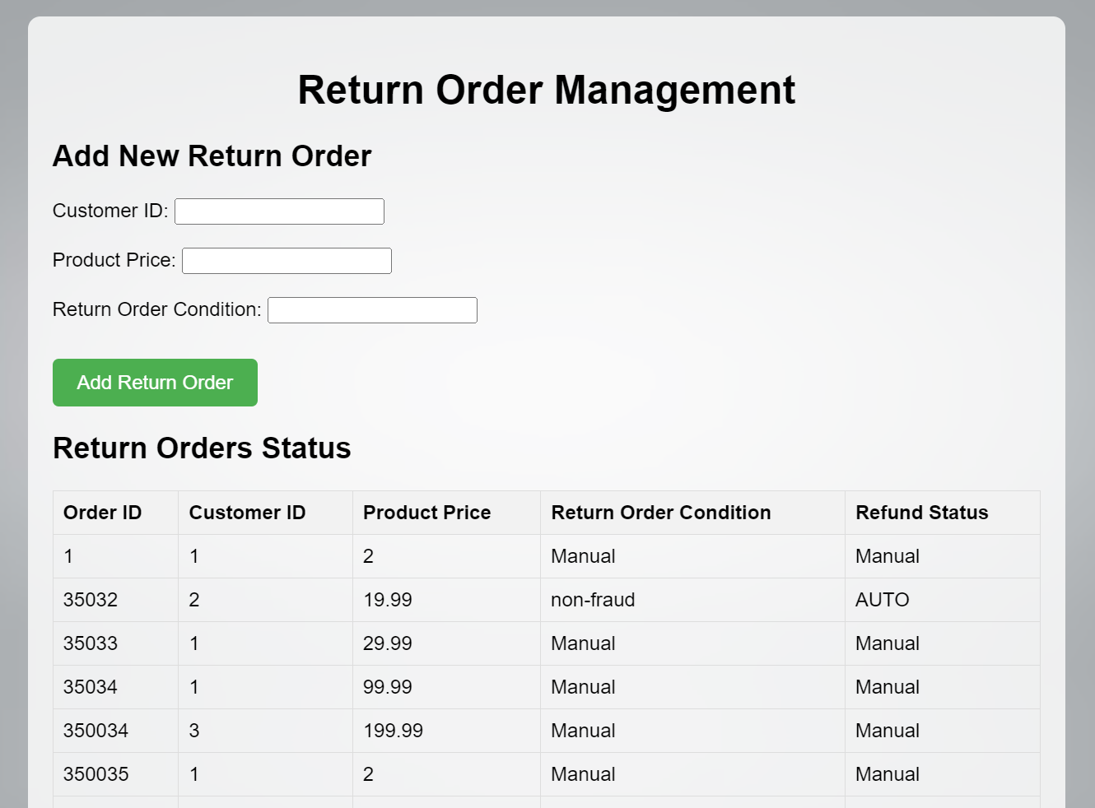
UI For Return order Analysis

Slide 28
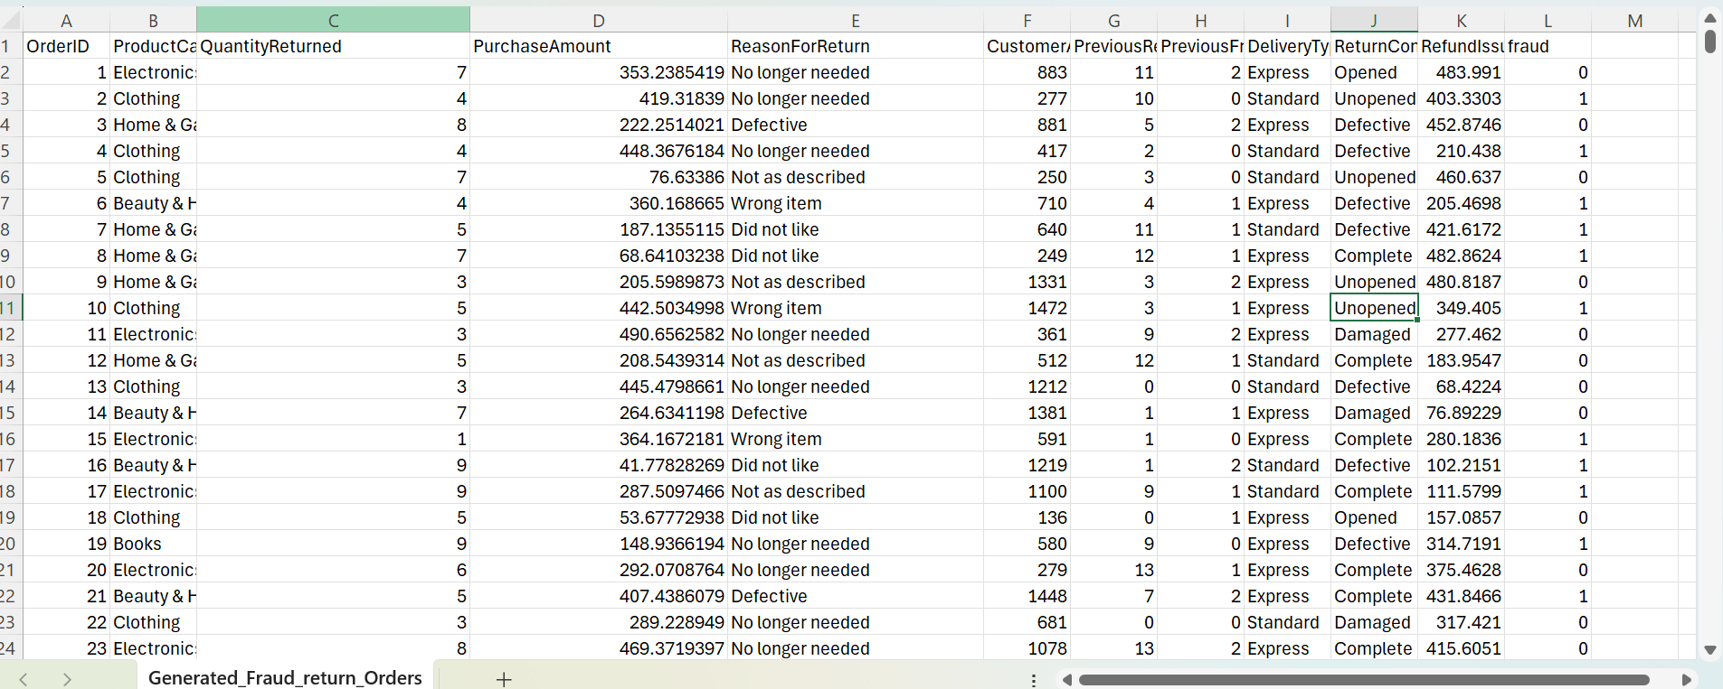
Dataset

Slide 29

Demo

Slide 30

Q &A

