Slide 1

Fundamental of Electrical and Electronics Engineering
Syllabus
Module-1: D.C. Circuits
Voltage and Current Sources , KCL, KVL , Loop and Nodal Equations , Network Theorems. Star Delta Transformations , Simple Series and Parallel Circuits.
Module-2:A.C.Circuits
Alternating Quantities, RMS and Average Value, Phase, Phase Difference , Power and Power Factor , Series and Parallel AC Circuits , Resonance , Faraday’s Law of Electromagnetic Induction.

Slide 2
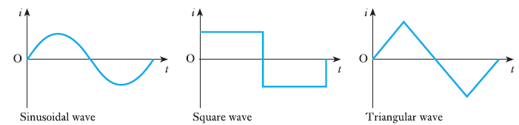
Fundamental of Electrical and Electronics Engineering
Alternating quantities
Alternating system – in which the magnitudes of the voltage and of the current vary in a repetitive manner.

Slide 3
Fundamental of Electrical and Electronics Engineering
Alternating quantities
Alternating current can be abbreviated to a.c., hence a system with such an alternating current is known as an a.c. system. The curves relating current to time are known as waveforms.

Slide 4
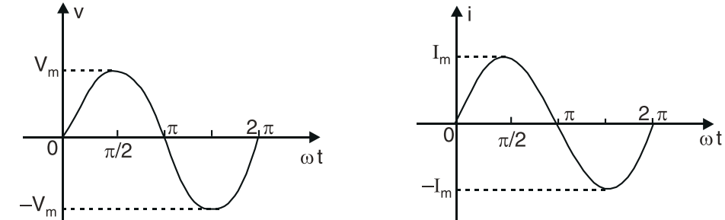
Fundamental of Electrical and Electronics Engineering
Sinusoidal voltage
A voltage which changes its polarity at regular intervals of time is called sinusoidal voltage.
When an alternating voltage is applied in a circuit, the current flows first in one direction and then in the opposite direction; the direction of current at any instant depends upon the polarity of the voltage.

Slide 5
Fundamental of Electrical and Electronics Engineering
Sinusoidal voltage
The sine waveform produces the least disturbance in the electrical circuit and is the smoothest and efficient waveform.
The mathematical computations, connected with alternating current work, are much simpler with this waveform.
Compatibility with generator and AC motor: Many power generators, such as generators driven by rotating turbines or alternators, naturally produce sinusoidal voltages.

Slide 6
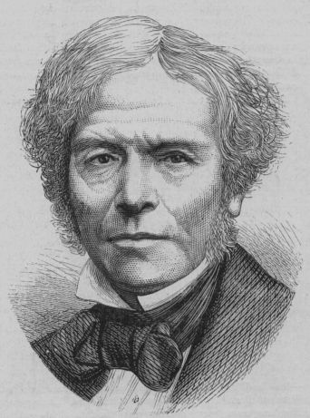
Fundamental of Electrical and Electronics Engineering
Electromagnetic induction
When the magnetic flux linking a conductor changes, an e.m.f. is induced in the conductor. If the conductor forms a complete loop or circuit, a current will flow in it. This phenomenon is known as electromagnetic induction.
Michael Faraday first discovered it, using some of the works of Hans Christian Oersted. His work started at first using different combinations of wires and magnetic strengths and currents, but it wasn't until he tried moving the wires that he got any success.

Slide 7
Fundamental of Electrical and Electronics Engineering
Electromagnetic induction
The basic requirement for inducing e.m.f. in a coil is not the magnetic flux linking the coil but the change in flux linking the coil. No change in flux, no e.m.f. induced in the coil.
The change in flux linking the coil can be brought about in two ways. First, the conductors (or coils) are moved through a stationary magnetic field. Secondly, the conductors are stationary, and the magnetic field is moving. In either case, the basic principle is the same i.e. the amount of flux linking the conductors (or coils) is changed.
The e.m.f. and hence current in the conductors (or coils) will persist so long as the magnetic flux linking them is changing.

Slide 8
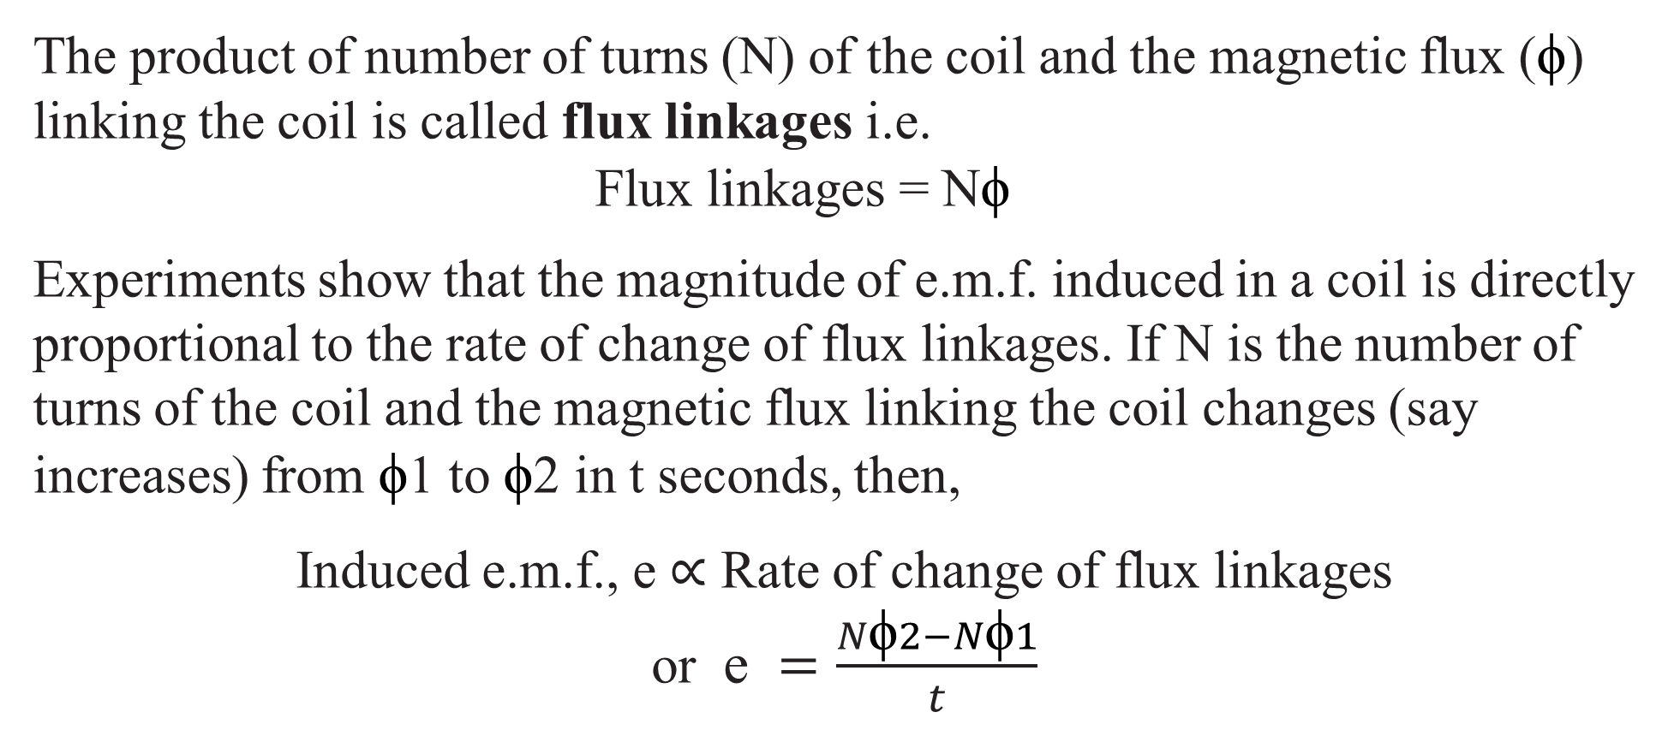
Fundamental of Electrical and Electronics Engineering
Electromagnetic induction
The product of number of turns (N) of the coil and the magnetic flux (ϕ) linking the coil is called flux linkages i.e.
Flux linkages = N$\text{ϕ}$
Experiments show that the magnitude of e.m.f. induced in a coil is directly proportional to the rate of change of flux linkages. If N is the number of turns of the coil and the magnetic flux linking the coil changes (say increases) from ϕ1 to ϕ2 in t seconds, then,
Induced e.m.f., e ∝ Rate of change of flux linkages
or e $=\frac{N\text{ϕ}2−N\text{ϕ}1}{t}$

Slide 9
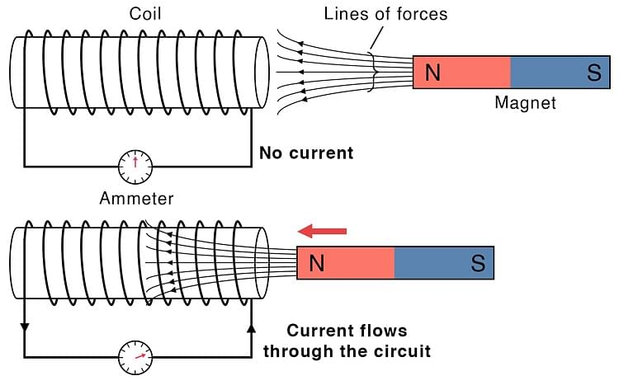
Fundamental of Electrical and Electronics Engineering
Electromagnetic induction
It turns out that electromagnetic induction is created by just that - the moving of a conductive substance through a magnetic field.

Slide 10
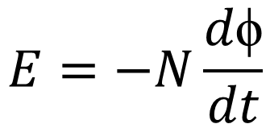
Fundamental of Electrical and Electronics Engineering
Electromagnetic induction
It states that the magnitude of EMF induced in the coil is directly proportional to the rate of change of magnetic flux associated with that coil.
$$E=−N\frac{d\text{ϕ}}{dt}$$

Slide 11
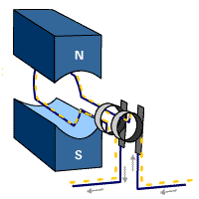
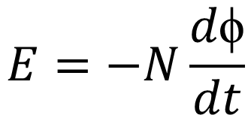
Fundamental of Electrical and Electronics Engineering
Electromagnetic induction
Lenz’s Law
The induced electromotive force with different polarities induces a current whose magnetic field opposes the change in magnetic flux through the loop in order to ensure that the original flux is maintained through the loop when current flows in it.
$$E=−N\frac{d\text{ϕ}}{dt}$$

Slide 12
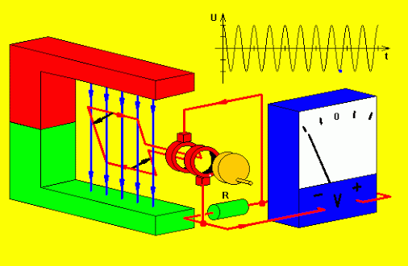
Fundamental of Electrical and Electronics Engineering
Electromagnetic induction

Slide 13
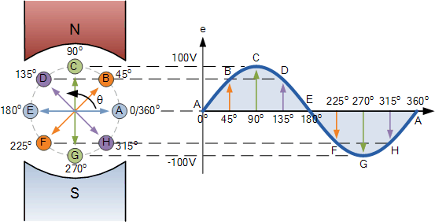
Fundamental of Electrical and Electronics Engineering
Electromagnetic induction

Slide 14
Fundamental of Electrical and Electronics Engineering
Waveform terms and definitions
Waveform. The shape of the curve obtained by plotting the instantaneous values of voltage or current as ordinate against time as abcissa is called its waveform or waveshape.
Instantaneous value. The value of an alternating quantity at any instant is called instantaneous value. The instantaneous values of alternating voltage and current are represented by v and i respectively.
Cycle. One complete set of positive and negative values of an alternating quantity is known as a cycle.

Slide 15
Fundamental of Electrical and Electronics Engineering
Waveform terms and definitions
Time period. The time taken in seconds to complete one cycle of an alternating quantity is called its time period.
Frequency. The number of cycles that occur in one second is called the frequency (f) of the alternating quantity.
Amplitude. The maximum value (positive or negative) attained by an alternating quantity is called its amplitude or peak value.

Slide 16
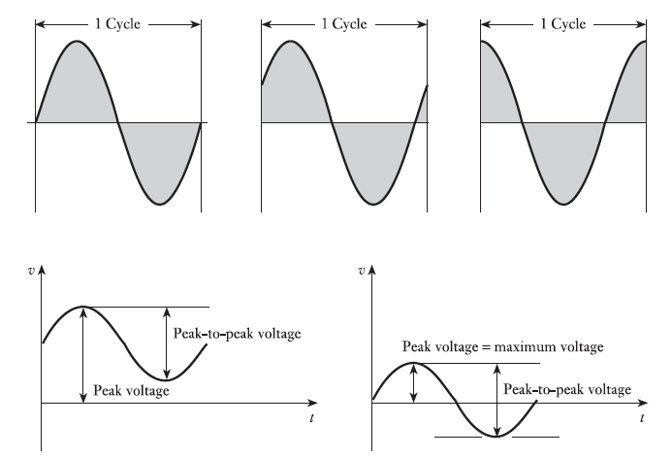
Fundamental of Electrical and Electronics Engineering

Slide 17
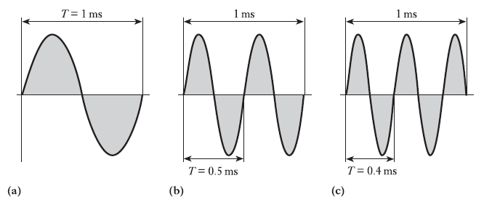
Fundamental of Electrical and Electronics Engineering

Slide 18
Fundamental of Electrical and Electronics Engineering
In a d.c. system, the voltage and current are constant so that there is no problem of specifying their magnitudes.
However, an alternating voltage or current varies from instant to instant. A natural question arises how to express the magnitude of an alternating voltage or current. There are four ways of expressing it, namely
(i) Peak value (iii) R.M.S. value or effective value | (ii) Average value or mean value (iv) Peak-to-peak value

Slide 19
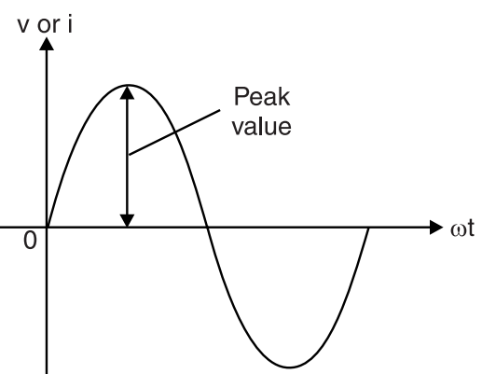
Fundamental of Electrical and Electronics Engineering
Peak value
It is the maximum value attained by an alternating quantity. The peak or maximum value of an alternating voltage is represented by V_{m}. The knowledge of peak value is important in case of testing materials. However, peak value is not used to specify the magnitude of alternating voltage or current. Instead, we generally use r.m.s. values to specify alternating voltages and currents.

Slide 20
Fundamental of Electrical and Electronics Engineering
Average value
The average value of a waveform is the average of all its values over a period of time. In performing such a computation, we regard the area above the time axis as positive area and area below the time axis as negative area. The algebraic signs of the areas must be taken into account when computing the total (net) area.

Slide 21

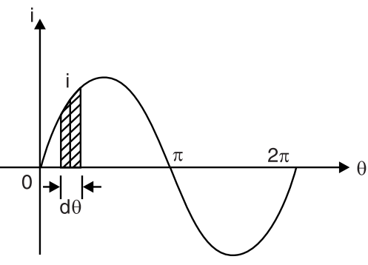
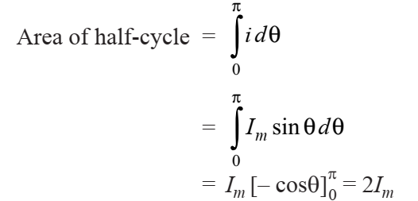
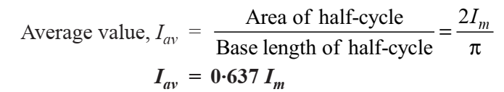
Fundamental of Electrical and Electronics Engineering
Average value

Slide 22
Fundamental of Electrical and Electronics Engineering
RMS value
The average value cannot be used to specify a sinusoidal voltage or current. It is because its value over one-cycle is zero and cannot be used for power calculations.
Therefore, we must search for a more suitable criterion to measure the effectiveness of an alternating current (or voltage). The obvious choice would be to measure it in terms of direct current that would do work (or produce heat) at the same average rate under similar conditions. This equivalent direct current is called the root-mean-square (r.m.s.) or effective value of alternating current.

Slide 23
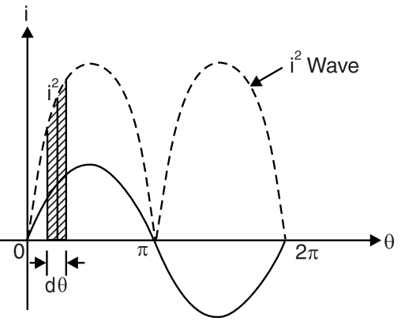
Fundamental of Electrical and Electronics Engineering
RMS value
The effective or r.m.s. value of an alternating current is that steady current (d.c.) which when flowing through a given resistance for a given time produces the same amount of heat as produced by the alternating current when flowing through the same resistance for the same time.

Slide 24
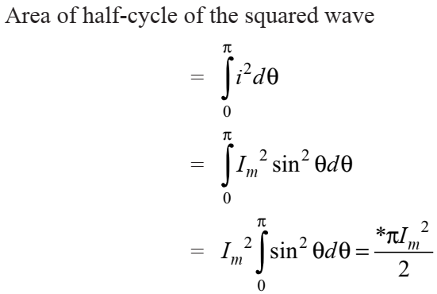
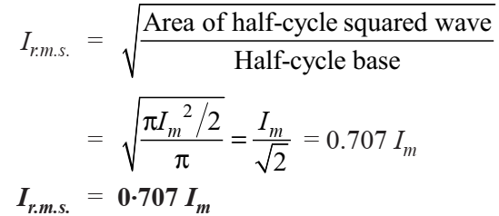
Fundamental of Electrical and Electronics Engineering
RMS value

Slide 25

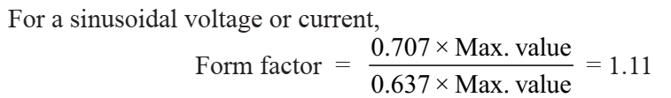
Fundamental of Electrical and Electronics Engineering
Form factor
Form factor. The ratio of r.m.s. value to the average value of an alternating quantity is known as form factor.
The form factor gives a measure of the “peakiness” of the waveform. The peakier the wave, the greater is its form factor and vice-versa. For instance, a sine wave is peakier than a square wave. Hence the former has a greater form factor (1·11) than the latter. Similarly, a triangular wave is more peaky than a sine wave and has a form factor of 1·15.

Slide 26

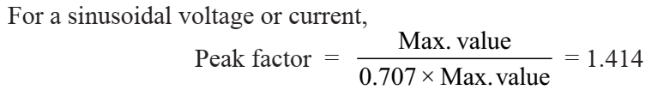
Fundamental of Electrical and Electronics Engineering
Peak factor
Peak factor. The ratio of maximum value to the r.m.s. value of an alternating quantity is known as peak factor
The peak factor is of much greater importance because it indicates the maximum voltage being applied to the various parts of the apparatus. For instance, when an alternating voltage is applied across a cable or capacitor, the breakdown of insulation will depend upon the maximum voltage. The insulation must be able to withstand the maximum rather than the r.m.s. value of voltage.

Slide 27
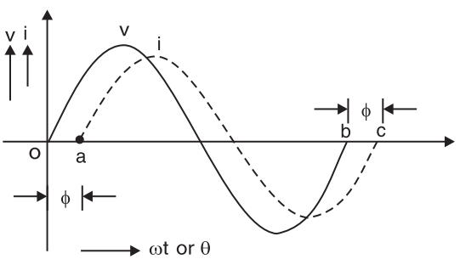
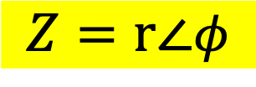
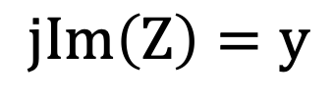

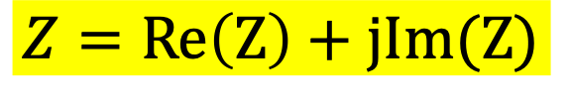
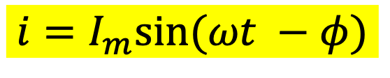
Fundamental of Electrical and Electronics Engineering
Phase and phase difference
A complex number that represents the amplitude and phase of the sinusoid is called the phasor.
Polar form of complex number
Rectangular form of complex form
$$Z=r\text{∠}φ$$
$$Z=Re\left(Z\right)+jIm(Z)$$
$$Re\left(Z\right)=x$$
$$jIm\left(Z\right)=y$$
$$i=I_{m}sin⁡(ωt −φ)$$

Slide 28
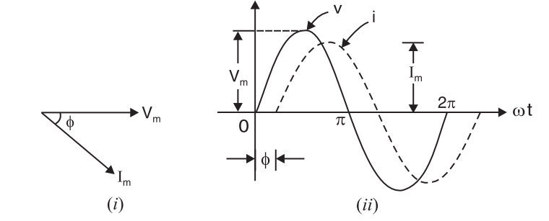


Fundamental of Electrical and Electronics Engineering
Phase and phase difference
When two alternating quantities of the same frequency have different zero points, they are said to have a phase difference.
$$v=V_{m}sin⁡(ωt)$$
$$i=I_{m}sin⁡(ωt −φ)$$

Slide 29
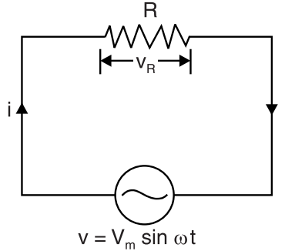

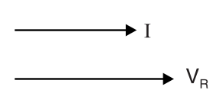


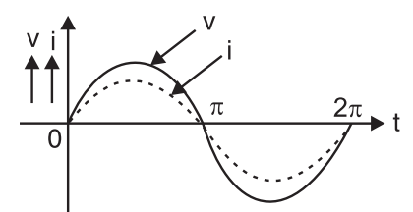

Fundamental of Electrical and Electronics Engineering
Phase and phase difference

Slide 30
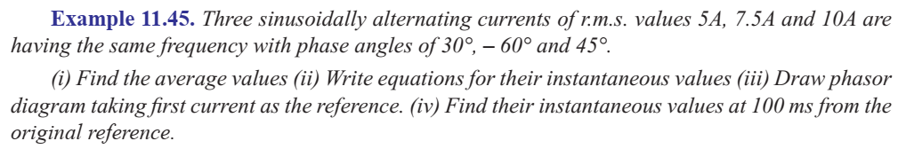
Fundamental of Electrical and Electronics Engineering
Phase and phase difference

Slide 31
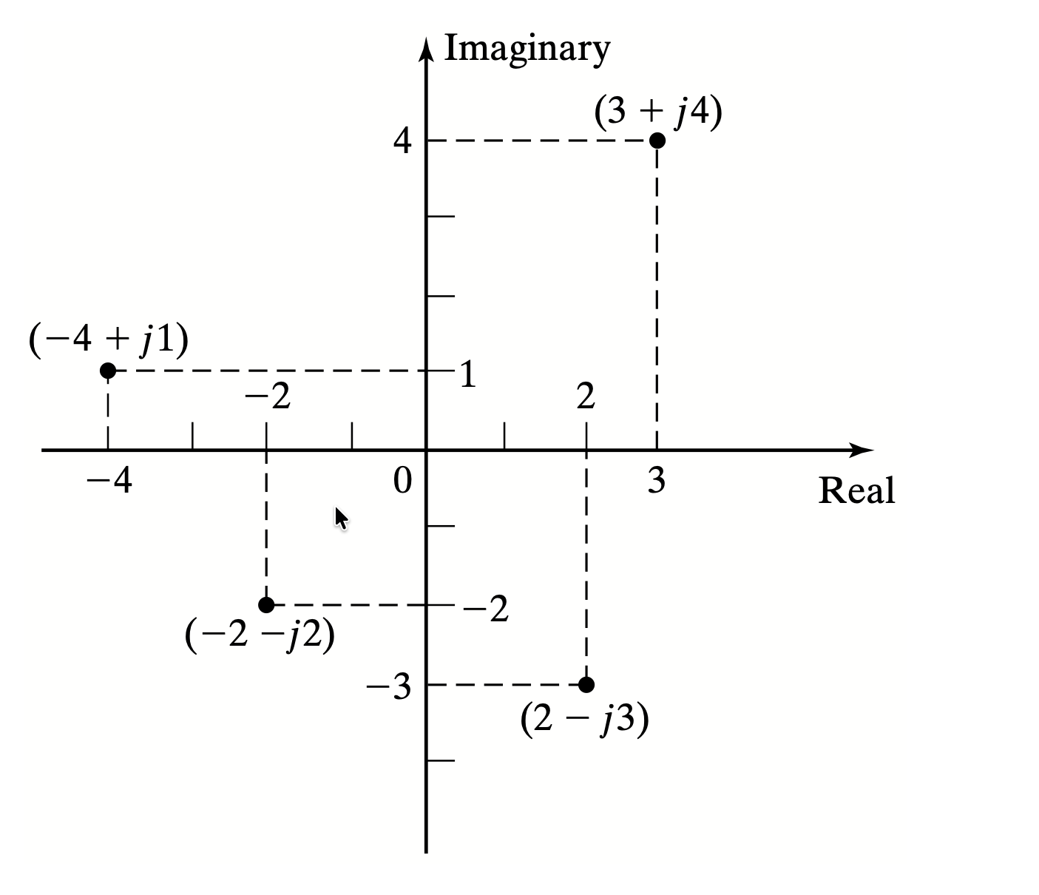
Fundamental of Electrical and Electronics Engineering
Graphical representation of complex numbers in rectangular form.

Slide 32
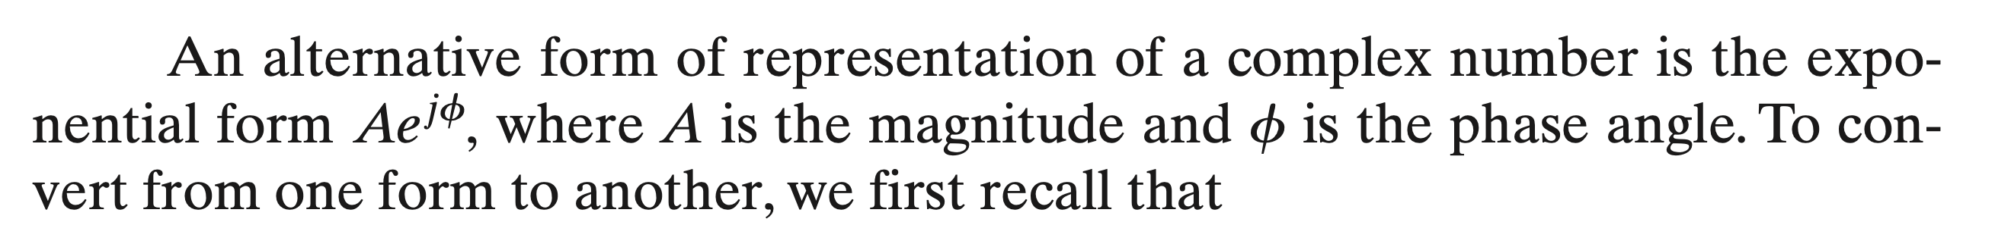
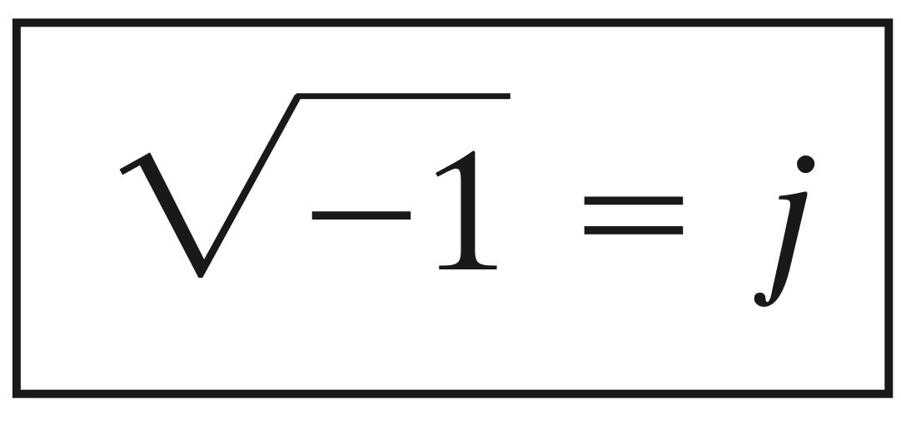
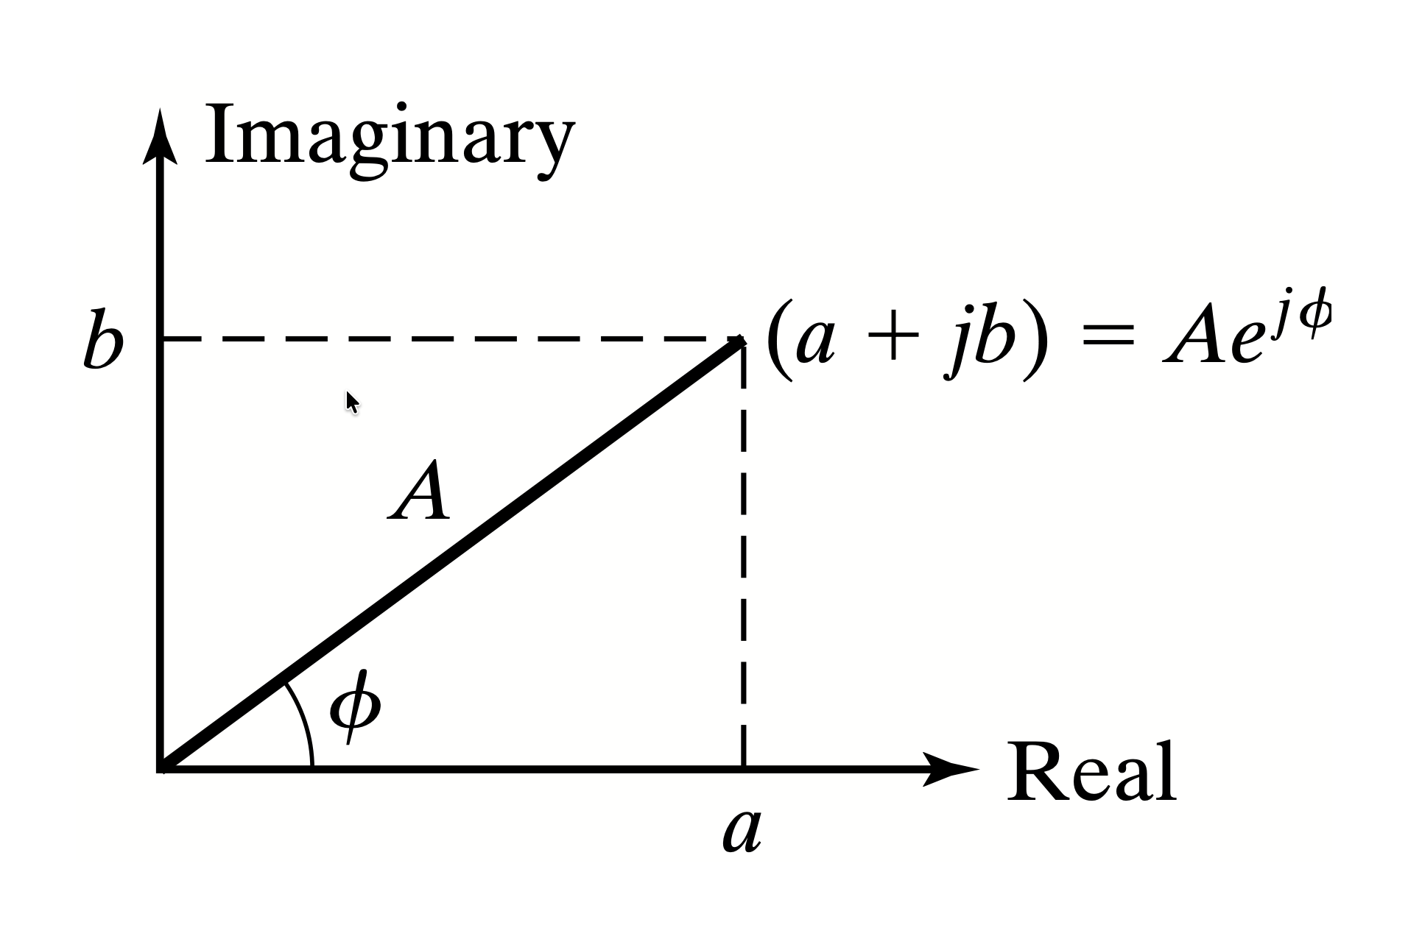
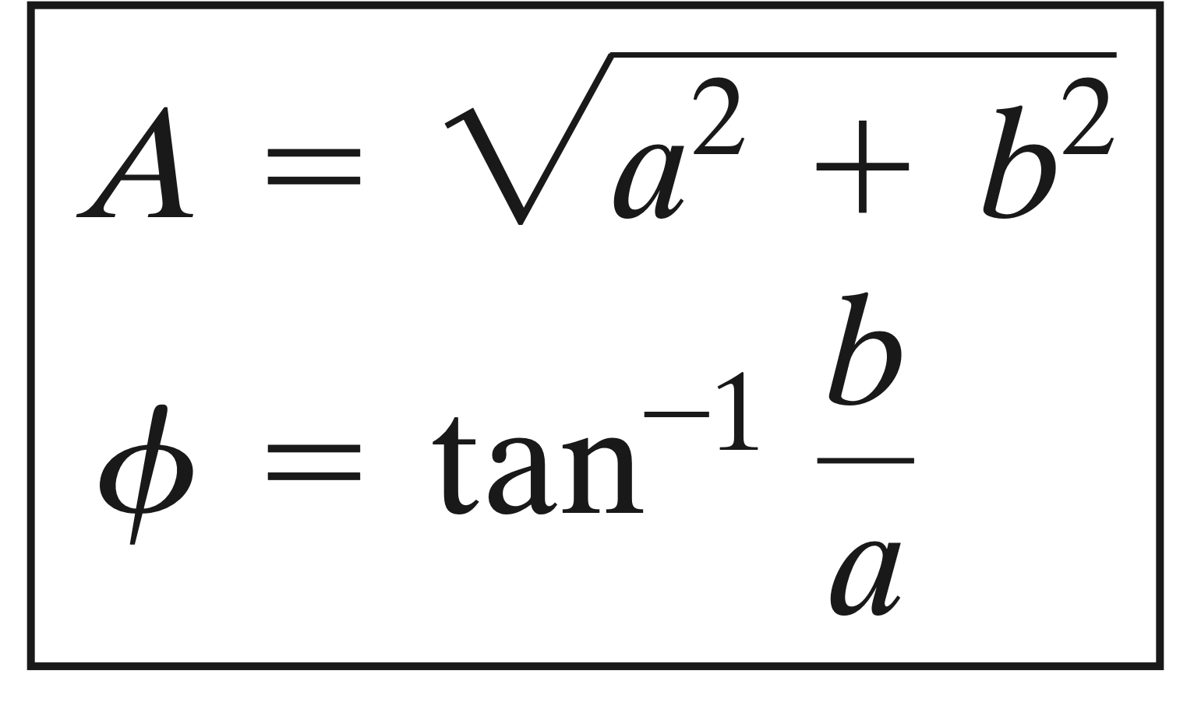
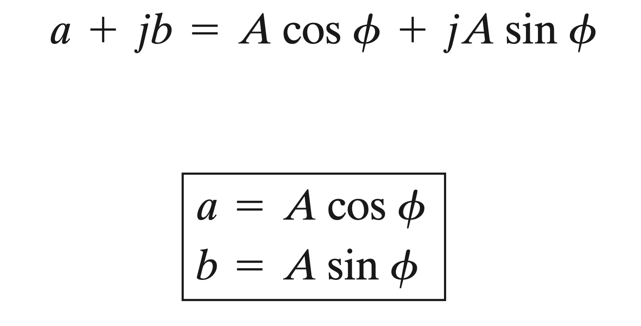
Fundamental of Electrical and Electronics Engineering
Graphical representation of a complex number in exponential form or polar form.

Slide 33
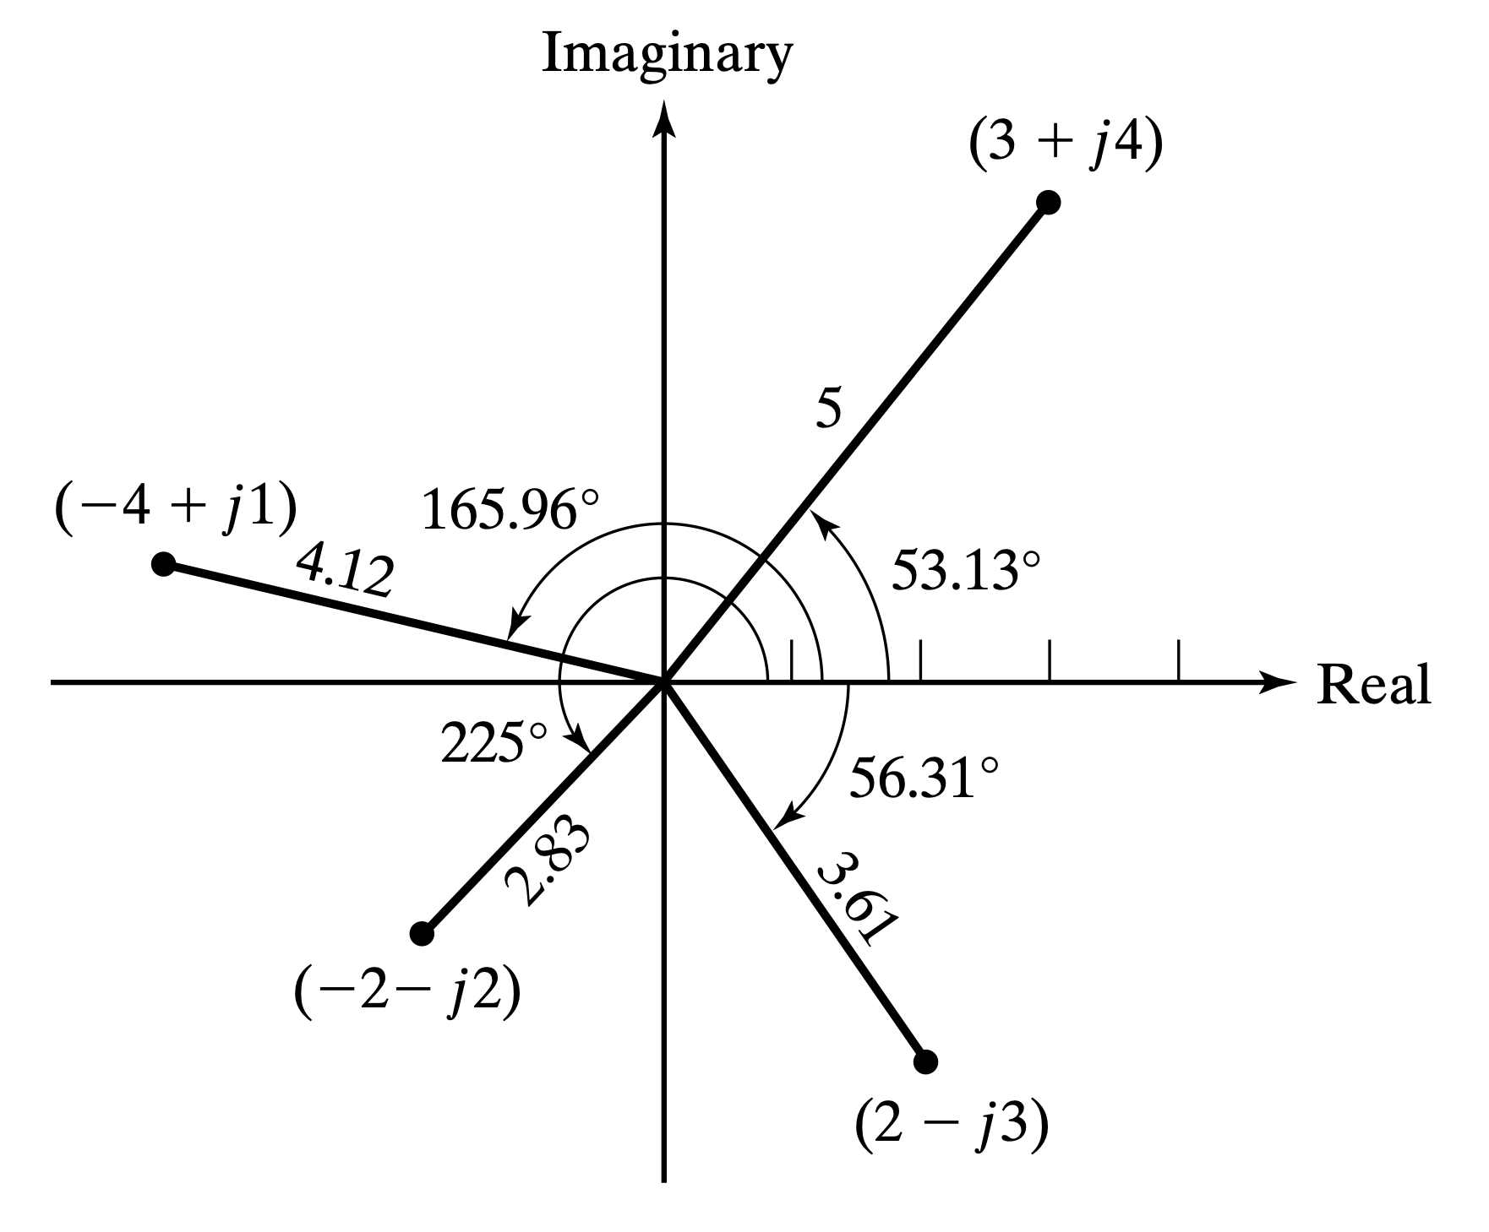
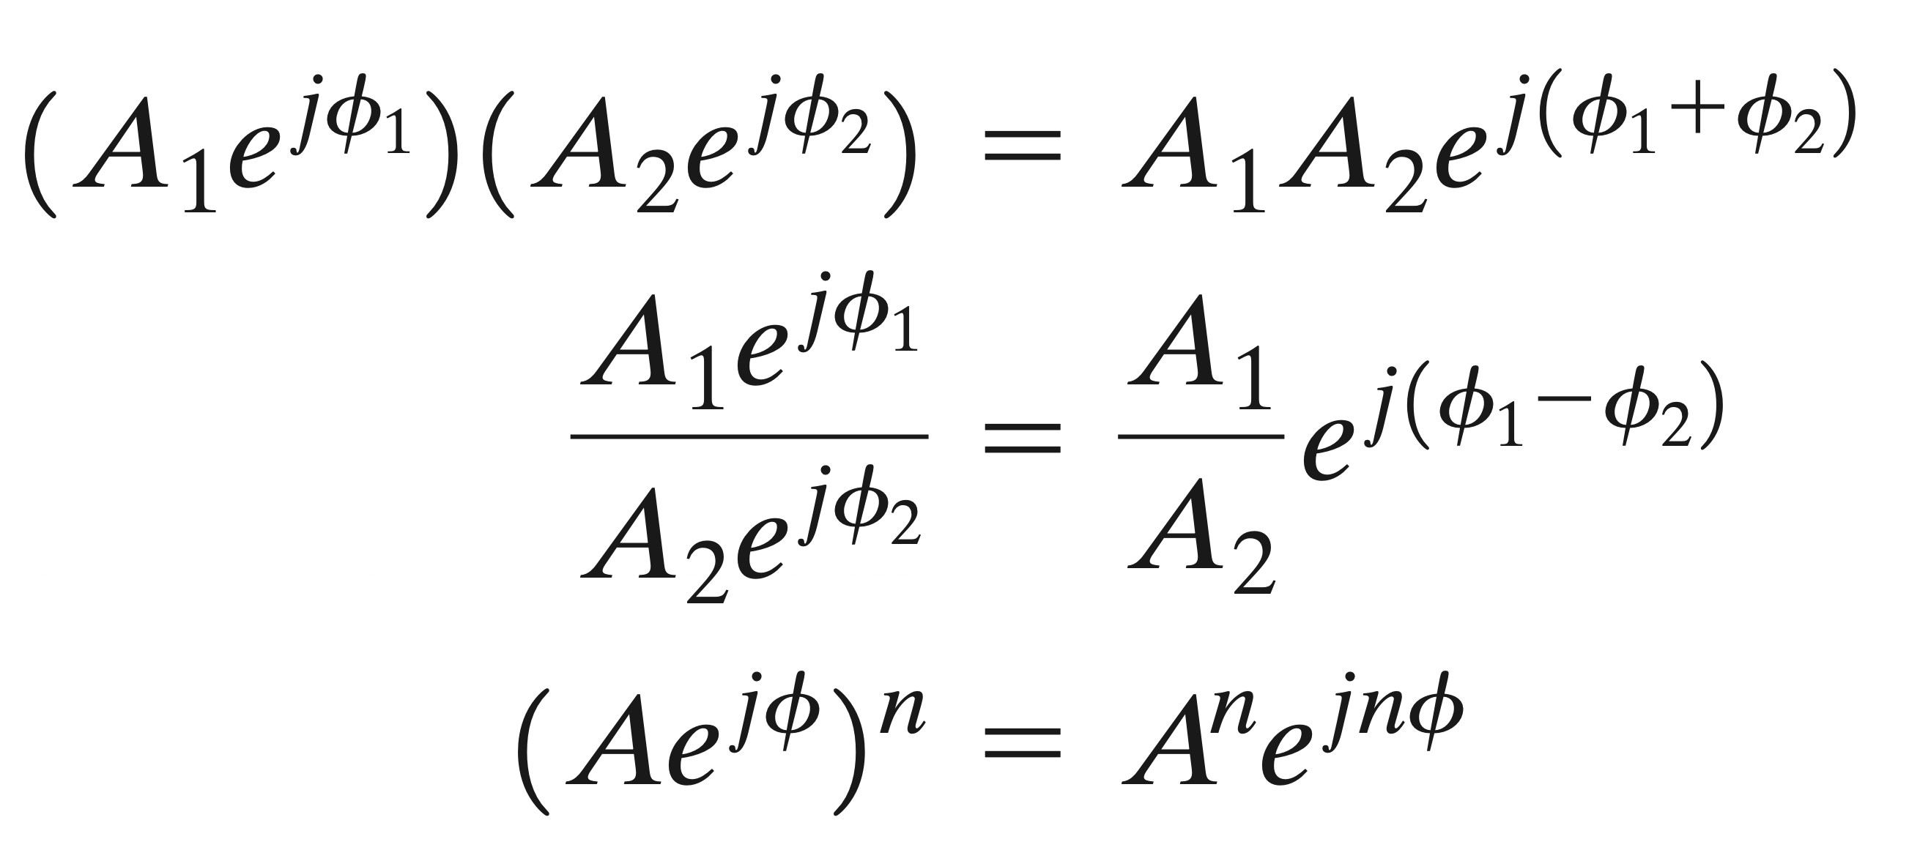
Fundamental of Electrical and Electronics Engineering
Polar form representation of the complex numbers

Slide 34







Conversion:
The idea of phasor representation is based on Euler’s identity
where Re and Im stand for the real part of and the imaginary part of
V is thus the phasor representation of the sinusoid

Slide 35
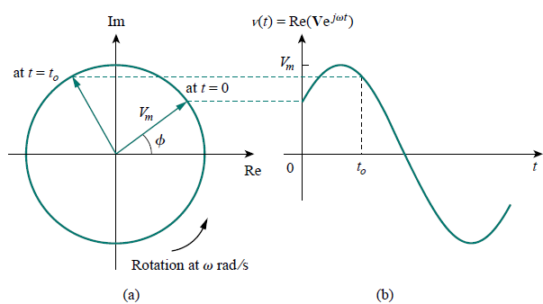

Slide 36
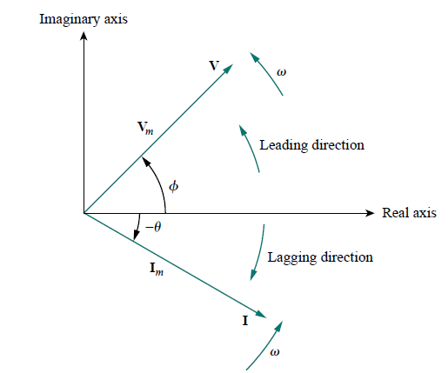

Fundamentals of Electrical and Electronics (CSE-1004)
Phasor Diagram
A graphical representation of phasors, showing the relationship between multiple AC quantities (voltage, current) in terms of their magnitudes and phases.

Slide 37
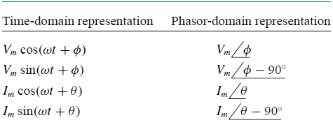
Fundamentals of Electrical and Electronics (CSE-1004)

Slide 38
Fundamentals of Electrical and Electronics (CSE-1004)
The differences between v(t) and V should be emphasized:
1. v(t) is the instantaneous or time-domain representation, while V is
the frequency or phasor-domain representation.
2. v(t) is time dependent, while V is not.
3. v(t) is always real with no complex term, while V is generally complex.
Phasor analysis applies only when frequency is constant.
It applies in manipulating two or more sinusoidal signals only if they are of the same frequency.

Slide 39
Fundamentals of Electrical and Electronics (CSE-1004)
PHASOR RELATIONSHIPS FOR CIRCUIT ELEMENTS

Slide 40
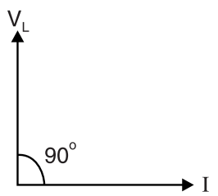
Fundamentals of Electrical and Electronics (CSE-1004)
Note: The voltage and current are 90º out of phase. Specifically, the current lags the voltage by 90º

Slide 41
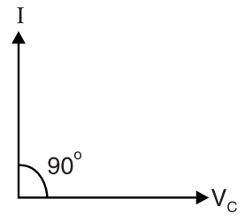
Fundamentals of Electrical and Electronics (CSE-1004)
Note: The voltage and current are 90º out of phase. Specifically, the current leads the voltage by 90º

Slide 42
Fundamentals of Electrical and Electronics (CSE-1004)
Impedance and Admittance
The impedance represents the opposition which the circuit exhibits to the flow of sinusoidal current.
R is the resistance and X is the reactance (Capacitive/Inductive)
Admittance is the reciprocal of impedance, measured in siemens (S).

Slide 43
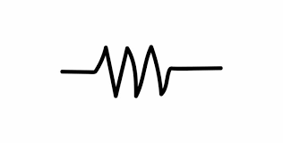

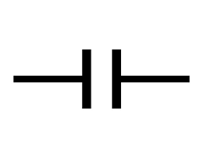
Fundamentals of Electrical and Electronics (CSE-1004)
Element Unit Symbol Impedance Admittance
Resistance (R) Ohm Z = R Y = 1/R
Inductor (L) Henry Z = jωL Y = 1/jωL
Capacitance (C) Farad Z = 1/jωC Y = jωC

Slide 44
Fundamentals of Electrical and Electronics (CSE-1004)

Slide 45
Fundamentals of Electrical and Electronics (CSE-1004)
INSTANTANEOUS AND AVERAGE POWER
Instantaneous power p(t) absorbed by an element is the product of the instantaneous voltage v(t) across the element and the instantaneous current i(t) through it.

Slide 46
Fundamentals of Electrical and Electronics (CSE-1004)
The first part is constant or time independent. Its value depends on the phase difference between the voltage and the current.
The second part is a sinusoidal function whose frequency is 2ω, which is twice the angular frequency of the voltage or current.
The instantaneous power changes with time and is therefore difficult to measure. The average power is more convenient to measure.

Slide 47
Fundamentals of Electrical and Electronics (CSE-1004)
The average power is the average of the instantaneous power over one period.
Note: The wattmeter, the instrument for measuring power, responds to average power.

Slide 48
Note: A resistive load (R) absorbs power at all times, while a reactive load (L or C) absorbs zero average power.
Apparent power (in VA)
The angle θv − θi is called the power factor angle
EFFECTIVE OR RMS VALUE
The effective value of a periodic current is the dc current that delivers the same average power to a resistor as the periodic current.

Slide 49
Fundamentals of Electrical and Electronics (CSE-1004)
The effective value of a periodic signal is its root mean square (rms) value.

Slide 50
Solve for I_{o} using Mesh Analysis and Superposition theorem

Slide 51
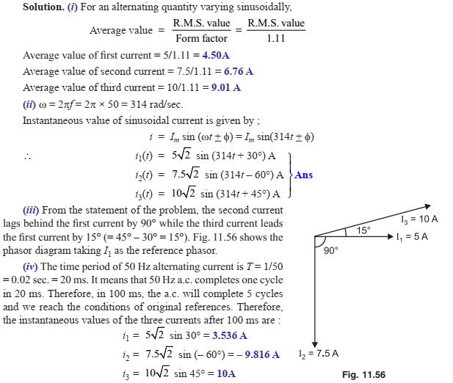
Fundamental of Electrical and Electronics Engineering
Phase and phase difference

Slide 52
Fundamental of Electrical and Electronics Engineering
Phase and phase difference

Slide 53
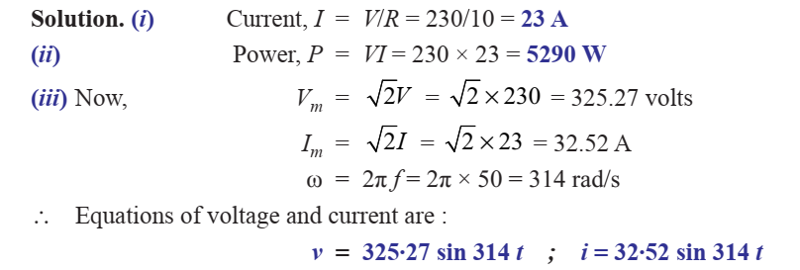
Fundamental of Electrical and Electronics Engineering
Phase and phase difference

Slide 54
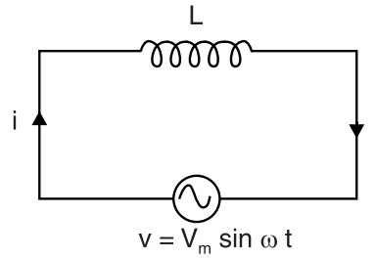
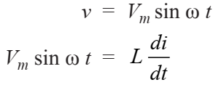





Fundamental of Electrical and Electronics Engineering
Phase and phase difference

Slide 55
Fundamental of Electrical and Electronics Engineering
Phase and phase difference

Slide 56

Fundamental of Electrical and Electronics Engineering
Phase and phase difference

Slide 57






Fundamental of Electrical and Electronics Engineering
Phase and phase difference

Slide 58
Fundamental of Electrical and Electronics Engineering
Phase and phase difference

Slide 59

Fundamental of Electrical and Electronics Engineering
Phase and phase difference

Slide 60




Fundamental of Electrical and Electronics Engineering
Phase and phase difference

Slide 61




Fundamental of Electrical and Electronics Engineering
Phase and phase difference

Slide 62




Fundamental of Electrical and Electronics Engineering
Phase and phase difference

Slide 63

Fundamental of Electrical and Electronics Engineering
Phase and phase difference

Slide 64
Fundamental of Electrical and Electronics Engineering

Slide 65

Fundamental of Electrical and Electronics Engineering

Slide 66
Fundamental of Electrical and Electronics Engineering

Slide 67

Fundamental of Electrical and Electronics Engineering

Slide 68
Fundamental of Electrical and Electronics Engineering

Slide 69

Fundamental of Electrical and Electronics Engineering

Slide 70


Fundamental of Electrical and Electronics Engineering

Slide 71

Fundamental of Electrical and Electronics Engineering

Slide 72

Fundamental of Electrical and Electronics Engineering

Slide 73

Fundamental of Electrical and Electronics Engineering

Slide 74

Fundamental of Electrical and Electronics Engineering

Slide 75
Fundamental of Electrical and Electronics Engineering

Slide 76

Fundamental of Electrical and Electronics Engineering

Slide 77
Fundamental of Electrical and Electronics Engineering

Slide 78

Fundamental of Electrical and Electronics Engineering

Slide 79

Fundamental of Electrical and Electronics Engineering

Slide 80

Fundamental of Electrical and Electronics Engineering

Slide 81

Fundamental of Electrical and Electronics Engineering

Slide 82


Fundamental of Electrical and Electronics Engineering

Slide 83

Fundamental of Electrical and Electronics Engineering

Slide 84

Fundamental of Electrical and Electronics Engineering

Slide 85
Fundamental of Electrical and Electronics Engineering

Slide 86
Fundamental of Electrical and Electronics Engineering

Slide 87
Fundamental of Electrical and Electronics Engineering

Slide 88
Fundamental of Electrical and Electronics Engineering

Slide 89
Fundamental of Electrical and Electronics Engineering
Q3 Using superposition theorem obtain the response I for the circuit shown in Figure

Slide 90
Fundamental of Electrical and Electronics Engineering
Q4 Determine the current through Z3 using superposition theorem for the circuit shown in Figure

Slide 91
Fundamental of Electrical and Electronics Engineering
Q4 Solution

Slide 92
Fundamental of Electrical and Electronics Engineering
Q5 Find the Thevinin’s and Norton’s equivalent circuits at the terminals a-b for the circuit shown in Figure

Slide 93
Fundamental of Electrical and Electronics Engineering
Q6 Find the Thevinin’s and Norton’s equivalent circuits at the terminals a-b for the circuit shown in Figure

