Slide 1
USED YIELD PREDICTION
Name: R. Venkata Tagore Reddy
Profession: Data Science Intern
Submitted to
Learn and Build

Slide 2
Topic:
Developing a machine learning model for crop yield prediction is crucial for precision agriculture. It involves multiple datasets and complex steps due to various factors affecting crop yield, such as climate, weather, soil, fertilizer use, pH, and seed variety. Existing models provide reasonable estimates but aim for improved performance. Training the model involves historical data and features, while testing evaluates its performance using unseen data. The objective is to create a ML model that considers these factors to provide predictions and prescriptions for farmers, enabling them to increase crop productivity and profitability.
Motivation:
Crop yield prediction plays a vital role in decision-making for farmers, as it helps them optimize their agricultural practices and increase productivity.
By incorporating machine learning algorithms and leveraging multiple datasets, such as climate, weather, soil, and agricultural practices, accurate predictions can be made.
To develop a robust ML model that takes into account these factors and provides actionable insights and prescriptions to farmers. This empowers them to make informed decisions, enhance crop productivity, and ultimately improve their profitability.

Slide 3
About Data:
The datasets used for analysis consists of information on different features which are helpful to predict Crop Yield by considering various climate factors. The key variables in the datasets are:
Climate Variables: These include factors like temperature, pH, humidity, and rainfall. Climate variables help assess the impact of weather patterns on crop growth.
Crop Characteristics: Variables related to the crop itself, such as crop type or species, planting date, planting density, cultivar/variety, and previous crop rotation, can influence yield outcomes.
Historical Yield Data: Past yield records for the specific crop and field provide valuable information for training the ML model. These records help identify trends, patterns, and relationships between different variables and the corresponding yield outcomes.

Slide 4
Exploratory Data Analysis (EDA):
During EDA, summary statistics and visualizations will be utilized to examine the distribution of the response variable and its relationship.
Bar plots and correlation analysis will be employed to understand the associations between crop_data across different situations.
Line plots, bar plots and joint plots used on Crop_production dataset to get an in detail information about crops.
Remaining datasets used to analyze the data and fetch the required information.
The analysis will focus on uncovering meaningful insights about crop yield and help them achieve their objectives of increasing profitability, good crop production, and crop suggestion.

Slide 5
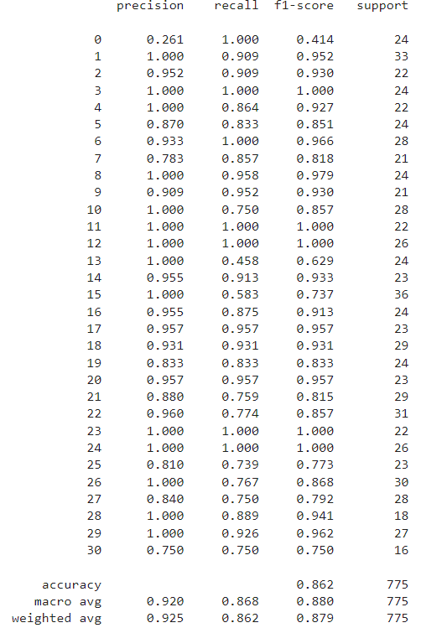
Final Model:
Random Forest Classification
The features like “Temperature”, “Humidity”, “pH”, “Rainfall”, “Crop” yields best result on “Random Forest Classification” when compared with all other classification models.

Slide 6
Findings from Models:
As we observed in correlation matrix, the features like “Temperature”, “Humidity”, “pH”, “Rainfall”, “Crop”, “Soil Nature”, “Climate Changes” plays a crucial role in deciding which crop should be grown to yield high profit according to the season.
After careful considering of all the features, I trained and evaluated many models to predict the output accurately. Finally, I found “Random Forest Classification” model is best fit for our crop yield prediction which gives best accuracy on “Training” as well as on “Testing” dataset by considering the above mentioned features.

Slide 7
Conclusion:
I trained many classification models to predict the accurate result for the given scenario. After careful consideration, I decided that “Random Forest Classification” model is best fit for our crop yield prediction which gives best accuracy on “Training” as well as on “Testing” dataset by considering the features like “Temperature”, “Humidity”, “pH”, “Rainfall”, “Crop”, “Soil Nature”, “Climate Changes” .
Future Work:
Develop methods to automatically identify and incorporate crop growth stages into the prediction models, as different stages have distinct yield potentials and respond differently to environmental factors, allowing for more accurate predictions throughout the growing season.
Integrate data on crop diseases, pests, and their prevalence to develop predictive models that account for the impact of these factors on crop yield, helping farmers identify potential risks and take proactive measures.
Thank You

