Slide 1
TELECOM CUSTOMER CHURN PREDICTION
Name: R. Venkata Tagore Reddy
Profession: Data Science Intern
Submitted to
Learn and Build

Slide 2
Topic:
The objective of this project is to develop an application for a telecommunication company's marketing, product development, and sales teams. The application utilizes customer churn data to generate graphs and figures that provide valuable insights. These insights can guide the development of products and a targeted marketing plan focused on retaining customers for longer durations. Additionally, the application aims to assist in the creation of a sales strategy that helps customers select suitable products, thereby minimizing dissatisfaction and reducing the likelihood of customer churn. Overall, the application aims to improve customer retention, enhance customer satisfaction, and optimize the company's marketing and sales approaches.
Motivation:
Retaining Customers: Customer retention is critical for telecom companies as acquiring new customers is more expensive than retaining existing ones. By accurately predicting customer churn, telecom companies can proactively take measures to retain valuable customers and reduce attrition rates.
Improving Customer Satisfaction: High churn rates indicate dissatisfaction with the telecom services. By predicting churn, telecom companies can identify the root causes of dissatisfaction and address them promptly. This can lead to improved customer satisfaction and loyalty, fostering long-term relationships.
Competitive Advantage: In a highly competitive telecom market, accurate churn prediction gives companies a competitive edge. By proactively identifying and addressing customer churn, telecom companies can differentiate themselves by offering superior customer service, personalized offerings, and customized retention strategies.

Slide 3
About Data:
Telecom customer churn prediction relies on various types of data to develop accurate predictive models. Here are some common types of data used in telecom customer churn prediction:
Customer Demographic Data: This includes information about the customer's age, gender, location, income level, and other demographic attributes. Demographic data can provide insights into customer preferences and behaviors that may influence churn.
Service Usage Data: Service usage data includes details about the customer's call patterns, text messaging, data usage, and service plan utilization. This data helps understand how customers engage with different services and identify usage patterns that may indicate potential churn.
Billing and Payment Data: Billing and payment data provide information on the customer's payment history, billing disputes, overdue payments, and payment methods. It can reveal financial stress or dissatisfaction that might contribute to churn.
Churn Indicator Data: Churn indicator data is historical data that identifies customers who have previously churned or terminated their services. This data serves as the target variable for building predictive models and training algorithms to predict future churn.

Slide 4
Exploratory Data Analysis (EDA):
During EDA, summary statistics and visualizations will be utilized to examine the distribution of the response variable and its relationship.
There is negligible difference in customer percentage/ count who changed the service provider. Both genders behaved in similar fashion when it comes to migrating to another service provider/firm which is visualize by “pie” chart.
“Histogram” shows that 75% of customer with Month-to-Month Contract opted to move out as compared to 13% of customrs with One Year Contract and 3% with Two Year Contract
Major customers who moved out were having Electronic Check as Payment Method. -- Customers who opted for Credit-Card automatic transfer or Bank Automatic Transfer and Mailed Check as Payment Method were less likely to move out.
The analysis will focus on uncovering meaningful insights about telecom customer churn and help them achieve their objectives of increasing profitability, customers get good products, and good service as well.

Slide 5
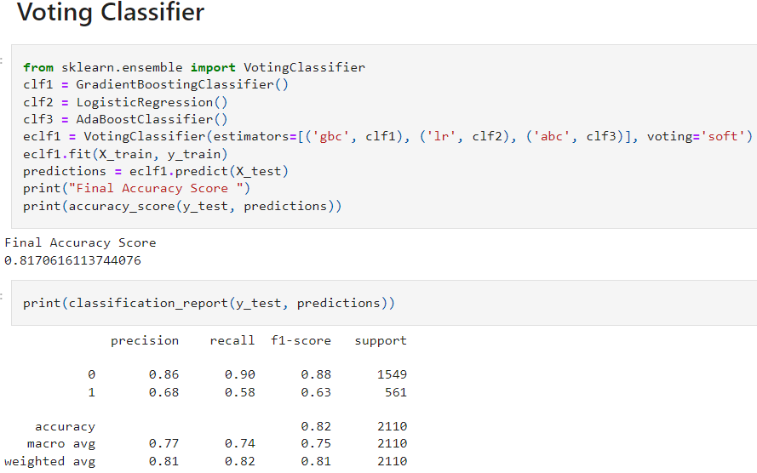
Final Model:
Voting Classifier
The features like “TechSupport”, “PaymentMethods”, “StreamingMovies”, “StreamingTV”, “OnlineSecurity” yields best result on “Voting Classifier” when compared with all other classification models.

Slide 6
Findings from Models:
As we observed in correlation matrix, the features like “TechSupport”, “PaymentMethods”, “StreamingMovies”, “StreamingTV”, “OnlineSecurity” plays a crucial role in analyzing the telecom customer churn.
After careful considering of all the features, I trained and evaluated many models to predict the output accurately. Finally, I found “Voting Classifier” model is best fit for our telecom customer churn which gives best accuracy on “Training” as well as on “Testing” dataset by considering the above mentioned features.

Slide 7
Conclusion:
I trained many classification models to predict the accurate result for the given scenario. After careful consideration, I decided that “Voting Classifier” model is best fit for our telecom customer churn prediction which gives best accuracy on “Training” as well as on “Testing” dataset by considering the features like “TechSupport”, “PaymentMethods”, “StreamingMovies”, “StreamingTV”, “OnlineSecurity” .
Future Work:
Integration with Customer Relationship Management (CRM) Systems: Integrate churn prediction models with CRM systems to enable seamless implementation of retention strategies and automate customer interactions. This integration allows for timely intervention, personalized offers, and efficient management of customer relationships.
Advanced Modeling Techniques: Explore and implement advanced machine learning techniques such as deep learning, ensemble models, or reinforcement learning to improve the accuracy and predictive power of churn prediction models. These techniques have the potential to capture complex patterns and interactions in the data, leading to more accurate predictions.
Thank You

