Slide 1
USED CAR PRICE PREDICTION
Name: R. Venkata Tagore Reddy
Profession: Data Science Intern
Submitted to
Learn and Build

Slide 2
Topic:
A used car dealership seeks data analysis expertise to optimize pricing strategies and enhance profitability in the competitive market. By understanding the relationship between mileage and sale prices, considering brand-specific variations, and identifying additional factors impacting customer pricing preferences, the dealership aims to attract customers, garner positive feedback, and solidify its position as a leading player in the industry
Motivation:
Understanding the correlation between mileage and sale prices helps determine if additional factors should be considered for pricing decisions.
Examining variations in the relationship between mileage and price across different car brands enables tailored pricing strategies for different customer segments.
Setting prices that align with customer expectations enhances satisfaction, leading to positive feedback and repeat business.
Leveraging data analysis helps identify factors beyond mileage that customers value, supporting effective market positioning and competitiveness.

Slide 3
About Data:
The dataset used for analysis consists of information on the mileage and sale prices of used cars. The key variables in the dataset are:
Mileage: This variable represents the recorded mileage of each car in miles. It indicates the distance the car has traveled and can serve as a proxy for its overall usage and condition.
Sale Price: This variable represents the price at which each car was sold. It reflects the market value of the car and is influenced by various factors, including mileage.
It also contains 11 characters. They are: ['Cars', 'Location', 'Year', 'Kilometers_Driven', 'Fuel_Type', 'Transmission', 'Owner_Type', 'Mileage', 'Engine', 'Power', 'Seats','Price’] to train and test the model.

Slide 4
Exploratory Data Analysis (EDA):
During EDA, summary statistics and visualizations will be utilized to examine the distribution of the response variable (sale price) and its relationship with the mileage.
Box plots, scatter plots, and correlation analysis will be employed to understand the associations between mileage and sale prices across different car brands.
Furthermore, other relevant variables, such as the age of the car, fuel efficiency, or horsepower, may be explored to identify potential additional factors that might play a role in determining the price a customer is willing to pay.
The analysis will focus on uncovering meaningful insights to inform the dealership's pricing strategy and help them achieve their objectives of increasing profitability, customer satisfaction, and market traction.

Slide 5
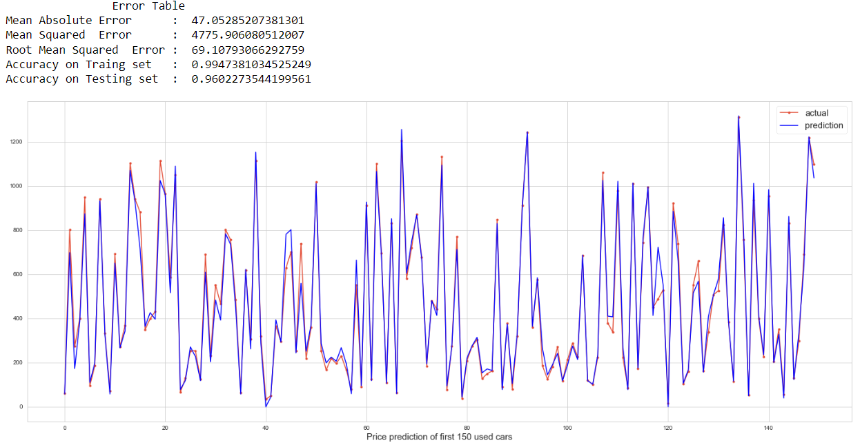
Final Model:
GradientBoostingRegressor
The features like “Power”, “Engine”, “Year”, “Transmission”, “Fuel_Type”, “Mileage” yields best result on “GradientBoostingRegressor” when compared with all other regression models.

Slide 6
Findings from Models:
As we observed in correlation matrix, the features like “Power”, “Engine”, “Year” places a crucial role in deciding the “Price” of car directly that means as the capacity of these features increases then “Price” also gets increase. Whereas the features like “Transmission”, “Fuel_Type”, “Mileage” places the important role in deciding the “Price” of car indirectly which means as the capacity of these features increases then “Price” gets decrease and vice-versa.
After careful considering of all the features, I trained and evaluated many models to predict the output accurately. Finally, I found “GradientBoostingRegressor” model is best fit for our used-car price prediction which gives best accuracy on “Training” as well as on “Testing” dataset by considering the above mentioned features.

Slide 7
Conclusion:
I trained many regression models to predict the accurate result for the given scenario. After careful consideration, I decided that “GradientBoostingRegressor” model is best fit for our used-car price prediction which gives best accuracy on “Training” as well as on “Testing” dataset by considering the features like “Power”, “Engine”, “Year”, “Transmission”, “Fuel_Type”, “Mileage”.
Future Work:
Keeping the current model as a baseline, we intend to use some advanced techniques algorithms to predict car prices as our future work. We intend to develop a fully automatic, interactive system that contains a repository of used-cars with their prices. This enables a user to know the price of a similar car using a recommendation engine, which we would work in the future.
Thank You

