Slide 1
PGS
A smart and efficient public grievance sytem

Slide 2
What is PGS?
One stop for all kinds of grievances to the government.
Issues are open. Any body can see the issues.
Lodge complaints and track the progress

Slide 3
Why this system?
Software companies use issue trackers. This lets them
Keep track of bugs and lacks in existing products
Prioritize the main issues
Involve users and address their needs
Hold developers responsible for resolving issues

Slide 4
Why this system?
A similar system for public grievances can
Make the government and its departments transparent
Let public assess their performance
Bring public involvement into the betterment of society

Slide 5
The existing system
Public grievance systems are present but are largely unknown.
No domain names for some. Citizens need to remember IP addresses.
Public must be aware of the departments of the government that is responsible to resolve their issues.

Slide 6
Proposed system
Public are using social media to put their grievances to government
Because it is simple and straight
Because it is open
It is what they do regularly
Lets us hold the government responsible for its inaction publicly.

Slide 7
Proposed system
We wanted to
Let citizens get involved in making better society.
Bring in accountability and transparency of enterprise practices.
Let the public asses the performance of the governments.
Bring in the ease of social media.
And use technology to solve the problem

Slide 8
How it works?
Citizens lodge complaints either directly through the website or with a tweet.
Issues are assigned to concerned department automatically.
Authorities verify the validity (if necessary).
The authorities act to resolve the issue and update status in realtime
One issue is resolved, it is approved by the citizens.

Slide 9
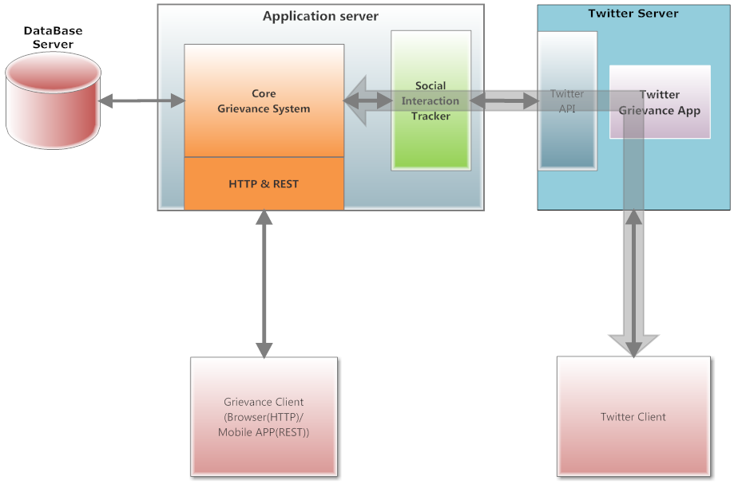
Architecture

Slide 10
Architecture
The core grievance system is responsible for keeping track of issues and their updates.
The Social Interaction Tracker monitors social media for issues in real-time.
The system is integrated with twitter using its public streaming API.
Its machine learning algorithms (NLTK) analyse the sentiment and automatically assign the issue to the concerned department.

Slide 11
Technologies used
Python 3 with Django 1.8
Nginx and gunicorn servers
PostgreSQL database server
Tweepy – Twitter OAuth client library
NLTK – Natural Language Tool Kit for Python
Googlemaps – Client library for Geolocation API

Slide 12
Links
Demo: http://pgs.ravitejap.in
Source code repository:
https://bitbucket.org/ravi_teja___/pgs-techngage

