Slide 1
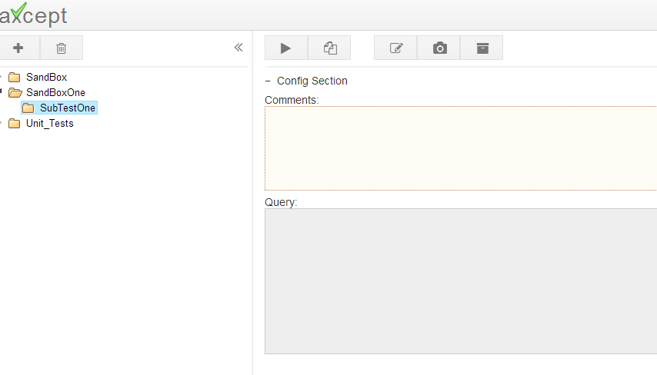
1.Edit Test
2.Write SQL query
3.Copy Expected Results

Slide 2
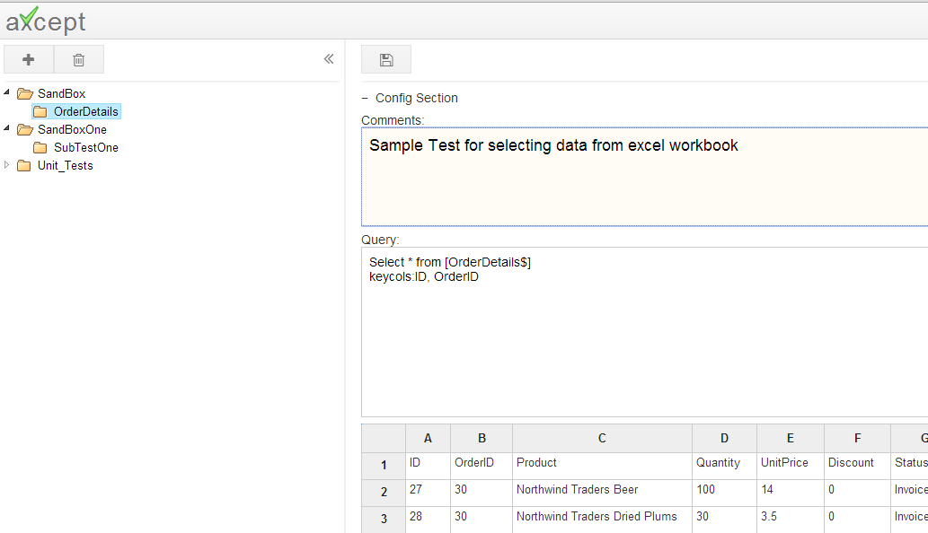
1.Eidt Test
2.Write SQL query
3.Copy Expected Results
Any valid SQL Query can be copy pasted from into the query section. axcept connects to database and executes the query on the database and validates results against the expected results.
Enter Test comments here.
SQL query goes here.
Note: Detailed steps on setting up a database connection, writing a query, defining variables and other options are explained in the Implement Tests Section

Slide 3
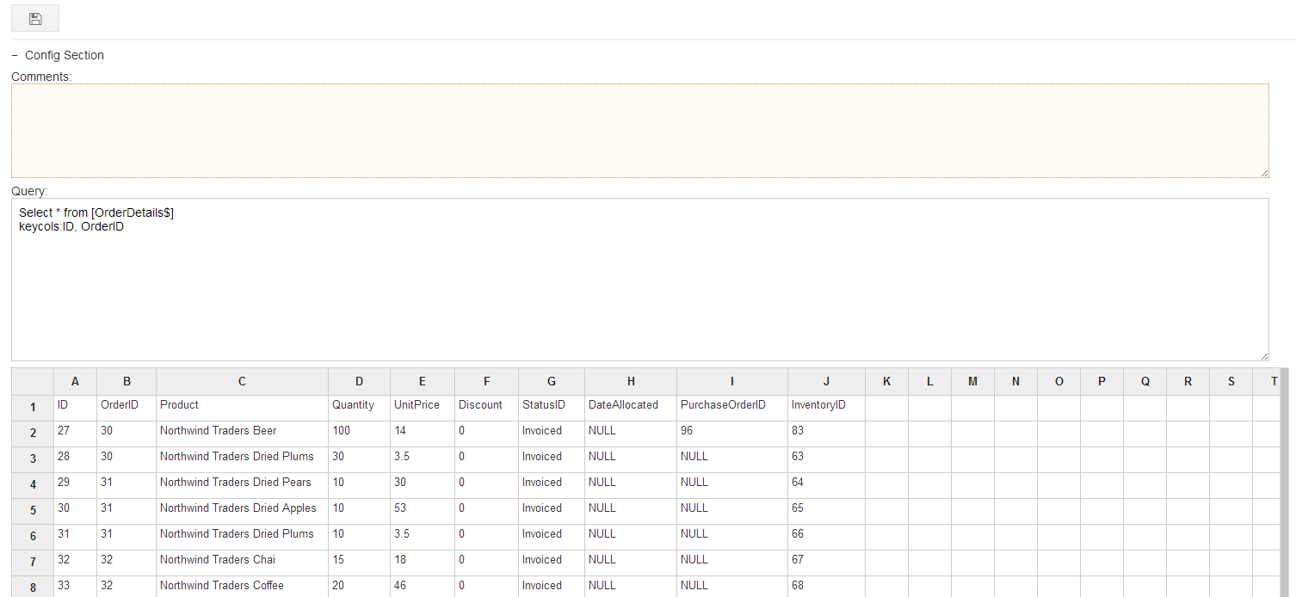
1.Eidt Test
2.Write SQL query
3.Copy Expected Results
Copy the data from database and paste in the below gird
Click on Save
2
1

