Slide 1
Page Types
Suite Page
Test Page
Database Connection
Database connection string
Connection Scope
Page Variables
Defining a variable
Using Variables
Variable Scope
Columns
Key Columns
Non Key Columns

Slide 2
Page Types

Slide 3
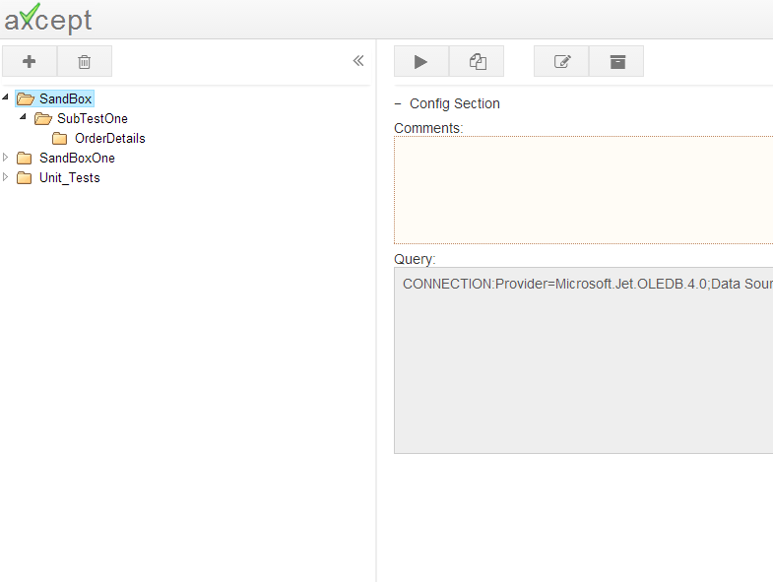
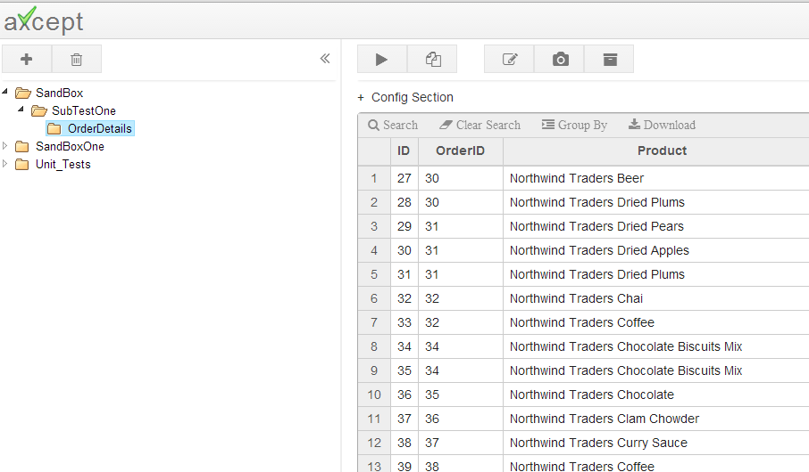
Page Types
axcept has no special properties to differentiate between a suite page and test page. The differentiation is made only if a folder/test is a parent or child.
If a folder contains at least one child then it is a suite page, and
If a folder is the last child in the hierarchy and does not contain any subfolders the it is a test page.
This is a suite page
This is a test page
Even if the data is copied into suite pages, the grid only shows if the folder is a test page (Last child)

Slide 4
Database Connection

Slide 5
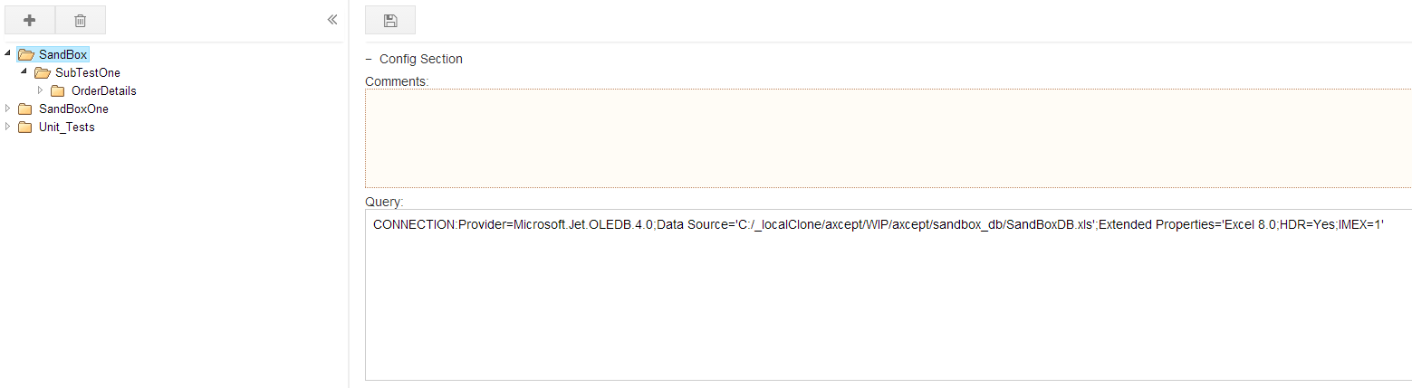
Database Connection
1.Connect ion String
2.Connection Scope
First step before writing any tests and sql queries is to connect to a database.
Follow the below steps:
Edit a suite/test page
In the query box write a connection string in below syntax
Click Save
List of Database connections for different databases can be found here
CONNECTION:<your connection string here>
3
2
Note: We recommend that the connection to database is established at top suite level folder so that a connection need not be established at every single test run.

Slide 6
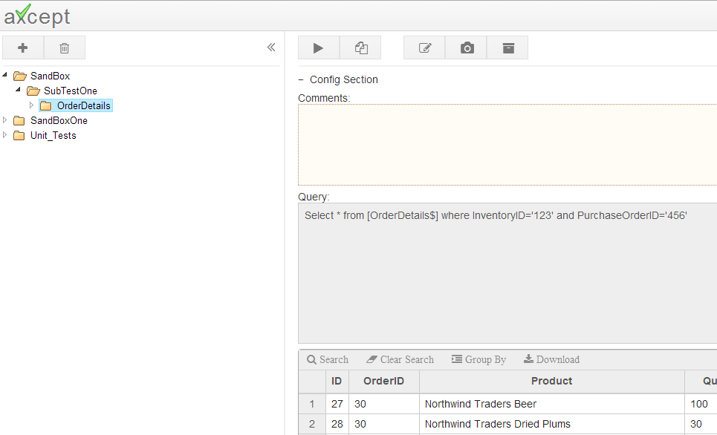
Database Connection
1.Connect ion String
2.Connection Scope
Database Connection is in scope if it is defined on the test page in question or somewhere in the parent hierarchy of the test page.
DB Connection here
Or DB Connection here
Or DB Connection here
Write any sql statements using the connection defined in any of the above pages.
Out of Scope:
In the above example DB Connection Defined in SandBox suite or its child pages can not be used in SubTestOne Page and SandBox pages

Slide 7
Page Variables

Slide 8
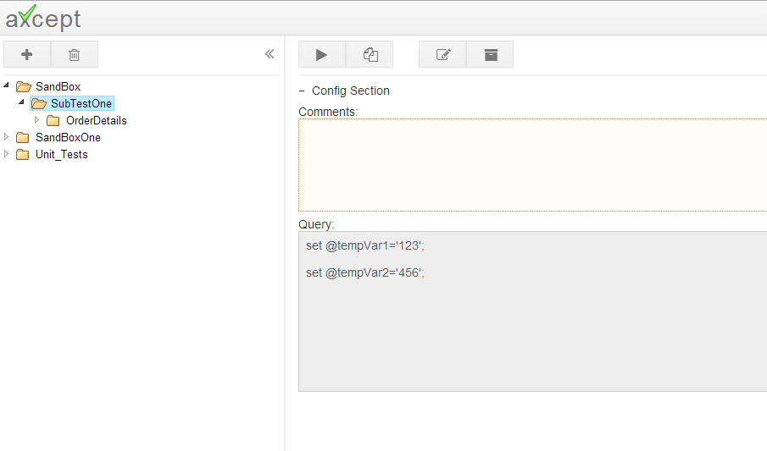
Page Variables
1.Define Variable
2.Use Variables
3.Variable Scope
Variables can be defined in suite or test page and can be reused across any child pages.
Syntax of defining a variable
Note: ‘@’ and ‘;’ are mandatory while declaring the variables.
Example: set @orderNo=‘123456’
set @<variablename>=<value>;

Slide 9
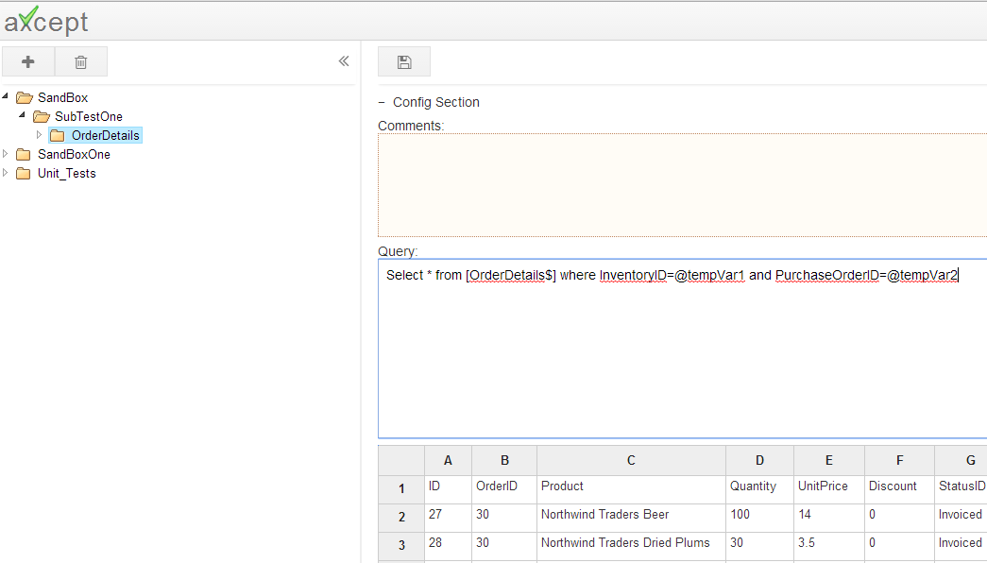
Page Variables
1.Define Variable
2.Use Variables
3.Variable Scope
Edit a test and replace static values with variables defined in any of the parent pages.
Click Save

Slide 10
Page Variables
1.Define Variable
2.Use Variables
3.Variable Scope
Post save the variables defined in the edit page are evaluated with the variables defined in the suite page.

Slide 11
Page Variables
1.Define Variable
2.Use Variables
3.Variable Scope
Variables are in scope if they are defined on the test page in question or somewhere in the parent hierarchy of the test page.
Define Variable A
Define Variable B
Define Variable C
Use variables A,B,C
Out of Scope:
In the above example Variable C can not be used in SubTestOne Page and SandBox pages
Variable B can not be used in SandBox Page
Variables A,B,C can not be used in any of the pages under SandBoxOne or Unit_Tests folders

Slide 12
Columns

Slide 13
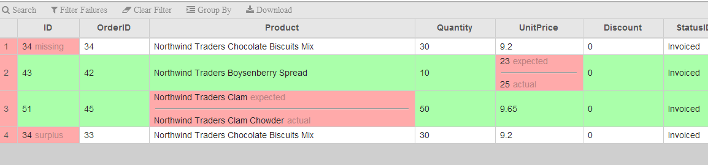
Columns
1.Key vs Non Key Cols
2.Syntax
Columns in axcept test are categorized as Key Columns and Non Key Columns.
Purpose:
axcept filters expected data rows basing on Key Columns and validate this data against actual data from database.
Results
if there is a mismatch in Key Columns the mismatches are shown as Missing, and the actual data will be shown as Surplus
If there is a mismatch in non key columns the mismatches will be show inline
In the below example
Order ID is Key Column, since the Order ID is different between expected and actual the mismatch is shown as Missing and Surplus, even though rest columns matched.
UnitPrice, Product are one of Non key columns and mismatch is shown inline.

Slide 14
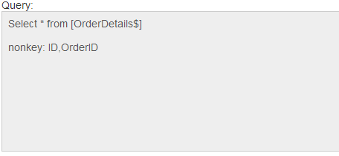
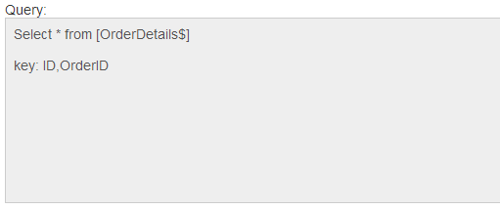
Columns
1.Key vs Non Key Cols
2.Syntax
Key, Non Key Columns should be listed separated by comas after the query.
Syntax of defining Key columns
Syntax of defining non key columns
key: <col1>,<col2>,<col3> ….
nonkey: <col1>,<col2>,<col3>…
Note:
It is NOT required to declare both key and nonkey columns.
Either of key column or a nonkey column declaration is sufficient to run the database tests

