Slide 1
New data snapshot
Custom axcept functions in query window
  Insert SQL select and SQL procedure into a temp tables

Slide 2
New data snapshot

Slide 3
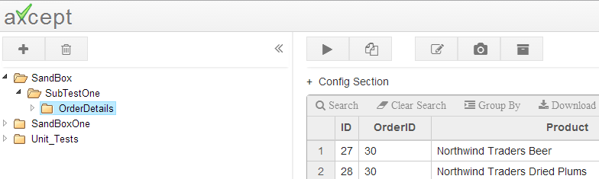
New data snapshot
In the Editing axcept Pages section we described how to Build expected results by copy form database, but if there could be situations where the current out put of sql query should be taken as expected result.
New data snapshot helps in taking the entire output from a sql query execute as expected results. This will help in save time incase of bulk updates of expected result
Steps to Follow:
Select a Test
Click on New data snapshot button
Note: Following are the prerequisites for this feature to work
Page has to be a test page for this button to be available (It is not available in suite Pages)
Query should already be written and saved inside a test page

Slide 4
Custom Functions

Slide 5
Custom Functions
There would be few scenarios where output of a stored procedure can not be assigned to a variable, or can not be inserted into a temp table.
<<toTable{} keyword can be used to insert output from stored procedure into temp table.
Syntax
insert into #tempTable <<toTable{exec<sql procName>}

