Slide 1
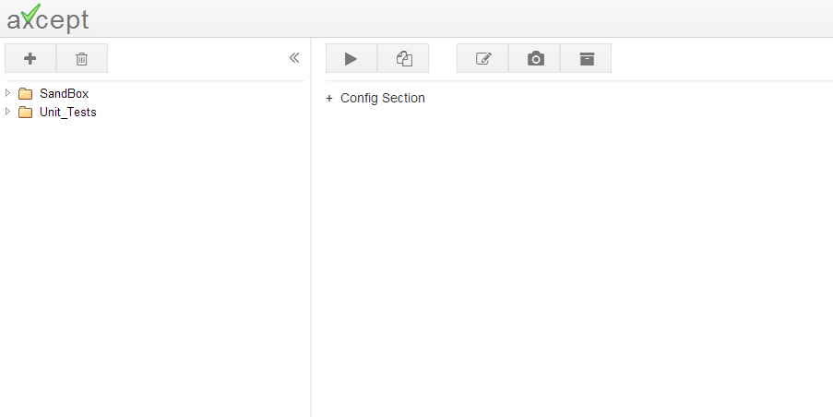
1.Add a Test
2.Give a Name
3.Create Sub Tests

Slide 2
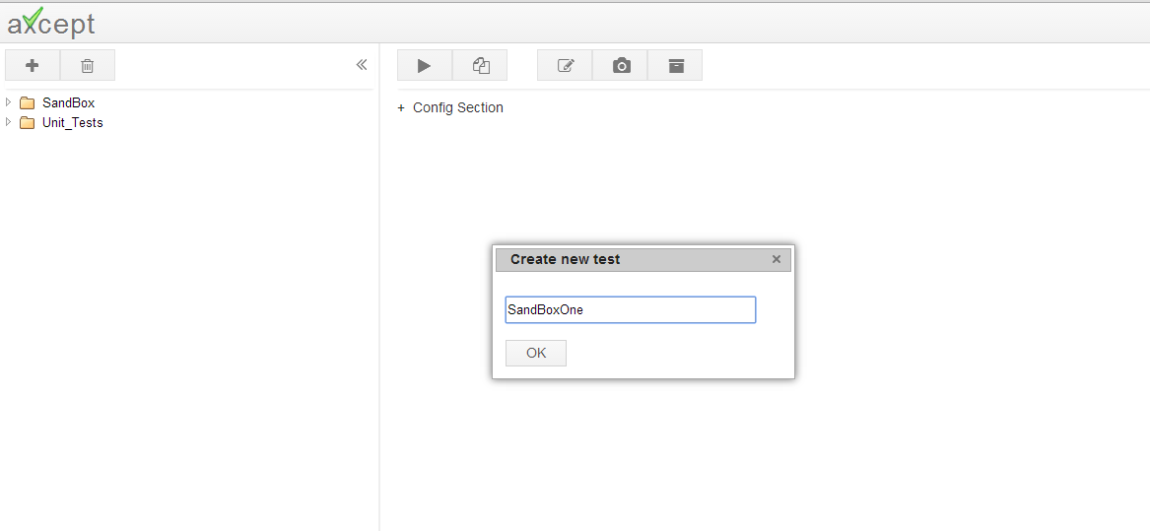
1.Add a Test
2.Give a Name
3.Create Sub Tests
Test Name should not have spaces or special Characters
Underscore is permitted

Slide 3
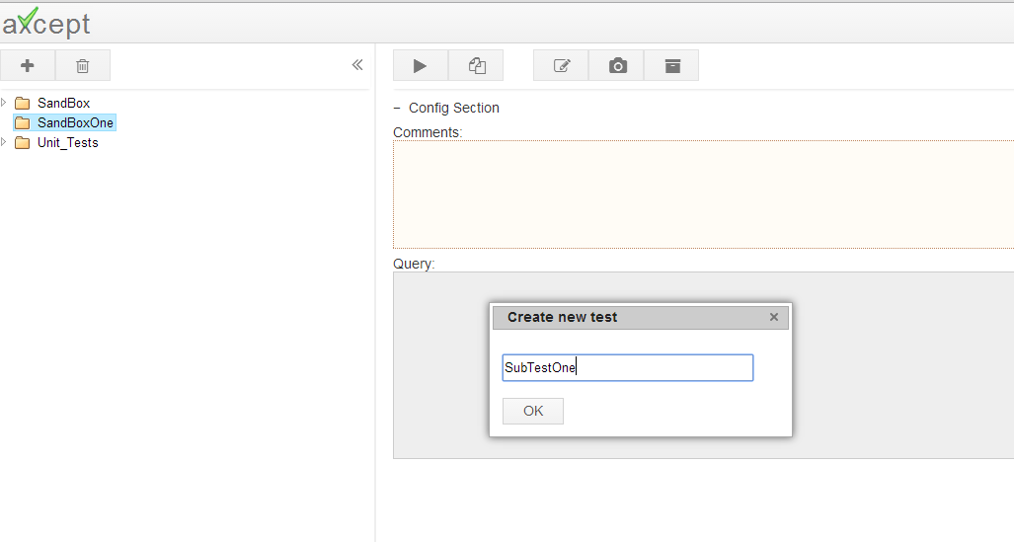
1.Add a Test
2.Give a Name
3.Create Sub Tests
To Create a sub test,
Select the parent folder
Click on Add Test Icon
Enter the Sub Test name
The rules for creating a new test also apply for sub tests
2
1
3

