Slide 1
Page Types
  Suite Page
  Test Page
Page Variables
  Defining a variable
  Using Variables
  Variable Scope
Columns
  Key Columns
  Non Key Columns
Custom axcept functions
  Insert SQL select and SQL procedure into a temp tables

Slide 2
Page Types

Slide 3
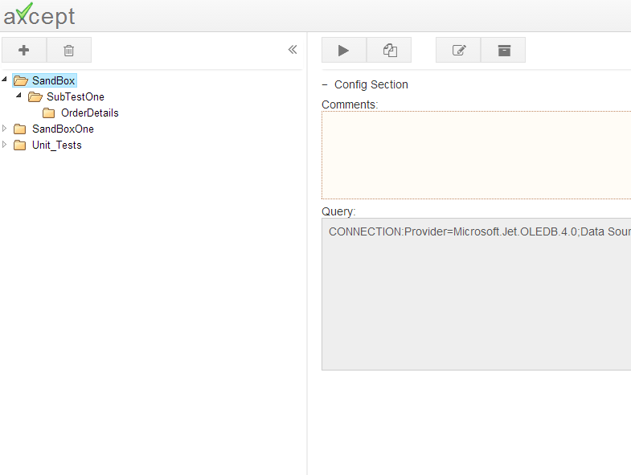
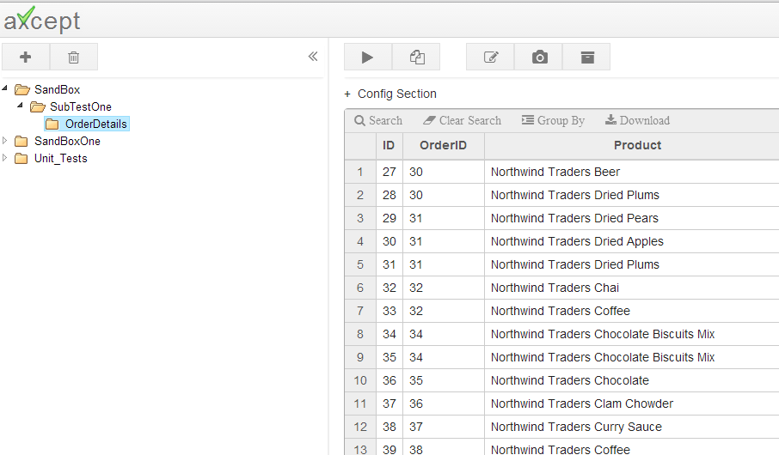
Page Types
axcept has no special properties to differentiate between a suite page and test page. The differentiation is made only if a folder/test is a parent or child.
If a folder contains at least one child then it is a suite page, and
If a folder is the last child in the hierarchy and does not contain any subfolders the it is a test page.
This is a suite page
This is a test page
Even if the data is copied into suite pages, the grid only shows if the folder is a test page (Last child)

Slide 4
Page Variables

Slide 5
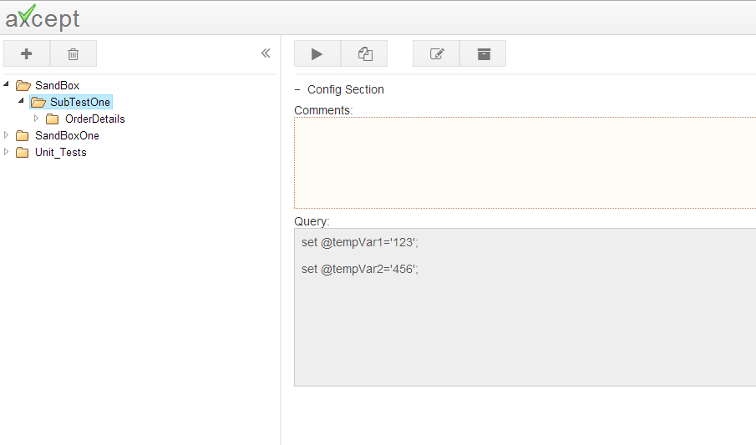
Page Variables
1.Define Variable
2.Use Variables
3.Variable Scope
Variables can be defined in suite or test page and can be reused across any child pages.
Syntax of defining a variable
Note: ‘@’ and ‘;’ are mandatory while declaring the variables.
Example: set @orderNo=‘123456’
set @<variablename>=<value>;

Slide 6
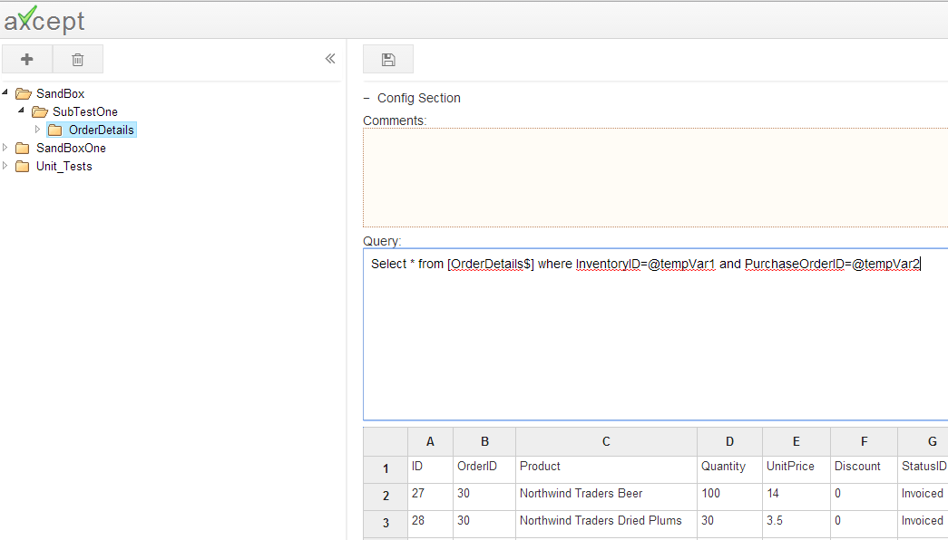
Page Variables
1.Define Variable
2.Use Variables
3.Variable Scope
Edit a test and replace static values with variables defined in any of the parent pages.
Click Save

Slide 7
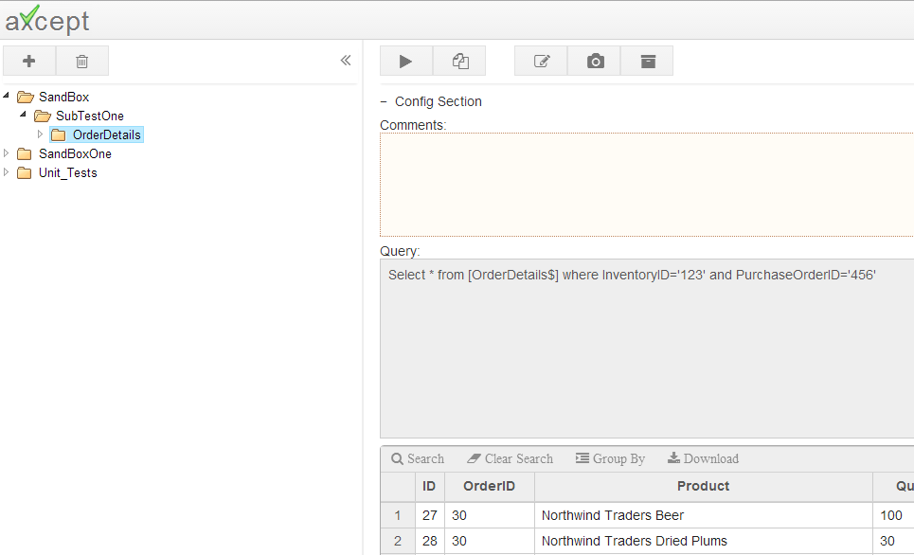
Variables
1.Define Variable
2.Use Variables
3.Variable Scope
Post save the variables defined in the edit page are evaluated with the variables defined in the suite page.

Slide 8
Page Variables
1.Define Variable
2.Use Variables
3.Variable Scope
Variables are in scope if they are defined on the test page in question or in somewhere in the parent hierarchy of the test page.
Define Variable A
Define Variable B
Define Variable C
Use variables A,B,C
Out of Scope:
In the above example Variable C can not be used in SubTestOne Page and SandBox pages
Variable B can not be used in SandBox Page
Variables A,B,C can not be used in any of the pages under SandBoxOne or Unit_Tests folders

Slide 9
Columns

Slide 10
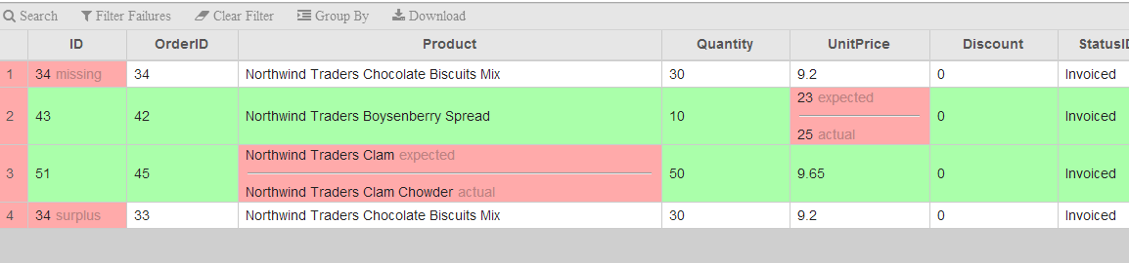
Columns
1.Key vs Non Key Cols
2.Syntax
Columns in axcept test are categorized as Key Columns and Non Key Columns.
Purpose:
axcept filters expected data rows basing on Key Columns and validate this data against actual data from database.
Results
if there is a mismatch in Key Columns the mismatches are shown as Missing, and the actual data will be shown as Surplus
If there is a mismatch in non key columns the mismatches will be show inline
In the below example
Order ID is Key Column, since the Order ID is different between expected and actual the mismatch is shown as Missing and Surplus, even though rest columns matched.
UnitPrice, Product are one of Non key columns and mismatch is shown inline.

Slide 11
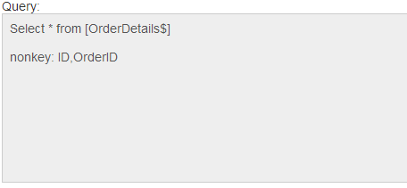
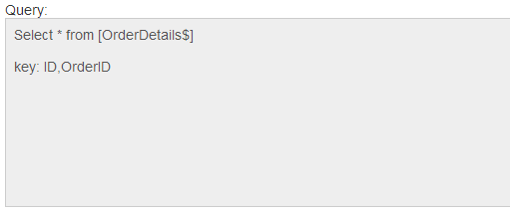
Columns
1.Key vs Non Key Cols
2.Syntax
Key, Non Key Columns should be listed separated by comas after the query.
Syntax of defining Key columns
Syntax of defining non key columns
key: <col1>,<col2>,<col3> ….
nonkey: <col1>,<col2>,<col3>…
Note:
It is NOT required to declare both key and nonkey columns.
Either of key column or a nonkey column declaration is sufficient to run the database tests

Slide 12
Custom Functions

Slide 13
Custom Functions
There would be few scenarios where output of a stored procedure can not be assigned to a variable, or can not be inserted into a temp table.
<<toTable{} keyword can be used to insert output from stored procedure into temp table.
Syntax
insert into #tempTable <<toTable{exec<sql procName>}

