Slide 1
Running from UI

Slide 2
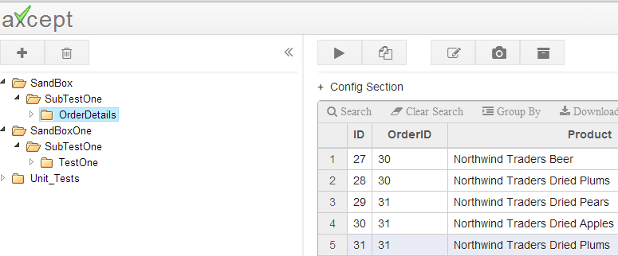
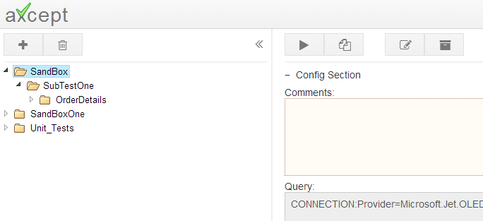
Running a Test:
Click on a Test and Click Run.
Running a Suite:
We can also run all tests in a suite by selecting a suite and clicking on run.
Note: Once a Run button is clicked the page will be redirected to results page
The results pages are different from Test page and Suite page, details are given in the next slides

Slide 3
Running from Command Prompt

Slide 4
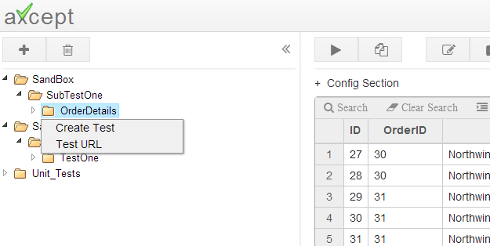
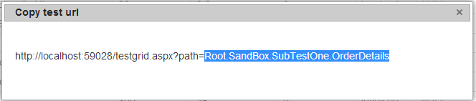
1.Get Test URL Path
2.Run from Command Prompt
axcept tests can also be run from command prompt and one has to logon to the sever to run a test/suite from command prompt.
First step is to get the URL path of the test or suite, follow the below steps
Right Click on a Test and select Test URL Option
Copy the Root path of the test

Slide 5
1.Get Test URL Path
2.Run from Command Prompt
Logon to the sever and find runner_sql.exe under bin folder. (bin is located in the folder axcept is installed)
Open Command prompt on server and run the following command by passing test path copied in step 2 of previous slide
Example for Running without Run Params:
C:\_localClone\axcept\WIP\axcept\bin\runner_sql.exe “Root.SandBox.SubTestOne.OrderDetails
Once a test run is completed, the results are displayed in the command prompt window
<path name>/bin/runner_sql.exe <Test Name>

Slide 6
Test Results History

Slide 7
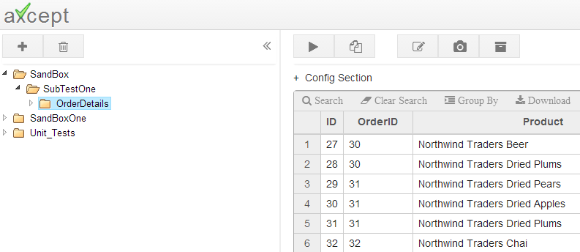
1. Results
2.Result History By Date
3.Reading Test Results
Click on a Test and Click Results.

Slide 8
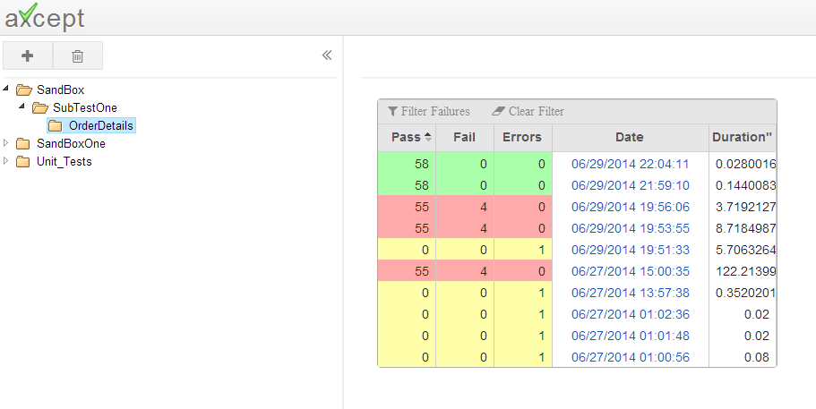
1. Results
2.Result History By Date
3.Reading Test Results
Result History is shown by Date and Time.
Click on specific date to see the results.
Pass
Fail
Exception

Slide 9
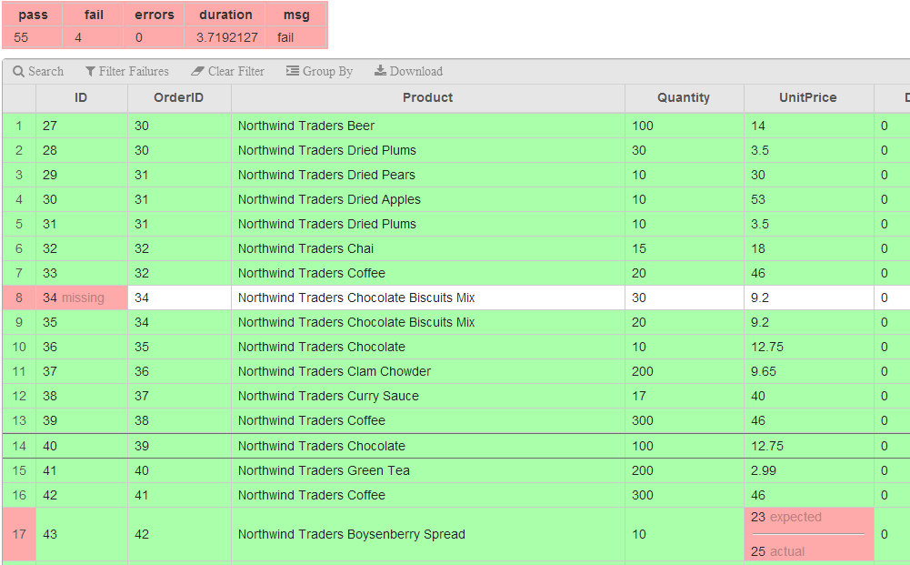
1. Results
2.Result History By Date
3.Reading Test Results
Matched values are shown in green.
Mismatches, Missing, Surplus are shown in Red

Slide 10
Suite Results History

Slide 11
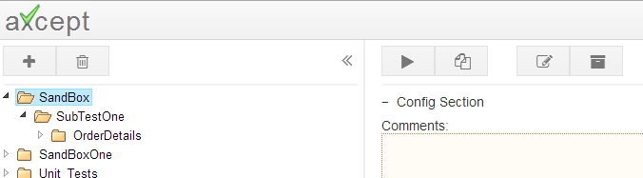
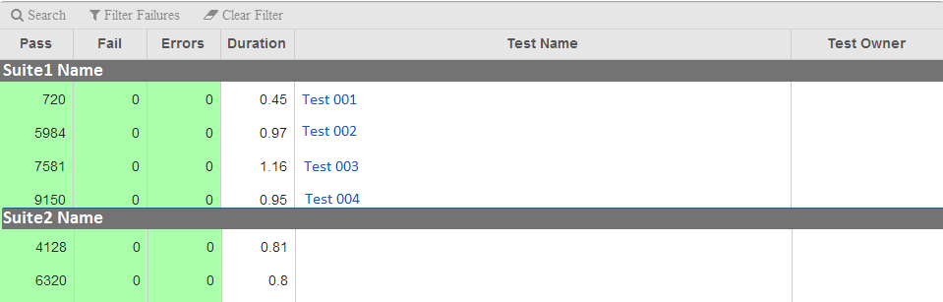
Suite Results work same as Individual Test Results, except they have additional step that shows test pages grouped by sub suites, and show all the test results as Summary. See Step 3
Step 1:Click on the suite that you want to view the results and click on Results Button
Step 2: Takes you to the result history page order by last run date. Click on any test result by date
Step 3: The page will navigate to suite History page. Click on any of the test page link to navigate to detailed test results

