Slide 1
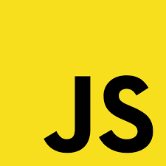
JavaScript

Slide 2
JavaScript (JS) the most used programming language 2024.
Created by Brendan Eich at Netscape in just ten days in 1995

Slide 3
JavaScript needs to run in a “host” environment like Browser or Node.
We call that “JavaScript Runtime”.

Slide 4
The “JavaScript Runtime” defines things like: - Input/Output - Networking, - Storage - Graphics - Access to DOM (Browser)

Slide 5
A JavaScript Runtime has a special component called the “JavaScript Engine”
The “JavaScript Engine” executes JavaScript code.

Slide 6
Famous JavaScript Engines: - Chrome has V8 - Firefox has SpiderMonkey - Safari has JavaScriptCore - Edge has Chrome’s V8

Slide 7
The HTML/CSS/JS Techstack let us create “Cross Platform Apps”: - Browser Apps - Desktop Apps - Mobile Apps

Slide 8
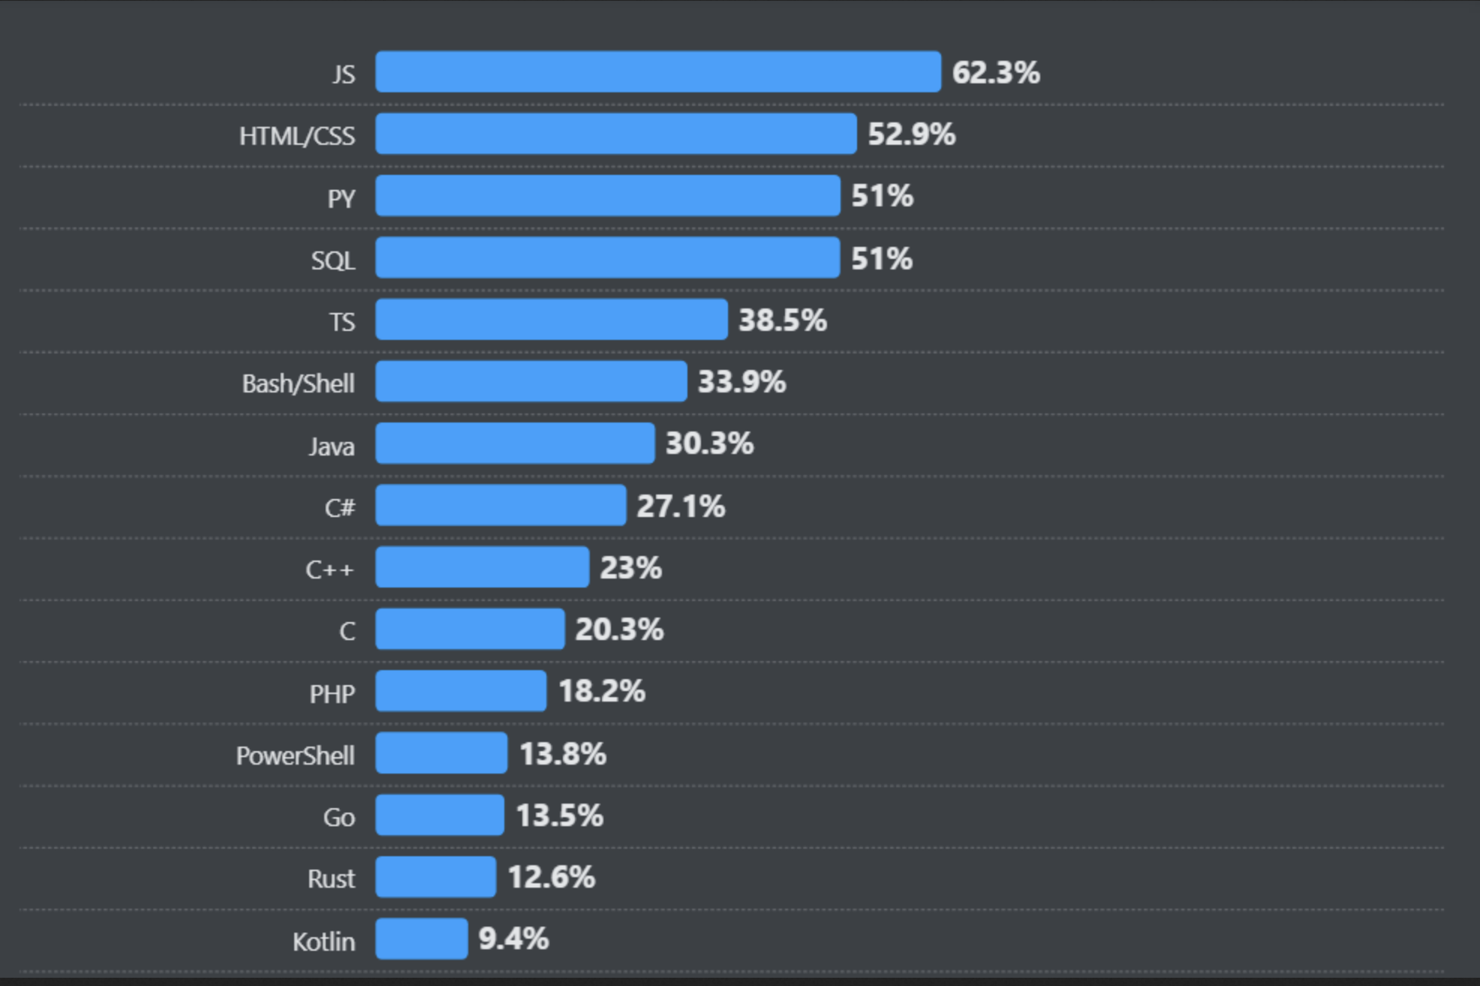
Stackoverflow Developer Survey
“Most used programming languages 2024”

Slide 9
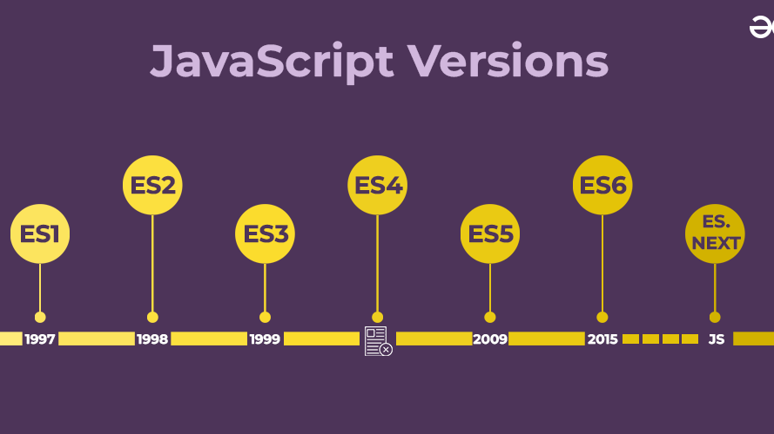

Slide 10
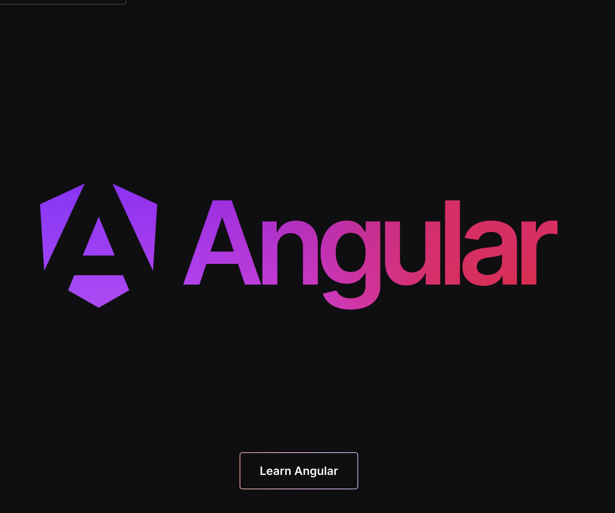
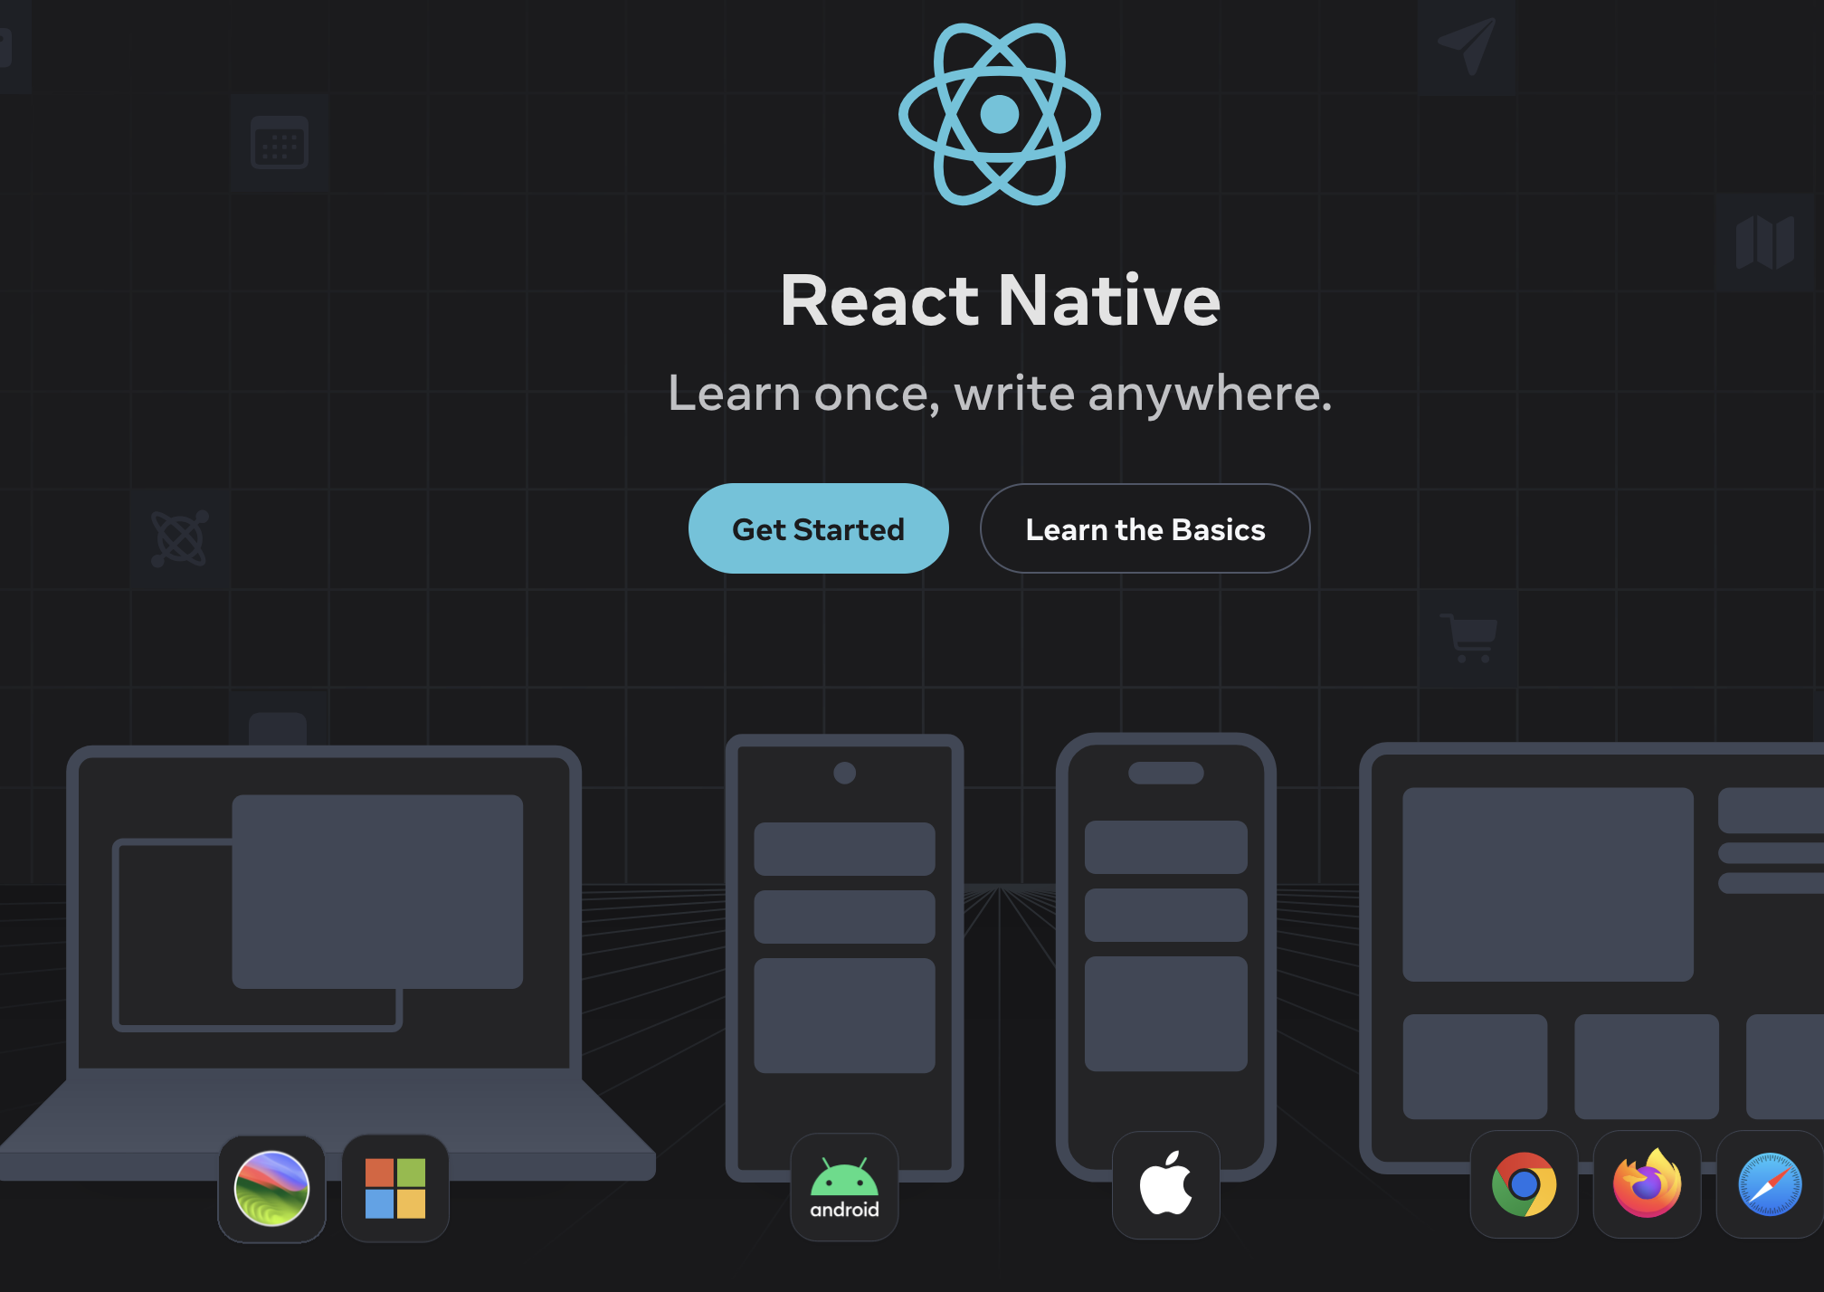

Slide 11
7 Primitive Datatypes in JavaScript
Type | Example Value | Value Ranges | Typeof Result
String | "hello" | Abriatry long Unicode characters | “string”
Number | 42, -3.14 | Double precision Floating Point -Infinity, Infinity, NaN | “number”
Boolean | true | true or false | “boolean”
Undefined | undefined | undefined | “undefined”
Null | null | null | “object”
BigInt | 9000000000n | Abritary long numbers | “bigint”
Symbol | Symbol('id') | Unique and immutable | “symbol”

