Slide 1



CES analysis
Clinical data
Estimate baseline mutation rates
WGS/WES
MAF
Trinucleotide-context–specific relative rates
Inference of variant selections
Clinical outcome analysis
Somatic variant data
Gene-by-gene mutation rates
Basic & epistatic models
Kaplan-Meier
&
multivariable Cox
Figure 1. The study workflow incorporated the mutation dataset to filter candidate driver variants, quantify the effect sizes, and then evaluate clinical outcomes given each mutation.

Slide 2
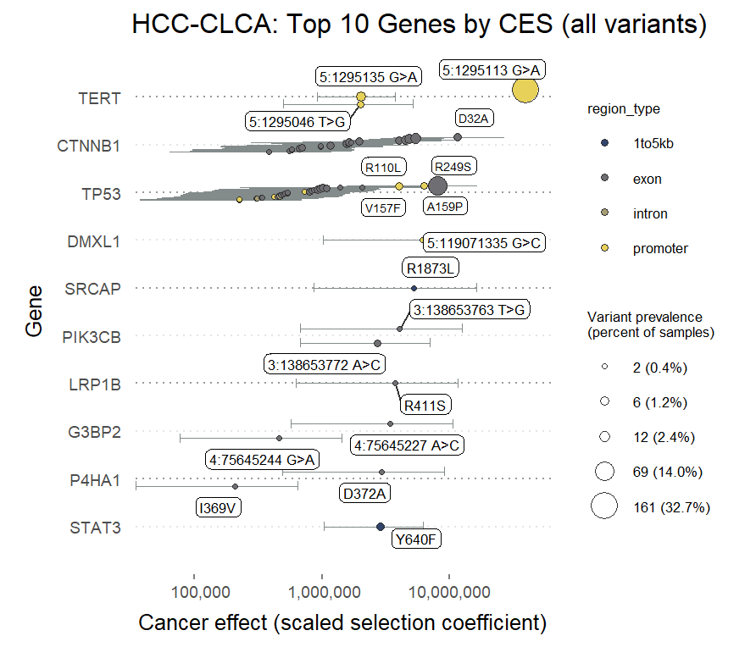
Figure 2.

Slide 3
