Slide 1

Temitope Badekale

Slide 2
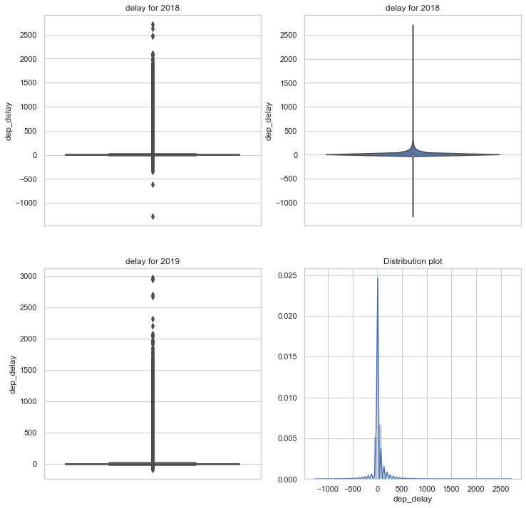
EDA-Question 1
Box plot and violin plot of departure delay.
Distribution of the departure delay is not normally distributed.
Ttest analysis using .normaltest in scipy.stats
The p_value was close to zero also confirming the departure delay is not normally distributed.

Slide 3
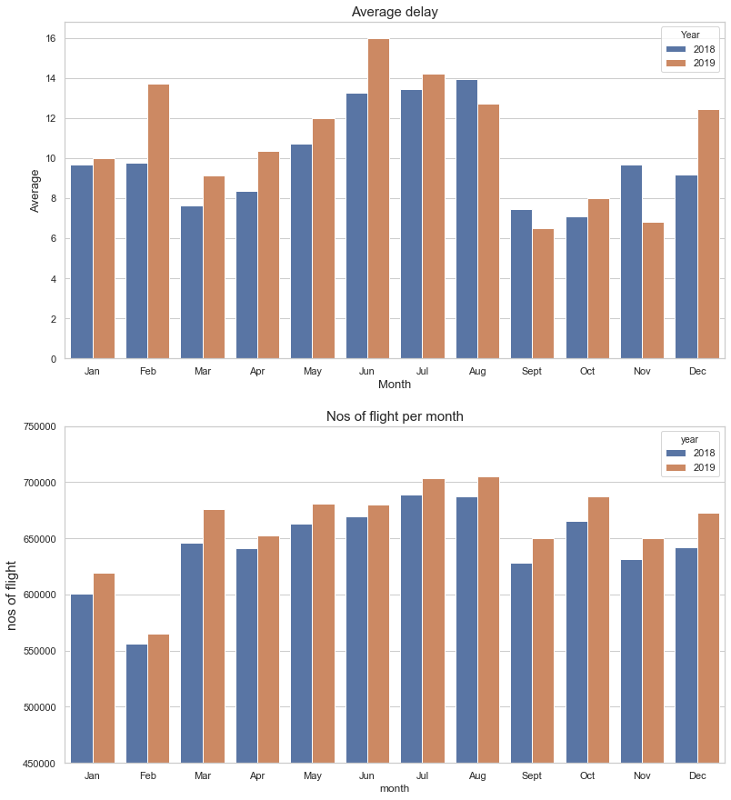
EDA-Question 2
The average monthly departure delay in 2018 is different from that of 2019.
For 2019:June,July,Aug have the highest Ave delay
For 2018 : Aug, July ,June
The number of flight is not the main factor for delay flight e.g. Oct and March.

Slide 4
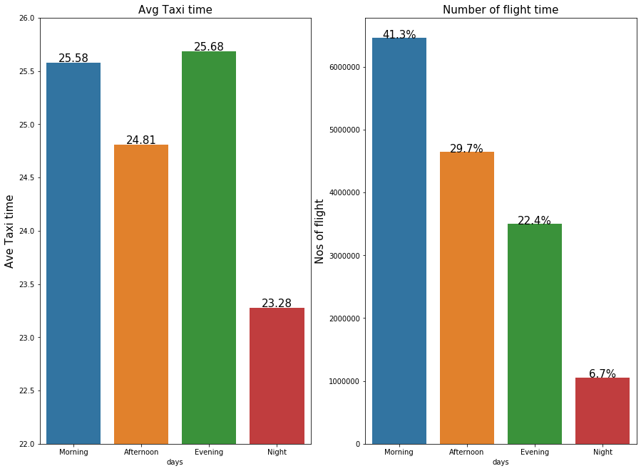
EDA-Question 4
Most flight occur in the morning .
The highest taxi time is in the Evening 5pm-9pm,Morning 5am – 12noon
Numbers of flight is not a big factor for taxi time evening period as low flight count
The number of flight is not a main factor for delay flight e.g. Oct and March.

Slide 5
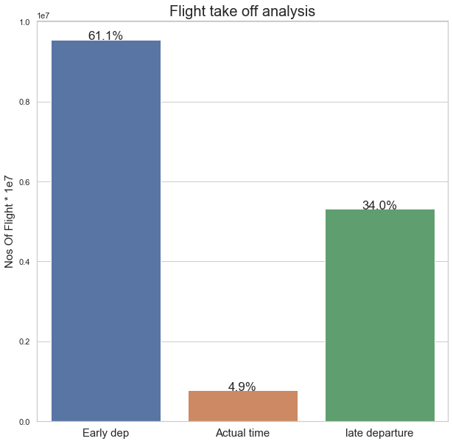
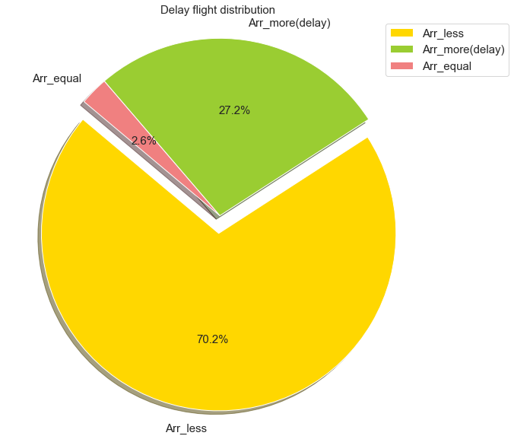
EDA-Question 5
Most flight have early departure.
Most flight with delay fly faster

Slide 6
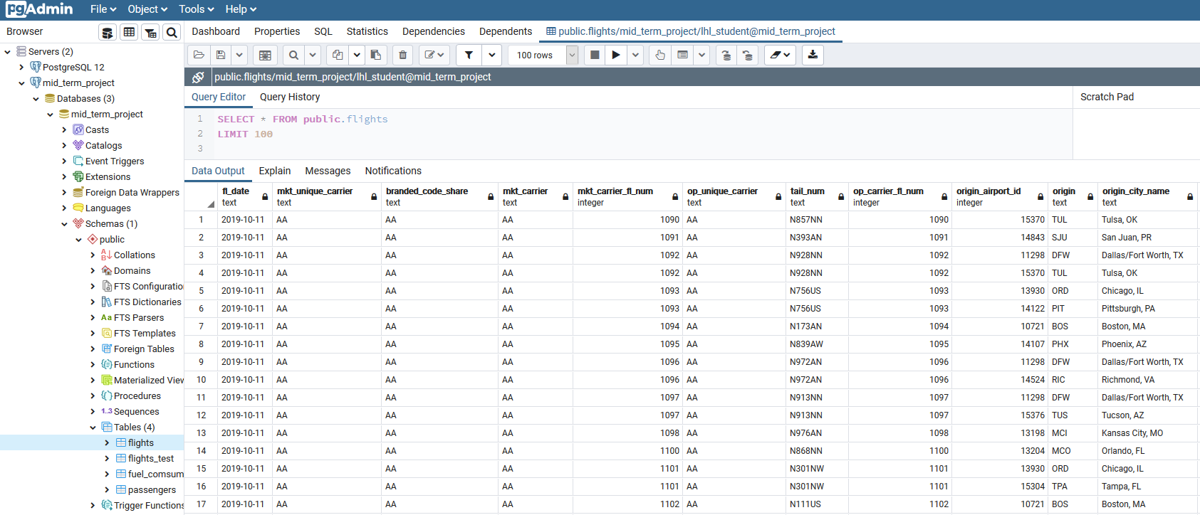
Regression
Connecting to the Database
Connect to the Data base using pgAdmin and psycopg2.connect in python.
The flights data as 15 million rows too much for my system to handle.
Use the command shell I randomly sample the data to 1 million rows

Slide 7
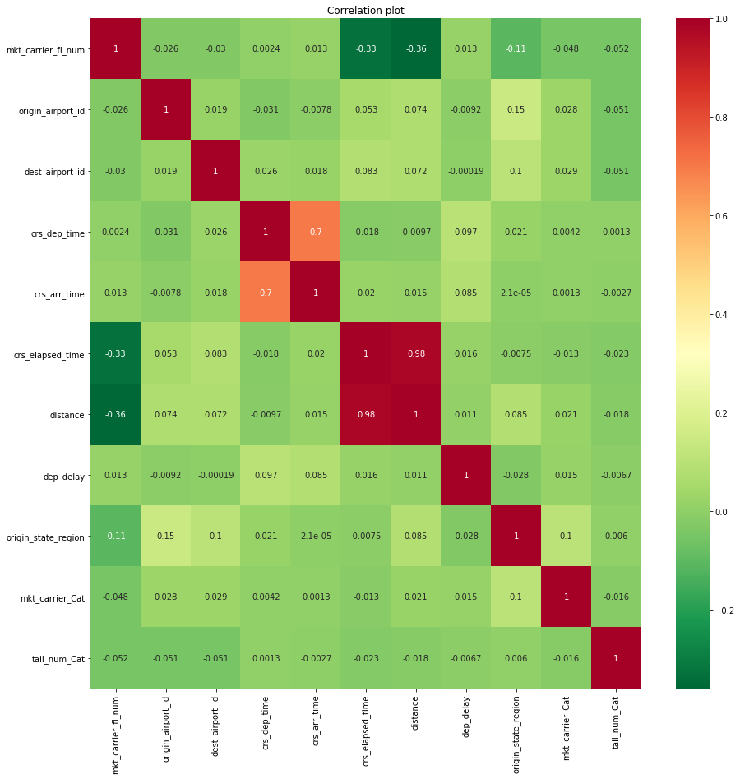
Regression
Data Wrangling
I have 42 columns in the origin data set but for the regression modeling I used 20.
I check the distribution of each columns on the subsample to confirm it represent the actual data well.
The 20 columns was further reduced to 13 because some of them where highly correlated like origin_airport_id , origin , origin_city_ name etc.
I checked for missing datas
I used sns.Pairplot and sns.heatmap for visual inspection of the data sample.

Slide 8
Regression
Feature Engineering
Months, Days of the week, Year
Weekends.
Airport size (using number of flight )
Region in the state (North-East, Midwest, South, West)
I now have 983308 rows, 18 columns to work with before running one hot encoding
Label Encoder and one hot encoding of variable
I did some binning like airport size by flight to small, medium, large and X-large based on the number of flight
Train test split (train size = 0.75)
It was an iterative process for me just to help improve my model

Slide 9
Linear Regression
Ridge
Lasso
Random Forest Regressor
XGB Regressor
SVM.SVR
Regression

Slide 10
Linear Regression
Performance Metrics
Mean Square Root - 2127.66
R2 score – 0.01541
Regression
Using normalize data the R2 value remains the same

Slide 11
Ridge Regression
Performance Metrics
Mean Square Root - 2127.66
R2 score – 0.01541
Regression
Ridge gave the best R2 compare to Linear , Lasso and Random forest.
I performed more feature engineering to optimize the R2 score .

Slide 12
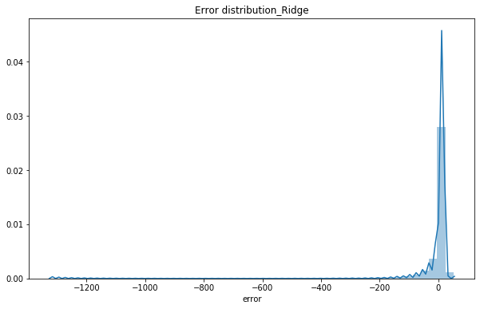
Observation
Ridge regression performed slightly better than Random forest, linear and Lasso
I could not use XGB Regressor and SVM.SVR due to high numbers of rows and low computing power
Regression

Slide 13
Conclusion
One of the reason I believed made my regression model not to perform well was because I could not get historical weather report.
I also could not use model like SVM.SVR, Xgboost and Grid search on my data due to lack of computing power.
Regression

