Slide 1

Temitope Badekale

Slide 2
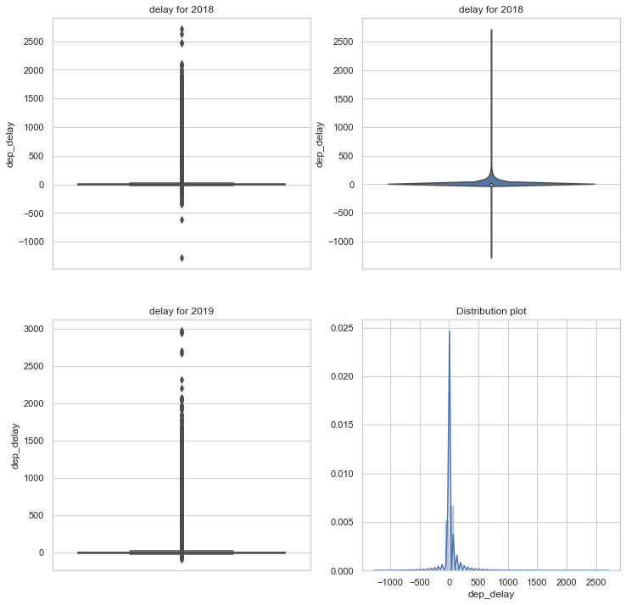
Question 1
Box plot and violin plot of departure delay.
Distribution of the departure delay is not normally distributed.
Ttest analysis using .normaltest in scipy.stats the p_value was close to zero also confirming the delay is not normally distributed.

Slide 3
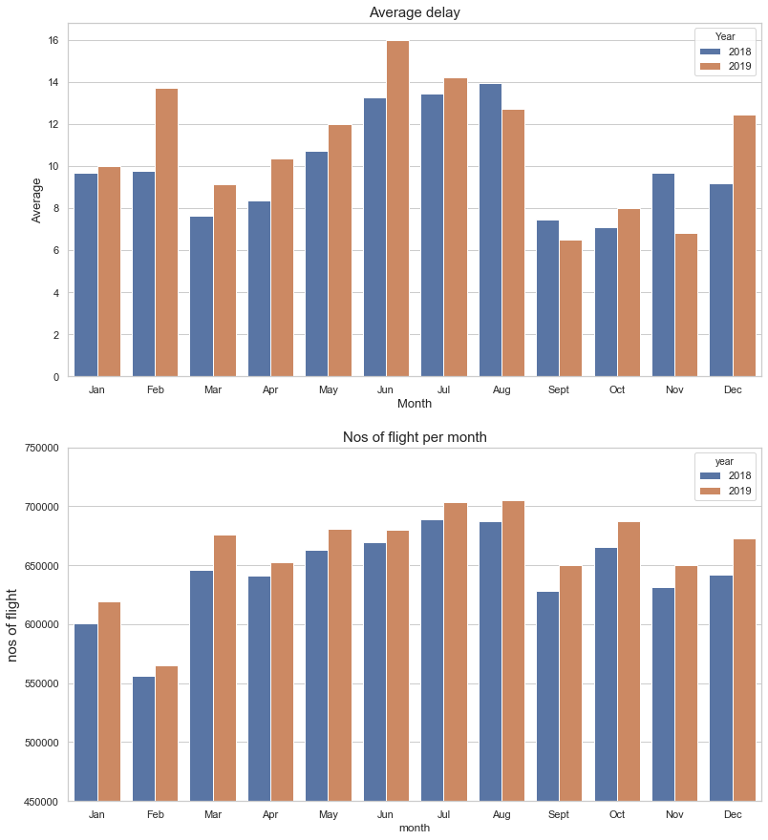
Question 2
The average monthly mean in 2018 is different from that of 2019.
For 2019:June,July,Aug have the highest Ave delay
For 2018 : Aug, July ,June
The number of flight is not the main factor for delay flight e.g. Oct and March.

Slide 4
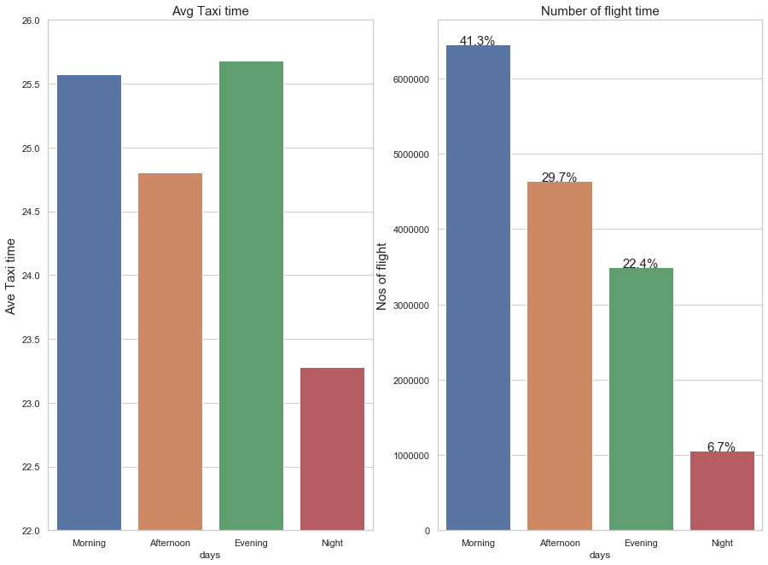
Question 4
Most flight occur in the morning .
The highest taxi time is in the Evening 5pm-9pm,Morning 5am – 12noon
Numbers of flight is not a big factor for taxi time evening period as low flight count
The number of flight is not a main factor for delay flight e.g. Oct and March.

Slide 5
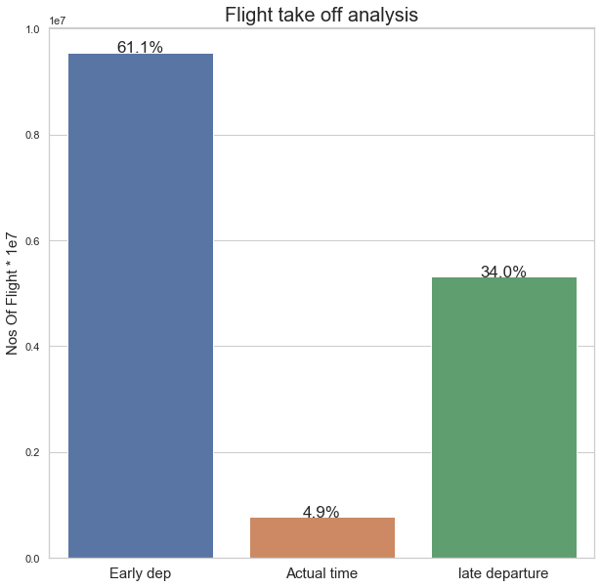
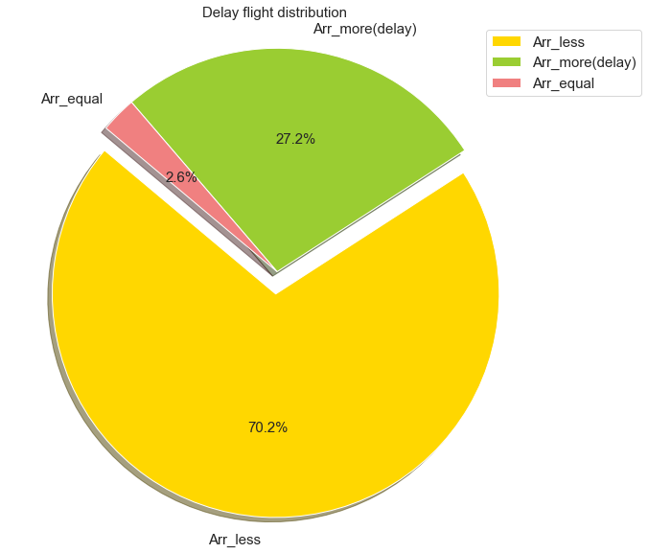
Question 5
Most flight have early departure.
Most flight with delay fly faster

