Slide 1
Prolog Debugging
Procedural Interpretation and Debugging Prolog Programs

Slide 2
Outcomes
How Prolog Programs are executed: the Procedural Interpretation
Tracing, Graphical Tracing, and Debugging Prolog Programs

Slide 3
Lesson Overview (Agenda)
In the following lesson, we will explore:
Declarative Knowledge in Prolog Programs and procedural interpretation
List notation preview
Tracing Prolog's Search
Graphical Tracing

Slide 4
DECLARATIVE MEANING
In Context 1, that is, writing a program in a file, OR at the user pseudofile prompt |:
A clause ends with a period.
A clause in this context is a statement that is true because you are stating that it is true.
When writing a Prolog program, you are defining a new world by stating what is true.
You write down a set of clauses in a file, each ending with a period,

Slide 5
DECLARATIVE MEANING
In Context 1, writing a program in a file OR at the user pseudofile prompt |:
thispred(arg).
  Means in English that (any or all of these)
  thispred is true of arg
    Example: dead(einstein).
    dead is true of einstein
    einstein is dead
  arg is thispred
    Example: blue(sky).
    sky is blue
  arg is a thispred
    Example: person(todd).
    todd is a person

Slide 6
DECLARATIVE MEANING
In Context 1, writing a program in a file OR at the user pseudofile prompt |:
thispred(X).
  Note that in this case, the uppercase X is a variable.
  We would probably not want to say things like this
  English meaning
    for all X, thispred is true of X no matter what X is
    for all X, X is thispred no matter what X is
    for all X, X is a thispred no matter what X is
X is called a singleton variable, because there are no other X's just one.
We can always use the anonymous variable _ to replace a singleton, which means this is equivalent thispred(_).

Slide 7
DECLARATIVE MEANING
In Context 1, writing a program in a file OR at the user pseudofile prompt |:
thispred(arg1, arg2).
  Means in English that (any or all of these)
  thispred is true of arg1 and arg2
    Example: parent(bill, joan).
      bill is parent of joan
    Example: greaterthan(two,one).
      two greaterthan one

Slide 8
DECLARATIVE MEANING
In Context 1, writing a program in a file OR at the user pseudofile prompt |:
thispred(arg1, X).
  Means in English that (any or all of these)
  For all X, thispred is true of arg1 and X no matter what X is
    Example: parent(bill, X).
      bill is parent of everbody
      bill is parent of X no matter what/who X is
thispred(X, arg2).
  Means in English that (any or all of these)
  For all X, thispred is true of X and arg2 no matter what X is
    Example: parent(X, bill).
      everybody is parent of bill
      X is parent of bill no matter what X is

Slide 9
DECLARATIVE MEANING
In Context 1, writing a program in a file OR at the user pseudofile prompt |:
thispred(X, Y).
  Means in English that (any or all of these)
  We would not want to say this.
  For all X, for all Y thispred is true of X and Y no matter what X and Y are
    Example: parent(X, Y).
      everybody is parent of everbody
      X is parent of Y no matter what/who X is and no matter what/who Y is
Note that X and Y are both singleton variables in this case, so we could rewrite it as below and it means the same thing:
thispred(_, _).

Slide 10
DECLARATIVE MEANING
In Context 1, writing a program in a file OR at the user pseudofile prompt |:
thispred(X, Y):-
this(X),
that(Y).
  Means in English that
  For all X, for all Y thispred is true of X and Y no matter what X and Y are if
  this(X) is true and that(Y) is true.
Note that neither X nor Y are singleton variables in this case, because they each appear more than once in the clause. The two X's have to be the same thing, and the two Y's have to be the same thing.

Slide 11
DECLARATIVE MEANING
In Context 1, writing a program in a file OR at the user pseudofile prompt |:
thispred(X, Y):-
this(X,Y);
that(X,Y).
  Means in English that
  thispred is true of X and Y if
  this(X,Y) is true or that(X,Y) is true.
The or character is optional. We could rewrite as two clauses without the or
thispred(X, Y):-
this(X,Y).
thispred(X, Y):-
that(X,Y).

Slide 12
Prolog List Notation Preview
Examples of lists:
[ a, b, c, d]
[]
[ ann, tennis, tom, running]
[ link(a,b), link(a,c), link(b,d)]
[ a, [b,c], d, [ ], [a,a,a], f(X,Y) ]

Slide 13
Head and Tail
L = [ a, b, c, d]
  a is head of L
  [ b, c, d] is tail of L
More notation, vertical bar:
  L = [ Head | Tail]
  L = [ a, b, c] = [ a | [ b, c]] = [ a, b | [ c]] = [ a, b, c | [ ] ]

Slide 14
PROCEDURAL INTERPRETATION OF
PROLOG PROGRAMS
The program we write in Prolog doesn't run until we
Launch the Prolog interpreter
Use consult to load our Prolog clauses into the interpreter's
issue a query at the ?- prompt, example ?- a,b,c.
The interpreter applies the procedural interpretation

Slide 15
PROCEDURAL INTERPRETATION
  Example query are a and b and c true: ?- a,b,c.
  If no parts of query remain, return variable binding
  Take the next part of the query off the front for scanning
  Scan the facts and the left side of rules for a match
  If a fact matches, apply the variable binding from the match, goto 1.
  If the left side of a rule matches, apply the variable binding, add the right side of the rule to the front of the query, goto 1.
  If nothing matches and there is a choice point, backtrack to 3
  Otherwise, fail

Slide 16
Tracing Prolog's Execution
When we debug a Prolog program, we watch the interpreter apply the procedural interpretation
Debugging Prolog: https://www.swi-prolog.org/pldoc/man?section=debugoverview
The following special predicates are available for tracing Prolog's execution
trace/0 : for goals that follow, go step by step, displaying information
notrace/0 : stop further tracing
spy(P) : specifies that predicate P (example, parent) be traced
nospy(P) : stops tracing of predicate P

Slide 17
Examples of Tracing
Let's try tracing our family and ancestor predicates
?- trace.
true.
[trace] ?- parent(X,bob).
Call: (8) parent(_5980, bob) ? creep
Exit: (8) parent(bill, bob) ? creep
X = bill ;
Redo: (8) parent(_5980, bob) ? creep
Exit: (8) parent(joan, bob) ? creep
X = joan.
[trace] ?-
Enter/return to creep one step at a time
Semicolon to find other solutions

Slide 18
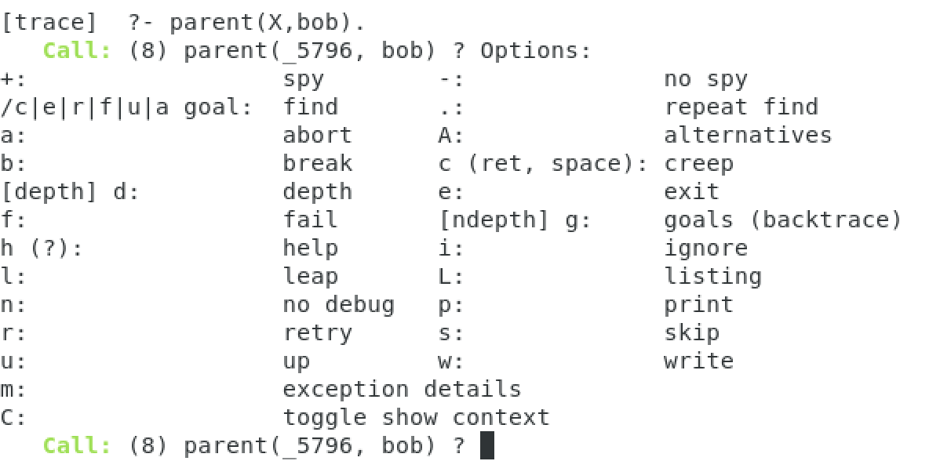
Examples of Tracing
Question mark ? for help:

Slide 19
Tracing command examples
Command Name | command | meaning
creep | c or space or carriage return | proceed to the next step in the trace
leap | l | continue execution, stop at next spy point, if any
abort | a | abort prolog execution
no debug | n | continue execution in "no debug" mode
skip | s | skip tracing of calls to children of this goal

Slide 20
Time to check your learning!
Let’s see how many key concepts from tracing you recall by answering the following questions!
How does the user turn on goal tracing?
How does the user turn off goal tracing?
What command would abort the goal and return to the prolog prompt?

Slide 21
Graphical Tracing
Resource: https://www.swi-prolog.org/gtrace.html
The graphical tracing facility helps the programmer view the tracing process by showing source code, variable bindings, and the call stack
Graphical tracing is turned on with the built-in predicate, guitracer/0
Thereafter, tracing, when turned on, will be done in a graphical window.
We can turn on graphical mode and tracing mode at the same time: gtrace/0
We can turn off graphical mode with noguitracer/0

Slide 22
Time to check your learning!
Let’s see how many key concepts from topic graphical tracing you recall by answering the following questions!
How can the programmer turn on graphical tracing?
What is the difference between guitracer(0) and gtrace(0)?

Slide 23
Conclusion
In this lesson, you learned how to step through prolog's execution for the purposes of debugging.
In the next lesson, you will learn to use prolog structures and matching.

