Slide 1
Knowledge Representation: Logic

Slide 2
Knowledge Representation Languages
Mathematical Logic Hierarchy
Proposition Calculus (0th order)
  No variables or quantifiers
  Propositions together with logical connectives
Predicate Calculus (1st order)
  Adds Variables for terms, and quantification
Second Order Logics (2nd order)
  Adds variables for predicates

Slide 3
Propositional Calculus
Propositions are true or false
  The moon is made of cheese
  Socrates is a man
  Men are mortal
  The population of the world is 3 million
Questions are not propositions
  What is the meaning of life, the universe, and everything?
  Where is the door?

Slide 4
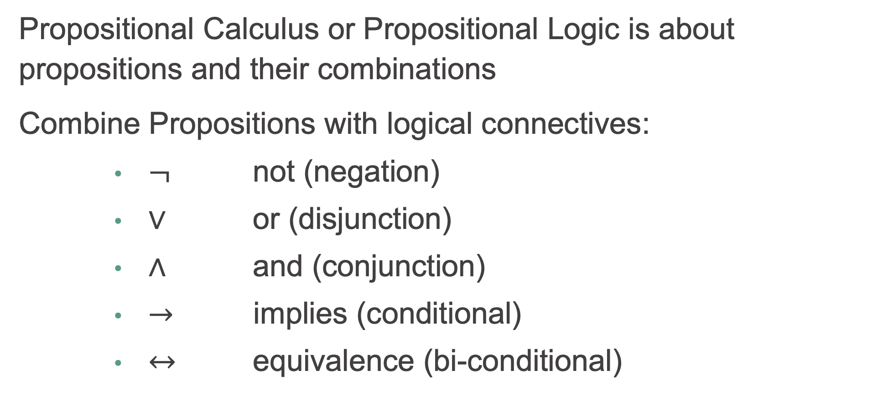
Propositional Calculus (cont'd)
Propositional Calculus or Propositional Logic is about propositions and their combinations
Combine Propositions with logical connectives:
  $¬$ not (negation)
  $∨$ or (disjunction)
  $∧$ and (conjunction)
  $→$ implies (conditional)
  $↔$ equivalence (bi-conditional)

Slide 5
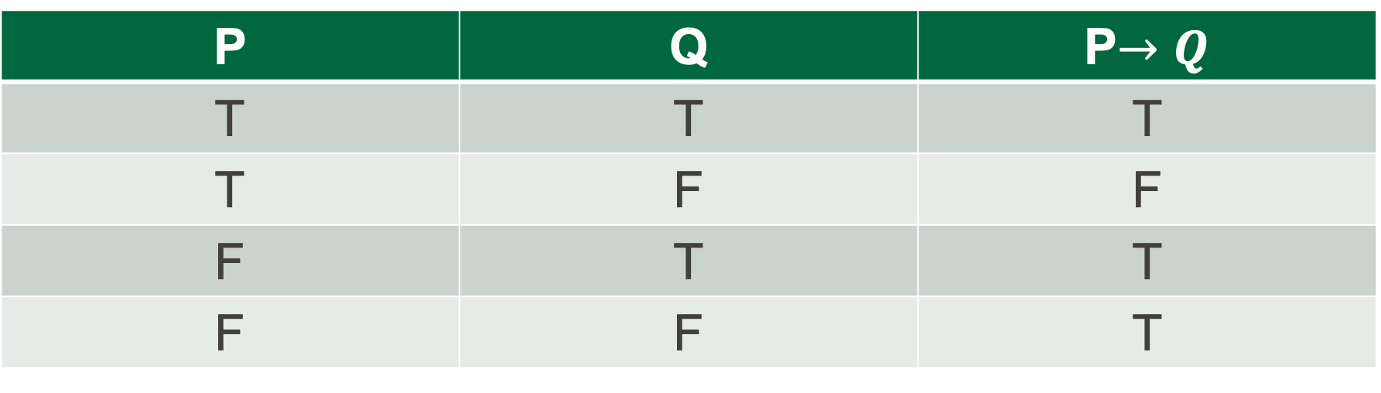
Truth tables
How logical are humans?
Truth tables show the truth value of propositions and their combinations
We can use symbols like p and q to represent propositions
P | Q | P$→Q$
T | T | T
T | F | F
F | T | T
F | F | T

Slide 6
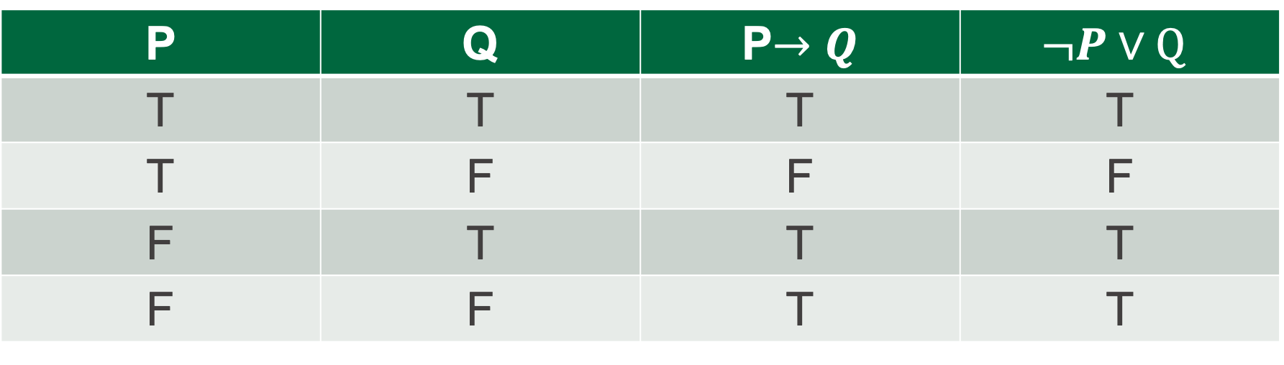

Logical Equivalence
It turns out we don't need all of the connectives
Truth table proves P$→Q$ is logically equivalent to $¬P∨Q$
There is no way to assign values to P or Q to make these two formulas (formulae) different
P | Q | P$→Q$ | $$¬P∨Q$$
T | T | T | T
T | F | F | F
F | T | T | T
F | F | T | T

Slide 7

When P is false
Many of us have some trouble with the last line of the previous truth table:
P | Q | P$→Q$
F | F | T
Our intuition tells us that so much falsity in P and Q cannot result in truth?
Explanation: P->Q is not as strong as our human intuition wants to make it. It's saying that if P is true, then there is more to the story. But if P is false, you can stop reading, the story is already finished, in that we know the overall statement is true.

Slide 8
When P is false (cont'd)
Think of the following P->Q, F -> F statement, which is true:
If 2 < 1 then all humans are extremely wealthy
Our human intuition wants to say, no it's not true, because "making" 2 < 1 true would not cause humans to be wealthy, the concepts are unrelated
After we get used to it, we can see that 2<1 is simply false, and it doesn't make sense to imagine "making" it true. The "making" it true is not part of the statement (it's a weak statement).
Our intuition wants to draw a causal relationship between "making" P true, and causing Q (all humans to be wealthy).
Our intuition wants to say "no such relationship exists" so "false"
Logic says if P is false, then the statement is true and it doesn't matter what Q is

Slide 9
Why do we care about logic?
Propositional Calculus is a tool that allows us to derive conclusions from combinations of simpler statements known to be true
We are seeing the workings of a system where we can
  Make statements that we know to be true
  The logical entailments of those statements are also true
  Prolog systematically finds logical entailments

Slide 10
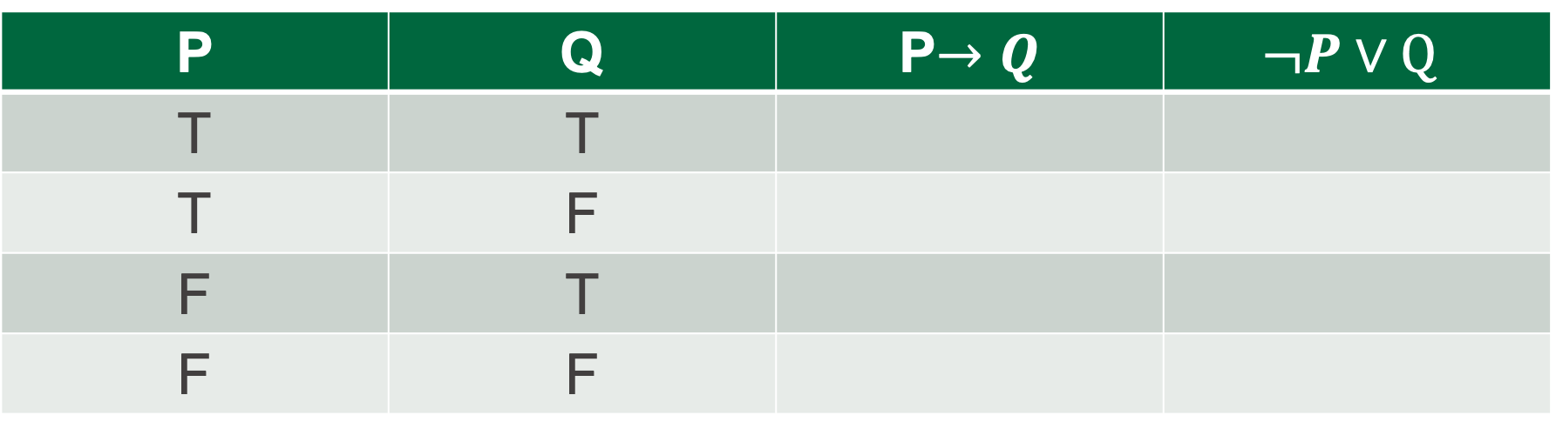
Time to check your learning!
Let’s see how many key concepts from propositional calculus you recall by filling in the truth table:
P | Q | P$→Q$ | $$¬P∨Q$$
T | T
T | F
F | T
F | F

Slide 11
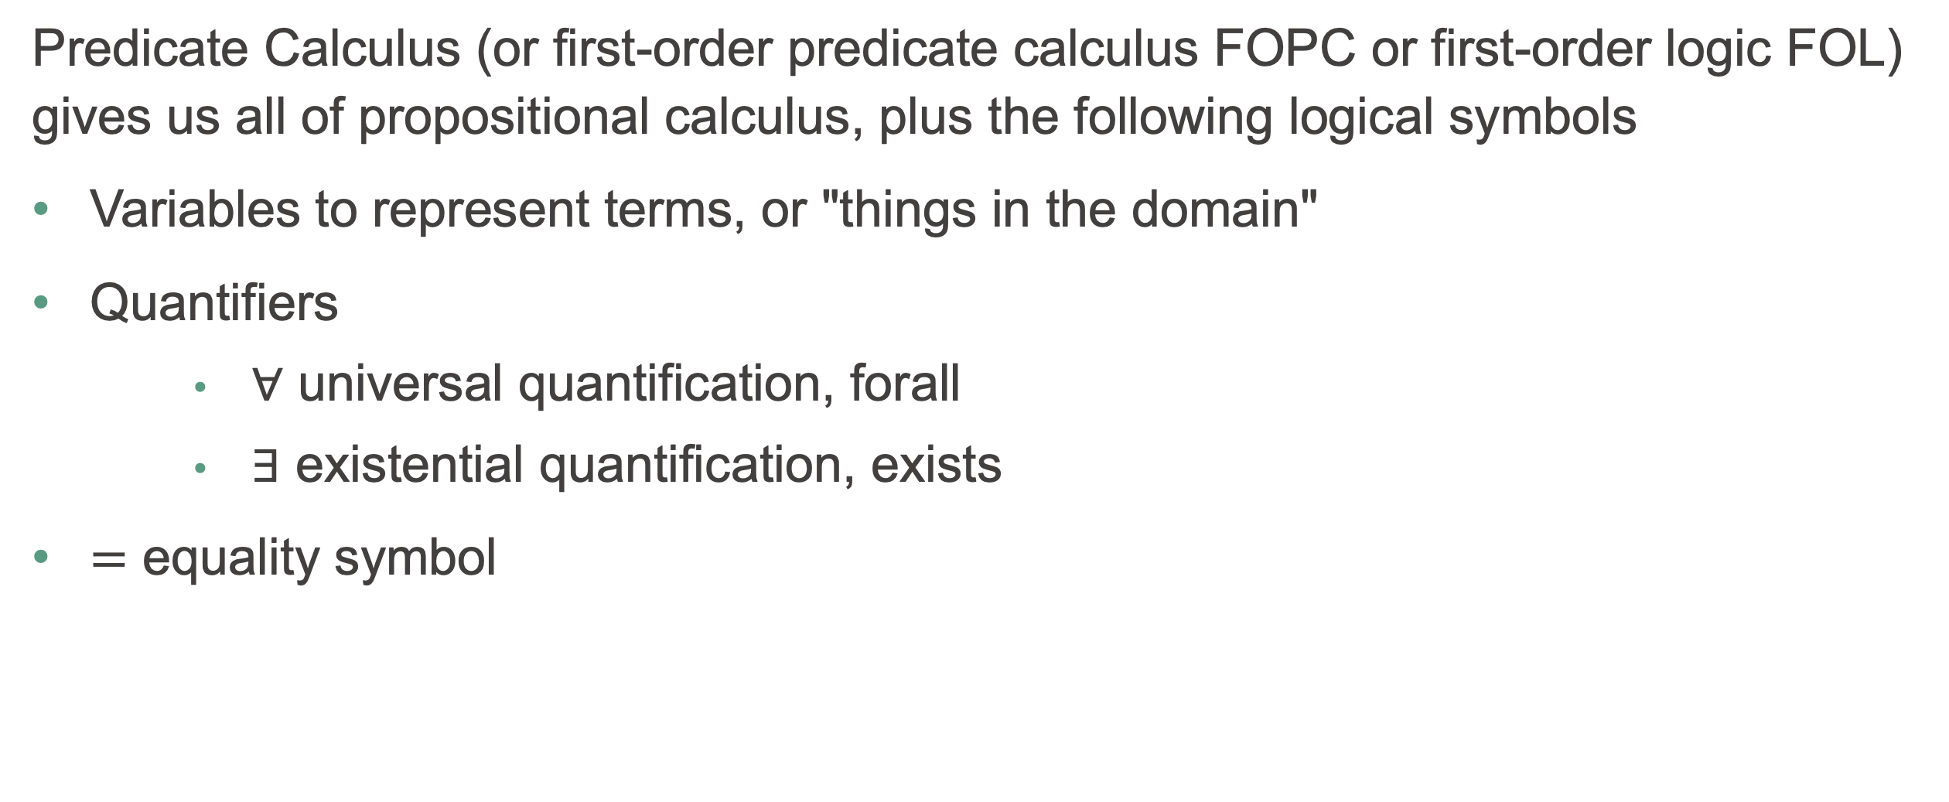
Predicate Calculus
Predicate Calculus (or first-order predicate calculus FOPC or first-order logic FOL) gives us all of propositional calculus, plus the following logical symbols
Variables to represent terms, or "things in the domain"
Quantifiers
  $∀$ universal quantification, forall
  $∃$ existential quantification, exists
$=$ equality symbol

Slide 12
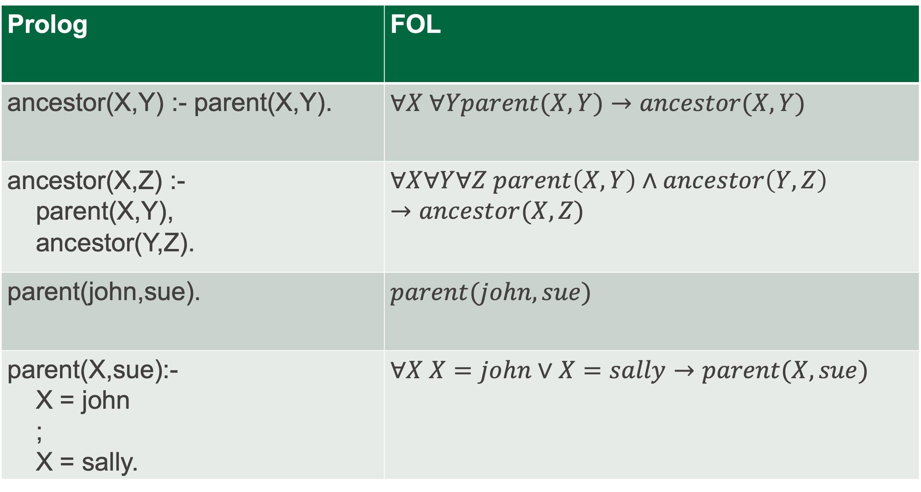
First Order Logic equivalents to Prolog statements
Prolog | FOL
ancestor(X,Y) :- parent(X,Y). | $$∀X ∀Yparent(X,Y)→ancestor(X,Y)$$
ancestor(X,Z) :- parent(X,Y), ancestor(Y,Z). | $$∀X∀Y∀Z parent\left(X,Y\right)∧ancestor\left(Y,Z\right)→ancestor(X,Z)$$
parent(john,sue). | $$parent(john,sue)$$
parent(X,sue):- X = john ; X = sally. | $$∀X X=john∨X=sally→parent(X,sue)$$

Slide 13
Predicate Calculus (cont'd)
As well as the additional logical symbols, predicate calculus adds non-logical symbols:
function symbols of different arity
for example: +, -, 0, 1, 2, todd, triangle
predicate symbols of different arity
for example: <, rides_a_bike, triangle_exists,

Slide 14
First-order terms represent things
With the additional symbols, we can build terms that represent things in our domain of discourse:
Variables: Any variable is a term.
Functions: Any expression f(t₁,...,t_{n}) of n arguments, where each argument t_{i} is a term and f is a function symbol of arity n, is a term.
Constants: A special case of a function term where the arity is 0

Slide 15
Term examples
+(3,4) : a term that denotes a number
  3 is a constant, which strictly speaking is a function that takes no arguments
  4 is another function of no arguments
  + is a function of arity 2
temperature_of(mars) : a term that denotes a temperature
  mars is a constant
  temperature_of is a function of arity 1

Slide 16
FOL Formulas represent statements about things
We saw that terms represent things.
Formulas, or well-formed formulas (formulae), or wwfs, are built up from predicates (and equality) that take terms as arguments, and make true or false statements about things
for example:
  =(+(1,1),2)
  <(temperature_of(mars),3)
  rides_a_bike(todd)

Slide 17
Prolog terminology vs Predicate Calculus terminology
Unfortunately, the terminology differs between the Predicate Calculus and Prolog:
term in FOL
  is a function applied to zero or more arguments
  represents a thing,
    for example +(3,4) with two arguments represents a number, seven
    4 with zero arguments represents a number, four
    mother_of(bob) with one argument represents a person, bob's mother
Atomic Well-formed formula (WWF), also called "atom", in FOL
  is a predicate applied to zero or more arguments which are terms
  represents a true-or-false statement about zero or more terms (things)

Slide 18

Prolog terminology vs Predicate Calculus terminology
(cont'd)
Non-atomic WWF in FOL
  Is also a statement
  Involves logical connectives like $¬, ∧,∨$ (not, and, or)

Slide 19
Prolog terminology vs Predicate Calculus terminology
term in Prolog is any structure:
  Functions applied to arguments
    +(3,4)
    mother_of(bob)
  Predicates applied to arguments
    >(4,3)
    parent(bill,bob)
  Everything is a term, even something such as a:-b,c
    :-(a,','(b,c))
atom in Prolog is a function of no arguments, such as a, todd, etc
numbers in prolog are also functions of no arguments, such as 3, 66, etc

Slide 20
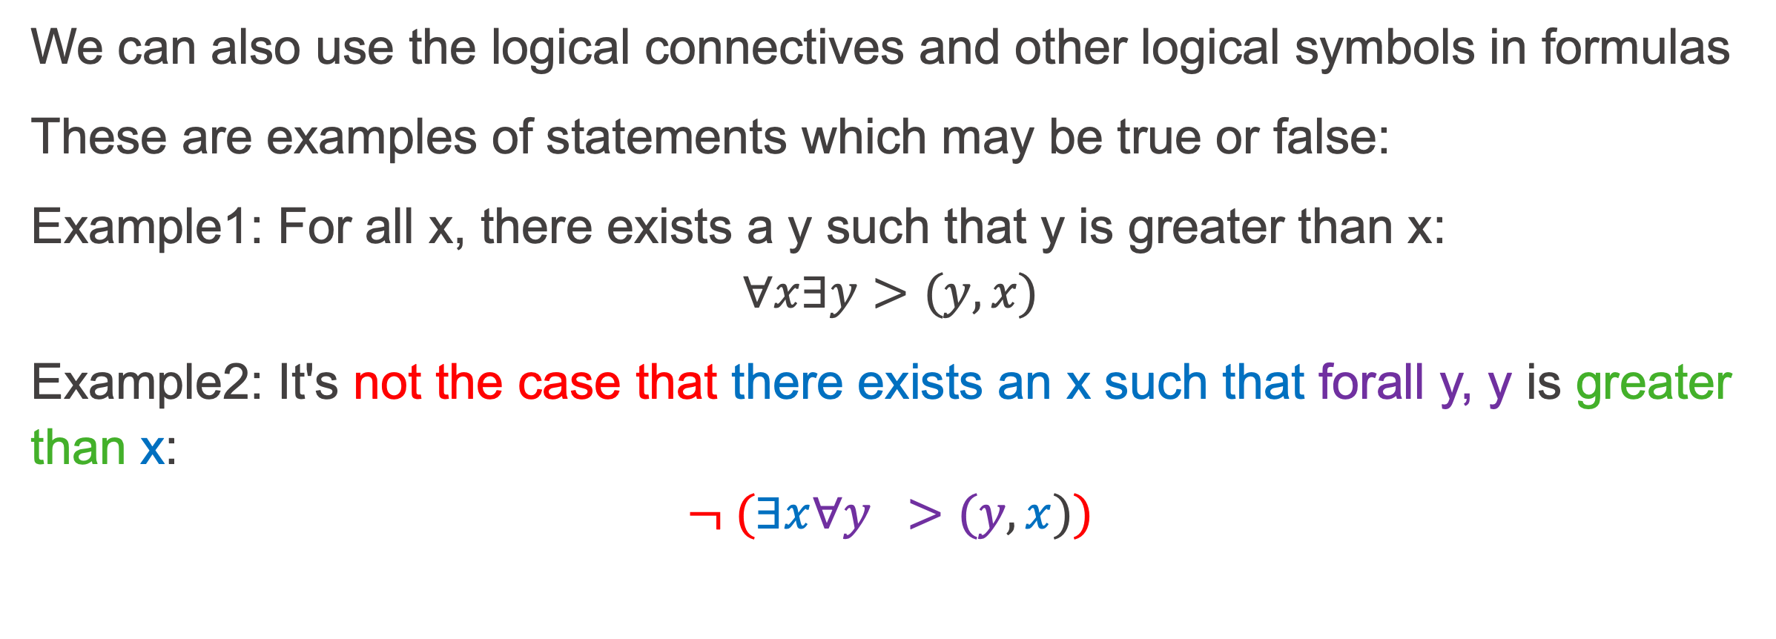
FOL Formulas (cont'd)
We can also use the logical connectives and other logical symbols in formulas
These are examples of statements which may be true or false:
Example1: For all x, there exists a y such that y is greater than x:
$$∀x∃y>(y,x)$$
Example2: It's not the case that there exists an x such that forall y, y is greater than x:
$$¬ (∃x∀y >(y,x))$$

Slide 21
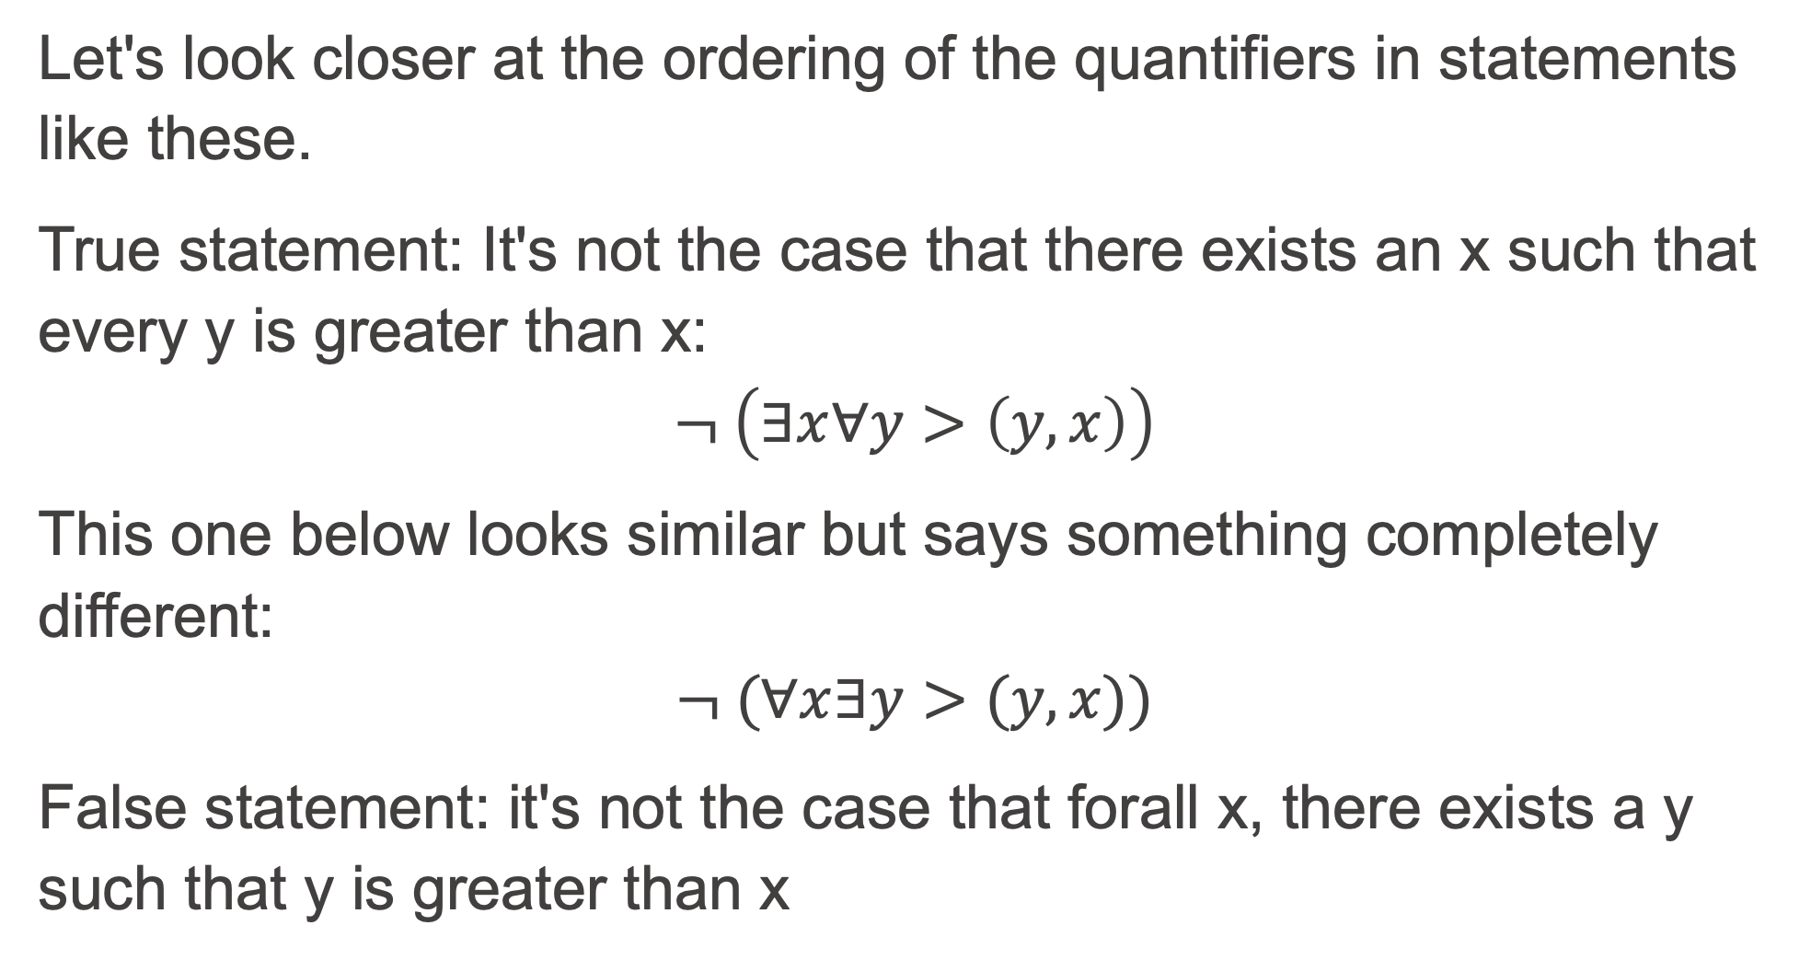
Formulas (cont'd)
Let's look closer at the ordering of the quantifiers in statements like these.
True statement: It's not the case that there exists an x such that every y is greater than x:
$$¬ \left(∃x∀y>\left(y,x\right)\right)$$
This one below looks similar but says something completely different:
$$¬ (∀x∃y>(y,x))$$
False statement: it's not the case that forall x, there exists a y such that y is greater than x

Slide 22
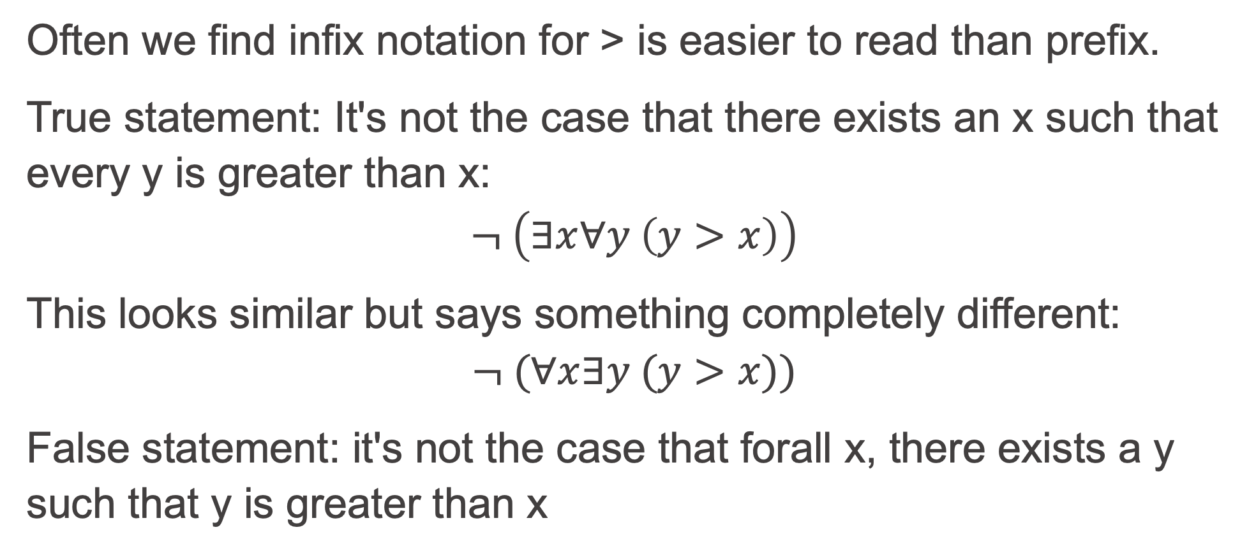
More reader friendly with infix notation of greater-than?
Often we find infix notation for > is easier to read than prefix.
True statement: It's not the case that there exists an x such that every y is greater than x:
$$¬ \left(∃x∀y \left(y>x\right)\right)$$
This looks similar but says something completely different:
$$¬ (∀x∃y (y>x))$$
False statement: it's not the case that forall x, there exists a y such that y is greater than x

Slide 23
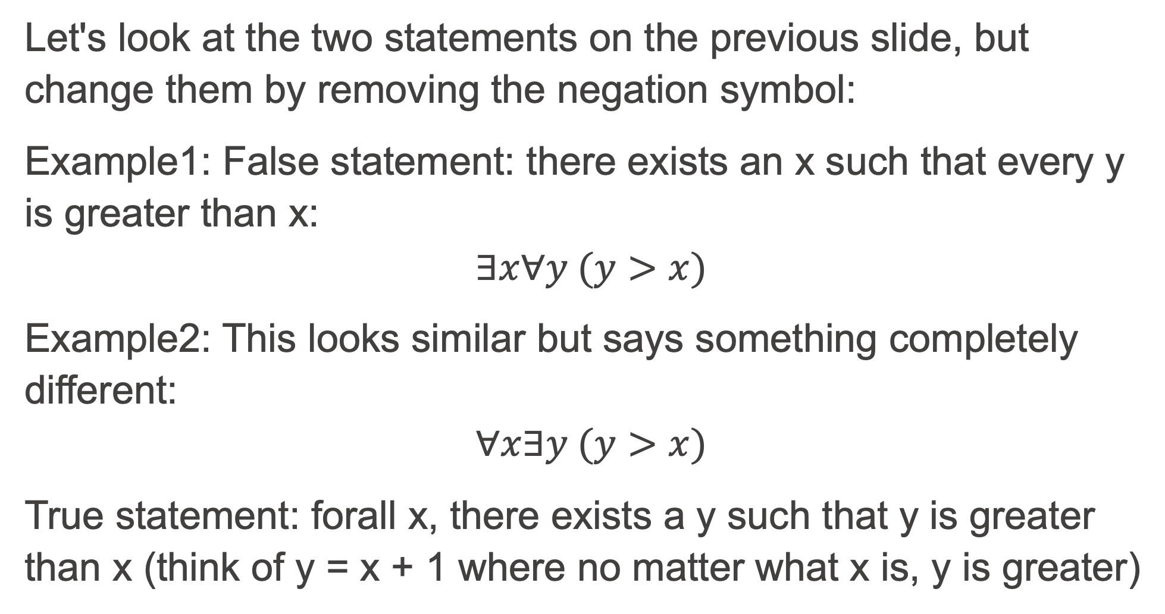
Now, without the negation
Let's look at the two statements on the previous slide, but change them by removing the negation symbol:
Example1: False statement: there exists an x such that every y is greater than x:
$$∃x∀y (y>x)$$
Example2: This looks similar but says something completely different:
$$∀x∃y (y>x)$$
True statement: forall x, there exists a y such that y is greater than x (think of y = x + 1 where no matter what x is, y is greater)

Slide 24
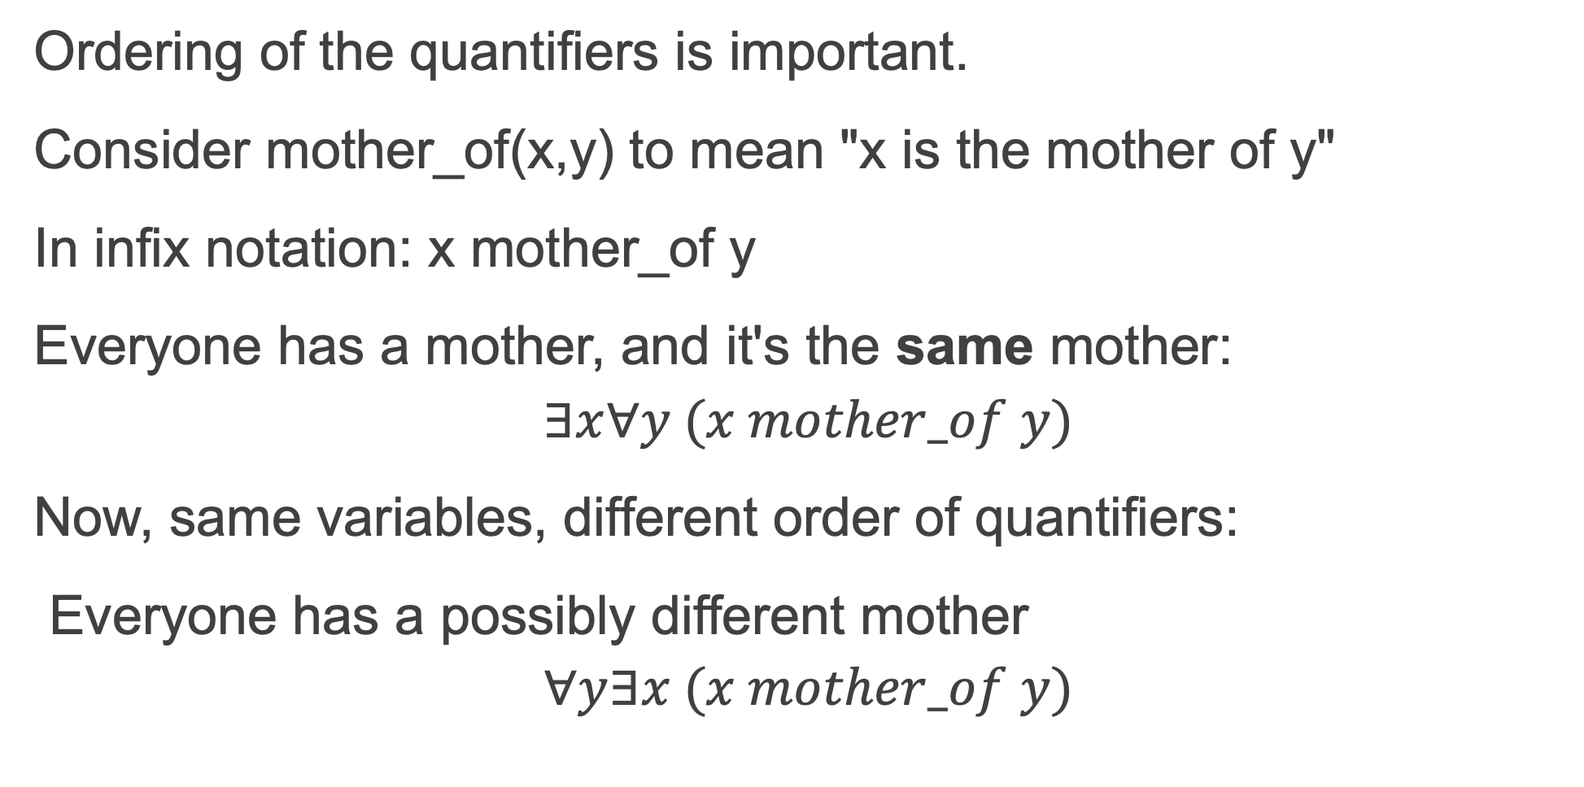
More intuitive example?
Ordering of the quantifiers is important.
Consider mother_of(x,y) to mean "x is the mother of y"
In infix notation: x mother_of y
Everyone has a mother, and it's the same mother:
$$∃x∀y (x mother_of y)$$
Now, same variables, different order of quantifiers:
Everyone has a possibly different mother
$$∀y∃x (x mother_of y)$$

Slide 25
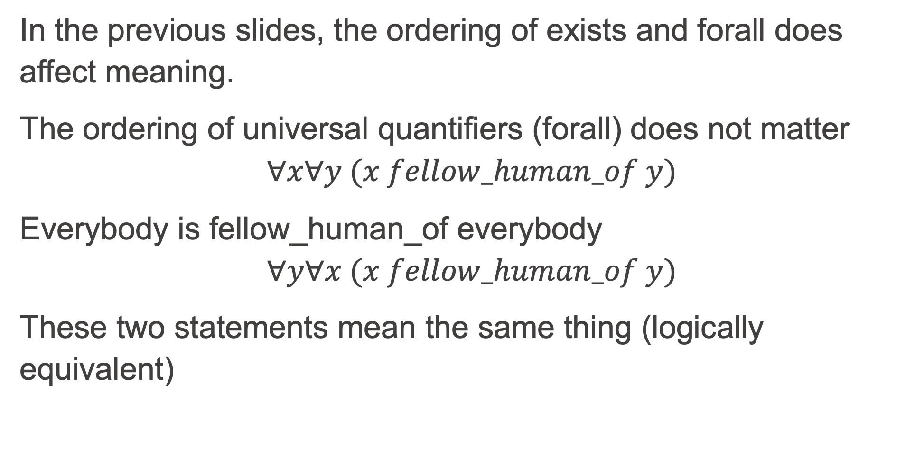
Order of universal quantifiers?
In the previous slides, the ordering of exists and forall does affect meaning.
The ordering of universal quantifiers (forall) does not matter
$$∀x∀y (x fellow_human_of y)$$
Everybody is fellow_human_of everybody
$$∀y∀x (x fellow_human_of y)$$
These two statements mean the same thing (logically equivalent)

Slide 26
Free variables
A variable that is not bound to any quantifier in a formula is called a free variable
We don't want to write logical sentences with free variables because those variable values depend on the interpretation
We are trying to say things that are true regardless of interpretation, and free variables prevent that
So, when we see free variables in Sitcalc or Prolog, they aren't actually free, they are implicitly prenex universally quantified

Slide 27
Prenex universal quantification
A formula is in prenex normal form when all the quantifiers are together on the left side of the formula, in what's called the prefix.
A related idea is prenex universal quantification, which is when a variable is universally quantified and the quantifier is in the prefix.
If there are no free variables in a formula, and all quantifiers in the prefix are universal, then we can drop the prefix if we assume all resulting free variables are prenex universally quantified

Slide 28
FOL Axioms
We can “create” a new world by making statements that are true in that world, very much like an author writing a novel makes statements about what is true in that novel world.
Unlike a novelist, we make our statements using first-order logic sentences instead of (for example) English sentences.
The statements we make in first-order logic, to specify a world, are called axioms
Axioms are taken to be true without proof because they are stated, similarly to how a novelist makes statements about the characters of a novel
Axioms must be consistent, because a contradiction can be used to prove anything by contradiction (inconsistent axioms are useless to us).

Slide 29
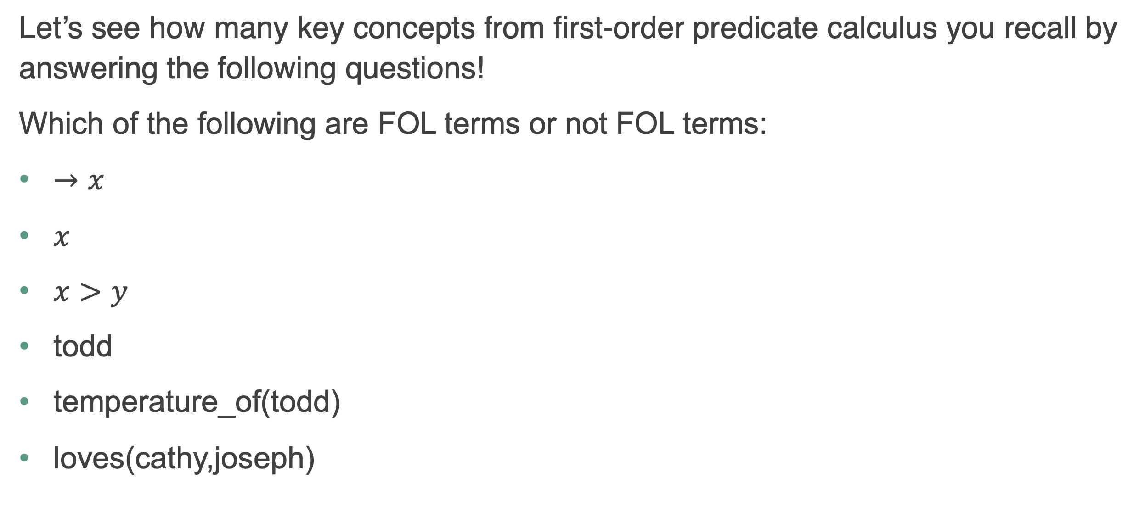
Time to check your learning!
Let’s see how many key concepts from first-order predicate calculus you recall by answering the following questions!
Which of the following are FOL terms or not FOL terms:
$→x$
$x$
$x>y$
todd
temperature_of(todd)
loves(cathy,joseph)

Slide 30
Higher-order logic
Second-order (and higher-order) logic involves quantifying over not just variables (terms), but also predicates
These systems are more expressive, but things get complicated
Their model-theoretic properties are less well-behaved than those of first-order logic
In this course, we will limit our scope to First Order Logic (FOL) in order to benefit from the nice model-theoretic properties of FOL
First Order Logic can be converted to clausal form
All Prolog programs are sets of Horn clauses, a specific clausal form

Slide 31
Time to check your learning!
Let’s see how many key concepts from Higher Order Logic you recall by answering the following questions!
If Higher-Order logics are more expressive, why do we limit ourselves to First-Order logic in this course?

