Slide 1
Knowledge Representation: Logic To CNF To Prolog

Slide 2
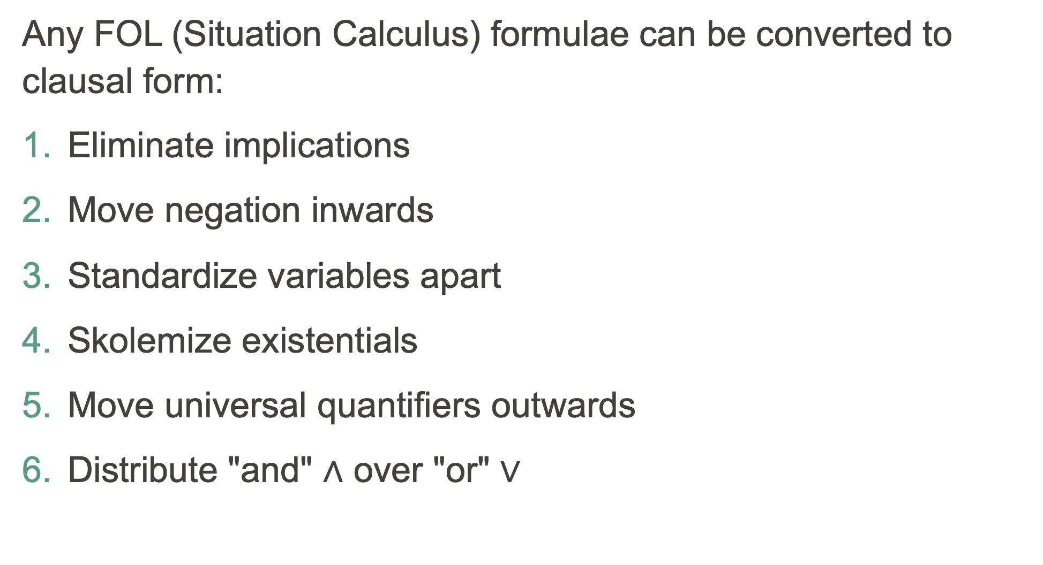
Clausal Normal Form
Any FOL (Situation Calculus) formulae can be converted to clausal form:
Eliminate implications
Move negation inwards
Standardize variables apart
Skolemize existentials
Move universal quantifiers outwards
Distribute "and" $∧$ over "or" $∨$

Slide 3

CNF Step 1: remove implication
$$P→Q$$
becomes the logically equivalent
$$¬P∨Q$$
Example
$$∀x man\left(x\right)→human\left(x\right)$$
Becomes
$$∀x ¬man\left(x\right)∨human\left(x\right)$$

Slide 4
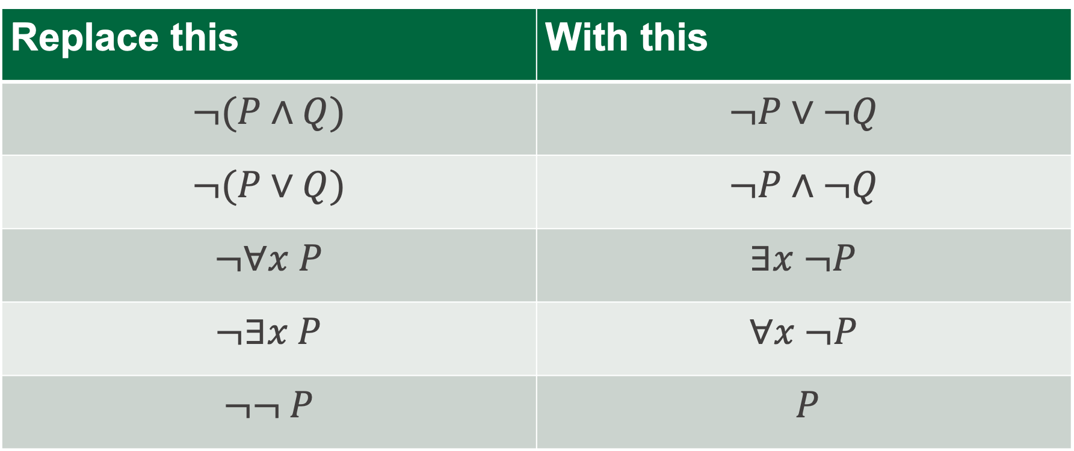
CNF Step 2: move negation inwards
Replace this | With this
$$¬(P∧Q)$$ | $$¬P∨¬Q$$
$$¬(P∨Q)$$ | $$¬P∧¬Q$$
$$¬∀x P$$ | $$∃x ¬P$$
$$¬∃x P$$ | $$∀x ¬P$$
$$¬¬ P$$ | $$P$$

Slide 5
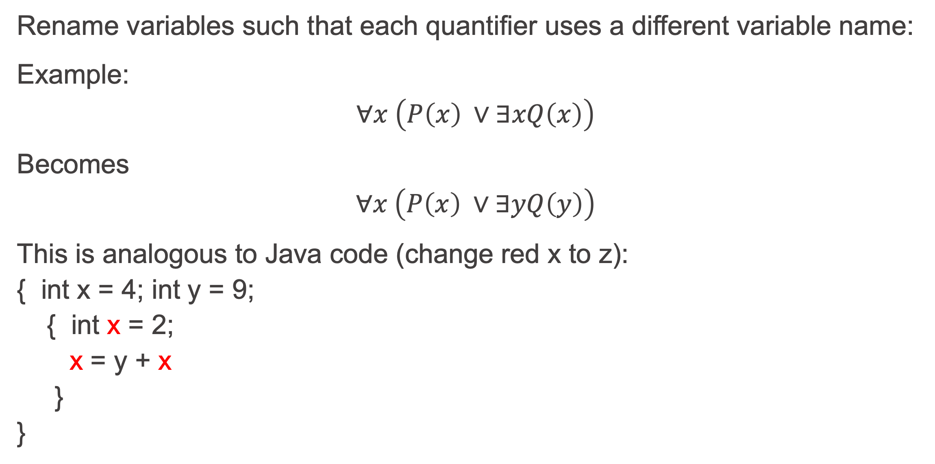
CNF Step 3: Standardize Variables Apart
Rename variables such that each quantifier uses a different variable name:
Example:
$$∀x \left(P\left(x\right) ∨∃xQ\left(x\right)\right)$$
Becomes
$$∀x \left(P\left(x\right) ∨∃yQ\left(y\right)\right)$$
This is analogous to Java code (change red x to z):
{ int x = 4; int y = 9;
{ int x = 2;
x = y + x
}
}

Slide 6
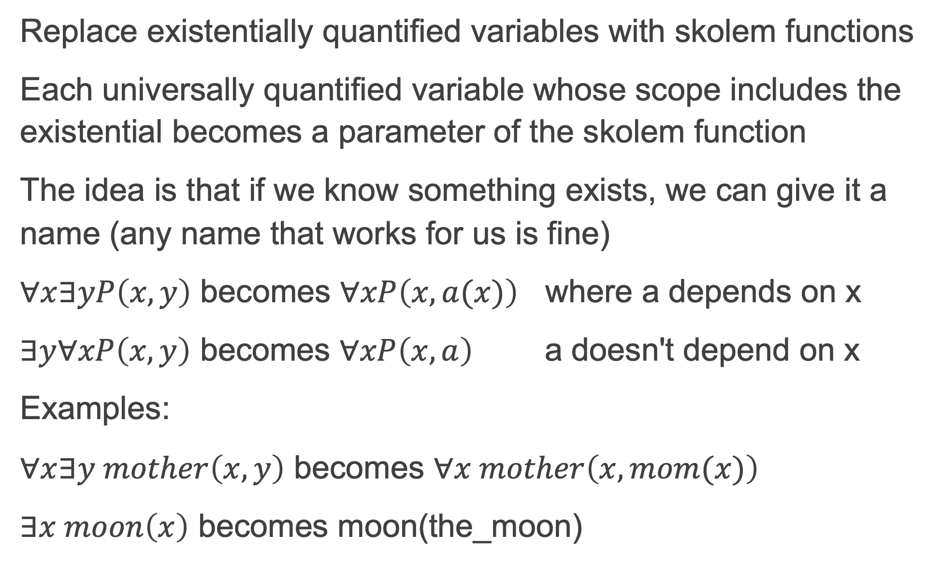
CNF Step 4: Skolemize
Replace existentially quantified variables with skolem functions
Each universally quantified variable whose scope includes the existential becomes a parameter of the skolem function
The idea is that if we know something exists, we can give it a name (any name that works for us is fine)
$∀x∃yP\left(x,y\right)$ becomes $∀xP\left(x,a(x)\right)$ where a depends on x
$∃y∀xP\left(x,y\right)$ becomes $∀xP\left(x,a\right)$ a doesn't depend on x
Examples:
$∀x∃y mother\left(x,y\right)$ becomes $∀x mother\left(x,mom(x)\right)$
$∃x moon\left(x\right)$ becomes moon(the_moon)

Slide 7
CNF Step 5: move universal quantifiers outwards
After skolemizing, we have only universal quantifiers
Because we've standardized variables apart, we can move them all to the outer left
In fact, we can now assume all variables are universally quantified, and just drop the universal quantifiers

Slide 8
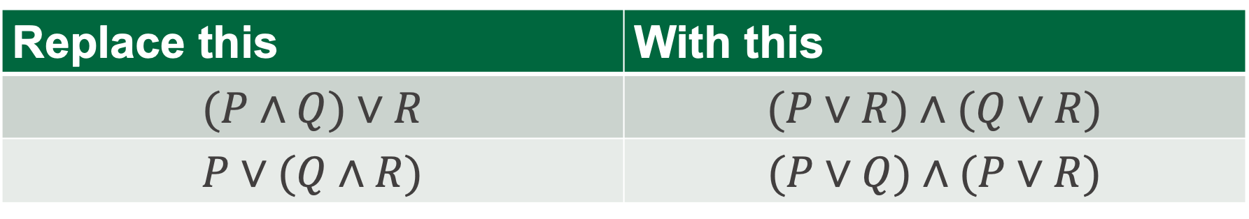
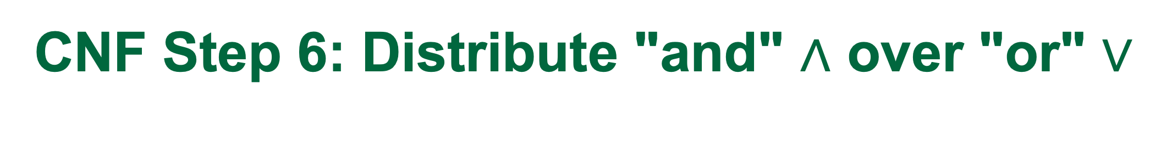
CNF Step 6: Distribute "and" $∧$ over "or" $∨$
Replace this | With this
$$(P∧Q)∨R$$ | $$(P∨R)∧(Q∨R)$$
$$P∨(Q∧R)$$ | $$(P∨Q)∧(P∨R)$$

Slide 9

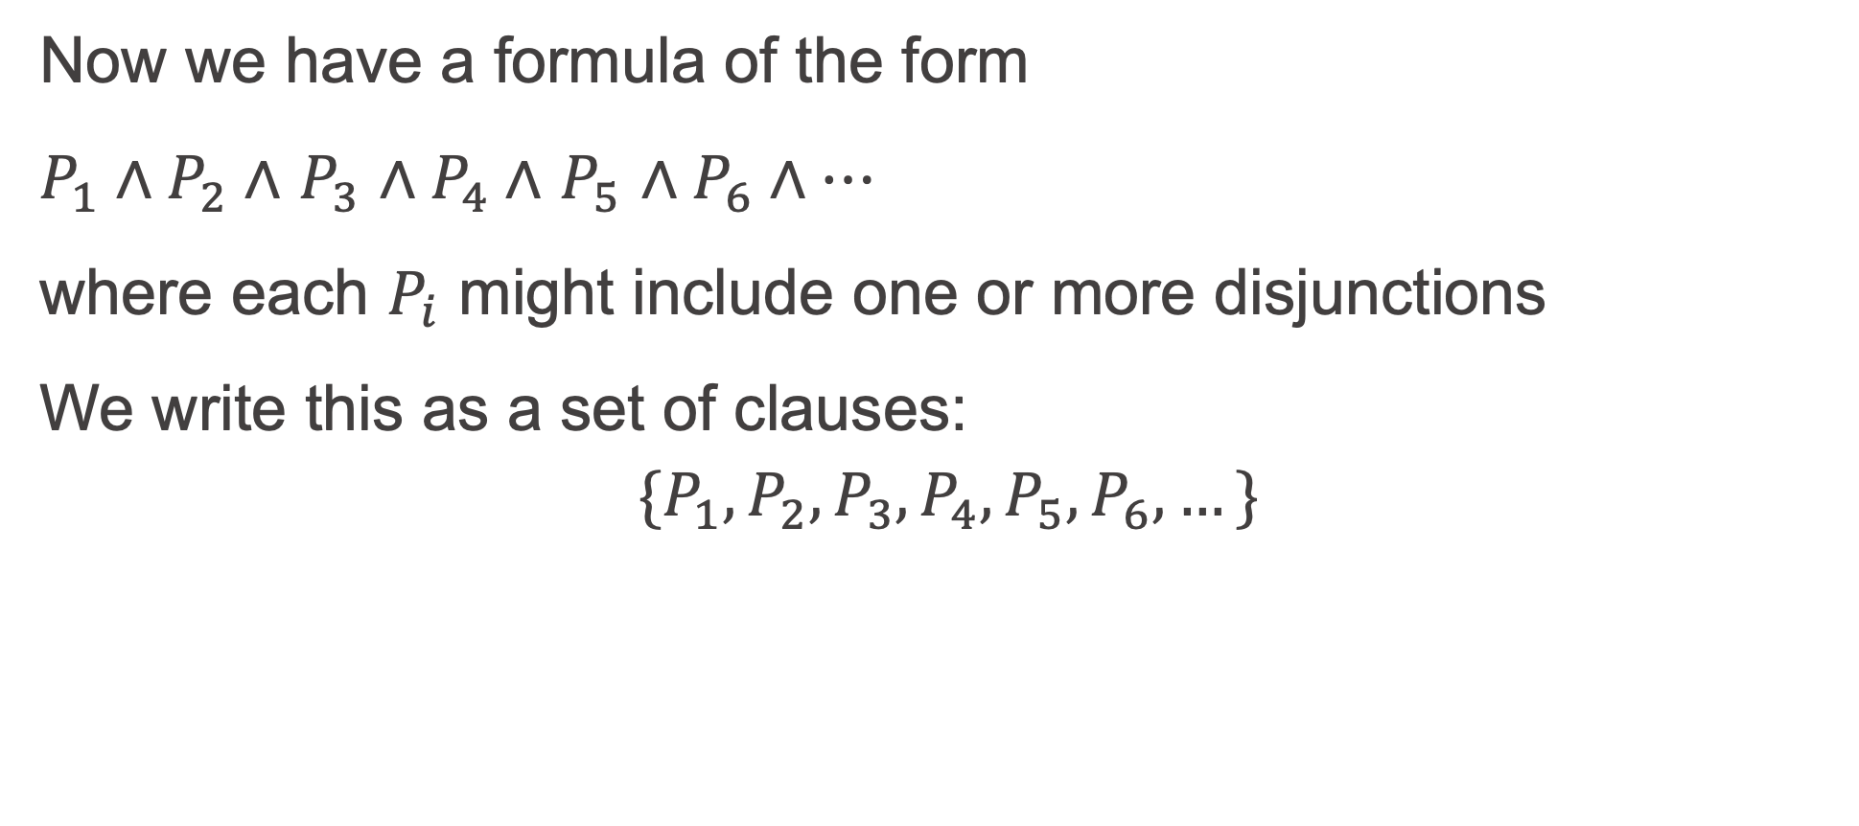
Write down the CNF
Now we have a formula of the form
$P_{1}∧P_{2}∧$ $P_{3}$ $∧P_{4}∧$ $P_{5}$ $∧P_{6}∧…$
where each $P_{i}$ might include one or more disjunctions
We write this as a set of clauses:
$${\{P}_{1},P_{2},P_{3},P_{4},P_{5},P_{6},…\}$$
These P_{i} in general each have this form
$$L_{1}∨L_{2}∨…∨¬N_{1}∨{¬N}_{2}∨…$$

Slide 10


A Prolog program is a set of Horn clauses
A Horn clause is any clause that has at most one positive literal (0 or 1 positive literals). The positive literals are the L_{i}
When we write a Prolog program, we are writing down a set of Horn clauses with 0 or 1 L :
${\{P}_{1},P_{2},P_{3},P_{4},P_{5},P_{6},…\}$
One positive, several Negative
One positive, zero Negative
Zero positive, several Negative
When restricted to be Horn clauses, these P_{i} in a Prolog program each have this form
L $∨¬N_{1}∨{¬N}_{2}∨…$
or
L
or
$$¬N_{1}∨{¬N}_{2}∨…$$

Slide 11
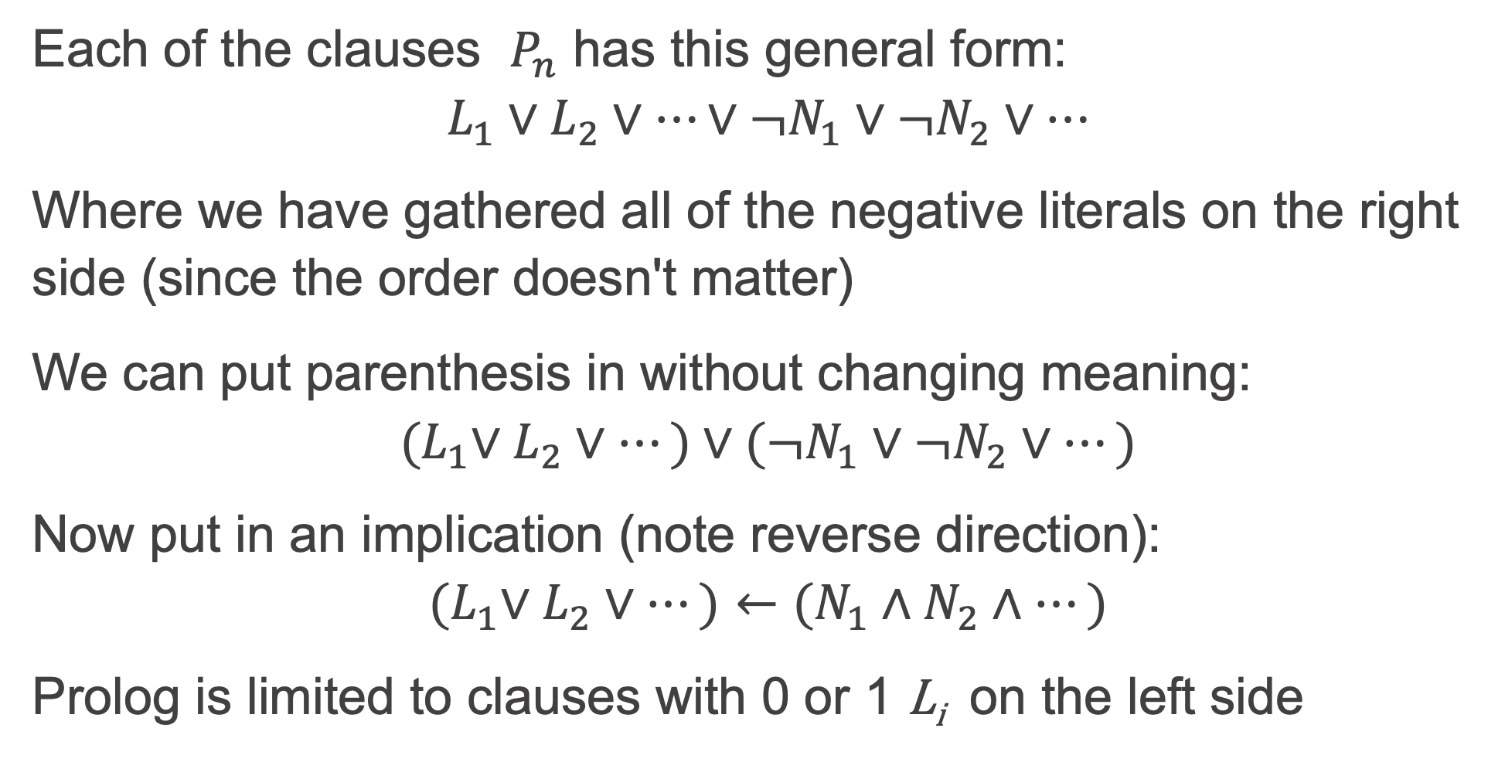
Converting CNF to Prolog
Each of the clauses $P_{n}$ has this general form:
$$L_{1}∨L_{2}∨…∨¬N_{1}∨{¬N}_{2}∨…$$
Where we have gathered all of the negative literals on the right side (since the order doesn't matter)
We can put parenthesis in without changing meaning:
$${(L}_{1}∨L_{2}∨…)∨(¬N_{1}∨{¬N}_{2}∨…)$$
Now put in an implication (note reverse direction):
$${(L}_{1}∨L_{2}∨…)←(N_{1}∧N_{2}∧…)$$
Prolog is limited to clauses with 0 or 1 L_{i} on the left side

Slide 12
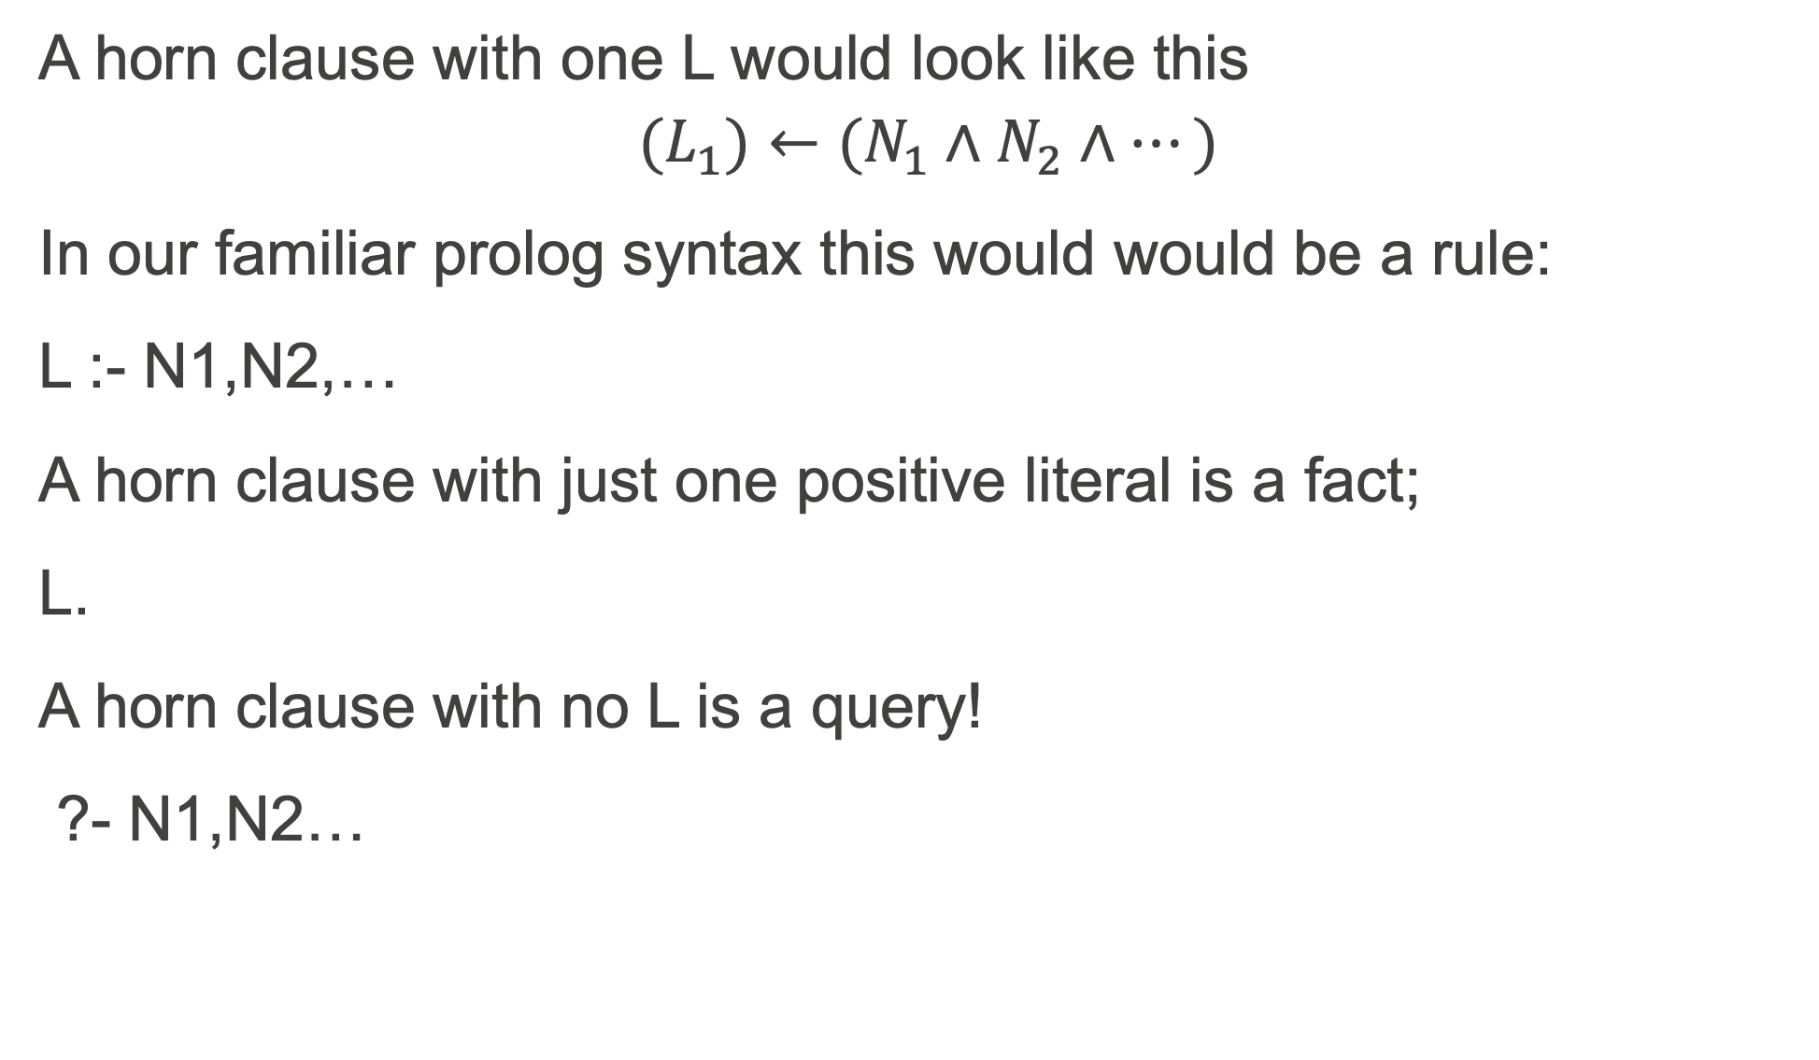
Horn Clauses
A horn clause with one L would look like this
$${(L}_{1})←(N_{1}∧N_{2}∧…)$$
In our familiar prolog syntax this would would be a rule:
L :- N1,N2,…
A horn clause with just one positive literal is a fact;
L.
A horn clause with no L is a query!
?- N1,N2…

Slide 13
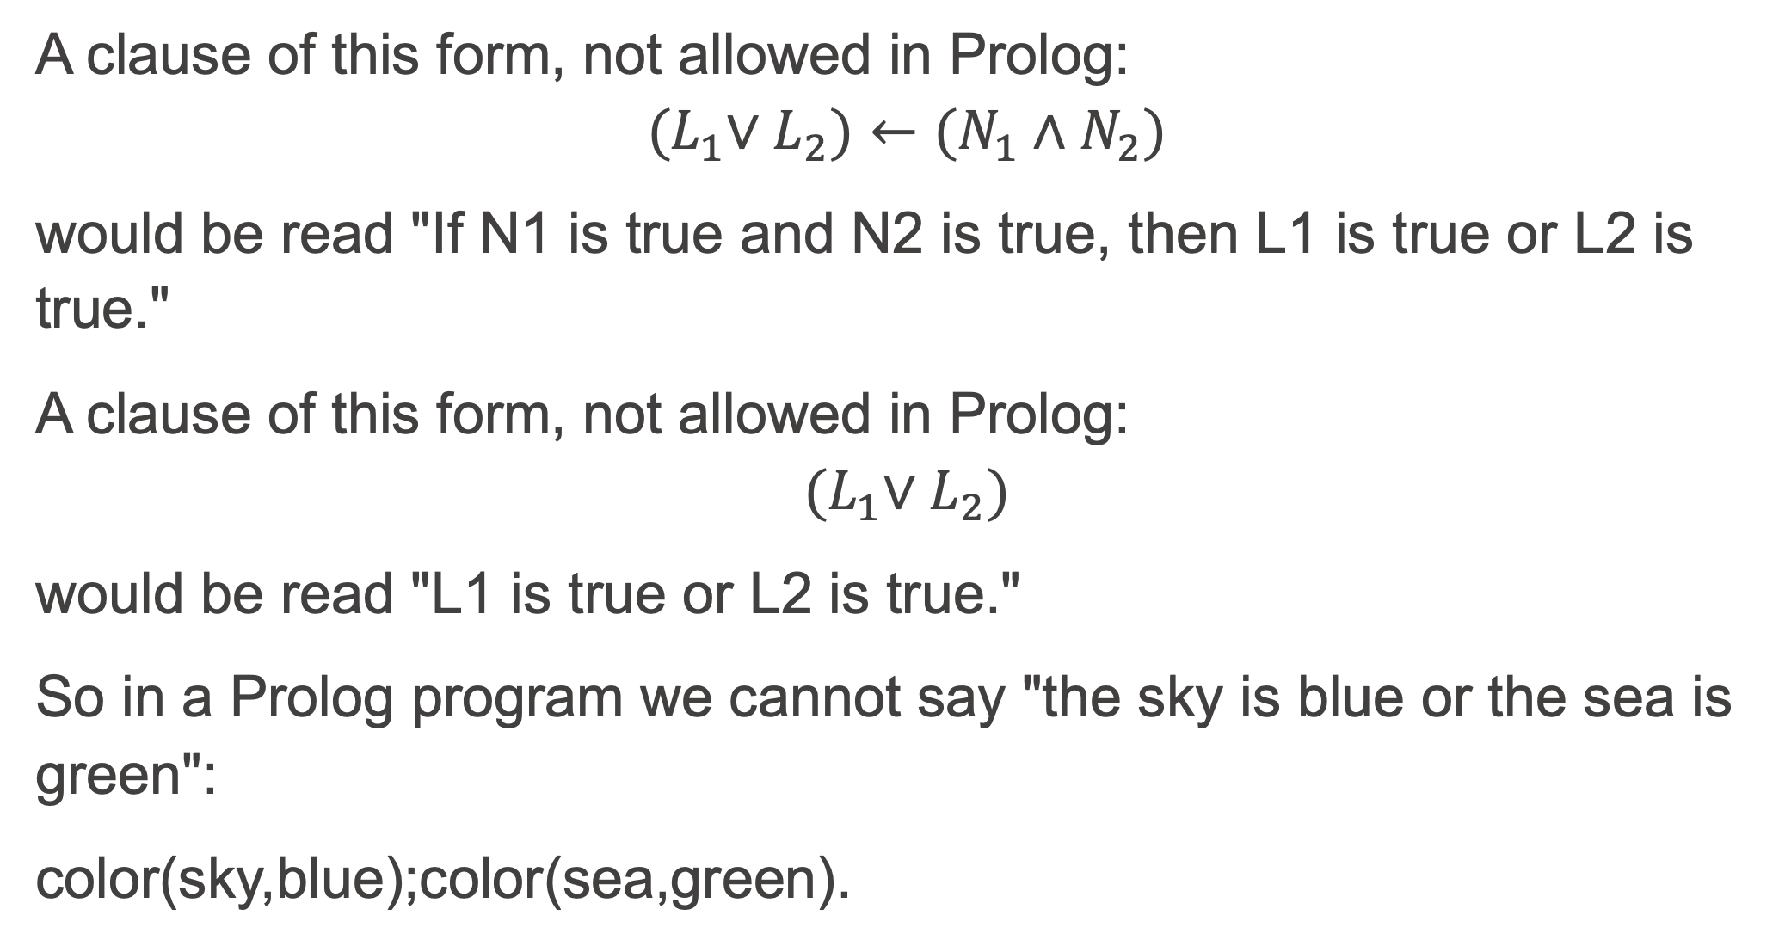
Prolog is limited to Horn Clauses
A clause of this form, not allowed in Prolog:
$${(L}_{1}∨L_{2})←(N_{1}∧N_{2})$$
would be read "If N1 is true and N2 is true, then L1 is true or L2 is true."
A clause of this form, not allowed in Prolog:
$${(L}_{1}∨L_{2})$$
would be read "L1 is true or L2 is true."
So in a Prolog program we cannot say "the sky is blue or the sea is green":
color(sky,blue);color(sea,green).

Slide 14
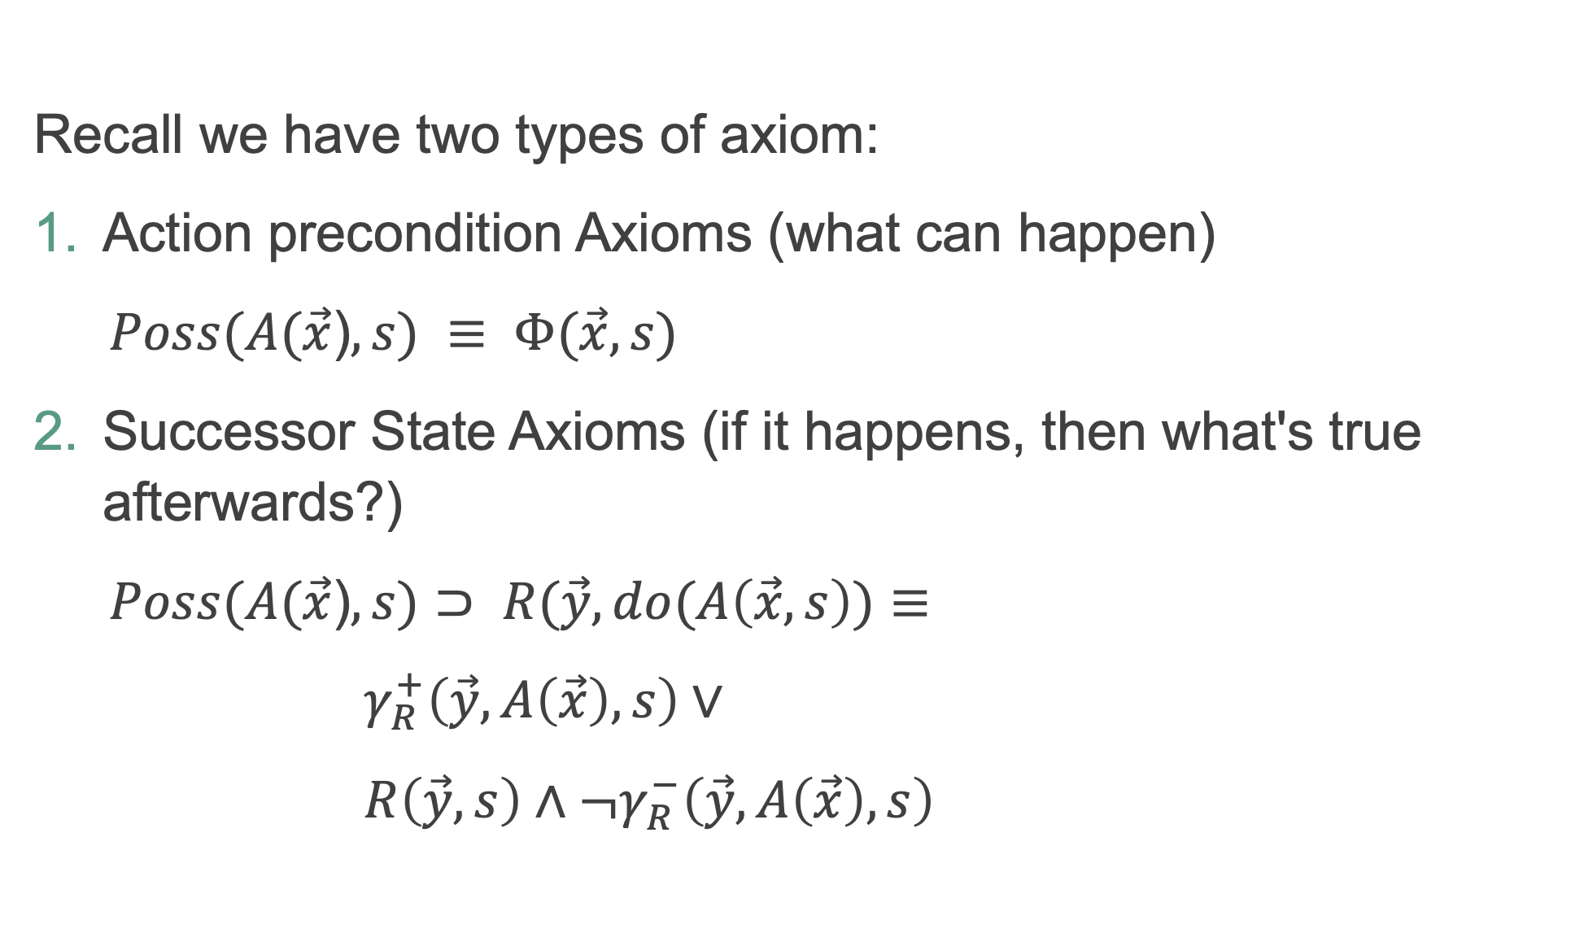
Example: Sitcalc to Prolog
Recall we have two types of axiom:
Action precondition Axioms (what can happen)
$Poss(A(\vec{x}$)$,s) ≡ Φ(\vec{x},s)$
Successor State Axioms (if it happens, then what's true afterwards?)
$Poss(A(\vec{x}$)$,s)⊃ R(\vec{y},do(A\left(\vec{x},s\right))≡$
${ γ}_{R}^{+}\left(\vec{y},A\left(\vec{x}\right),s\right)∨$
$R\left(\vec{y},s\right)∧¬γ_{R}^{−}\left(\vec{y},A\left(\vec{x}\right),s\right)$

Slide 15
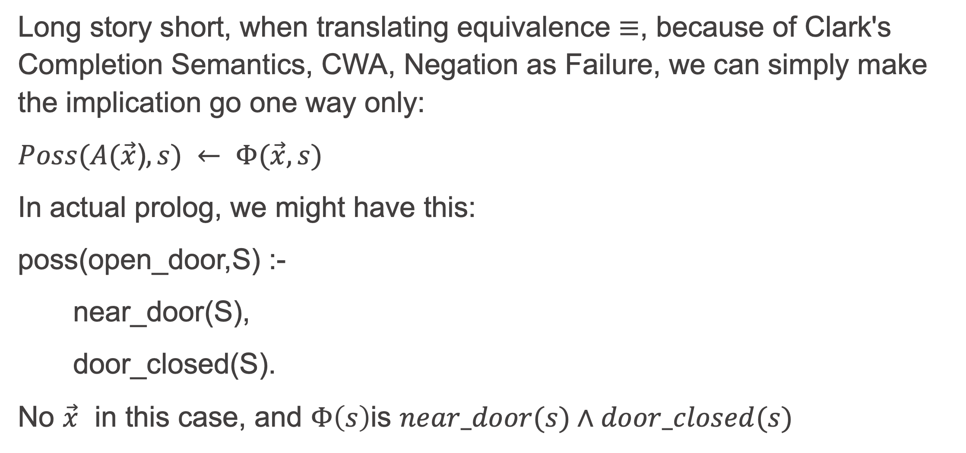
Precondition Axioms
Long story short, when translating equivalence $≡$, because of Clark's Completion Semantics, CWA, Negation as Failure, we can simply make the implication go one way only:
$Poss(A(\vec{x}$)$,s) ← Φ(\vec{x},s)$
In actual prolog, we might have this:
poss(open_door,S) :-
near_door(S),
door_closed(S).
No $\vec{x}$ in this case, and $Φ\left(s\right)$is $near_door(s)∧door_closed(s)$

Slide 16
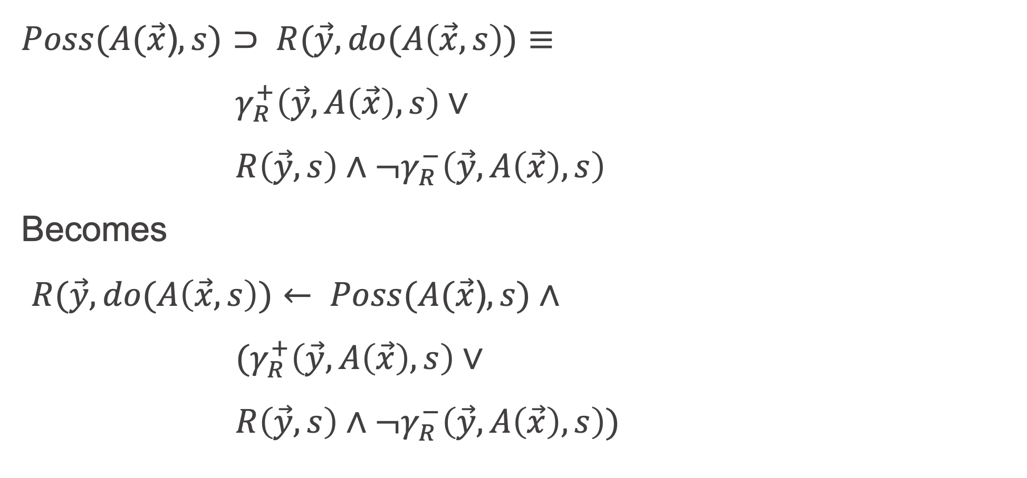
Successor State Axioms
$Poss(A(\vec{x}$)$,s)⊃ R(\vec{y},do(A\left(\vec{x},s\right))≡$
${ γ}_{R}^{+}\left(\vec{y},A\left(\vec{x}\right),s\right)∨$
$R\left(\vec{y},s\right)∧¬γ_{R}^{−}\left(\vec{y},A\left(\vec{x}\right),s\right)$
Becomes
$R(\vec{y},do(A\left(\vec{x},s\right))← Poss(A(\vec{x}$)$,s)∧$
${ (γ}_{R}^{+}\left(\vec{y},A\left(\vec{x}\right),s\right)∨$
$R\left(\vec{y},s\right)∧¬γ_{R}^{−}\left(\vec{y},A\left(\vec{x}\right),s\right))$

Slide 17
Not so fast?
Let's replace the three parts of that first big formula on the previous slide with A, B, C:
A -> B <-> C
(-A or B) <-> C
(-A or B) <- C (make implication go one way)
-C or –A or B
A,C->B
B<-A,C
When you look carefully, this is the second formula

Slide 18
(reminder) Steps to Axiomatize a Domain
In the following steps, the word "determine" implies "write down"
Understand the domain by reading about it, studying it, and thinking about it
Determine the set of fluents that are sufficient to represent a state in the domain
Determine the set of actions that effect (bring about) change in the state (fluent truth values)
Determine the precondition axioms for actions in terms of fluents
Determine the successor state axiom for each fluent
Determine the fluent values in the initial situation s0 (we use [] for s0).

