Slide 1
Natural Language with Prolog

Slide 2
Agenda
Summarize Situation Calculus/planning
Discuss Assignment 3
Discuss Lab 6
Lesson: Natural Language with Prolog

Slide 3
Summary of Chatbot operation
User enters a list of words
List of words is parsed to achieve the logical form based on semantics
Logical form is converted to Clausal Form
Clausal Form is asserted to prolog database (assertions) or issued as a query (questions)

Slide 4
talk predicate
talk(Sentence, Reply) :-
% parse the sentence
parse(Sentence, LF, Type),
% convert the FOL logical form into a Horn
% clause, if possible
clausify(LF, Clause, FreeVars), !,
% concoct a reply, based on the clause and
% whether sentence was a query or assertion
reply(Type, FreeVars, Clause, Reply).

Slide 5
Intermediate steps
If we want to see the intermediate steps of the talk predicate, we can use a query like this (an assertion):
?- parse([a, man, observed, a, particle],LF,Type),clausify(LF,Clause,Freevars),reply(Type, FreeVars, Clause, Reply).
LF = exists(man1, @man(man1)&exists(particle1, @particle(particle1)& @observe(man1, particle1))),
Type = assertion,
Clause = (man(man1), particle(particle1), observe(man1, particle1)),
Freevars = [],
Reply = asserted((man(man1), particle(particle1), observe(man1, particle1))) .

Slide 6
Intermediate steps (cont'd)
Or like this (question):
?- parse([who,observed,particle1],LF,Type),clausify(LF,Clause,Freevars),reply(Type, FreeVars, Clause, Reply).
LF = @observe(_A, particle1)=> @answer(_A),
Type = query,
Clause = (answer(_A):-observe(_A, particle1)),
Freevars = [],
Reply = answer([man1]) .

Slide 7
Clausify
The clausify predicate translates logical form into the equivalent clausal form.
Recall that prolog can deal with only Horn clauses.
Example of statement that cannot be converted to a Horn clause:
Canada is a country or the sky is blue
Logical form: country(canada) or blue(sky)
Clausal form (prolog syntax): country(canada);blue(sky).
We cannot say this in prolog because it is not a horn clause.

Slide 8
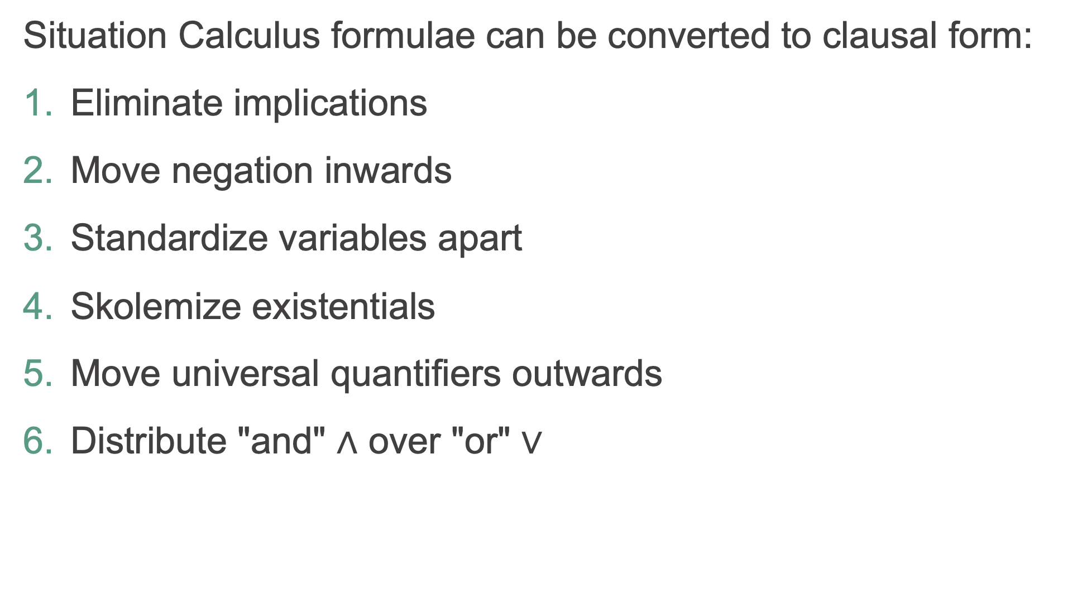
Clausal Normal Form (clausify)
Situation Calculus formulae can be converted to clausal form:
Eliminate implications
Move negation inwards
Standardize variables apart
Skolemize existentials
Move universal quantifiers outwards
Distribute "and" $∧$ over "or" $∨$

Slide 9
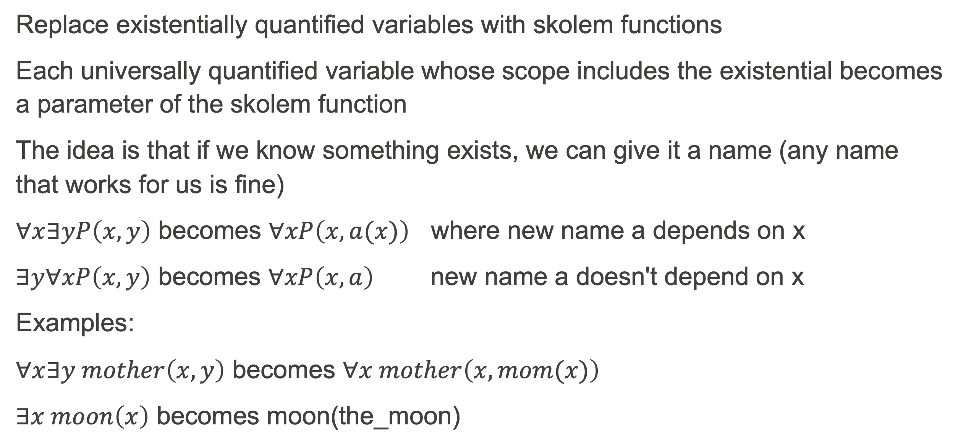
CNF Step 4: Skolemize
Replace existentially quantified variables with skolem functions
Each universally quantified variable whose scope includes the existential becomes a parameter of the skolem function
The idea is that if we know something exists, we can give it a name (any name that works for us is fine)
$∀x∃yP\left(x,y\right)$ becomes $∀xP\left(x,a(x)\right)$ where new name a depends on x
$∃y∀xP\left(x,y\right)$ becomes $∀xP\left(x,a\right)$ new name a doesn't depend on x
Examples:
$∀x∃y mother\left(x,y\right)$ becomes $∀x mother\left(x,mom(x)\right)$
$∃x moon\left(x\right)$ becomes moon(the_moon)

Slide 10
Prolog code
% asserts that F is clausal form of exists(X,F0) clausify(exists(X,F0),F,V) :- % something like exists(X,man(X)& _)
F0 = @G&_, % G is something like man(X)
skolem(G,X),
clausify(F0,F,V). % F0 is now @man(man2)&_ and yellow part gone
skolem(G,X):-
functor(G,Name,1), % functor(man(X),man,1), see functor/3 doc
gensym(Name,X), % X becomes manN for some integer N
assert(pn(X,X)). % assert(pn(man2,man2)) when N is 2

