Slide 1


Slide 2
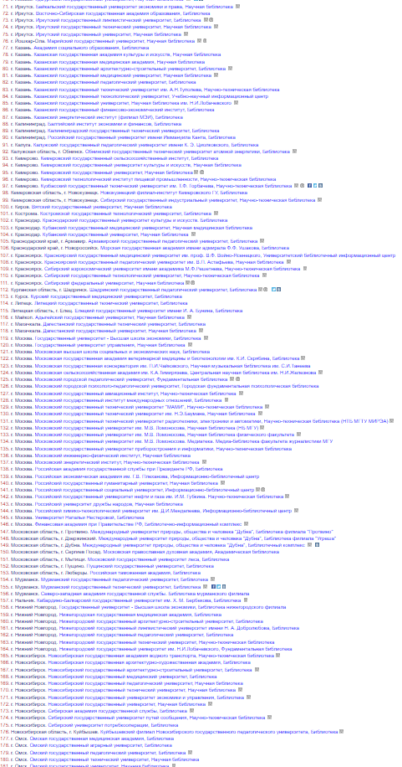
Problem:
NO COMMON UNIVERSITY LIBRARY SYSTEM IN USE
more then 1400 Uni
more than 300 different libraries!

Slide 3
Goals:
Library Management System
1. Remote
2. Secure
3. Multi-user

Slide 4
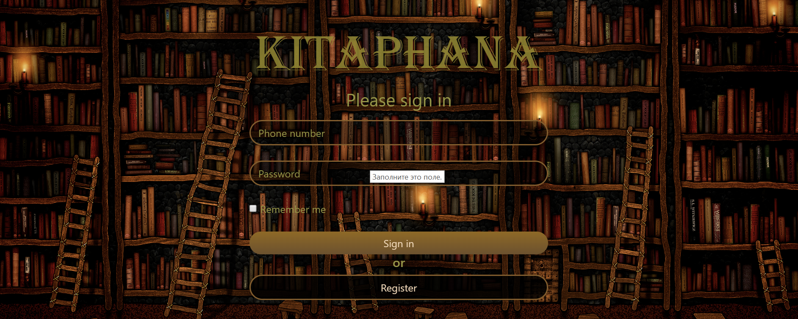
solution:

Slide 5
potential:
extension to work with any University in the world

Slide 6
Market:
1. contextual advertising in social networks 2. personal offers in top universities

Slide 7
Business model:
10 thousand per month from each University
A*B*C = 10000*234590*12 = 28 150 800 000
A – unit transaction
B – mount of Uni in the World (Mail.ru 2015)
C – mount of months in a year

Slide 8
Description:
User
Control structures
DATA
Security system

Slide 9

Competition:
Universal library systems in Russia:
- Does not exist

Slide 10

COMPETITION TOMORROW:
Universal library systems in Russia:
-KitapHana

Slide 11
Team:
a team of young and ambitious enthusiasts
Students of the most potential University in the world
1. Genius - 2. Team Leader –
3. weapons expert –
4. the team mascot -

Slide 12
Capital:
2 euro per month
(hosting)

Slide 13
movie
(after search in use)

