Slide 1
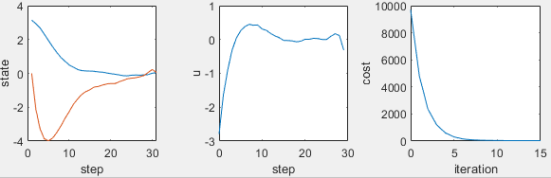
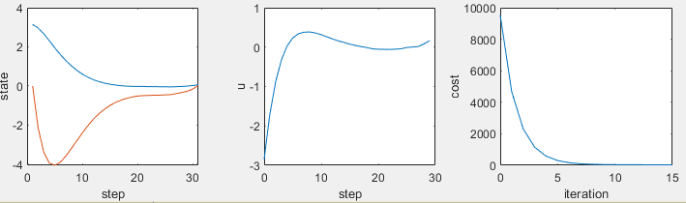
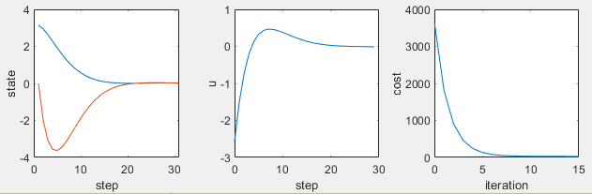
LTI case, noise in forward pass only
With noise, no average
With noise, average over 100 rollouts
No noise

Slide 2
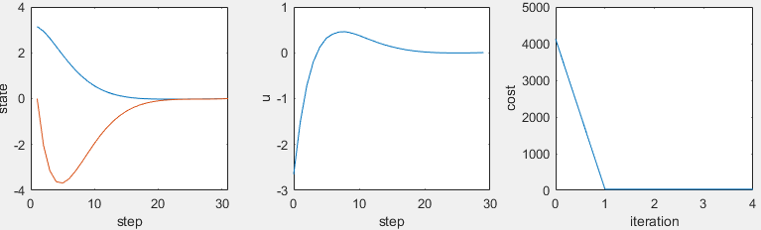
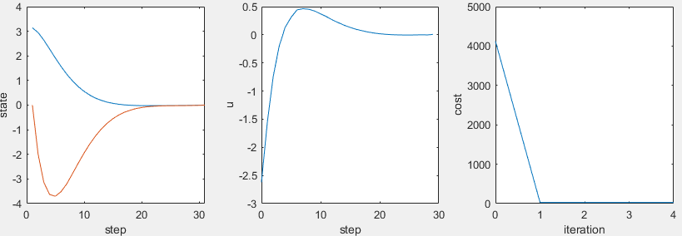
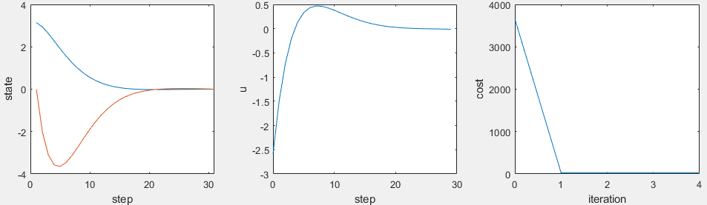
LTI ilqr full-state arma
Std(du)=0.01
Std(training noise)=0.01
No feedback in ID
Average over 100 rollouts for mean rollout
100 mean rollouts for one arma fit
Norm of all dx=0.05
Cost=30.1
Std(du)=0.01
Std(training noise)=0.01
With feedback in ID
Average over 100 rollouts for mean rollout
100 mean rollouts for one arma fit
Norm of all dx=0.01 except first ite 0.05
Cost=30.1
No noise solution
Cost=29.8

Slide 3
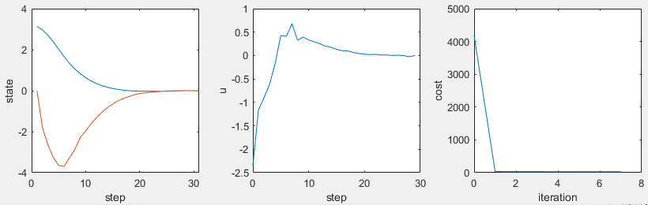
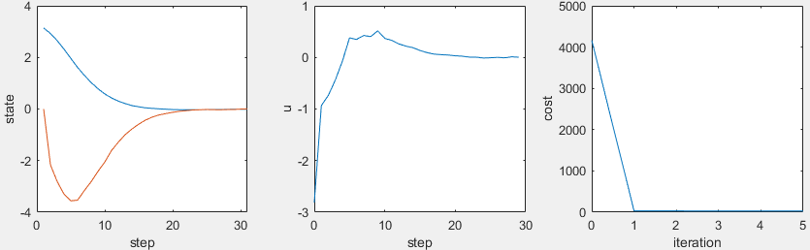
LTI ilqr full-state arma
Std(du)=0.01
Std(training noise)=0.01
With feedback in ID
Average over 1 rollouts for mean rollout
100 mean rollouts for one arma fit
Norm of all dx=0.01 except first ite 0.05
Cost=30.6
Std(du)=0.01
Std(training noise)=0.01
No feedback in ID
Average over 1 rollouts for mean rollout
100 mean rollouts for one arma fit
Norm of all dx=0.01 except first ite 0.05

Slide 4
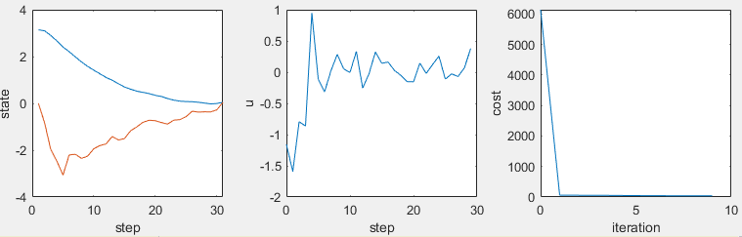
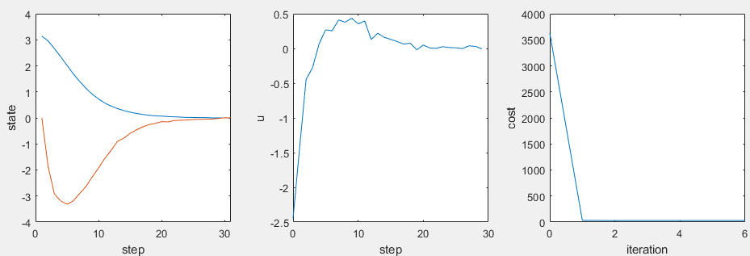
LTI ilqr full-state arma
Std(du)=0.01
Std(training noise)=0.05
With feedback in ID
Average over 1 rollouts for mean rollout
100 mean rollouts for one arma fit
Norm of all dx=0.07 except first ite 0.15
Cost=36.1
Std(du)=0.01
Std(training noise)=0.05
With feedback in ID
Average over 100 rollouts for mean rollout
100 mean rollouts for one arma fit
Norm of all dx=0.04 except first ite 0.1
Cost=31.5

Slide 5
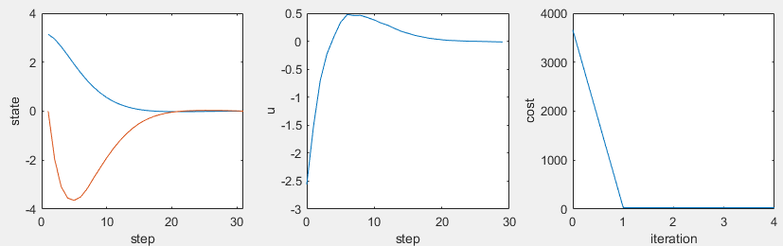
Std(du)=0.01
Std(training noise)=0.05
With feedback in ID
Average over 100 rollouts for mean rollout
100 mean rollouts for one arma fit
Cost=29.8 if run in noiseless sys

Slide 6
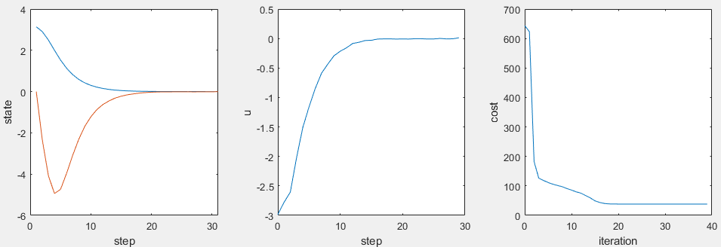
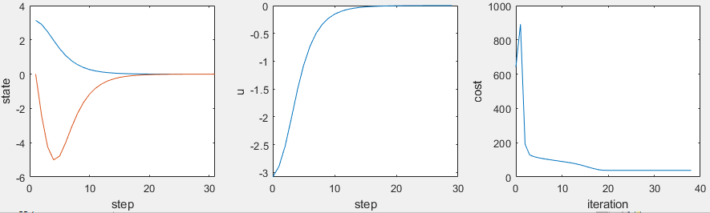
True pendulum swingup
Arma q=1
Std(du)=0.01
Std(training noise)=0.01
With feedback in ID
Average over 100 rollouts for mean rollout
40 mean rollouts for one arma fit
Cost=38.3
Time=330s
Noiseless full state arma
Cost=38.3
Time=2s

Slide 7
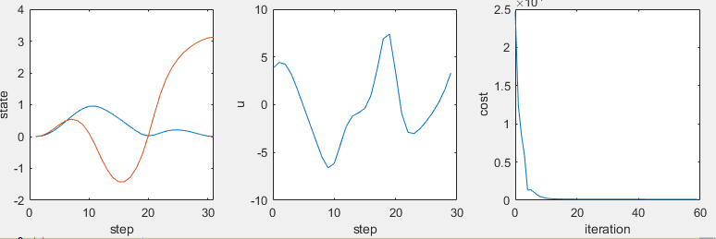
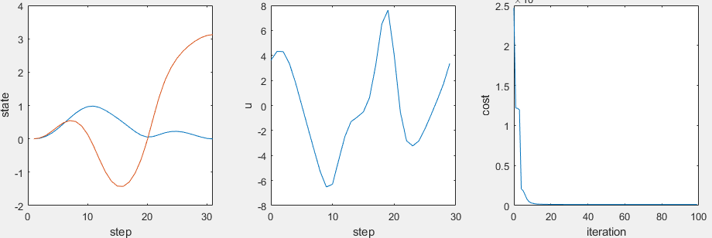
cartpole
Arma q=1
Noiseless full state arma
Cost=126
Time=1.6s
Std(du)=0.01
Std(training noise)=0.001
With feedback in ID
Average over 100 rollouts for mean rollout
50 mean rollouts for one arma fit
Cost=126
Time=457s

Slide 8
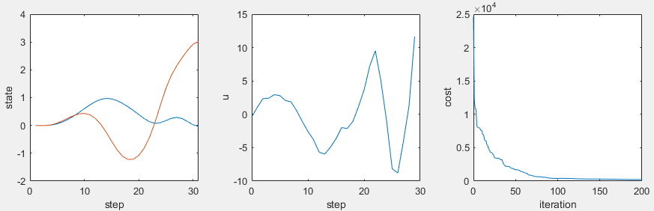
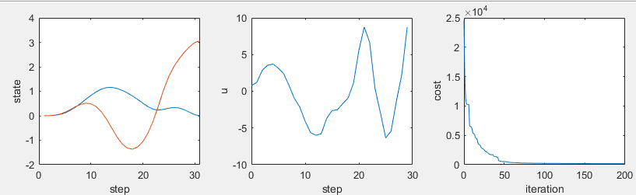
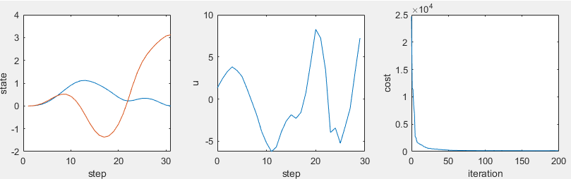
Cartpole Arma q=1
Std(du)=0.01
Std(training noise)=0.001
With feedback in ID
Average over 1 rollouts for mean rollout
50 mean rollouts for one arma fit
Cost=234
Time=34.7s
Std(du)=0.01
Std(training noise)=0.001
With feedback in ID
Average over 1 rollouts for mean rollout
100 mean rollouts for one arma fit
Cost=173
Time=37.7s
Std(du)=0.01
Std(training noise)=0.001
With feedback in ID
Average over 1 rollouts for mean rollout
200 mean rollouts for one arma fit
Cost=151
Time=53s

Slide 9
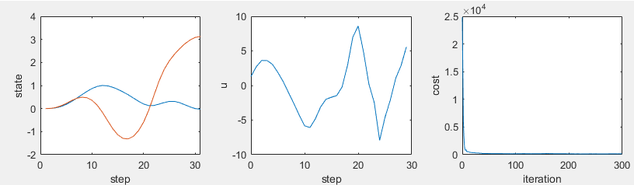
Std(du)=0.01
Std(training noise)=0.001
With feedback in ID
Average over 1 rollouts for mean rollout
400 mean rollouts for one arma fit
Cost=153
Time=111s
Multirollout for forward pass is needed to converge to the same point

Slide 10
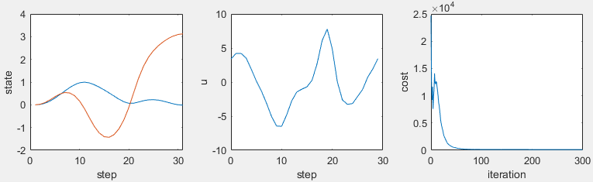
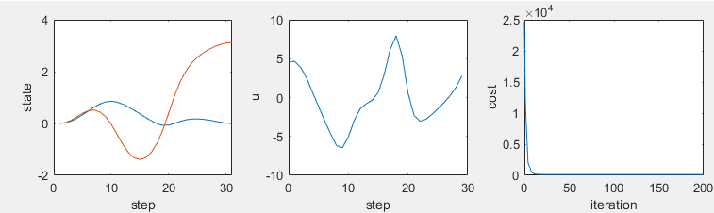
Std(du)=0.01
Std(training noise)=0.001
With feedback in ID
Average over 1 rollouts for id
Average over 100 rollouts for forwardpass
400 mean rollouts for one arma fit
Cost=127
Time=321s
Std(du)=0.01
Std(training noise)=0.0001
With feedback in ID
Average over 1 rollouts for id
Average over 100 rollouts for forwardpass
400 mean rollouts for one arma fit
Cost=126
Time=82s

Slide 11
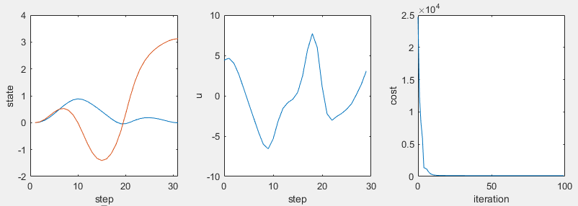
Std(du)=0.01
Std(training noise)=0.0001
Std(measurement noise)=0.0001
With feedback in ID and forward pass
Average over 100 rollouts for mean rollout
50 mean rollouts for one arma fit
Cost=126
Time=398.4s
Kalman filter in forward pass, not id

Slide 12
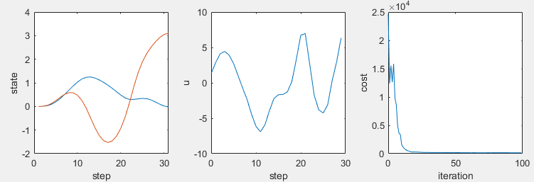
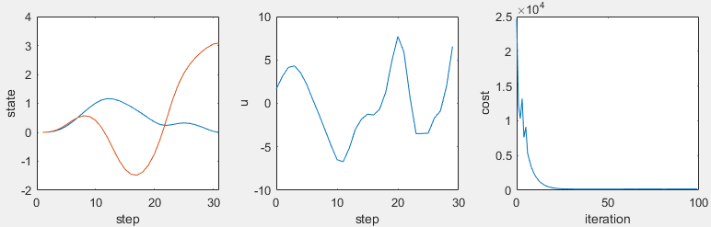
Std(du)=0.01
Std(training noise)=0.001
Std(measurement noise)=0.001
With feedback in ID on measurement
Average over 100 rollouts for mean rollout
50 mean rollouts for one arma fit
Cost=151
Time=730s
No Kalman filter in forward pass and id
Std(du)=0.01
Std(training noise)=0.001
Std(measurement noise)=0.001
With feedback and Kalman filter in forward pass and id
Average over 100 rollouts for mean rollout
50 mean rollouts for one arma fit
Cost=157
Time=898s

Slide 13
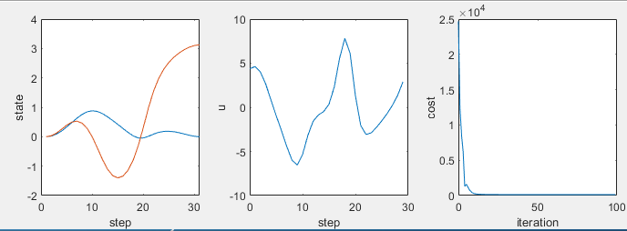
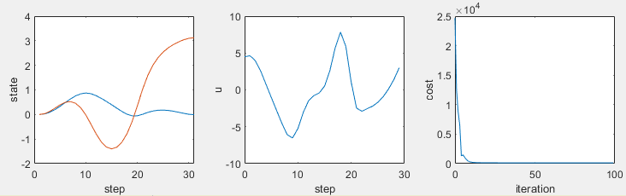
Std(du)=0.01
Std(training noise)=0.0001
Std(measurement noise)=0.0001
With feedback in ID on measurement (no Kalman filter)
Average over 100 rollouts for mean rollout
50 mean rollouts for one arma fit
Cost=126
Time=398.6s
Std(du)=0.01
Std(training noise)=0.0001
Std(measurement noise)=0.0001
With feedback and Kalman filter in ID and forward pass
Average over 100 rollouts for mean rollout
50 mean rollouts for one arma fit
Cost=126
Time=514s

Slide 14
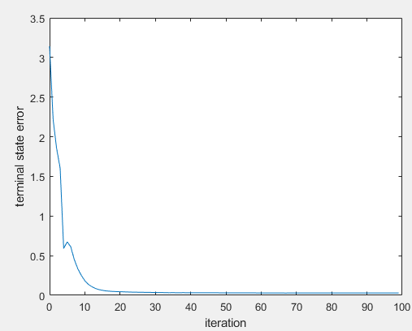
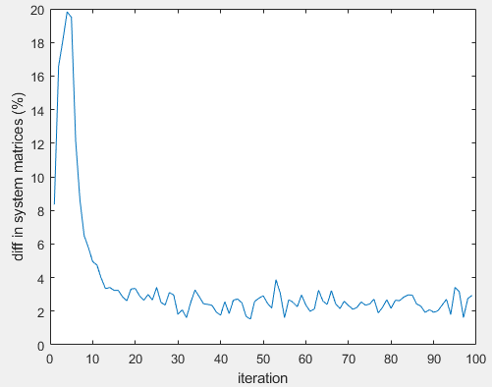
Std(du)=0.01
Std(training noise)=0.0001
Std(measurement noise)=0.0001
With feedback and Kalman filter in ID and forward pass
Average over 100 rollouts for mean rollout
50 mean rollouts for one arma fit
Cost=126
Time=514s

Slide 15
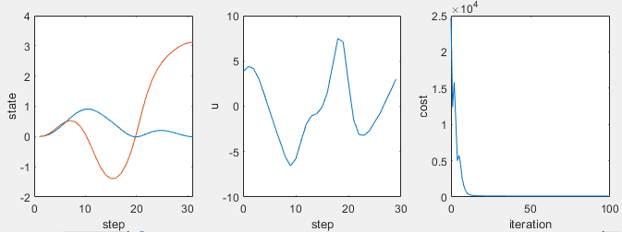
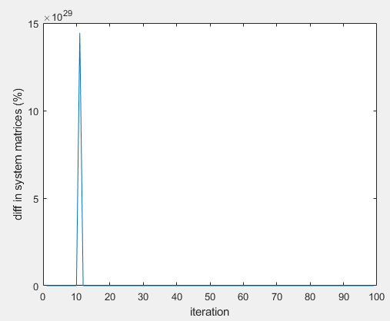
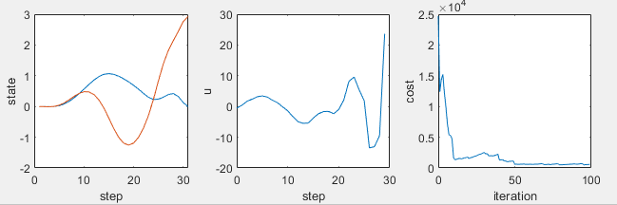
Noiseless ilqr for the first 10 iterations
With measurement and process noise
No multi rollout+perfect forward pass
Noise=1% of perturbation, Cost=126
With Kalman filter in ID
Noise=1% of perturbation
Noise=10% of perturbation, Cost=593
Without Kalman filter in ID

Slide 16
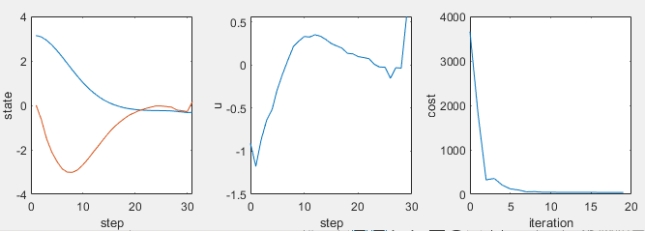
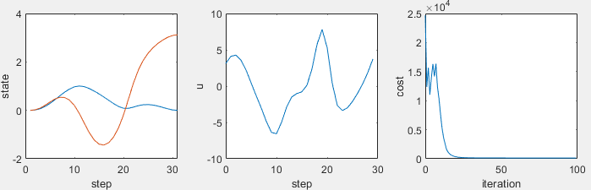
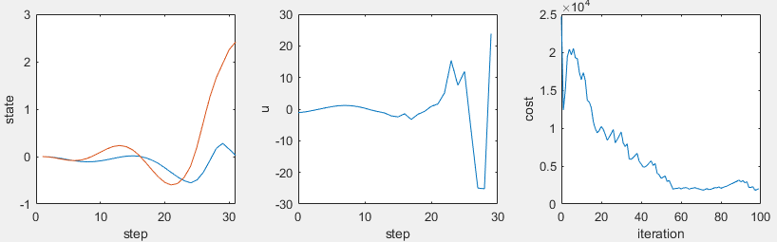
LTI Case
Std(du)=0.01
Std(training noise)=0.001
Std(measurement noise)=0.01
With feedback and Kalman filter in ID and forward pass
Same forward pass, 200 rollouts for id(not mean)
Z+du, skip first ite
Cost=41
Cartpole Case
Std(du)=0.01
Std(training noise)=0.0001
Std(measurement noise)=0.0001
With feedback and Kalman filter in ID and forward pass
Same forward pass, 200 rollouts for id(not mean)
Z+du, skip first ite
Cost=127
Cartpole Case
Std(du)=0.01
Std(training noise)=0.0001
Std(measurement noise)=0.0001
With feedback and Kalman filter in ID and forward pass
Same forward pass, 200 rollouts for id(not mean)
X_hat+du, skip first ite
Cost=2130

Slide 17
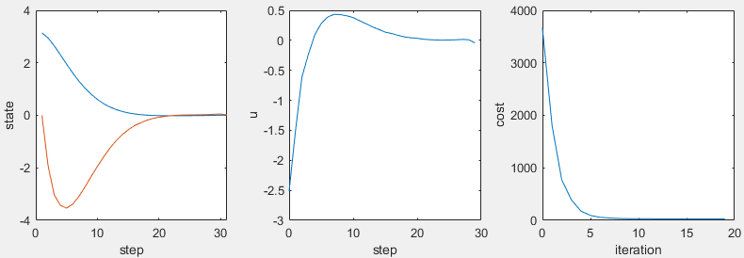
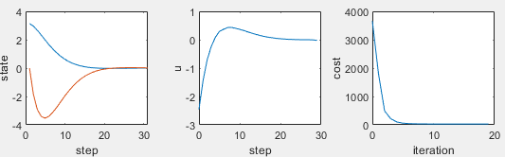
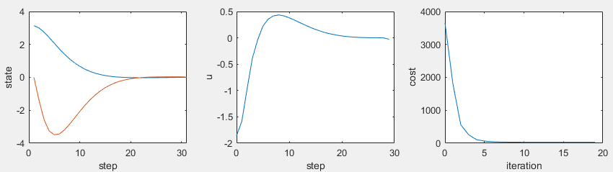
LTI Case
Std(du)=0.01
Std(training noise)=0.001
Std(measurement noise)=0.001
With feedback and Kalman filter in ID and forward pass
Average over 100 rollouts for mean rollout
50 mean rollouts for one arma fit
Cost=29
LTI Case
Std(du)=0.01
Std(training noise)=0.001
Std(measurement noise)=0.001
With feedback and Kalman filter in ID and forward pass
Same forward pass, 200 rollouts for id(not averaging)
dz+du, skip first ite
Cost=29
LTI Case
Std(du)=0.01
Std(training noise)=0.001
Std(measurement noise)=0.001
With feedback and Kalman filter in ID and forward pass
Same forward pass, 200 rollouts for id(not averaging)
dx_hat+du, skip first ite
Cost=30

Slide 18
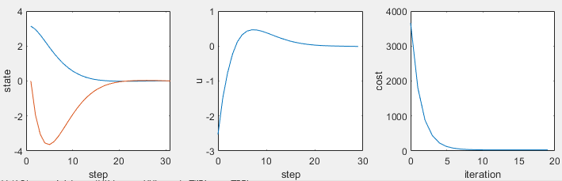
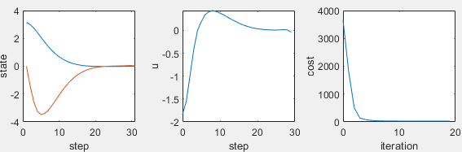
LTI Case
Std(du)=0.01
Std(training noise)=0.001
Std(measurement noise)=0.001
With feedback and Kalman filter in ID and forward pass
Average over 100 rollouts for mean rollout
50 mean rollouts for one arma fit
Direct closed-loop form (dz, du)
Cost=29
Cartpole Case - failed
Std(du)=0.01
Std(training noise)=0.001
Std(measurement noise)=0.001
With feedback and Kalman filter in ID and forward pass
Average over 100 rollouts for mean rollout
50 mean rollouts for one arma fit
Direct closed-loop form (dz, du)
LTI Case
Std(du)=0.01
Std(training noise)=0.001
Std(measurement noise)=0.001
With feedback and Kalman filter in ID and forward pass
Same forward pass, 400 rollouts for id(not mean)
dx_hat+du, skip first ite
Cost=30

Slide 19
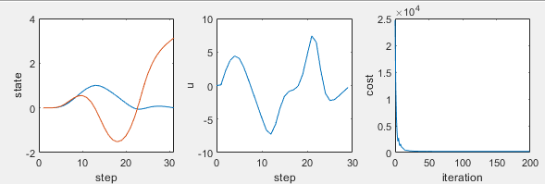
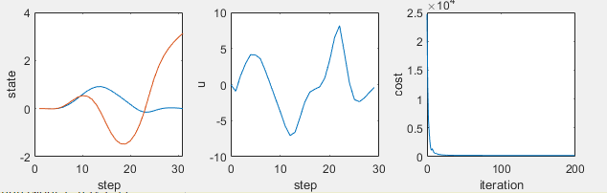
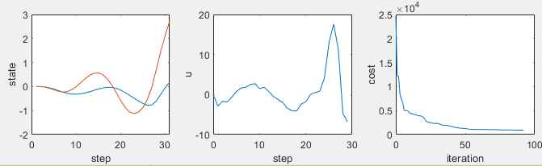
Cartpole arma q=2
Std(du)=0.01
Noiseless 50 rollouts for id
Time=5s
Mean(trajectory_error)=0.008
Cost=202
Cartpole arma q=2
Std(du)=0.01
Std(training noise)=0.0001
Std(measurement noise)=0
Noiseless forward pass
400 rollouts for id(not averaging)
Time=80s
Cost=208
Not reproduced
Cartpole arma q=2
Std(du)=0.01
Std(training noise)=0.0001
Std(measurement noise)=0.0001
Noiseless forward pass
400 rollouts for id(not averaging)
Time=71s
Cost=928

Slide 20
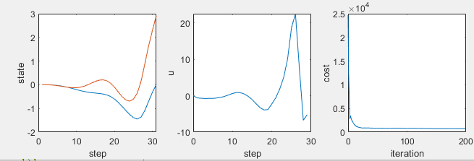
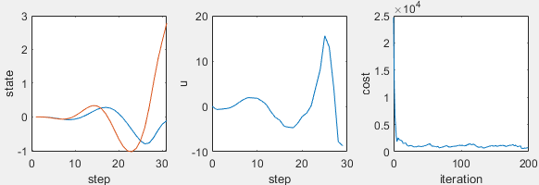
Cartpole arma q=2
Std(du)=0.01
Std(training noise)=0.0005
Std(measurement noise)=0
Noiseless forward pass
No feedback, no observer
Mean(trajectory_error)=0.01
400 rollouts for id(not averaging)
Time=305.2s
Cost=730.4
Cartpole arma q=2
Std(du)=0.01
Std(training noise)=0.0005
Std(measurement noise)=0
Noiseless forward pass
With feedback, no observer
Mean(trajectory_error)=0.02
400 rollouts for id(not averaging)
Time=351.5s
Cost=699.7，855

Slide 21
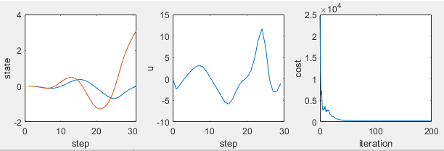
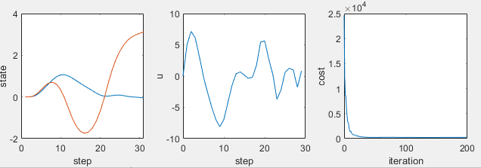
Cartpole arma q=2
Std(du)=0.01
Std(training noise)=0.0001
Std(measurement noise)=0
Noiseless forward pass
No feedback, no observer
Mean(trajectory_error)=0.01
400 rollouts for id(not averaging)
Time=329.3s
Cost=225.3
Cartpole arma q=2
Std(du)=0.01
Std(training noise)=0.0001
Std(measurement noise)=0
Noiseless forward pass
With feedback, no observer
Mean(trajectory_error)=0.009
400 rollouts for id(not averaging)
Time=330.5s
Cost=362.4
Cartpole arma q=2
Std(du)=0.01
Std(training noise)=0.0001
Std(measurement noise)=0
Noiseless forward pass
With feedback 0.1*Kt, no observer
Mean(trajectory_error)=0.01
400 rollouts for id(not averaging)
Time=333.9s
Cost=237.4

Slide 22
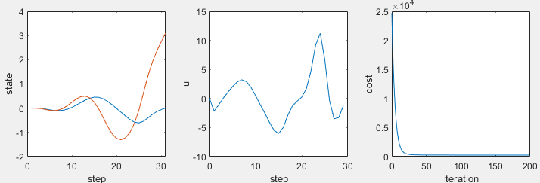
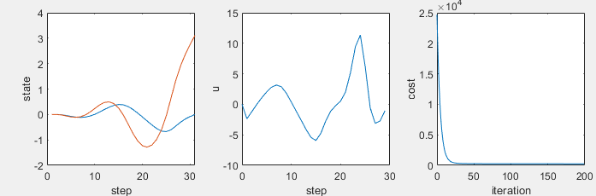
Cartpole arma q=2
Std(du)=0.01
Std(training noise)=0.0001
Std(measurement noise)=0
Noiseless forward pass
With feedback, no observer
Mean(trajectory_error)=0.009
Alpha=0.1
400 rollouts for id(not averaging)
Cost=248.5
Cartpole arma q=2
Std(du)=0.01
Std(training noise)=0.0001
Std(measurement noise)=0
Noiseless forward pass
No feedback, no observer
Mean(trajectory_error)=0.01
400 rollouts for id(not averaging)
Cost=251.0

Slide 23
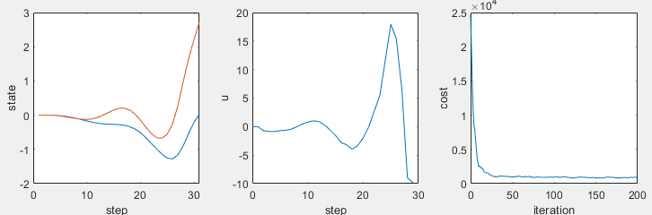
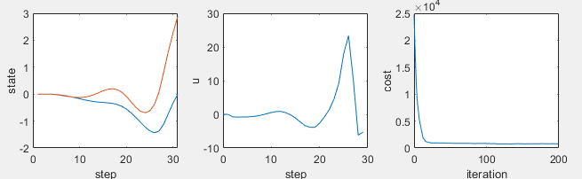
Cartpole arma q=2
Std(du)=0.01
Std(training noise)=0.0005
Std(measurement noise)=0
Noiseless forward pass
With feedback, no observer
Mean(trajectory_error)=0.009
Alpha=0.1
400 rollouts for id(not averaging)
Cost=948.2
Cartpole arma q=2
Std(du)=0.01
Std(training noise)=0.0005
Std(measurement noise)=0
Noiseless forward pass
No feedback, no observer
Mean(trajectory_error)=0.01
400 rollouts for id(not averaging)
Cost=782.7

Slide 24


Cartpole arma q=2
Std(du)=0.01
Noiseless forward pass
50 rollouts for id
Time=5s
Mean(trajectory_error)=0.008
Cost=202
Cartpole arma q=2
Std(du)=0.01
Std(training noise)=0.0001
Std(measurement noise)=0
Noiseless forward pass
No feedback, no observer
400 rollouts for id(not averaging)
Time=278s (most time in set noisy states)
Cost=253.6
Cartpole arma q=2
Std(du)=0.01
Std(training noise)=0.0001
Std(measurement noise)=0
Noiseless forward pass
With feedback, No Kalman filter
Mean(trajectory_error)=0.009
Alpha=0.1
400 rollouts for id(not averaging)
Time=276.2
Cost=249.2

Slide 25


Cartpole arma q=2
Std(du)=0.01
Std(training noise)=0
Std(measurement noise)=0.0001
Noiseless forward pass
No feedback, with Kalman filter
Mean(trajectory_error)=0.009
Alpha=0.1
400 rollouts for id(not averaging)
Time=134.3
Cost=278.5
Cartpole arma q=2
Std(du)=0.01
Std(training noise)=0
Std(measurement noise)=0.0001
Noiseless forward pass
No feedback, no observer
Mean(trajectory_error)=0.008
400 rollouts for id(not averaging)
Time=106.0
Cost=442.4

Slide 26


Cartpole arma q=2
Std(du)=0.01
Std(training noise)=0.0001
Std(measurement noise)=0.0001
Noiseless forward pass
With feedback, with Kalman filter
400 rollouts for id(not averaging)
Cost=311.4
Cartpole arma q=2
Std(du)=0.01
Std(training noise)=0.0001
Std(measurement noise)=0.0001
Noiseless forward pass
No feedback, no observer
400 rollouts for id(not averaging)
Cost=469.6

Slide 27


Cartpole arma q=2
Std(du)=0.01
Std(training noise)=0.0001
Std(measurement noise)=0.0001
Noiseless forward pass
With feedback, with Kalman filter
400 rollouts for id(not averaging)
Cost=364.0
Cartpole arma q=2
Std(du)=0.01
Std(training noise)=0.000
Std(measurement noise)=0.000
Noiseless forward pass
No feedback, No Kalman filter
400 rollouts for id(not averaging)
Cost=202
Initialized from the noisy training result

Slide 28


Cartpole arma q=2
Std(du)=0.01
Std(training noise)=0.0001
Std(measurement noise)=0
Noiseless forward pass
With feedback, no Kalman filter
400 rollouts for id(not averaging)
Cost=242

Slide 29


Cartpole arma q=2
Std(du)=0.01
Noiseless
400 rollouts for id(not averaging)
Cost=202

Slide 30



Cartpole arma q=2
Std(du)=0.01
Std(training noise)=0.0001
Std(measurement noise)=0
Noiseless forward pass
With feedback, no Kalman filter
400 rollouts for id(not averaging)
Cost=243
Init=0
Cartpole arma q=2
Std(du)=0.01
Std(training noise)=0.0001
Std(measurement noise)=0
Noiseless forward pass
With feedback, no Kalman filter
400 rollouts for id(not averaging)
Cost=243
Init=N(0, 0.5)
Cartpole arma q=2
Std(du)=0.01
Std(training noise)=0.0001
Std(measurement noise)=0
Noiseless forward pass
With feedback, no Kalman filter
400 rollouts for id(not averaging)
Cost=243
Init=N(0, 1)

Slide 31



Cartpole arma q=2
Std(du)=0.01
Std(training noise)=0.0001
Std(measurement noise)=0
Noiseless forward pass
With feedback, no Kalman filter
400 rollouts for id(not averaging)
Cost=215
Init=0
mislabel
Cartpole arma q=2
Std(du)=0.01
Std(training noise)=0.0001
Std(measurement noise)=0
Noiseless forward pass
With feedback, no Kalman filter
400 rollouts for id(not averaging)
Cost=215
Init=N(0, 0.5)
Cartpole arma q=2
Std(du)=0.01
Std(training noise)=0.0001
Std(measurement noise)=0
Noiseless forward pass
With feedback, no Kalman filter
400 rollouts for id(not averaging)
Cost=125
Init=N(0, 1)

Slide 32

Sac pendulum 2000 rollouts
Actual reward+entropy
Same initial
Original init from last terminal

Slide 33

Sac pendulum
Without terminal cost
With terminal cost
Same initial
Original init from last terminal

Slide 34

Cost curve for orange
90000steps
1969.68s
Same init

Slide 35



Cost curve for yellow
45000steps
Same init
850.16s

Slide 36


Pendulum
Same init
120000steps
2707.76s

Slide 37



Pendulum
90000steps
1967.48s
Init from the terminal state of the last episode
Good accuracy
Purple: 120000 same init
Green: 90000 init from last terminal

Slide 38


Pendulum sac
Sac trained with same initial, 90000 steps
Green: initial state sampled from N(0, pi), good reward but large state error=0.29
Orange: same initial state
Pendulum
Sac trained with same initial, 60000 steps, 1462.6s
Horizon=30
Accurate

Slide 39


Cartpole sac
Sac trained with same initial, 300000 steps, 7407.36s
Horizon = 30 steps

Slide 40


Acrobot openloop using D2C(ilqr+lls)
Umax=8.89
Time=1547.3s
1000 iterations
dt=0.01
Horizon=500 steps

Slide 41


Swimmer3 sac
Time=64035.0s
Total 600000 steps
Horizon=1600 steps

Slide 42


Pendulum td3
Time=937.6s
Total 60000 steps
Horizon = 30 steps

Slide 43


Cartpole td3
Time = 4304.5s
Horizon = 30
Total timesteps=300000

Slide 44


Acrobot openloop using D2C(ilqr+lls)
Umax=6.74
Time=1622.2s
1000 iterations
dt=0.01
Horizon=500 steps

Slide 45


Swimmer3 td3
Time=48038.0s
Total 680000 steps
Horizon=1600 steps

Slide 46


pendulum
cartpole

Slide 47

swimmer3

Slide 48

Outline plot

Slide 49

Swimmer6 td3
Time = 47508.4s
Terminal error = 0.02
Horizon = 1600 steps
Total steps = 750000

Slide 50

Swimmer6 sac
Time = 57372.7s
Terminal error = 0.035
Horizon = 1600 steps
Total steps = 600000

Slide 51

Fish td3
Time = 46238.7s
Terminal error = 0.029
Horizon = 1200 steps
Total steps = 900000

Slide 52

Fish sac
Time = 95769.1s
Terminal error = 0.028
Horizon = 1200 steps
Total steps = 1200000

Slide 53


Slide 54


Slide 55


Slide 56


full state arma q = 1 cartpole
Noiseless
Cost=126
Std(du)=0.01
Std(dx0)=0.001
Std(training noise)=0.0001
Std(measurement noise)=0.0001
With feedback in ID and forward pass
Average over 100 rollouts for mean rollout
50 mean rollouts for one arma fit
Cost=126
No Kalman filter

Slide 57


full state arma q = 1 pendulum
Noiseless
Cost=38.3
Std(du)=0.01
Std(dx0)=0.01
Std(training noise)=0.001
Std(measurement noise)=0.001
With feedback in ID and forward pass
Average over 100 rollouts for mean rollout
50 mean rollouts for one arma fit
Cost=38.3
No Kalman filter

Slide 58


full state arma q = 1 pendulum
Std(du)=0.01
Std(dx0)=0.01
Std(training noise)=0.001
Std(measurement noise)=0.001
With feedback in ID and forward pass
Average over 100 rollouts for mean rollout
50 mean rollouts for one arma fit
Cost=38.8
No average in forward pass
Std(du)=0.01
Std(dx0)=0.01
Std(training noise)=0.001
Std(measurement noise)=0.001
With feedback in ID and forward pass
Average over 100 rollouts for mean rollout
50 mean rollouts for one arma fit
Cost=38.8
No average in forward pass
Noiseless final forward pass
From ite 30 – 100 cost descent by around 0.3
Need last 30 iterations to be noiseless to get cost = 38.3

Slide 59


full state arma q = 1 cartpole
Std(du)=0.01
Std(dx0)=0.001
Std(training noise)=0.0001
Std(measurement noise)=0.0001
With feedback in ID and forward pass
Average over 100 rollouts for mean rollout
50 mean rollouts for one arma fit
Cost=143
No Kalman filter
No average in forward pass
Std(du)=0.01
Std(dx0)=0.001
Std(training noise)=0.0001
Std(measurement noise)=0.0001
With feedback in ID and forward pass
Average over 100 rollouts for mean rollout
50 mean rollouts for one arma fit
Cost=141
No Kalman filter
No average in forward pass
Noiseless final forward pass
Need last 100 iterations to be noiseless to get cost = 126

Slide 60

Cartpole arma q=2
Std(du)=0.01
Std(dx0)=0.001
Std(training noise)=0.0001
Std(measurement noise)=0.0001
With feedback, no Kalman filter
200 rollouts for averaging
Cost=202
Time=2684.6s
Cartpole arma q=2
Std(du)=0.01
Noiseless
50 rollouts for id
Time=5s
Cost=202

Slide 61


pendulum arma q=2
Std(du)=0.01
Std(dx0)=0.01
Std(training noise)=0.001
Std(measurement noise)=0.001
With feedback
100 rollouts for averaging
100 rollouts for id
Cost=30
Time=2857.7s
pendulum arma q=2
Std(du)=0.01
Noiseless
60 rollouts for id
Time=19s
Cost=30

Slide 62

cartpole arma q=2
Std(du)=0.01
Std(dx0)=0.001
Std(training noise)=0.0001
Std(measurement noise)=0.0001
With feedback
No averaging
50 rollouts for id
Cost=1930

Slide 63


full state arma q = 1 pendulum
Std(du)=0.01
Std(dx0)=0.01
Std(training noise)=0.001
Std(measurement noise)=0
With feedback in ID and forward pass
No average
Cost=38.3
full state arma q = 1 cartpole
Std(du)=0.01
Std(dx0)=0.001
Std(training noise)=0.0001
Std(measurement noise)=0.00
With feedback in ID and forward pass
No average
Cost=126
Noiseless final forward pass

Slide 64


