Slide 1
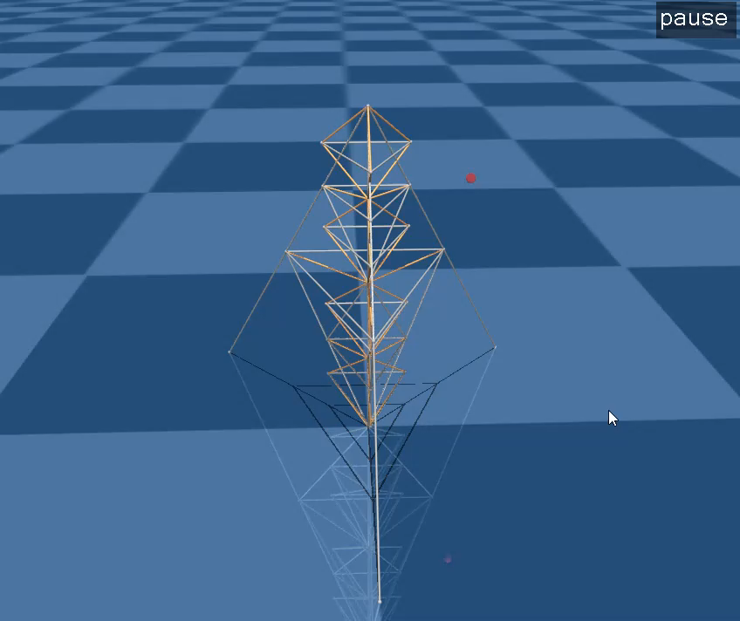
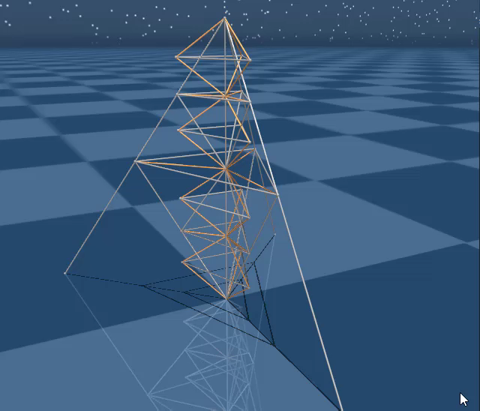
T2D1 Tower – MuJoCo Simulation
Control Algorithms
Trajectory optimization – iLQR
Feedback – LQG

Slide 2
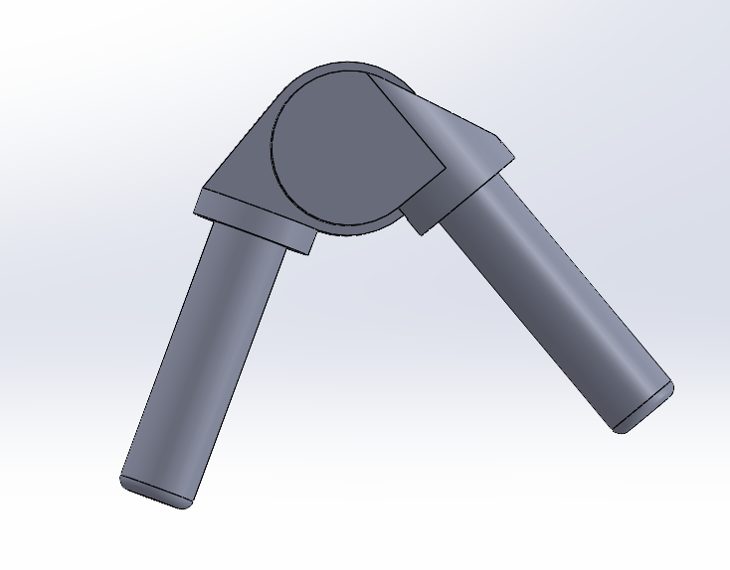
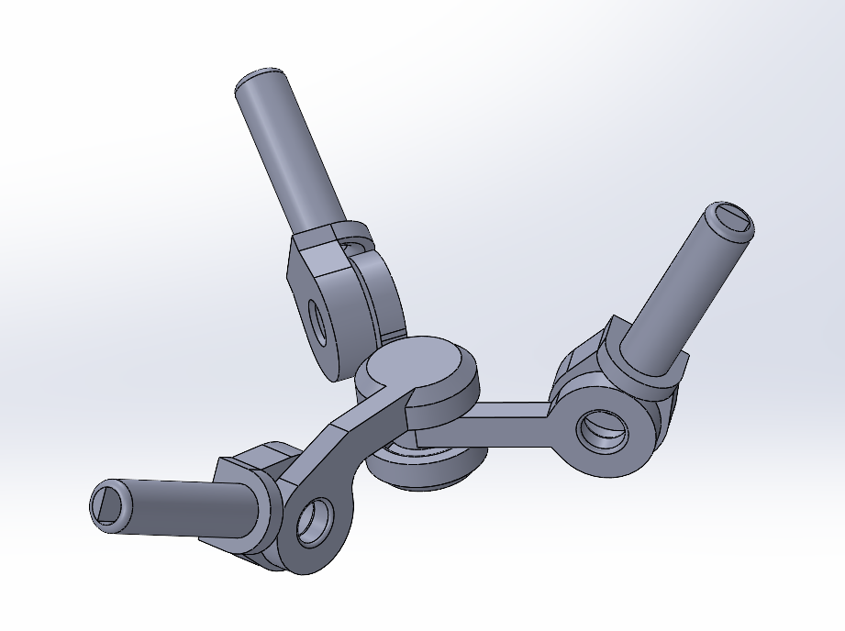
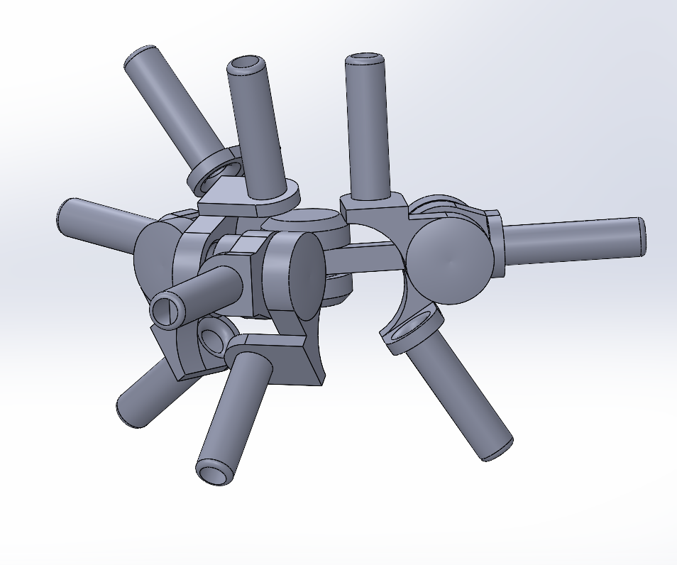
T2D1 Tower – Solidworks Joint Design
Class 2
Class 3
Class 9

Slide 3
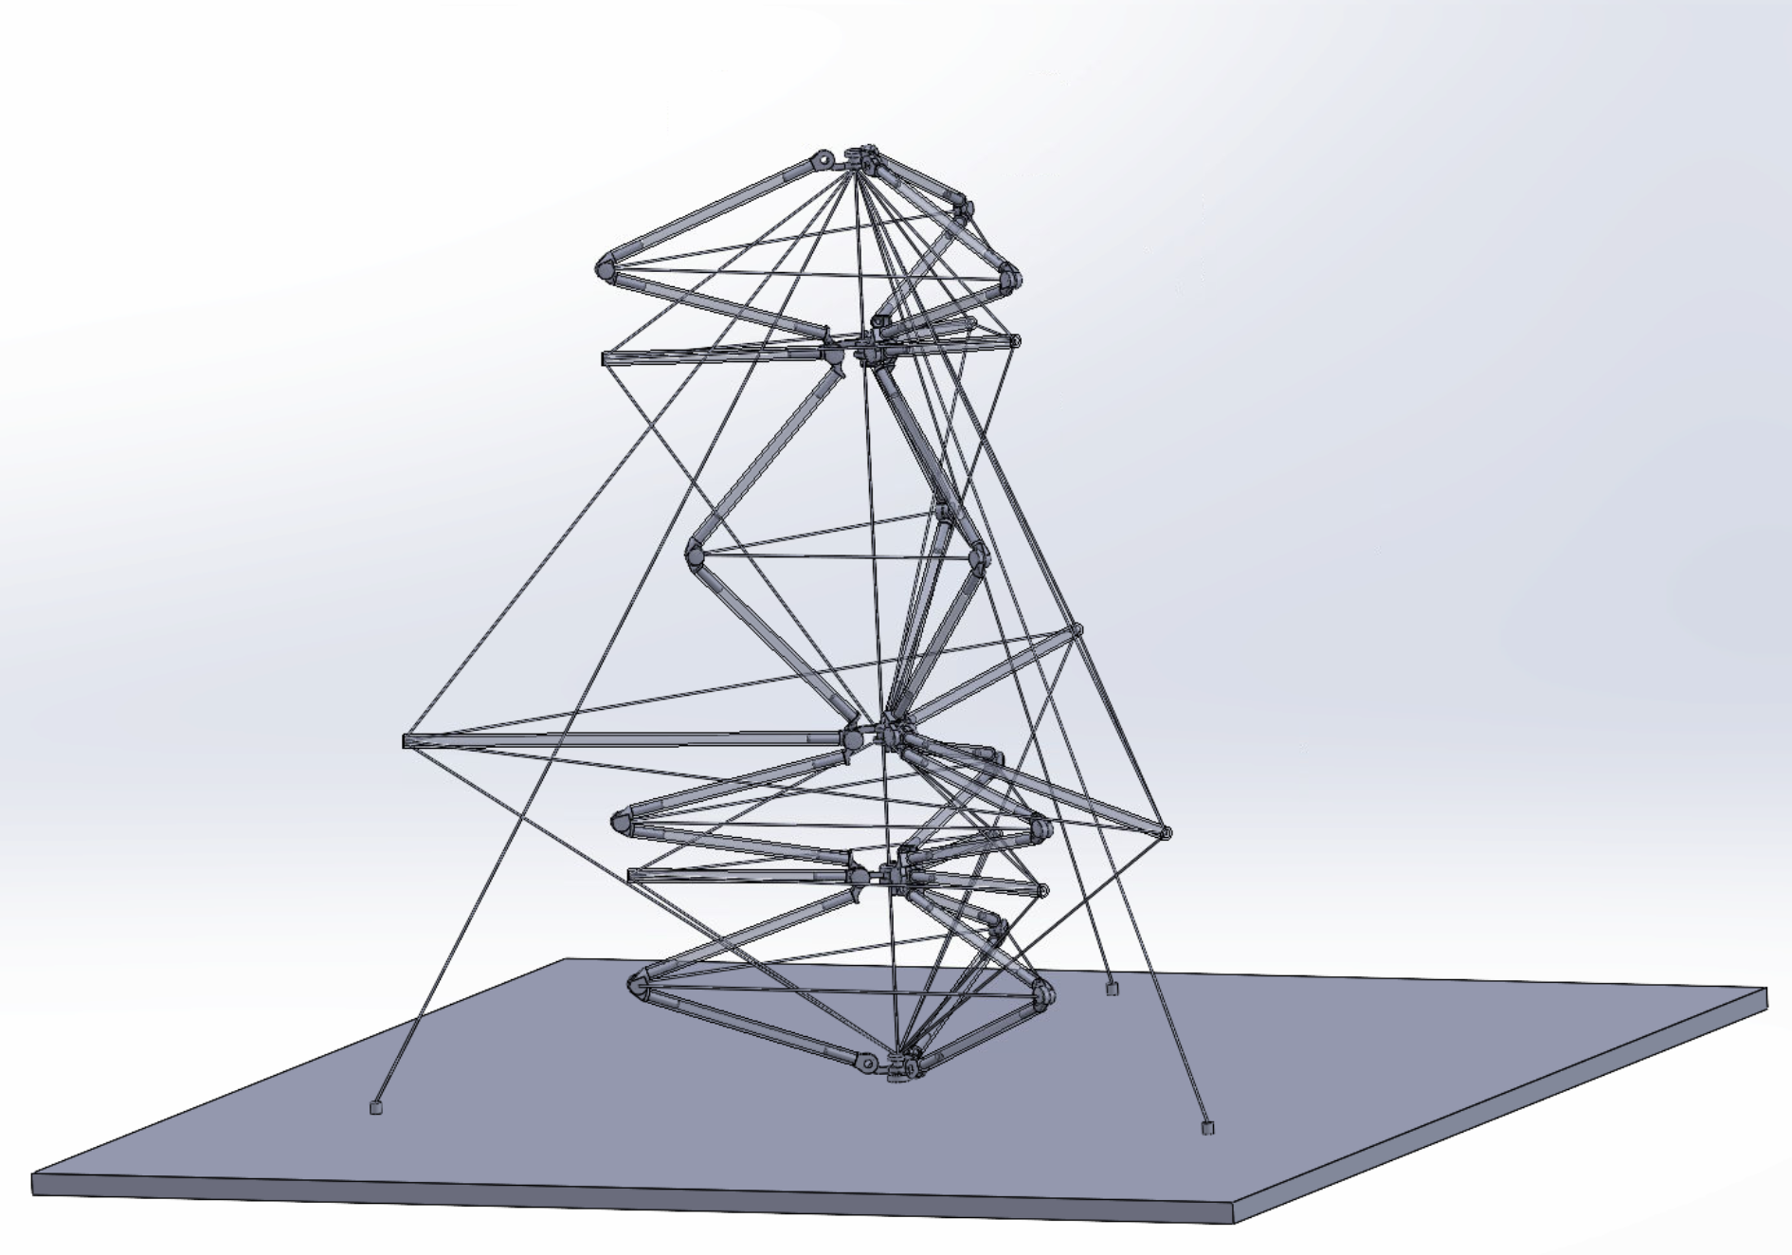
T2D1 Tower – Solidworks Model

Slide 4

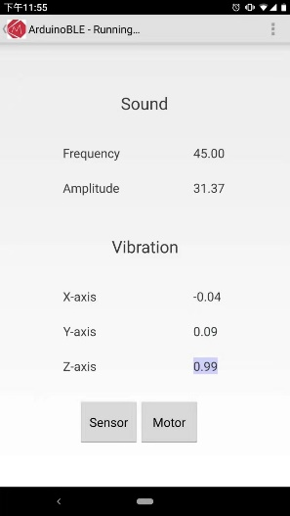
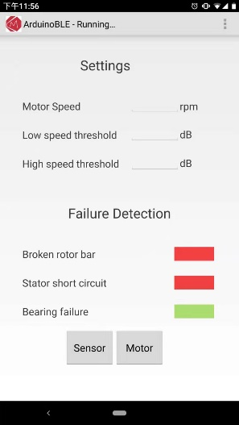
Arduino – FFT + ML Classification + BLE
Arduino
Accelerometer
Acceleration
Sound Hz
Sound sensor
FFT
Sound dB
Serial Port
FFT
Classification
Motor Status
Smartphone
Android App

Slide 5
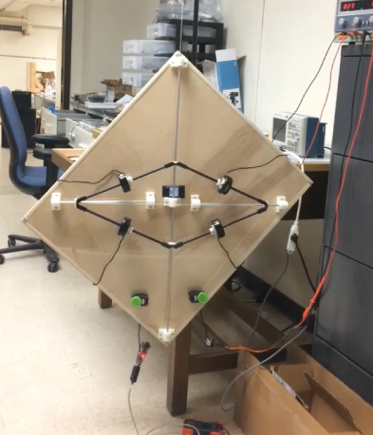
Arduino – Motor Control with PWM

