Slide 1
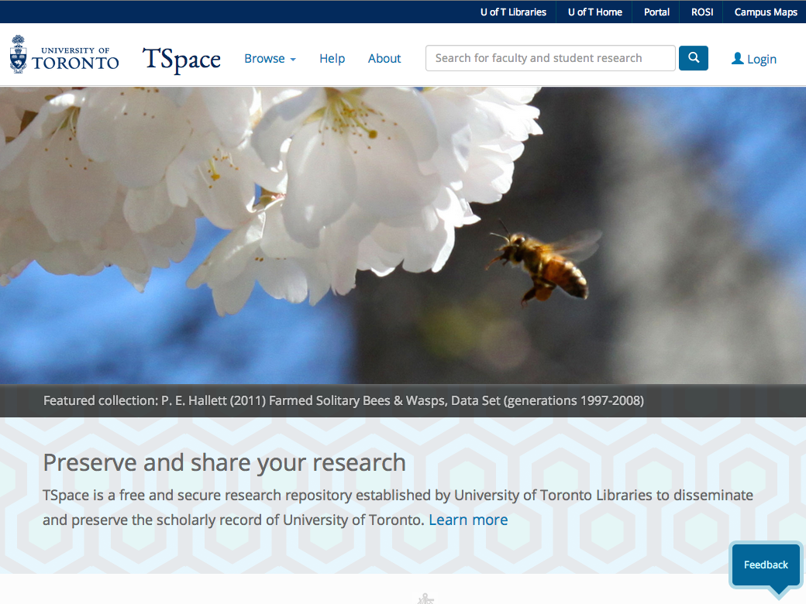
Introducing the new TSpace
Gordon Belray
Leslie Barnes
Lisa Gayhart
Sean Zhao
Courtney Bodi
Notes:
Lisa

Slide 2
The plan for today
Review:
Project update
New features
Outreach materials
Further assistance
Notes:
Lisa

Slide 3
TSpace upgrade: tspace.library.utoronto.ca
Started last year
ITS concentrated on it in the Spring
Second sprint at the end of the Summer
Fall testing
Launch during Open Access Week
Notes:
Lisa

Slide 4
New features
Improved search
Search engine optimization
New interface with responsive design
Accessibility
Notes:
Courtney

Slide 5
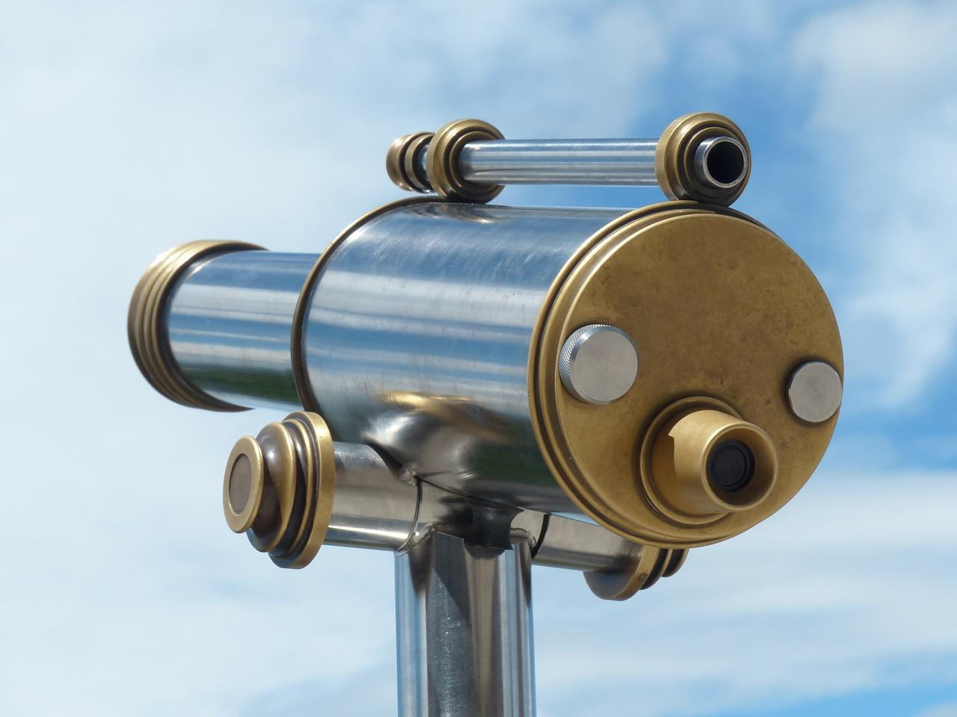
Improved search
Query spell checking
e.g. “Did you mean ‘Richard’?”
Accent insensitive
e.g. a “Cortes” query will return results with Cortes and Cortés
Notes:
Zhao

Slide 6

Search engine optimization
Added several enhancements that were requested by the Google Scholar team
Notes:
Zhao + Courtney
Mention Google Scholar + DSpace work
Added way for harvesters to find recently added items
Fixed date issued bug
Added extra hints for google scholar to find the primary file

Slide 7
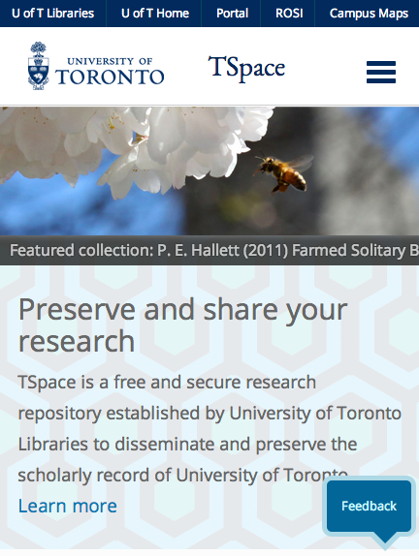
New interface with responsive design
Notes:
Gordon

Slide 8
Accessibility
AODA
January 1, 2021: WCAG 2.0 Level AA
WAVE tool: wave.webaim.org
Notes:
Gordon and Lisa

Slide 9
Outreach materials
Brochure*
TSpace submission checklist
Answers to common faculty questions
Notes:
Lisa
Update on status of brochure and how/when we will distribute - for info only now/talking points for faculty
Checklist - review checklist online and hand out hard copies

Slide 10
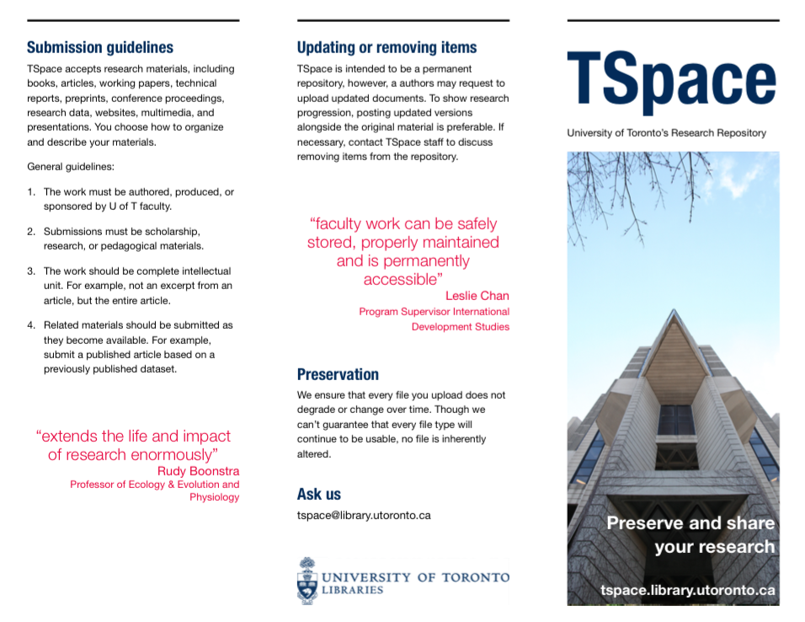
Brochure
Notes:
Lisa

Slide 11
Submission checklist: part 1
https://tspacedev.library.utoronto.ca/help/index.jsp#submit
Do you have permission to upload?
Is your item in final form?
Is your item scholarly or research oriented?
Are you a graduate student or faculty member?
Notes:
Leslie and Courtney
https://tspacedev.library.utoronto.ca/help/documents/TSpacechecklist.pdf
checklist is on tspace and available online

Slide 12
Submission checklist: part 2
Do you know which collection you would like to add you item to?
Do you know how best to describe your item?
Is your file format supported by TSpace?
Do you know which license you would like to use?
Notes:
Leslie and Courtney

Slide 13

Steps to clearing copyright
Check signed copyright agreement
Check www.sherpa.ac.uk/romeo
Check journal’s website
Contact the journal publisher directly
Notes:
Courtney
Find out if you have permission from your publisher

Slide 14
Talking to faculty members about TSpace
Common issues raised in advocacy
Great resource for working with faculty: http://www.rsp.ac.uk/grow/advocacy/issues/
“I need to publish in high impact journals to further my career”
“I haven’t got the time”
“Copyright is too complicated - my publisher won’t let me”
Notes:
Leslie

Slide 15
Where do we go from here?
Continue updating interface based on ongoing feedback
Updating and circulating support materials
Staffing
Notes:
Lisa

Slide 16
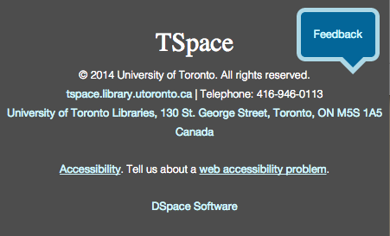
Thank You!
Questions?
tspace@library.utoronto.ca
Notes:
Lisa

