Slide 1
TEACHER: Lesson 1 plan (hidden slide)
Min | What | Slides
5 | Hook: fire in outer space (Pear Deck multiple choice) | 3
10 | Review the 3 transfers + Bill Nye (show about 10 min) | 4-5
12 | Radiation notes, sort examples, hook answer, and the Sun GIF | 6-10
13 | Light and color: absorb/reflect/transmit, blue object, shirts, filter, sky | 11-17
5 | Exit ticket (Showbie) | 18
5 | GAME (Gimkit) | 19
Fill-in sheet: Lesson 1. Key notes are red. Slide 4 is labeled DON’T WRITE THIS DOWN. Full plan is in the Word lesson plan.
Notes:
Hidden teacher slide. Timings total 50 minutes.

Slide 2
Radiation: Energy Without Touching
Lesson 1 · Energy Transfer
Notes:
Title slide.

Slide 3
Warm-up
Would a fire in outer space heat you up?
A. Yes
B. No
C. Only if you touched the FLAMES!!!
Notes:
PEAR DECK: add a Multiple Choice question from the Pear Deck sidebar. Options: A: Yes, B: No, C: Only if you touched the FLAMES!!! Do not reveal the answer yet. We come back to it on slide 9.

Slide 4
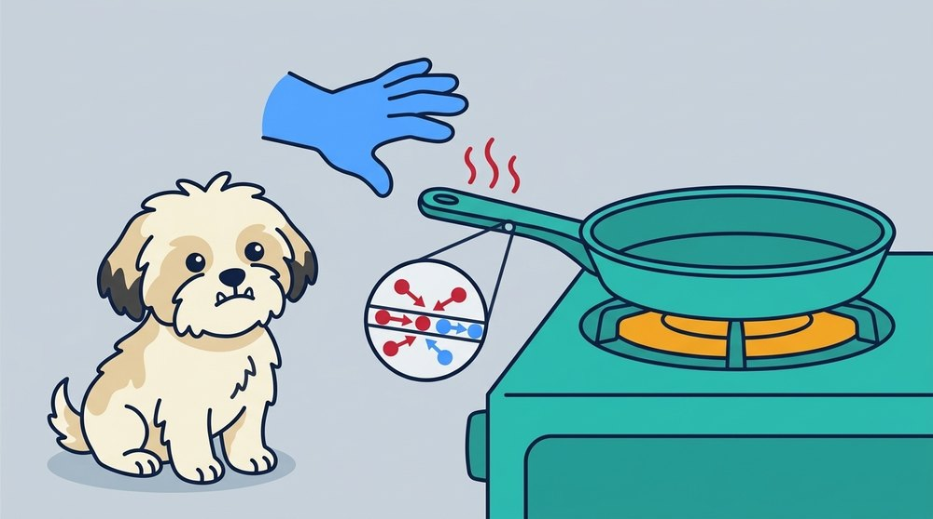
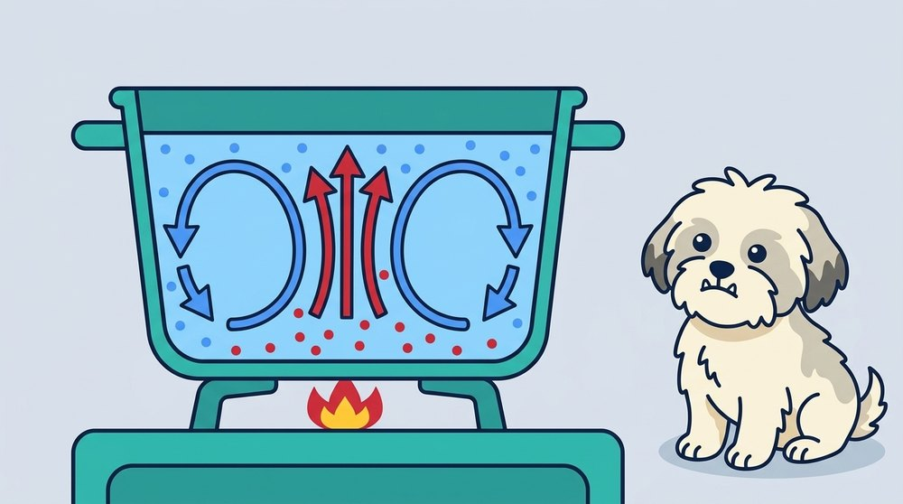
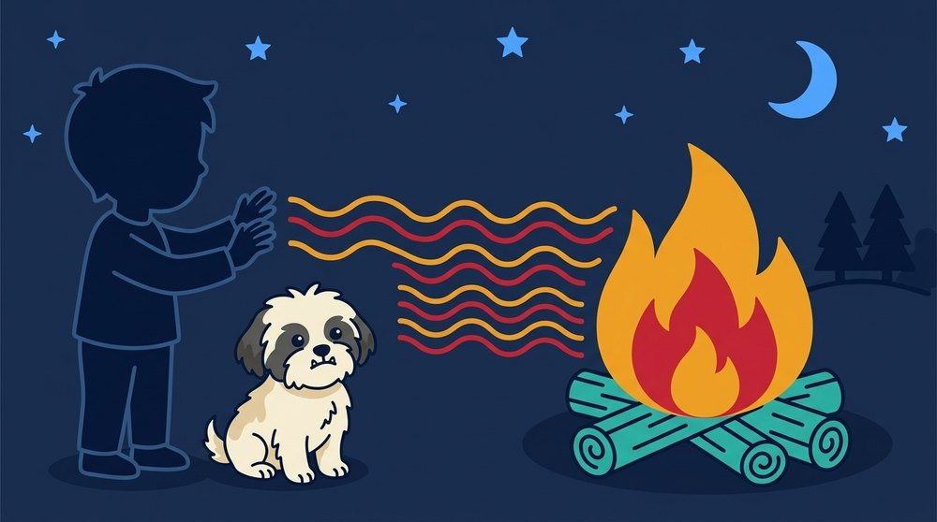
Three ways energy moves
(DON’T WRITE THIS DOWN)
Conduction
Convection
Radiation
Touching particles bump into each other.
Hot liquid or gas rises, cool sinks.
Energy moves as waves. It has many forms, like X-rays and Wi-Fi.
Notes:
Quick review from the last lesson. Labeled DON’T WRITE THIS DOWN because it previews the video and the next slides. Say it out loud: radiation comes in many forms, like X-rays and Wi-Fi. Lesson 2 covers them.

Slide 5
Video
VIDEO: Bill Nye – Heat
Watch for one example of conduction, convection, and radiation.
Notes:
Teacher shows the Bill Nye heat video (search: Bill Nye Heat). Full episodes run long, so show about 10 minutes and cue to the three transfer segments. Students jot one example of each on their fill-in sheet, Part A.

Slide 6
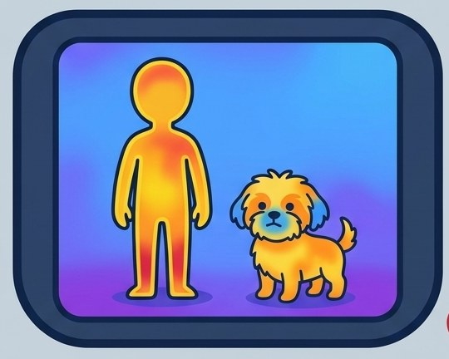
Radiation
Radiation = energy moving as waves
Needs NO matter. It crosses empty space
Everything above 0 K gives off radiation (even you!)
Notes:
Red notes are the ones to copy. 0 K is absolute zero.

Slide 7
Sort it
Conduction (C), Convection (V), or Radiation (R)? Write the letter on your sheet, Part B.
1. Warming your hands near a campfire
2. A hot mug warming your hands as you hold it
3. Boiling water swirling in a pot
4. The glowing wires inside a toaster warming your face
Notes:
Answers: 1 R, 2 C, 3 V, 4 R. Add 2 more of your own if time allows.

Slide 8
Your turn
Give an example of radiation that I did not list.
Notes:
PEAR DECK: add a Text Response question from the Pear Deck sidebar. Examples to expect: sun, heat lamp, microwave oven, light bulb, pizza oven.

Slide 9
Back to the fire in space
YES. Radiation crosses empty space
Conduction and convection need particles. Space has almost none
IMAGE
search: “campfire in outer space astronaut”
That is how the sun’s energy reaches Earth.
Notes:
Answer is A (Yes, you would feel the heat). C is a trap: touching flames is conduction and you would be burned, but radiation warms you from a distance.

Slide 10
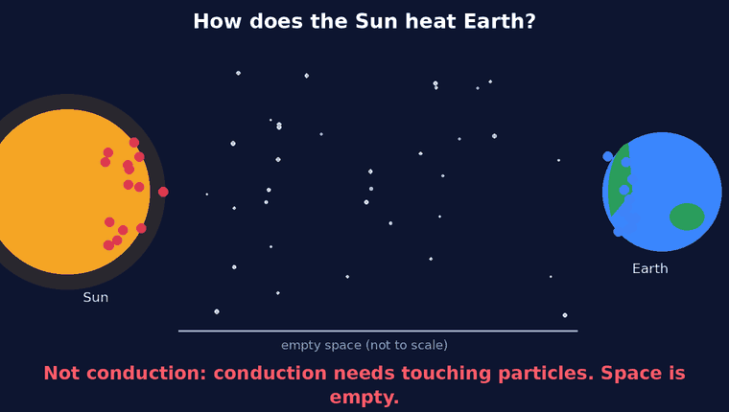
How does the Sun heat us?
Notes:
Animated GIF: it only plays in Slide show (present) mode, not in the editor. It shows why the Sun cannot heat Earth by conduction (no touching particles in space) or convection (no gas or liquid to flow), so it must be radiation. Pause after the first two captions and ask: what is left?

Slide 11
Light is radiation
Light is a type of radiation
White light = ALL the colors combined
IMAGE
search: “prism splitting white light rainbow”
Notes:
Tie back: the sun sends radiation, including all the colors of visible light.

Slide 12
Light hits an object. Three things can happen
Absorbed
Reflected
Transmitted
Light energy becomes thermal energy (heat).
Light bounces off.
Light passes through.
IMAGE
search: “black asphalt hot summer sun”
IMAGE
search: “mirror reflection light”
IMAGE
search: “clear glass window light”
Notes:
Students copy the three red notes.

Slide 13
Think
Why does a blue object look blue?
Notes:
PEAR DECK: add a Text Response question from the Pear Deck sidebar. Let them guess before the next slide.

Slide 14
Why it looks blue
We see the color that is REFLECTED
A blue object reflects blue and absorbs most other colors
IMAGE
search: “blue shirt white light diagram”
Notes:
Same idea for any color. Red apple: reflects red, absorbs the rest.

Slide 15
Black shirt vs. white shirt
Black absorbs most light, so it gets hotter
White reflects most light, so it stays cooler
IMAGE
search: “black and white shirts in sun”
Absorbed light becomes thermal energy.
Notes:
Optional quick demo: a black and a white paper under a lamp, then touch. Link to the quiz item about black and white shirts.

Slide 16
Predict
You look at a red apple through a blue filter. What color does it look? Why?
Notes:
PEAR DECK: add a Text Response question from the Pear Deck sidebar. Answer: very dark or black. The apple reflects red, but the blue filter blocks red light, so almost no light reaches your eye.

Slide 17
Blue sky, red sunset
Air scatters blue light more than red
At sunset light travels through more air, so blue is scattered away and red/orange is left
IMAGE
search: “red orange sunset sky”
Scatter = light bounced in many directions.
Notes:
Keep it simple. Other planets with different air can have different sky colors.

Slide 18
Exit Ticket
Explain why a black shirt gets hotter than a white shirt when you stand in the sun. Use the words absorb, reflect, and radiation in your answer.
Write your answer in Showbie, in the Exit Ticket folder.
Notes:
PEAR DECK: add a Text Response question from the Pear Deck sidebar. Plain text only. Full credit: sunlight is radiation; the black shirt absorbs most light and turns it into thermal energy; the white shirt reflects most light.

Slide 19
Game
GAME: Gimkit (search “Gimkit” and open our kit)
Conduction, convection, radiation + light and color review
https://www.gimkit.com/view/6aebe74509921b0f30fcf8d5
About 5 minutes
Notes:
About 5 minutes. Kit link: https://www.gimkit.com/view/6aebe74509921b0f30fcf8d5

