Slide 1
TEACHER: Lesson 2 plan (hidden slide)
Min | What | Slides
4 | Do-now: light speed (Pear Deck text) | 3-4
9 | Wavelength, frequency, and how they connect | 5-8
10 | PhET: Wave on a String (5) + Waves Intro (4), then debrief (1) | 9-11
14 | EM spectrum tour (one example per type) and colors of light | 12-23
4 | Exit ticket (Showbie) | 24
5 | GAME (Blooket or Gimkit) | 25
4 | Buffer
Fill-in sheet: Lesson 2. PhET worksheet is separate. If short on time, skip slides 22-23 and the game. Use the extra buffer to let the EM tour breathe. Slide 12 is labeled DON’T WRITE THIS DOWN.
Notes:
Hidden teacher slide. Timings total 50 minutes.

Slide 2
Waves, Wavelength, and the EM Spectrum
Lesson 2 · Energy Transfer
Notes:
Title slide.

Slide 3
Do-now
Guess: how many times could light travel all the way around the Earth in ONE second?
Notes:
PEAR DECK: add a Text Response question from the Pear Deck sidebar. Let them guess wildly. Reveal on the next slide.

Slide 4
Light is FAST
About 7.5
IMAGE
search: “light speed earth orbit”
trips around the Earth in one second
Light speed ≈ 300,000 km/s (3 × 10⁸ m/s)
ALL light and radiation travels at this speed in empty space
Notes:
Earth circumference is about 40,000 km, light covers 300,000 km each second, so about 7.5 trips. Compare to the fastest plane trips around the world, which take about a day or more.

Slide 5
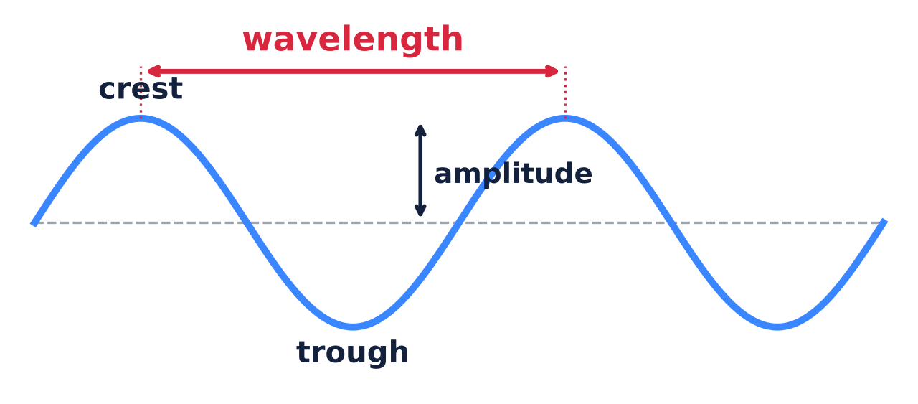
Parts of a wave
Wavelength = distance from crest to crest
Amplitude = how tall the wave is (not how long)
Notes:
Have them label the same diagram on the fill-in sheet, Part A.

Slide 6
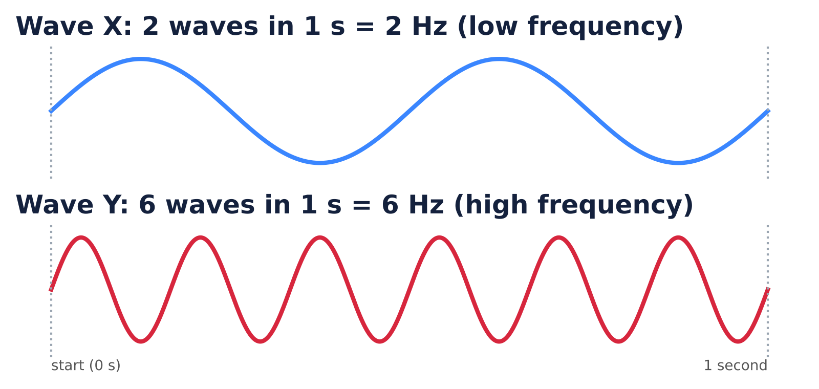
Frequency
Frequency = how many waves pass per second
Unit: hertz (Hz). 1 Hz = 1 wave per second
Notes:
Count the waves in one second: wave X has 2, wave Y has 6.

Slide 7
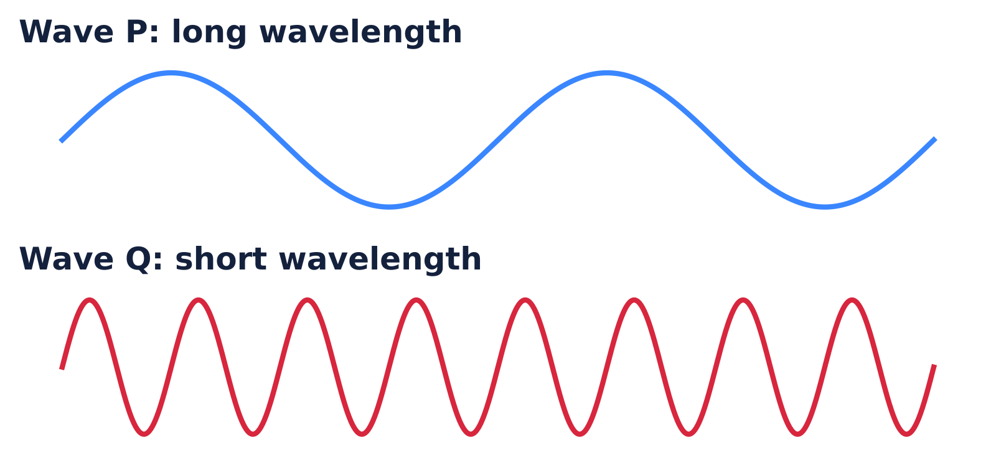
Wavelength and frequency are linked
Same speed: SHORT wavelength = HIGH frequency
Shorter wavelength = MORE energy per wave
Notes:
Analogy: if all waves move at the same speed, squeezing them shorter means more of them pass each second. Note: amplitude (height) is a different property. It is about brightness or loudness, not the energy of each wave.

Slide 8
Check
Wave Q is shorter than wave P. Which has the higher frequency?
A. Wave P
B. Wave Q
C. They are the same
Notes:
PEAR DECK: add a Multiple Choice question from the Pear Deck sidebar. Options: A: Wave P, B: Wave Q, C: They are the same. Answer: B. (Refer back to the previous slide.)

Slide 9
PhET: Wave on a String
Change the frequency. Watch the wavelength
Use the ruler to measure
5 min
https://phet.colorado.edu/en/simulations/wave-on-a-string
Use the PhET sheet, Part 1.
Notes:
PEAR DECK: add a Web Slide from the Pear Deck sidebar with the PhET link. Students work in pairs or alone on iPads.

Slide 10
PhET: Waves Intro
Try the Water, Sound, and Light tabs
What does frequency change? What does amplitude change?
4 min
https://phet.colorado.edu/en/simulations/waves-intro
Use the PhET sheet, Part 2.
Notes:
PEAR DECK: add a Web Slide from the Pear Deck sidebar with the PhET link.

Slide 11
Debrief
When you turned the frequency UP, what happened to the wavelength?
Notes:
PEAR DECK: add a Text Response question from the Pear Deck sidebar. Answer: it got shorter. Higher frequency, shorter wavelength.

Slide 12
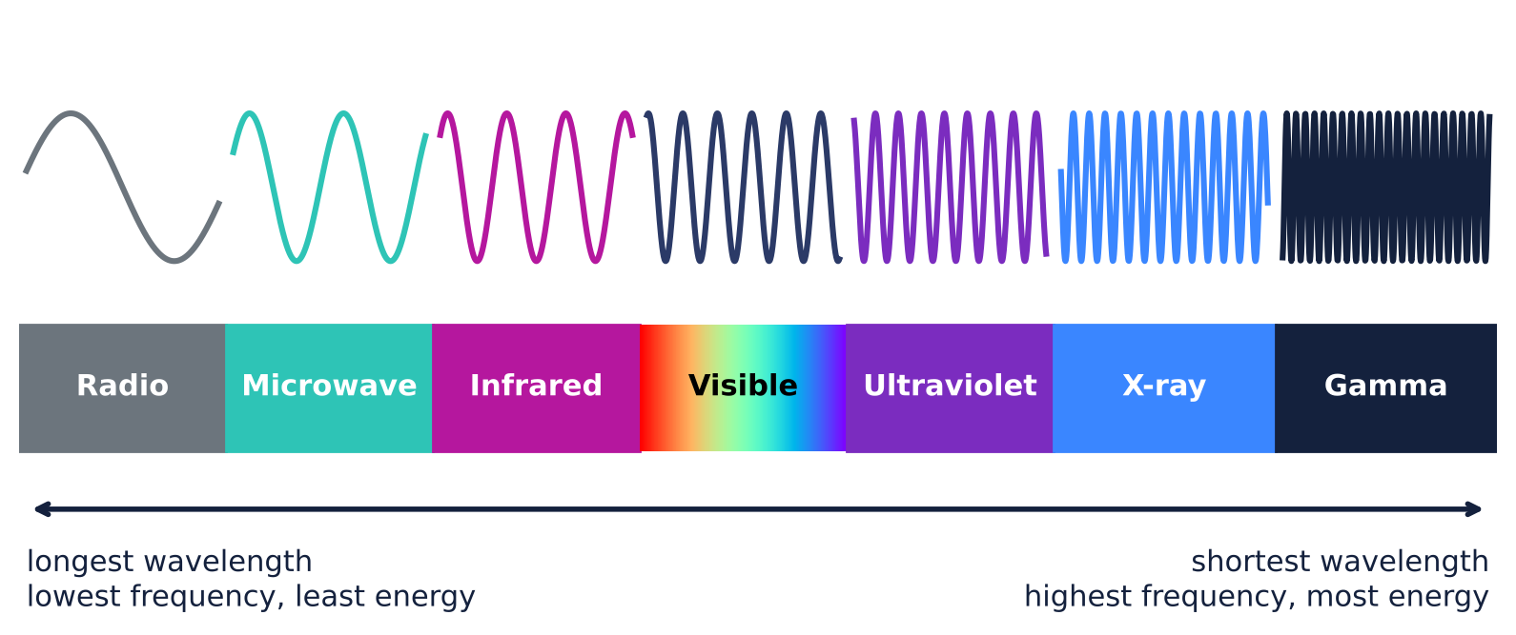
The electromagnetic (EM) spectrum
(DON’T WRITE THIS DOWN)
Radio → Microwave → Infrared → Visible → Ultraviolet → X-ray → Gamma
Notes:
Overview slide: students should NOT copy this. They will fill in the order on their sheet slide by slide. All are radiation and all travel at light speed in empty space.

Slide 13
Radio waves
Longest wavelength, lowest energy
Carry music, TV, and radio signals
IMAGE
search: “radio tower antenna”
AM/FM radio, TV broadcasts
Notes:
Radio waves are all around you all the time and are harmless.

Slide 14
Microwaves
Microwave ovens use them to heat the water in food
Wi-Fi and cell phones use them too
IMAGE
search: “microwave oven heating food”
Notes:
The oven makes water molecules in food vibrate faster. That is thermal energy.

Slide 15
Infrared (IR)
You feel it as heat
You give off IR. Thermal cameras can see it
IMAGE
search: “thermal camera image person hand”
TV remotes and heat lamps too.
Notes:
Connect to slide 6 of Lesson 1: everything above 0 K radiates, mostly as infrared at everyday temperatures.

Slide 16
Visible light
The only part we can see
Red = longest wavelength. Violet = shortest
IMAGE
search: “rainbow ROYGBIV spectrum”
Notes:
Quick: red, orange, yellow, green, blue, indigo, violet. Violet has the most energy of visible colors.

Slide 17
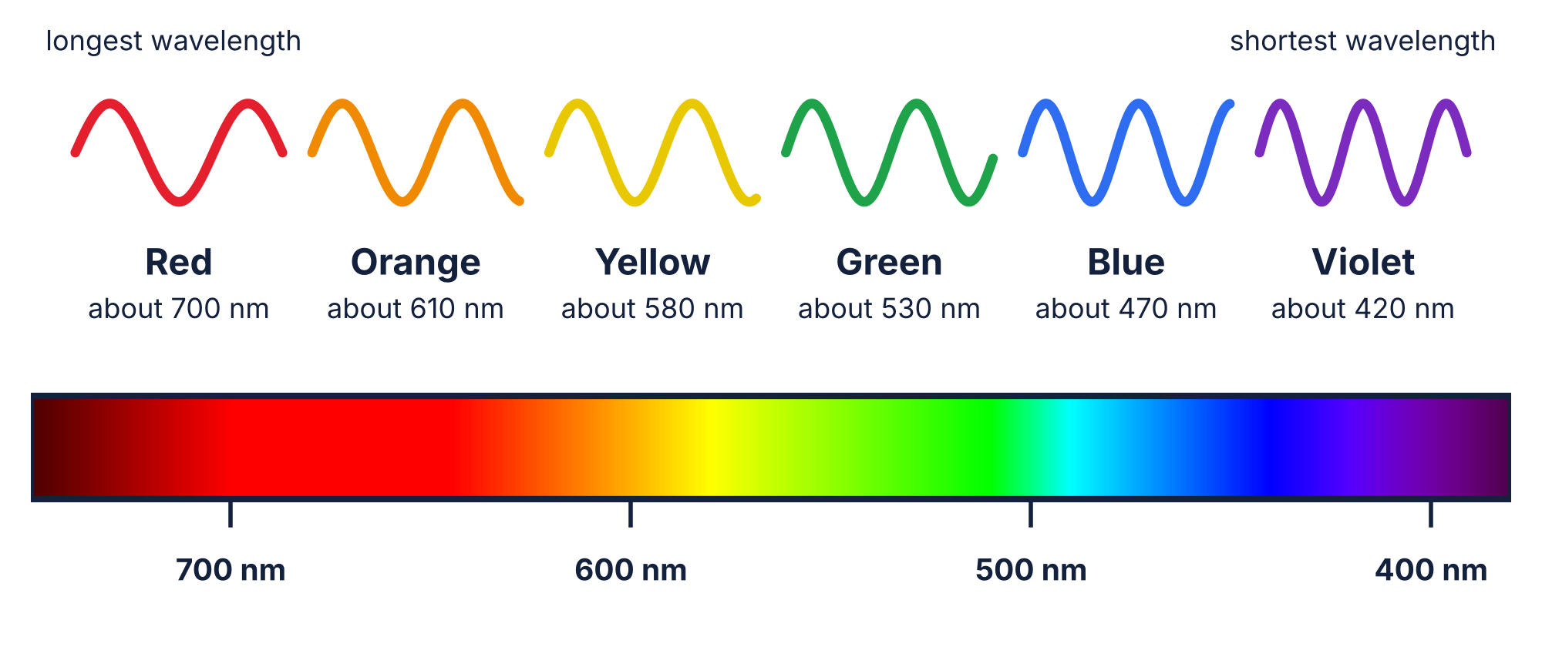
Colors of light
Each color of light has its own wavelength
Red is the longest (about 700 nm). Violet is the shortest (about 400 nm)
Notes:
1 nm (nanometer) is one billionth of a meter. Visible light is a tiny slice of the spectrum, about 400 to 700 nm. Different colors are just different wavelengths. Some lists add indigo between blue and violet. Link back: shorter wavelength means higher frequency and more energy per wave.

Slide 18
Check
Which color of light has the MOST energy per wave?
A. Red
B. Green
C. Violet
Notes:
PEAR DECK: add a Multiple Choice question from the Pear Deck sidebar. Options: A: Red, B: Green, C: Violet. Answer: C. Violet has the shortest wavelength, so the highest frequency and the most energy per wave.

Slide 19
Ultraviolet (UV)
More energy than visible light
Causes sunburn and can damage DNA
IMAGE
search: “sunscreen sunburn UV black light”
Sunscreen absorbs UV. Black lights glow in UV.
Notes:
Ask: why does UV cause sunburn but visible light does not? More energy per wave.

Slide 20
X-rays
Pass through skin, blocked by bone
High energy: can damage cells, so we limit exposure
IMAGE
search: “dentist x-ray teeth”
Notes:
The dentist leaves the room or uses a lead apron. Short exposures are safe.

Slide 21
Gamma rays
Shortest wavelength, highest energy
Made by nuclear reactions
IMAGE
search: “sterilizing medical equipment gamma”
Used to sterilize food and medical tools.
Notes:
Link to nuclear energy from earlier in the unit.

Slide 22
Think
Radio waves pass through you right now. Why aren’t they harmful, but UV and X-rays can be?
Notes:
PEAR DECK: add a Text Response question from the Pear Deck sidebar. Answer on next slide. Skip slides 22-23 if short on time.

Slide 23
Energy per wave matters
Radio: low energy per wave. Harmless
UV, X-ray, gamma: enough energy per wave to damage DNA
IMAGE
search: “radiation danger scale radio to gamma”
Notes:
Link to the quiz question about being hit with radio waves.

Slide 24
Exit Ticket
Wave A has a long wavelength. Wave B has a short wavelength. Which wave has the higher frequency, and which has more energy? Then name one type of radiation that is more energetic than visible light and tell one place you would find it.
Write your answer in Showbie, in the Exit Ticket folder.
Notes:
PEAR DECK: add a Text Response question from the Pear Deck sidebar. Plain text only. Full credit: Wave B has the higher frequency and more energy (shorter wavelength = higher frequency = more energy per wave). UV, X-ray, or gamma plus a place (sunburn/black light, dentist, sterilizing medical tools).

Slide 25
Game
GAME: Blooket (search “Blooket” and open our set)
Waves, wavelength, frequency, the EM spectrum, and colors of light review
https://dashboard.blooket.com/set/6aec0d3b72ea2e8ad26c31f5
About 5 minutes
Notes:
About 5 minutes. Blooket set: https://dashboard.blooket.com/set/6aec0d3b72ea2e8ad26c31f5 . To play, click Host (live game with a join code) or Homework (a link students can open), then share that.

