Slide 1
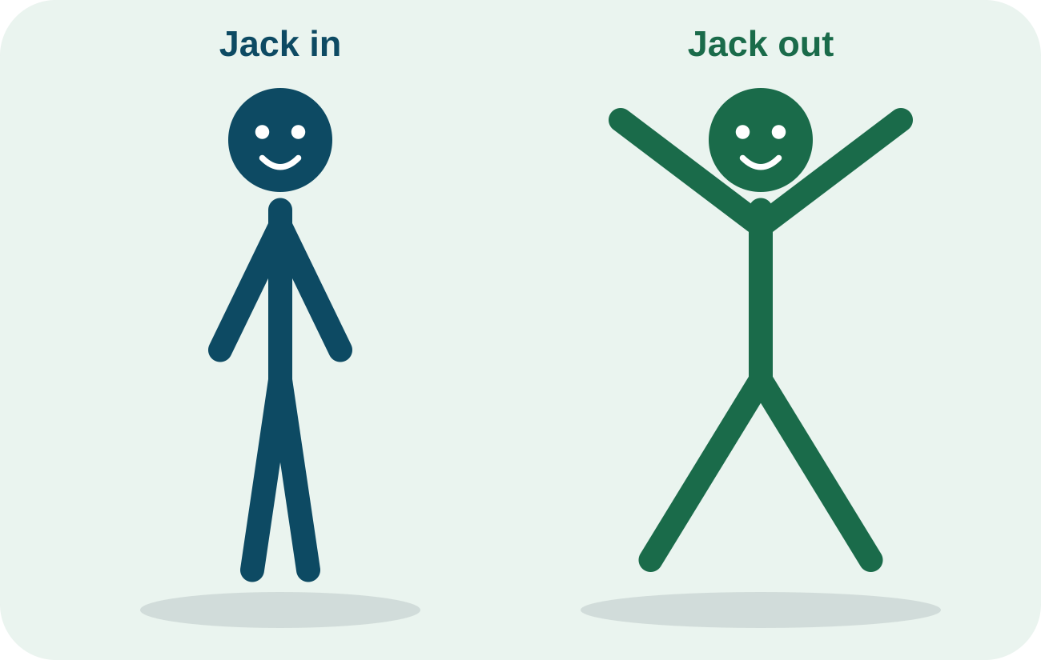
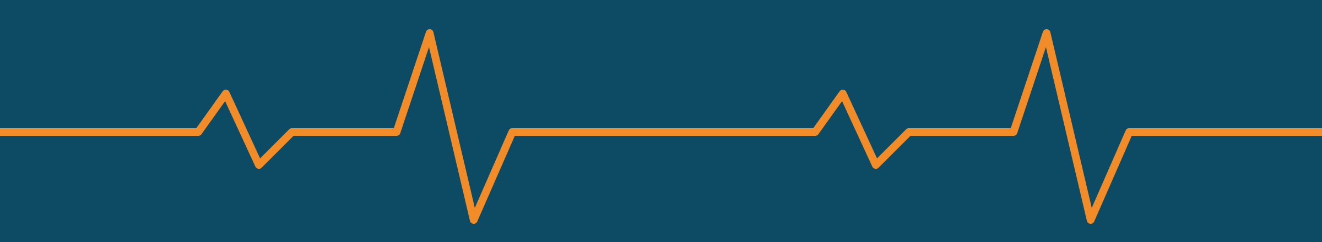
Does One Minute of Jumping Jacks Raise Heart Rate?
SAMPLE PRESENTATION
Sam & Riley · 7th Grade Science · Exercise Science Project
Notes:
SAMPLE. Names are fictional and all data are invented. The two sources are real articles.

Slide 2
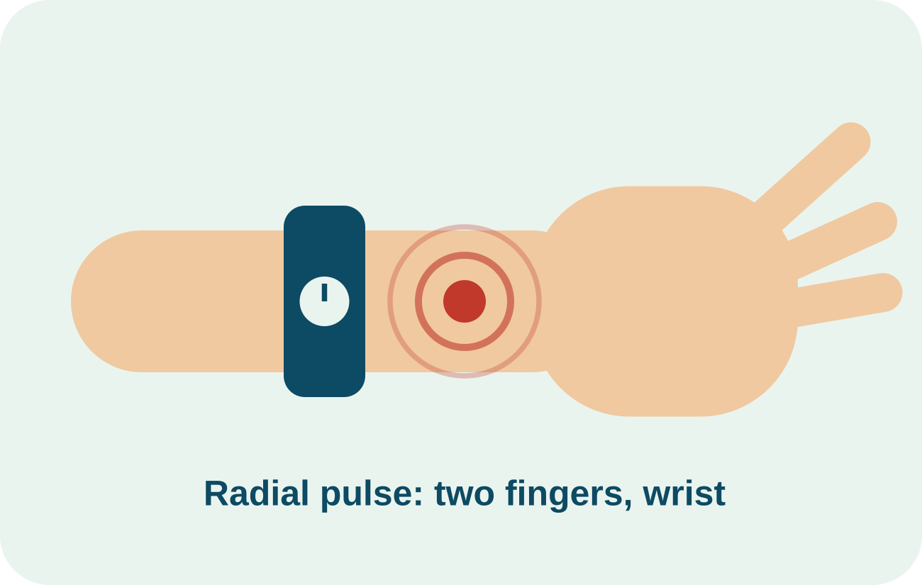
Why Heart Rate Matters
Heart rate is how many times your heart beats in one minute (bpm).
1
Scientists have estimated the highest heart rate a person can reach since the late 1930s (Robergs & Landwehr, 2002).
2
Doctors and coaches use predicted maximum heart rate to plan exercise (Tanaka et al., 2001).
3
We want to know how much one minute of jumping jacks raises a 12-year-old’s heart rate.
4
Who benefits? Anyone who exercises, and students learning how their bodies respond.
WHY THIS WORKS Every fact from a source has a tag. Our own goal (point 4) has none.
Notes:
Every fact from a source gets a tag. The last point is the pair’s own goal, so no tag.

Slide 3




Four Things to Know First
Resting heart rate
Exercise raises it
The beats per minute when you sit calmly.
Muscles need more oxygen, so the heart pumps faster.
Maximum heart rate
How to measure
For healthy adults, about 208 − 0.7 × age (Tanaka et al., 2001). At age 12 that is roughly 200 bpm.
Find the wrist pulse, count for 15 seconds, then multiply by 4.
WHY THIS WORKS Only the facts that help the audience understand the results. Only fact 3 needs a tag.
Notes:
Mirror the Introduction Worksheet: four key pieces of information. Only the max heart rate fact needs a citation.

Slide 4
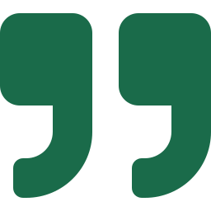
Related Research: Tanaka et al.
Tanaka, H., Monahan, K. D., & Seals, D. R. (2001). Age-predicted maximal heart rate revisited. Journal of the American College of Cardiology, 37(1), 153–156. https://doi.org/10.1016/S0735-1097(00)01054-8
What they did
What they found
Link to our project
Combined data from 351 studies (18,712 people), then tested their equation on 514 healthy people in a lab.
Maximum heart rate is about 208 − 0.7 × age. Age predicts most of it, for men and women, active or not.
It tells us the rough ceiling for heart rate, so we can see how hard jumping jacks really are.
WHY THIS WORKS Full citation, a plain-language summary, and a link back to our experiment.
Notes:
Source 1 of 2. The Tanaka equation was built for adults, so using it for a 12-year-old is only a rough estimate. The deck says so.

Slide 5
Related Research: Robergs & Landwehr
Robergs, R. A., & Landwehr, R. (2002). The surprising history of the “HRmax=220-age” equation. Journal of Exercise Physiology Online, 5(2), 1–10.
What they did
What they found
Link to our project
Traced where the famous “220 − age” formula came from and checked how accurate such formulas are.
The formula was not built from original research, and age-based formulas can miss by about 7 to 11 beats per minute.
Predicted maximums are rough guides. That is why we measure real heart rates.
WHY THIS WORKS Second source on its own slide, with a connection to our experiment.
Notes:
Source 2 of 2.

Slide 6



Question and Hypotheses
Research Question
How does one minute of jumping jacks affect a person’s heart rate compared with resting?
Hypothesis
If a person does jumping jacks for one minute, then their heart rate will increase by at least 50%, because their muscles need more oxygen and the heart pumps faster to deliver it.
Null Hypothesis
There will be no significant difference between resting heart rate and heart rate after one minute of jumping jacks.
WHY THIS WORKS The question is testable. The hypothesis uses If / then / because. The null says “no difference.”
Notes:
Hypothesis uses If / then / because. The null hypothesis says there is no difference.

Slide 7




Materials
Stopwatch (phone timer)
Metronome app set to 60 beats per minute
Data sheet on a clipboard
PHOTO PLACEHOLDER
Pencil
Our materials laid out on the lab table
Sneakers and open floor space
WHY THIS WORKS A complete bulleted list with specific items, and a photo of the real materials.
Notes:
Photo placeholder: the rubric asks for a photo on every slide. Replace with a real photo.

Slide 8
Procedure: 10 Trials
1
Riley sits quietly for 5 minutes.
2
Sam finds Riley’s wrist pulse, counts for 15 seconds, and multiplies by 4. Record resting bpm.
3
Riley does jumping jacks for exactly 1 minute, 1 jack per second.
4
Riley sits. Within 5 seconds, Sam counts the pulse for 15 seconds and multiplies by 4. Record bpm.
5
Rest until the pulse is back to normal.
Same pace every trial: 1 jack per second.
6
Repeat for 10 trials, always at the start of class.
WHY THIS WORKS Numbered steps with exact times and counts. Another group could repeat this.
Notes:
Specific times and counts so another group could repeat it. Riley is the test subject, Sam times and counts.

Slide 9

Variables and Controls
Independent Variable
Dependent Variable
Controlled Variables
Same person (Riley) every trial: so bodies match
Same pace (metronome): so effort matches
Same 5-minute seated rest: so every start is calm
Same counting method: so measuring matches
Exercise condition: resting vs. 1 minute of jumping jacks
Heart rate in beats per minute (bpm)
The one thing we change.
What we measure: 15-second count × 4.
What we could not control: how much Riley slept and ate each day. We wrote it down so we can notice if it matters.
WHY THIS WORKS IV, DV, and four controls with reasons, plus an honest note about what we couldn’t control.
Notes:
IV, DV, and at least 3 controls, each with a reason. Be honest about what could not be controlled.

Slide 10
Results: Table and Graph
SAMPLE DATA
Trial | Resting (bpm) | After Jumping Jacks (bpm)
1 | 76 | 132
2 | 72 | 128
3 | 80 | 140
4 | 74 | 126
5 | 78 | 136
6 | 70 | 124
7 | 82 | 142
8 | 75 | 130
9 | 77 | 138
10 | 73 | 129
Mean | 75.7 | 132.5
WHY THIS WORKS Table and graph sit together, with Title Case labels, units, and a Mean row.
Notes:
Table and graph together on one slide. Title Case headers with units, a Mean row, and a graph with labeled axes.

Slide 11
Percent Change and Statistics
SAMPLE DATA
+56.8 bpm
Mean increase
+75.0%
Mean percent change
p < 0.001
Paired t-test
Checked in Google Sheets with =T.TEST(range1, range2, 2, 1)
WHY THIS WORKS Percent change is fair across trials, and the statistics say whether the change is real.
Notes:
Percent change is fairer than raw bpm. Statistical analysis was done with a paired t-test and checked with Google Sheets T.TEST (paired, two-tailed).

Slide 12


Conclusion: Purpose, Claim, Evidence
Purpose
The purpose of this experiment was to investigate whether one minute of jumping jacks raises heart rate.
Claim
Based on the results, we found that heart rate was higher after jumping jacks. Our hypothesis was supported.
Evidence
According to the data, the average went from 75.7 bpm to 132.5 bpm, an increase of 56.8 bpm (75.0%). The paired t-test gave p < 0.001, so we reject the null hypothesis.
WHY THIS WORKS Each part starts with its sentence starter, and the evidence uses real numbers.
Notes:
Parts 1 to 3 of the five-part conclusion. Evidence uses real numbers from the results.

Slide 13



Conclusion: Reasoning
Jumping jacks
Muscles need more oxygen
Heart beats faster
More oxygen-rich blood delivered
During exercise, working muscles need more oxygen. The heart beats faster to pump more oxygen-rich blood to them, which causes heart rate to rise. Our mean after jumping jacks (132.5 bpm) is about two-thirds of the roughly 200 bpm maximum that the adult equation from Tanaka et al. (2001) predicts at age 12, so this was a moderate effort.
WHY THIS WORKS Science vocabulary explains why it happened, and a source helps interpret the result.
Notes:
Part 4. Science vocabulary plus a tie-back to Tanaka et al. The Tanaka equation is for adults, so the pair calls the comparison rough.

Slide 14
Evaluation and Reflection
A
B
C
Sources of Error
Improvements
Future Expansion
We counted the pulse for 15 seconds and multiplied by 4, so one missed beat changes the result by 4 bpm. Counting started about 5 seconds after stopping, so the heart had begun to slow.
Use a heart-rate monitor that records every beat. Have a third person call “go” and “stop” so counting starts right away.
With millions of dollars and 5 years, we would track 1,000 students ages 10 to 14 with wearable sensors to compare fitness levels and recovery time.
WHY THIS WORKS No “human error.” Each problem is specific and comes with a fix.
Notes:
Part 5. No “human error.” Each problem has a cause, an effect on the data, and a fix.

Slide 15


References
Robergs, R. A., & Landwehr, R. (2002). The surprising history of the “HRmax=220-age” equation. Journal of Exercise Physiology Online, 5(2), 1–10.
Tanaka, H., Monahan, K. D., & Seals, D. R. (2001). Age-predicted maximal heart rate revisited. Journal of the American College of Cardiology, 37(1), 153–156. https://doi.org/10.1016/S0735-1097(00)01054-8
Alphabetical: R comes before T
Each entry matches a tag in the Introduction
WHY THIS WORKS APA format, alphabetical, with italics and DOI. Two real sources, as the rubric requires.
Notes:
Alphabetical order by first author’s last name. Every entry matches a tag used in the Introduction.

Slide 16
Questions?
Thank you! Sam & Riley
Sample presentation: data invented, sources real

