Slide 1
Binary Trees - deleting a node
0. node is not in the tree
1. Node is a leaf

Slide 2
3. Node to be deleted has 1 subtree
4. Node to be deleted has two subtrees

Slide 3
Node is not in the tree
obviously not a problem

Slide 4
Node is a leaf
delete it.
the rest of the tree is still a bst

Slide 5
Node to be deleted has one subtree
Link past it

Slide 6
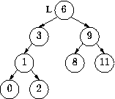

Node to be deleted has two subtrees
Replace value in node to be deleted with the
largest value in the left subtree
smallest value in the right subtree
Link past the the ex largest node
3

Slide 7
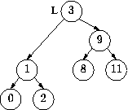
3

