Slide 1

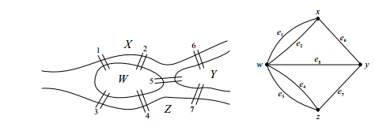
Graphs
(Euler)
Is it possible to leave home, cross each of the seven bridges
exactly once, and return home?

Slide 2
Graphs
Finding shortest routes in car navigation systems
Search engines use ranking algorithms based on graph theory
Optimizing time tables for schools or universities
Analysis of social networks
Optimizing utilization of railway systems
Compilers use coloring algorithms to assign registers to variables
Path planning in robotics
Large Scale Networks
Social Computing
Bio-informatics
And on and on… very widely applicable

Slide 3
Graphs
A graph G is a triple consisting of a
vertex set V (G)
an edge set E(G),
a relation R: E->V that associates two endpoint vertices with each edge (not necessarily distinct)

Slide 4
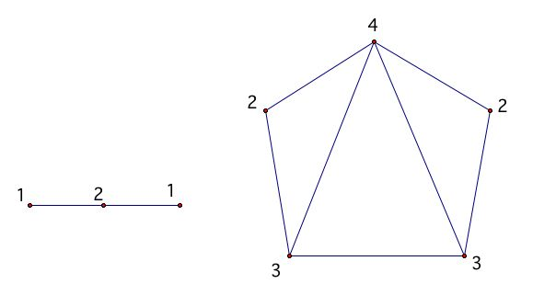
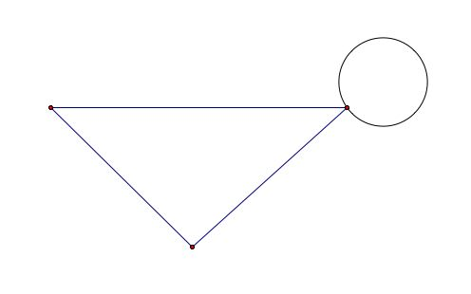
Graphs
Finite graph – V(G), E(G) are finite sets
Two vertices are adjacent if they are the endpoints of some edge
Simple – connected, no duplicate edges , no loops (endpoints of edge are unique)
Degree of a vertex = number of edges that have v as an endpoint

Slide 5
Graphs
Find all of the six simple graphs with 4 vertices.

Slide 6
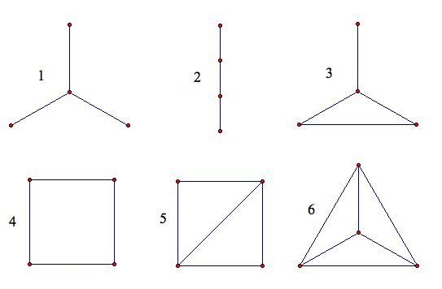
Graphs

Slide 7
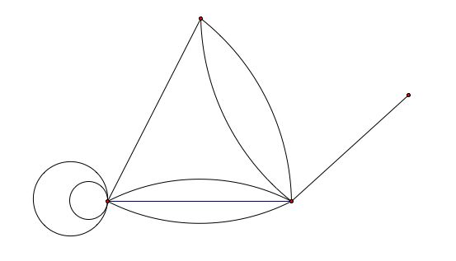
Graphs
Find the degree of each vertex of the graph:

Slide 8
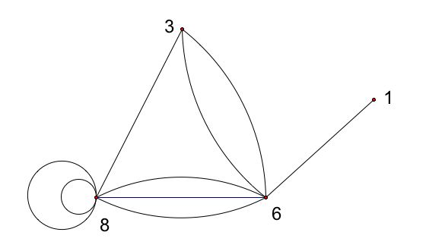
Graphs

Slide 9
Graphs
Eulerian graph - has an Eulerian Path
Eulerian Path – visits every edge exactly once
Eulerian Circuit - Eulerian Path which starts and
ends on the same vertex

Slide 10
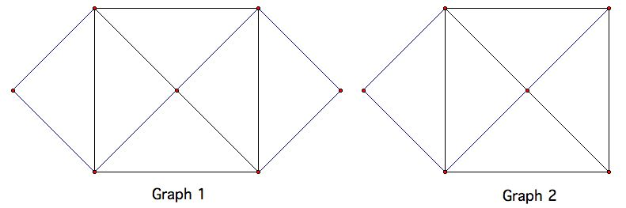
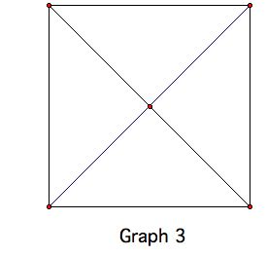
Graphs
Which have Eulerian circuits?

Slide 11
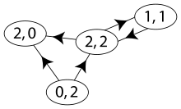
Graphs
Directed graph – edge endpoint vertices are ordered
in degree vs out degree

Slide 12
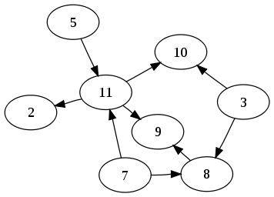
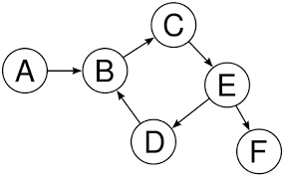
Graphs
Acyclic vs cyclic
(concept holds for undirected graphs as well)

Slide 13
Graphs
weighted directed graph - a directed graph with weights assigned to its edges
(called a network)

Slide 14
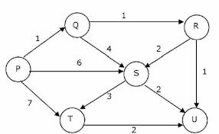
Graphs

Slide 15
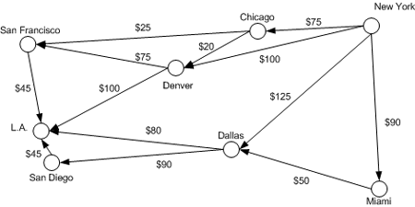
Graphs

Slide 16
Graphs
Data structures for graphs
Adjacency List
Adjacency Matrix
https://www.youtube.com/watch?v=2guA5uMEmZQ

Slide 17
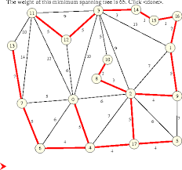
Graphs
a spanning tree T of an undirected graph G is a subgraph that includes all of the vertices of G,
which is a tree.

Slide 18
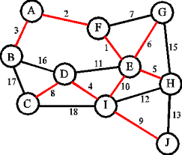
Graphs

Slide 19
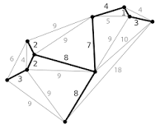
Graphs
A minimum spanning tree is a spanning tree of a connected, undirected graph.
connects all the vertices together with the minimal total cost

